Slide 1
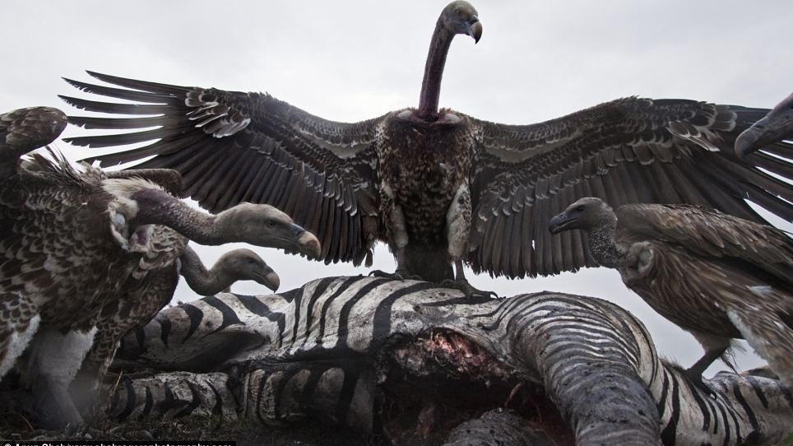
Evolution
Modeling selection

Slide 2
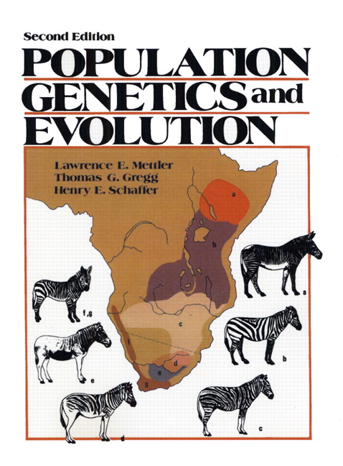
Progress
We have evidence for change through time
We know a mechanism creating change through time
We know where variation comes from
How do we integrate modern genetics and evolution?

Slide 3
The power of a null model
If the prediction of the null model is not fulfilled, some assumption of the model must be violated
Prediction
Genotype frequencies can be predicted from allele frequencies
Assumption
No evolutionary forces are acting
Measure genotype frequencies
Calculate allele frequencies
Calculate predicted genotype frequencies of idealized population
Idealized freq. = observed freq.
Idealized freq. ≠ observed freq.
HW Equilibrium
HW Disequilibrium

Slide 4
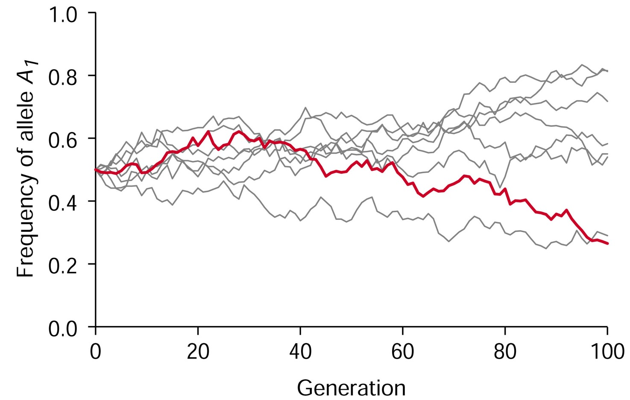
Evolution as change in allele frequencies across generation

Slide 5
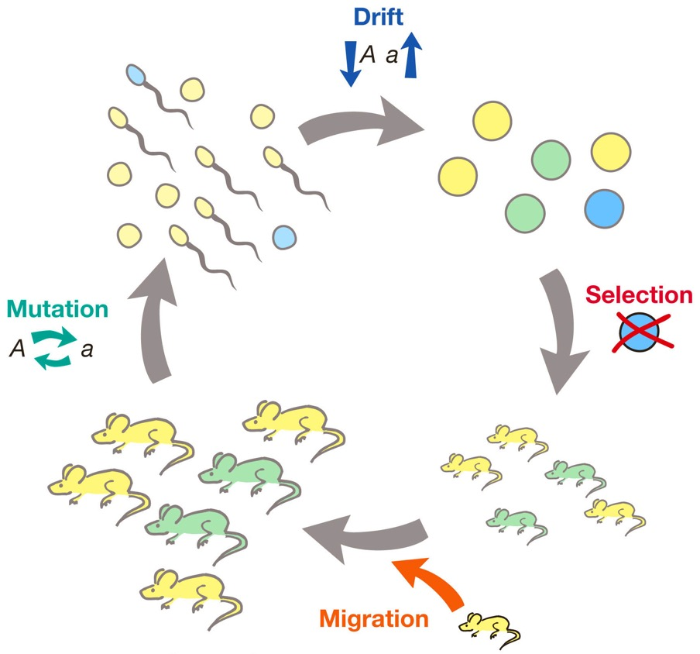
What constitutes an evolutionary force?
Mutation
Selection
Genetic drift (changes due to chance)
Migration
(Non-random mating)

Slide 6
How do evolutionary forces change allele frequencies?
Modeling selection
Modeling other evolutionary forces

Slide 7
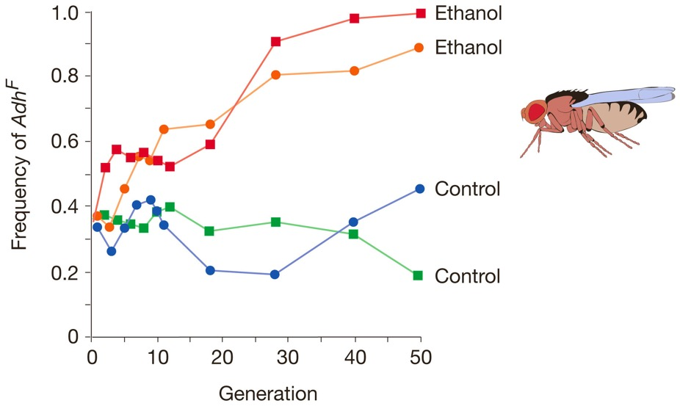
The effects of selection
Causes deviations from Hardy-Weinberg equilibrium
Changes allele frequencies from generation to generation
Why?
Because certain genotypes have a higher fitness than others!

Slide 8
How exactly does selection affect allele frequencies?
What do you predict for a rare beneficial allele in a population?
What do you predict for a common deleterious allele in a population?

Slide 9
What is fitness?
Fitness is the corollary of selection!
Fitness is a quantitative representation of natural and sexual selection, describing reproductive success
It is defined for specific genotypes or phenotypes and depends on the environmental context
Fitness is equal to the average contribution to the gene pool of the next generation that is made by individuals of the specified genotype or phenotype

Slide 10
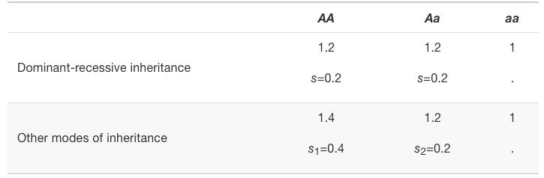
What is relative fitness?
Relative fitness…
…expresses the fitness of different genotypes relative to each other
…can be any positive number, including zero
It is often convenient to choose one genotype as a reference and set its relative fitness to 1
The difference in relative fitness between genotypes is the selection coefficient (s)

Slide 11
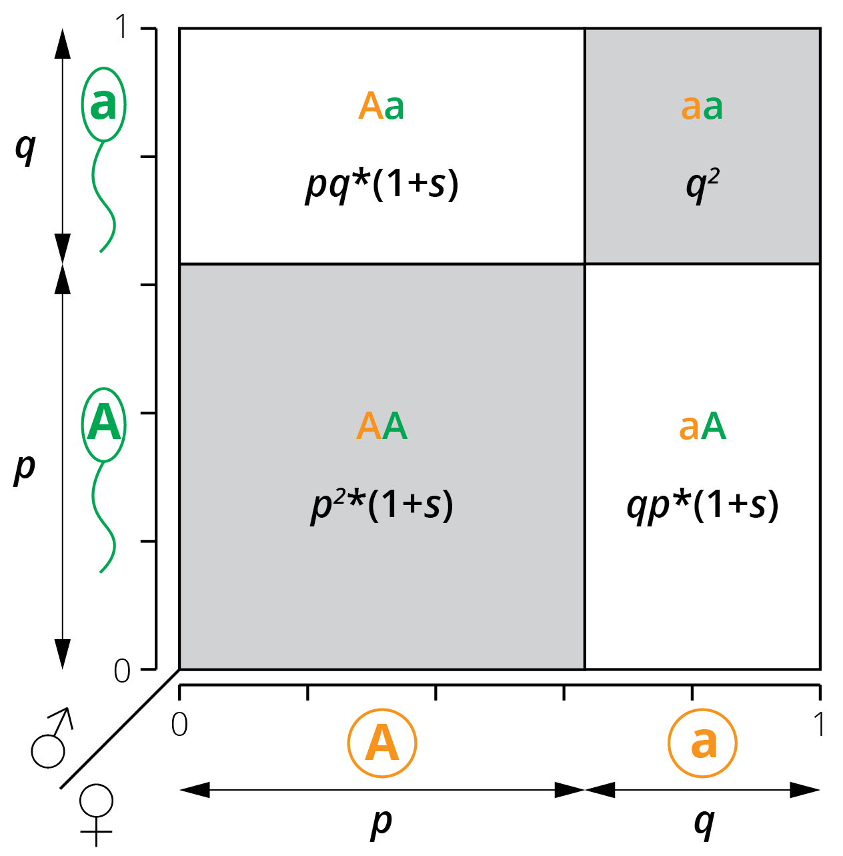
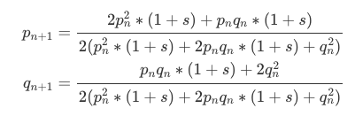
Simulating selection
Selection can be simulated by simply calculating allele frequencies across generation under consideration of s
Allele frequency after selection:

Slide 12
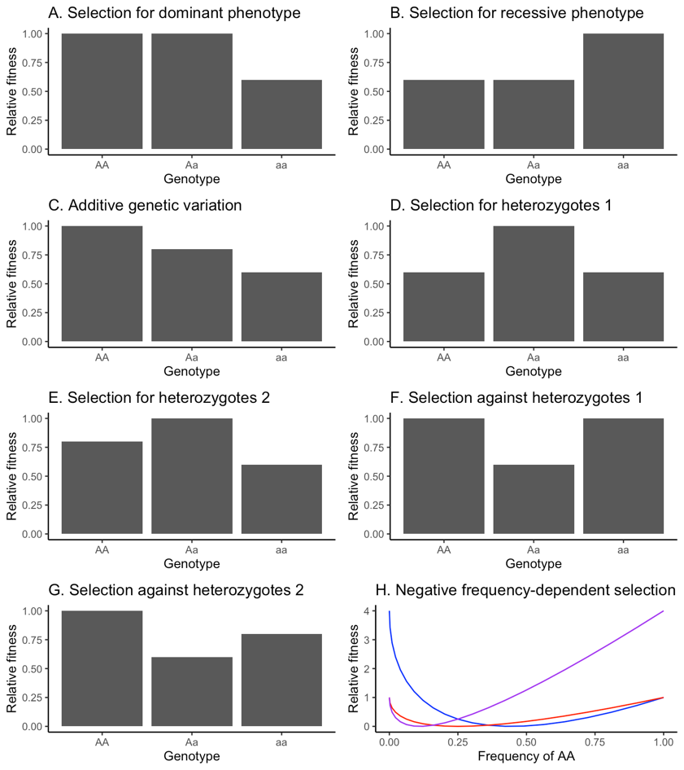
How does selection affect allele frequencies?
Key variables
Selection coefficient/fitness
Mode of inheritance
Dominant/recessive inheritance
Selection for dominant traits
Selection for recessive traits
Additive inheritance
Heterozygote advantage/disadvantage
Starting allele frequency (p₀)
Number of generations

Slide 13
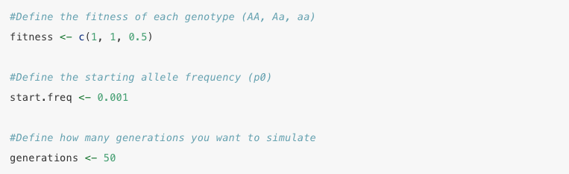
Simulating selection provides accurate predictions
Deleterious recessive allele
fitness <- c(1,1,0)
Starting allele frequency of 0.5
p₀ = 0.5
Run time
time = 50 generations

Slide 14
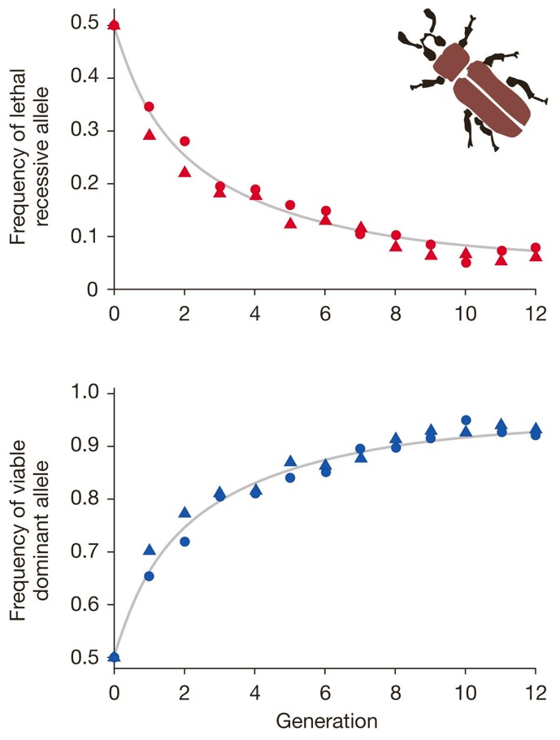
Simulating selection provides accurate predictions
Deleterious recessive allele
fitness <- c(1,1,0)
Starting allele frequency of 0.5
p₀ = 0.5
Run time
time = 50 generations

