Slide 1
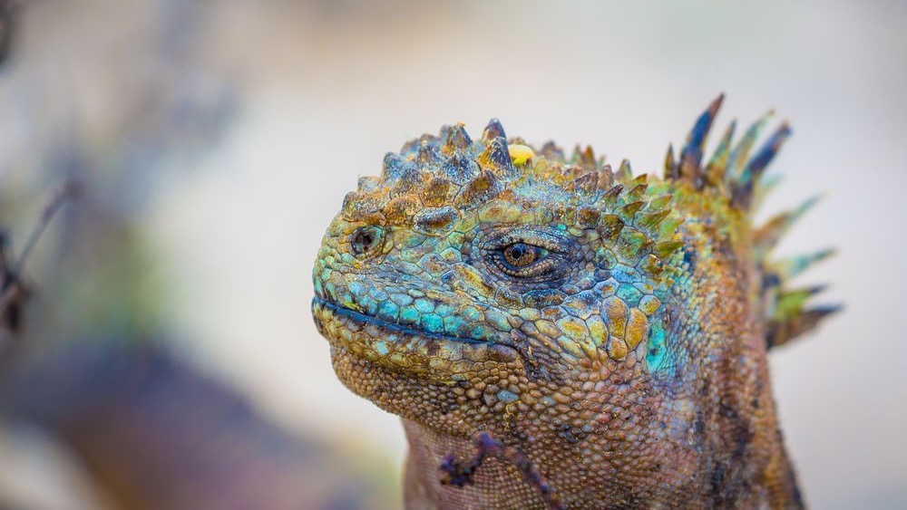

Slide 2
Discussion questions
In relation to the R exercise
Why are most male iguanas to large for surviving food limitation? How would you test your hypothesis?
Is there evidence for sexual conflict in Drosophila? How would you go about identifying the critical traits? Can you explain why male flies benefit from harming a female? What are the implications of sexual conflict on the average fitness of populations?
Can you explain how and why a female preference for male eye spots may have evolved? What model of female choice evolution best fits these observations? What alternative hypotheses might explain the observed patterns, and how could you address them experimentally?
The slope of sexual-selection gradients in females is often non-zero. Can you explain why multiple matings may be beneficial for females, even if their reproductive success is limited by time and energy?
Why do female pipefish court males? Is there sexual selection in species without dimorphism (like in crows)?
Why are vampire bats altruistic?

Slide 3
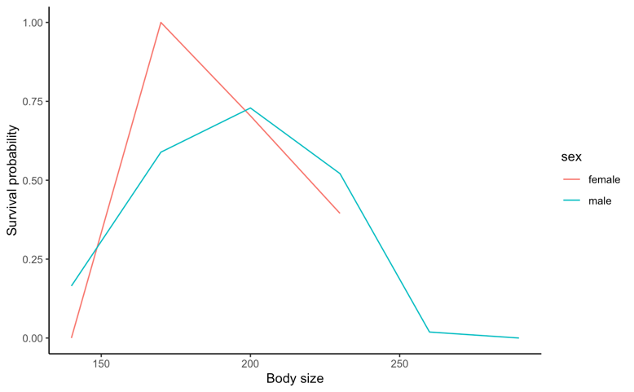
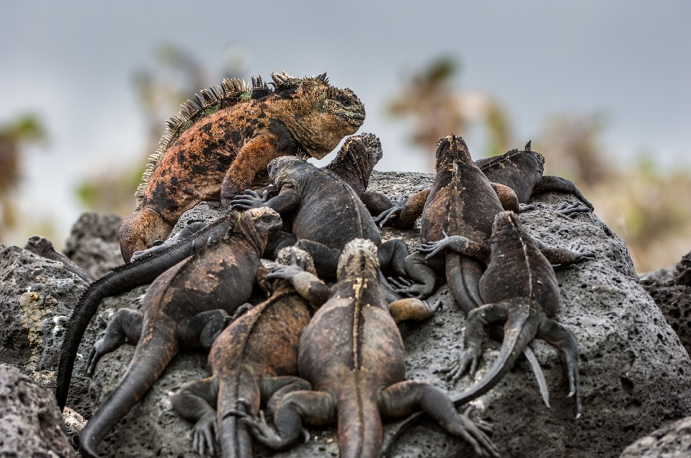
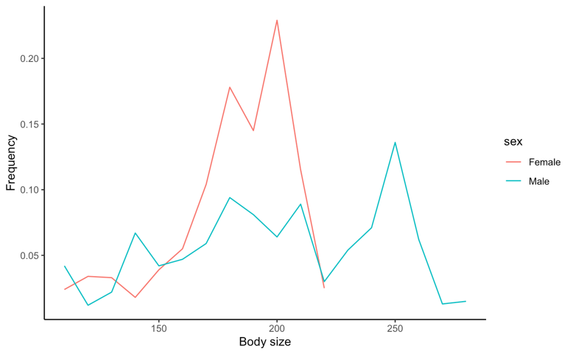
Survival vs. reproduction
Why are there males of suboptimal body size?

Slide 4
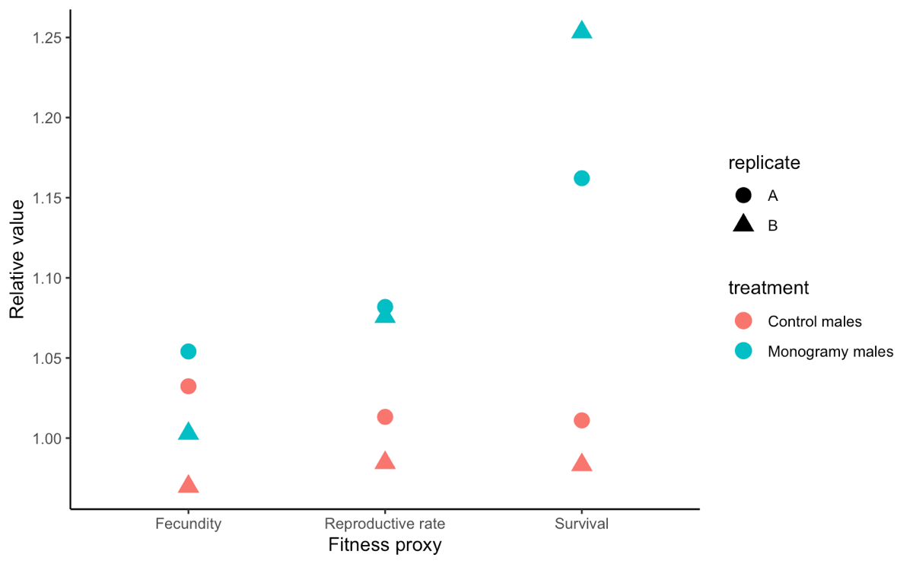
Monogamous males are less harmful to females

Slide 5
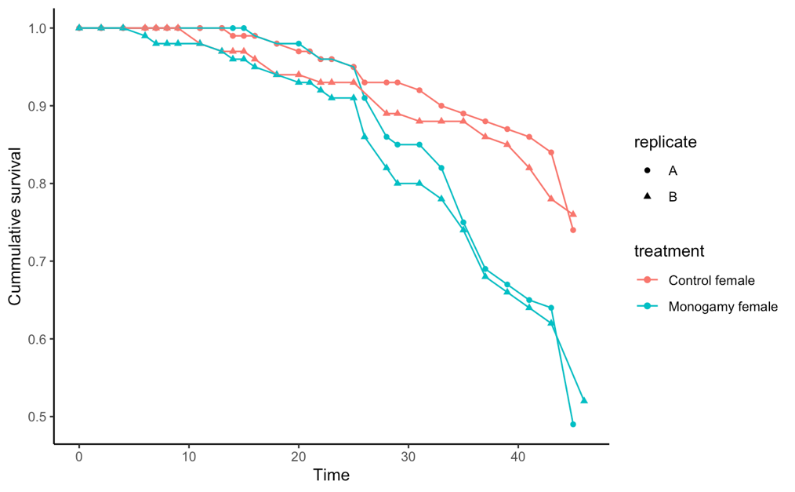
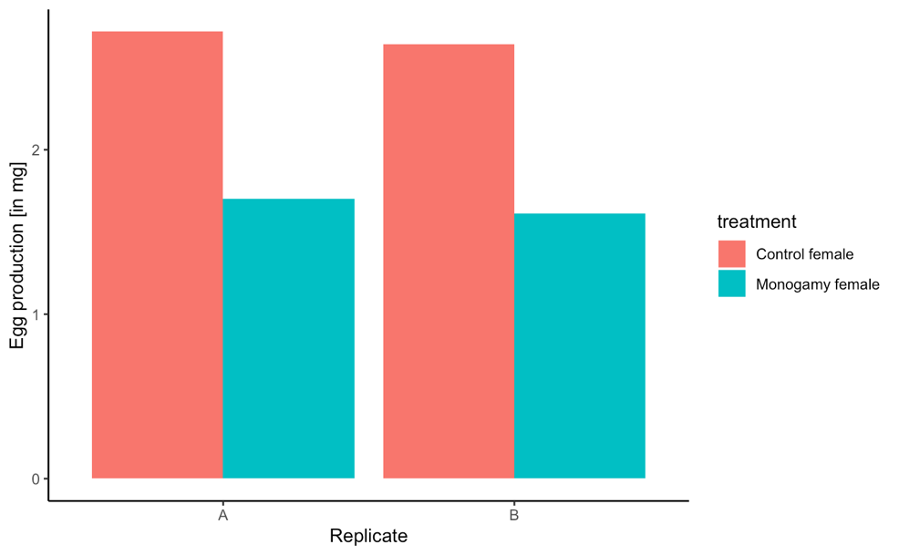
Monogamous females are less resistant to male harm
Is there evidence for sexual conflict in Drosophila?
How would you go about identifying the critical traits?
Can you explain why male flies might benefit from harming a female?
What are the implications of sexual conflict on the average fitness of populations?

Slide 6
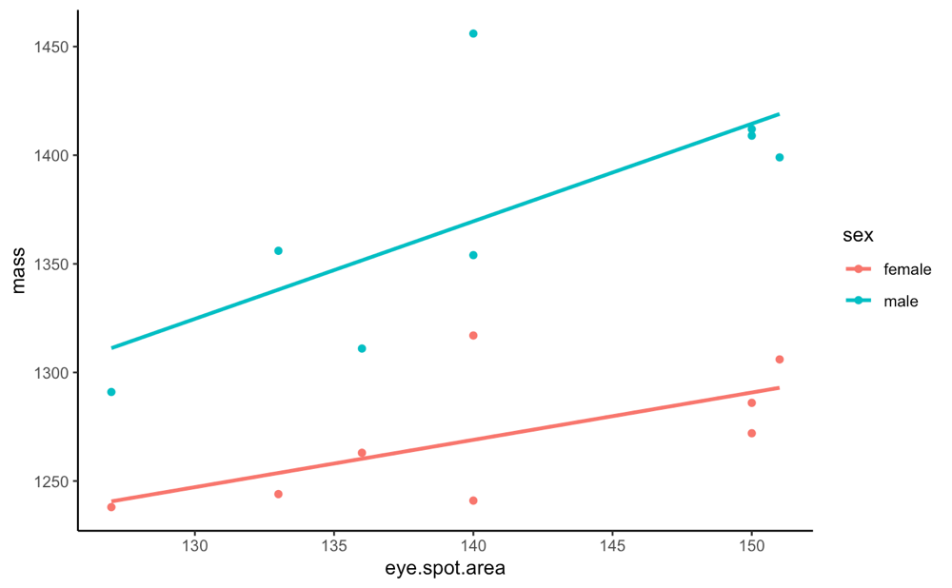
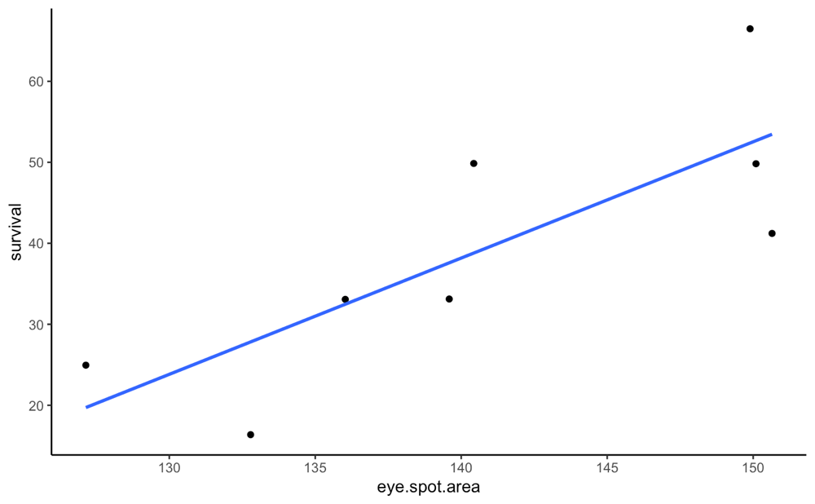
Indirect fitness benefits for choosy peahens
Can you explain how and why a female preference for male eye spots may have evolved?
What model of female choice evolution best fits these observations?
What alternative hypotheses might explain the observed patterns, and how could you address them experimentally?

Slide 7
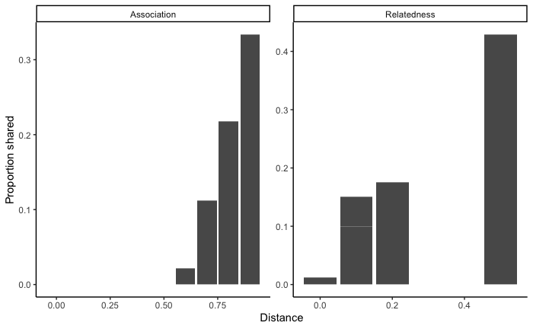
Altruism in vampire bats
Why are vampire bats altruistic?

Slide 8
What is a species and how do they arise?
We will talk about speciation next!
BUT first… take a week off!
Optional career day on Tuesday (April 6)

