Slide 1
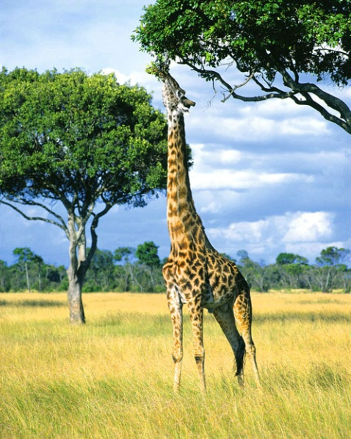
How do we infer adaptation?
How does phenotypic plasticity impact the study of adaptation?

Slide 2
Discussion questions
In relation to the R exercise
Is there correlation between style length and visitor length consistent with the hypothesis that pollinator size drives the evolution of style size?
Are the results of the translocation experiment consistent with the hypothesis that pollinator size drive the evolution of style size?
What are some of the caveats, and how could you address them?
Are population differences in size at maturation between low and high-predation environments the consequences of phenotypic plasticity or local adaptation?
Assuming that high-predation populations are ancestral, what does the experiment tell you about the evolution of phenotypic plasticity?
What are some potential reasons that the results of the experiment differs somewhat between the two drainages?
A big open question in evolutionary biology is how phenotypic plasticity impacts evolutionary change. Some argue that plasticity slows down evolution, while others think plasticity might actually potentiate evolution. Can you explain under what circumstances phenotypic plasticity might slow down or event prevent evolutionary change? Can you explain under what circumstances phenotypic plasticity might potentiate evolutionary change?

Slide 3
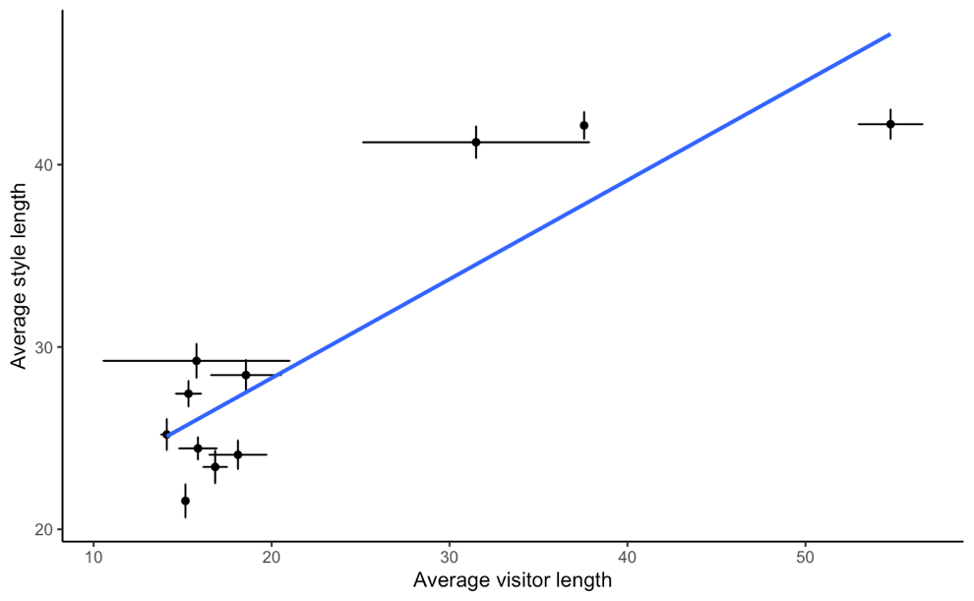
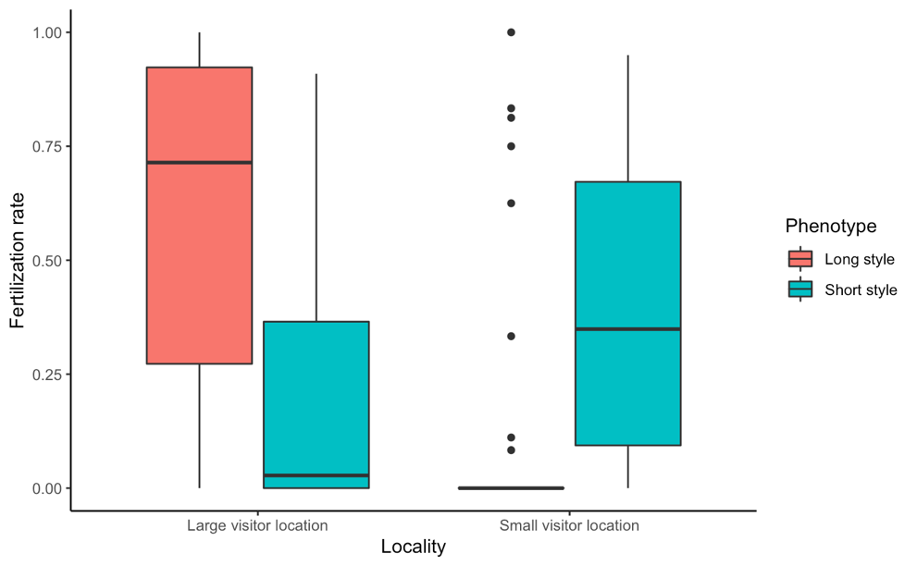
Pollinators and flower evolution
Is there correlation between style length and visitor length consistent with the hypothesis that pollinator size drives the evolution of style size? What are some of the caveats, and how could you address them?
Are the results of the translocation experiment consistent with the hypothesis that pollinator size drive the evolution of style size? What are some of the caveats, and how could you address them?

Slide 4
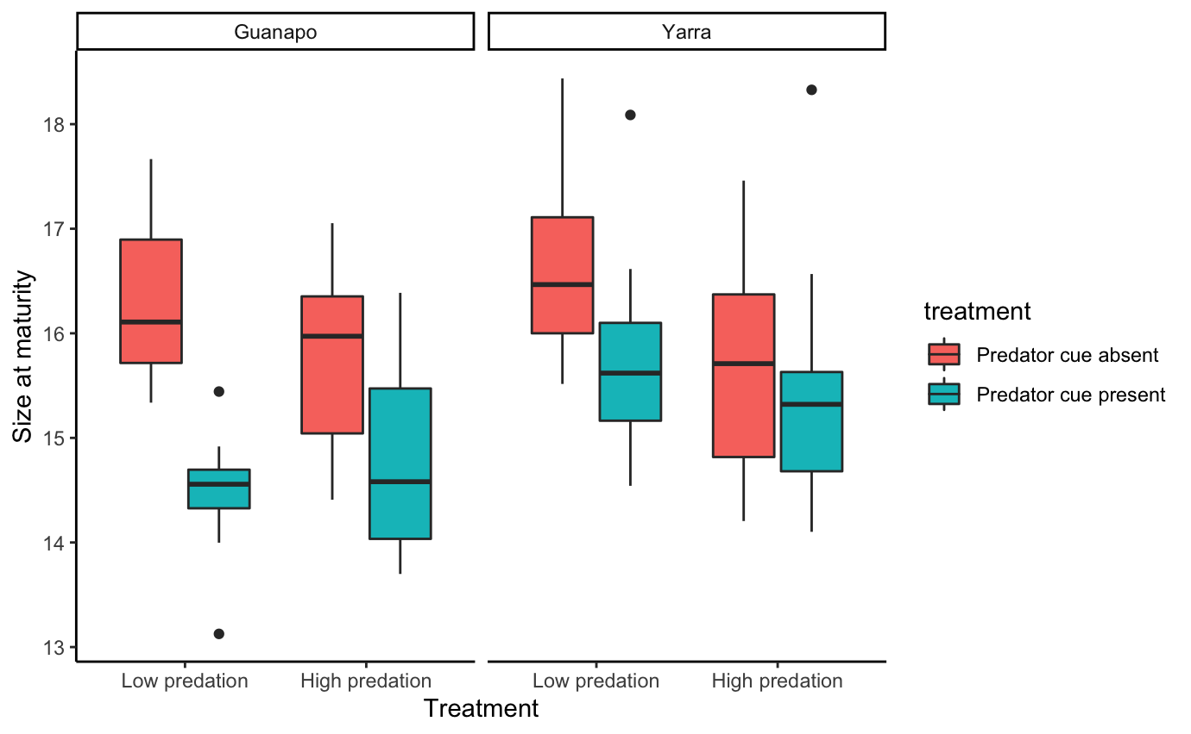
Phenotypic plasticity in guppies
Are population differences in size at maturation between low and high-predation environments the consequences of phenotypic plasticity or local adaptation?
Assuming that high-predation populations are ancestral, what does the experiment tell you about the evolution of phenotypic plasticity?
What are some potential reasons that the results of the experiment differs somewhat between the two drainages?

