Slide 1
Classifying Toxic Comments Our submission to the Kaggle Toxic Comment Classification Challenge
Damon pham, Samruda Pobbathi, Michael zhou

Slide 2
The Problem
It is difficult to keep conversations safe for all participants while ensuring freedom of speech.
This is especially challenging in online spaces, where people do not speak face-to-face.

Slide 3
The Data
63 million English comments scraped from user- and article-pages on Wikipedia between 2004 and 2015
Crowd-annotated labels: toxic, severely toxic, obscene, threatening, insult, identity hate

Slide 4
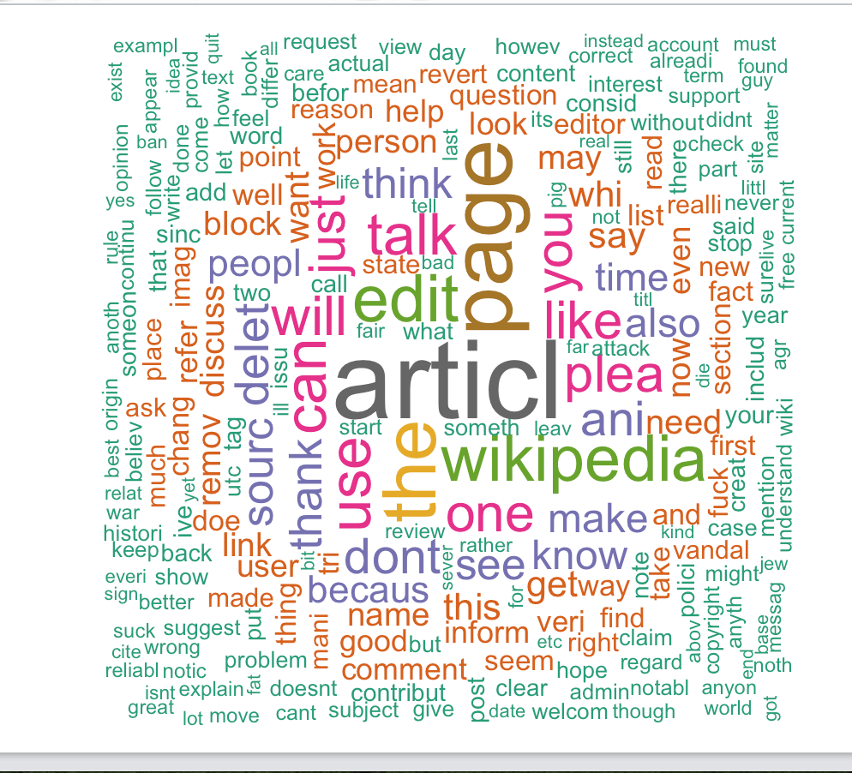
Word Cloud
(Of the non-toxic comments, of course) ☺

Slide 5
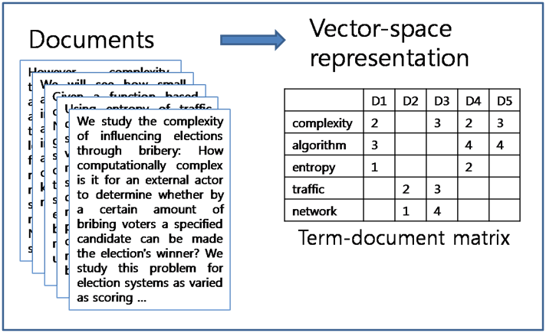
What we tried
Document term matrix

Slide 6
What we tried
Document term matrix
Machine learning
Labeled latent Dirichlet allocation (L LDA)
Latent semantic analysis-Naïve Bayes (LSA-NB)
Support vector machine (SVM)
LogitBoost

Slide 7
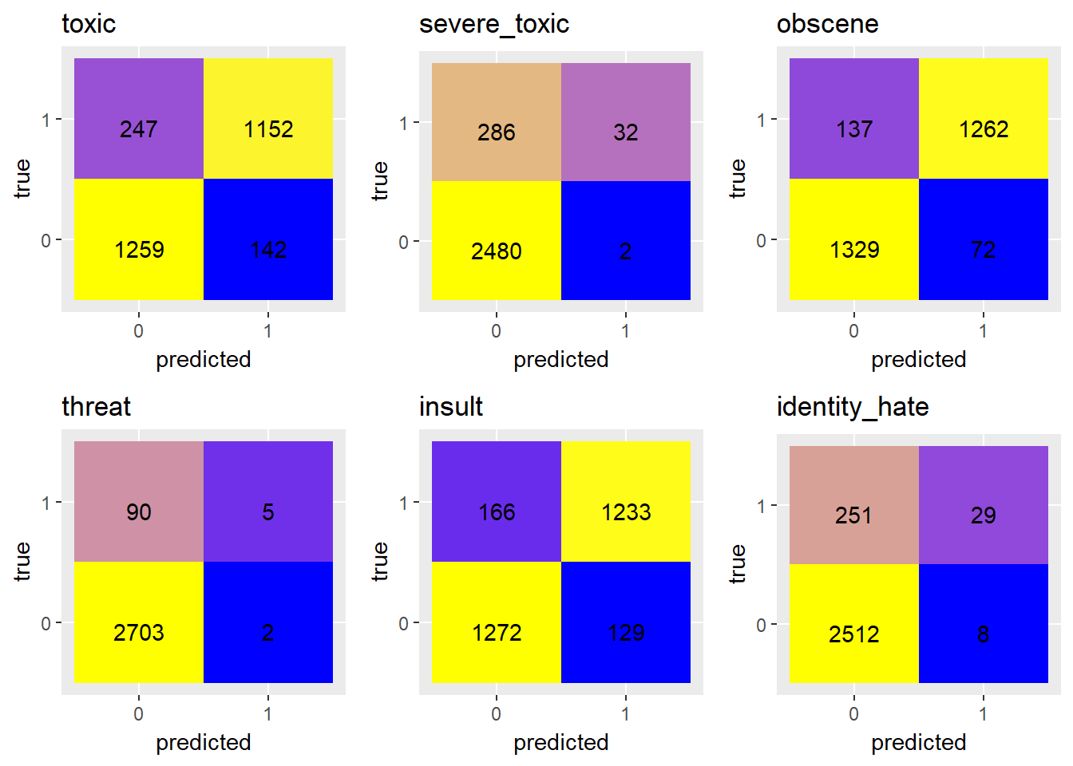
Results: SVM Confusion Matrices

Slide 8
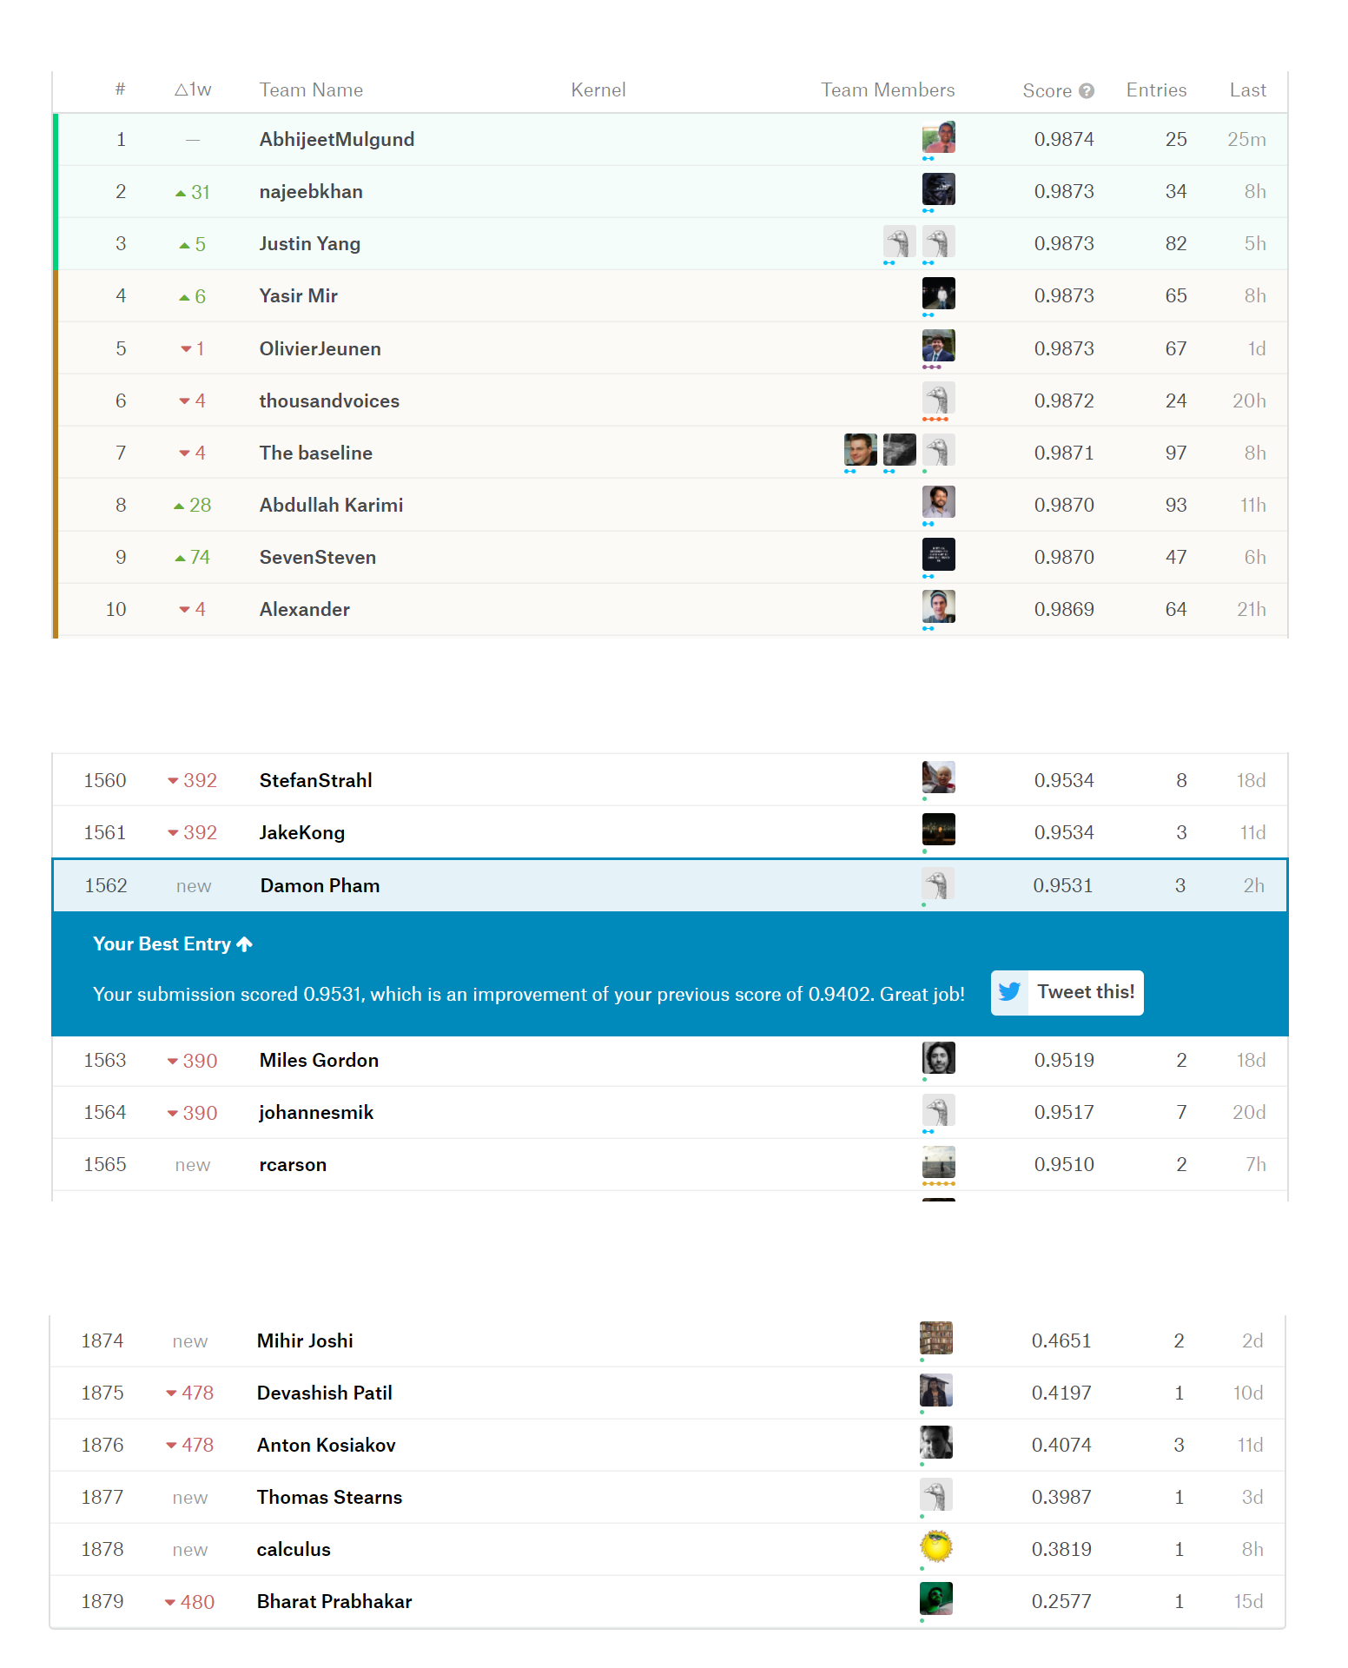
Results: SVM Leaderboard Rank
. . .
. . .

