Slide 1
Intelligence vs Artificial Intelligence
Powered Exoskeleton
Notes:
Created by: Michael Middleton
Period B4

Slide 2
Overview
History and Background
Implementation
Pros
Cons
Summary
Reference

Slide 3
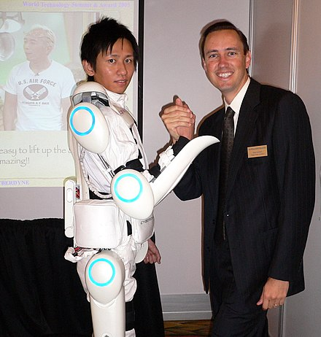
History and background
A powered exoskeleton is a piece of equipment that can fit over the human body, designed to assist with movements that require lots of energy.
Notes:
The technology shows promise in providing better ergonomic support, curbing repetitive stress injuries and decreasing fatigue among workers who, for example, have to crouch or hold their arms above their heads for significant portions of their workday.
The goal is to “make it so at the end of 30 years, you feel OK,” he said, “Not at the end of 30 years you’re on workers’ compensation. No one wants that.”

Slide 4
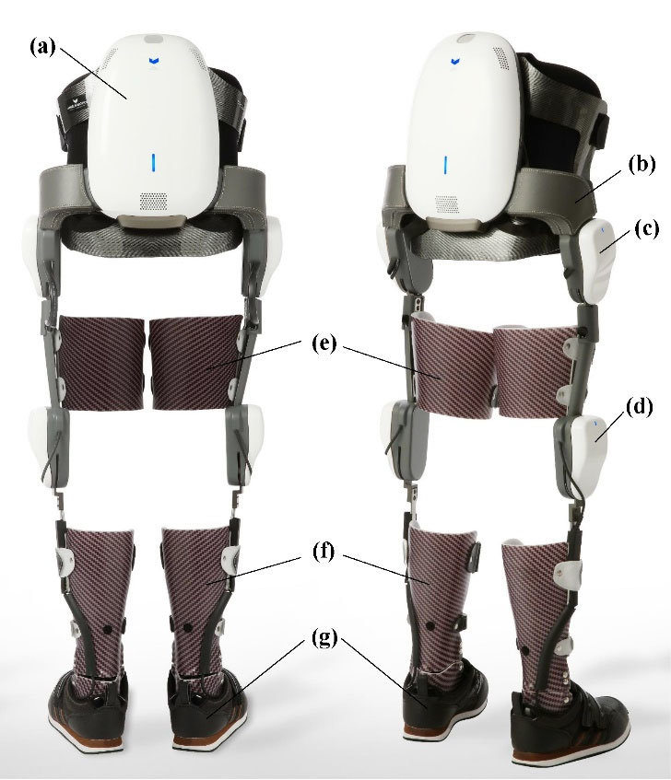
Implementation
Heavy lifting
Help with muscle paralysis
Firefighting
Caring for patients (lifting heavy patients into beds)
Notes:
Powered exoskeletons can be implemented in many ways. Firefighters can use exoskeletons to hold the fire hose steady so it does not blow them over. Nurses can use exoskeletons to aid with lifting and maneuvering heavy patients.

Slide 5
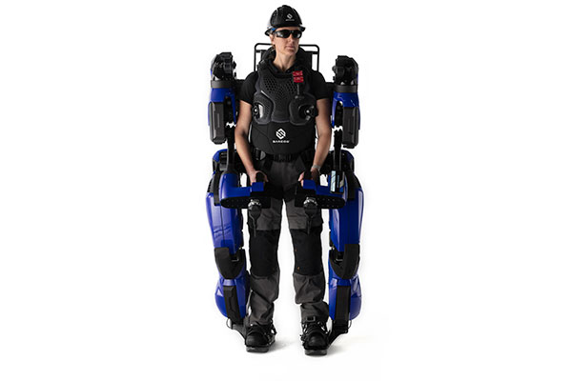
Can you buy an exoskeleton?
Yes, but it is both very expensive and hard to obtain.
Notes:
An exoskeleton is extremely versatile, as it can be used to assist with virtually any task. But for the time being, powered exoskeletons are expensive, at around $10K. This makes powered exoskeletons unrealistic for most, and they can often be hard to get even if you have the money to buy one. Most fully researched exoskeletons are found in Japan and do not ship to the United States.

Slide 6
Pros
Assists with almost any movement
Makes many tasks easier
Saves time and energy spent doing laborious tasks
Instantly increases strength
Notes:
An exoskeleton uses a system of motors and other devices to support the joints of the human body, which is beneficial if your joints are either injured or are not very strong. This makes laborious tasks faster and less taxing on the body.

Slide 7
Cons
It can be very expensive
It can be hard to obtain
It can sometimes have issues with syncing with the human body
Notes:
As most operational powered exoskeletons are found in Japan, they are hard to find. At around $10K-25K per exoskeleton, they are also not cheap. Another problem with some exoskeletons is that they can have programming issues or delays in movement. This can make using a powered exoskeleton difficult and frustrating.

Slide 8
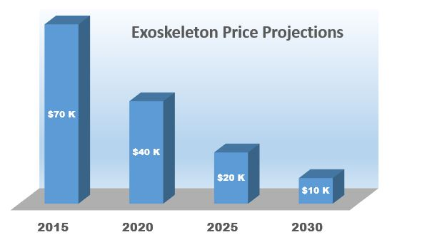
Exoskeleton Price Projections
The price of exoskeletons will go down over time.
Notes:
As of right now, the price of exoskeletons is still quite high. As more technological advancements in powered exoskeleton technology unfold, the price will inevitably decrease.

Slide 9
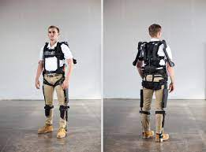
Summary
I am for exoskeleton technology. I think it is very useful for a broad range of tasks. It definitely has room for improvement, but it is still quite good for its specific tasks.

Slide 10
Reference
https://www.safetyandhealthmagazine.com/articles/17370-exoskeletons-in-the-workplace
https://www.researchgate.net/publication/318170755_Wearable_Robotics_Industrial_Robots_and_Construction_Worker%27s_Safety_and_Health
https://www.emerald.com/insight/content/doi/10.1108/IR-04-2022-0105/full/html
https://www.compositesworld.com/articles/composites-in-exoskeletons (photo)

