Slide 1

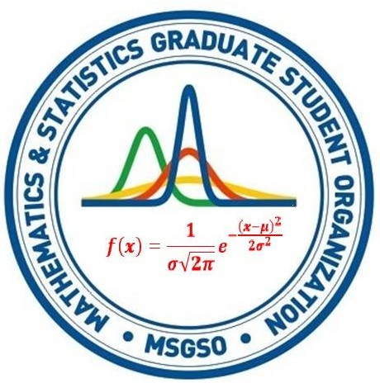


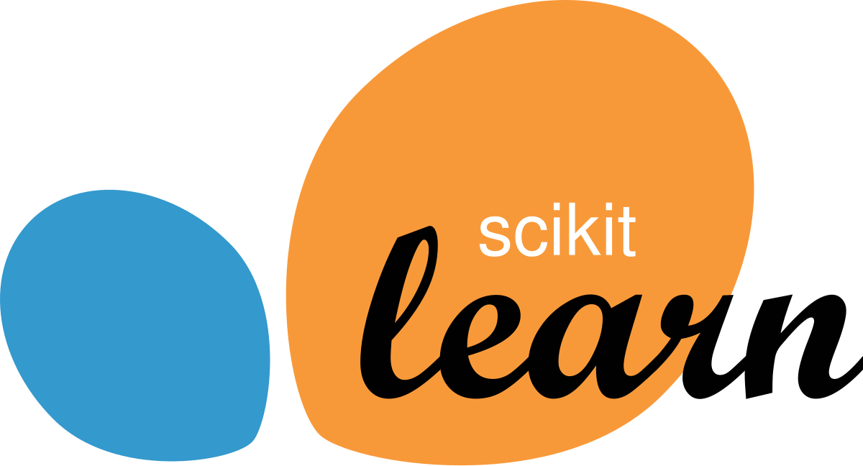
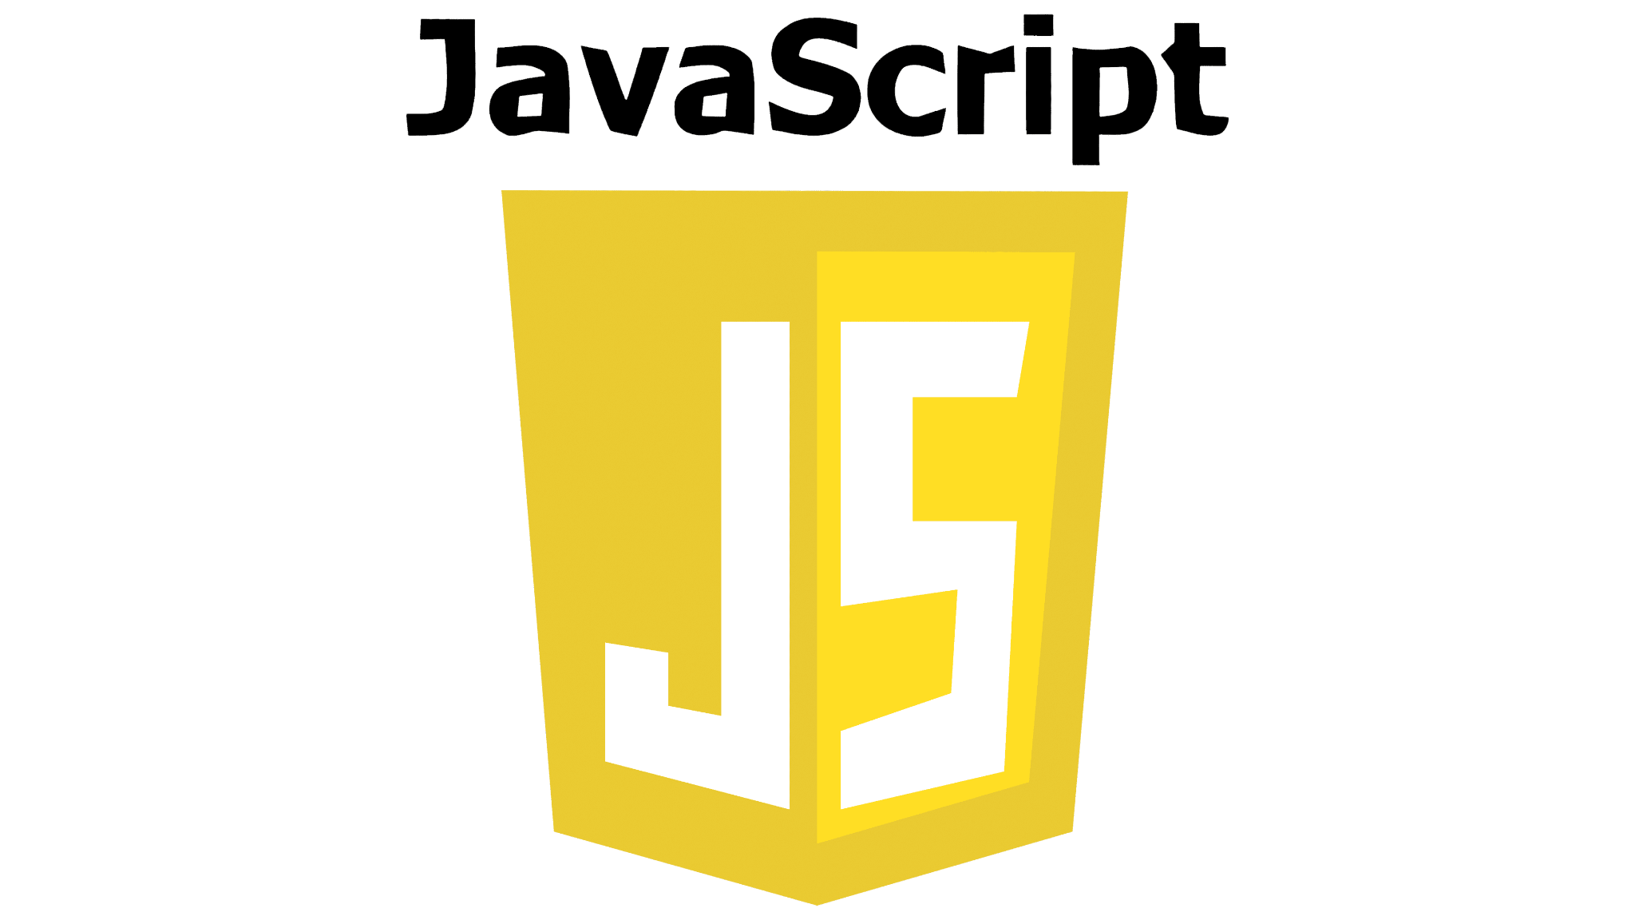
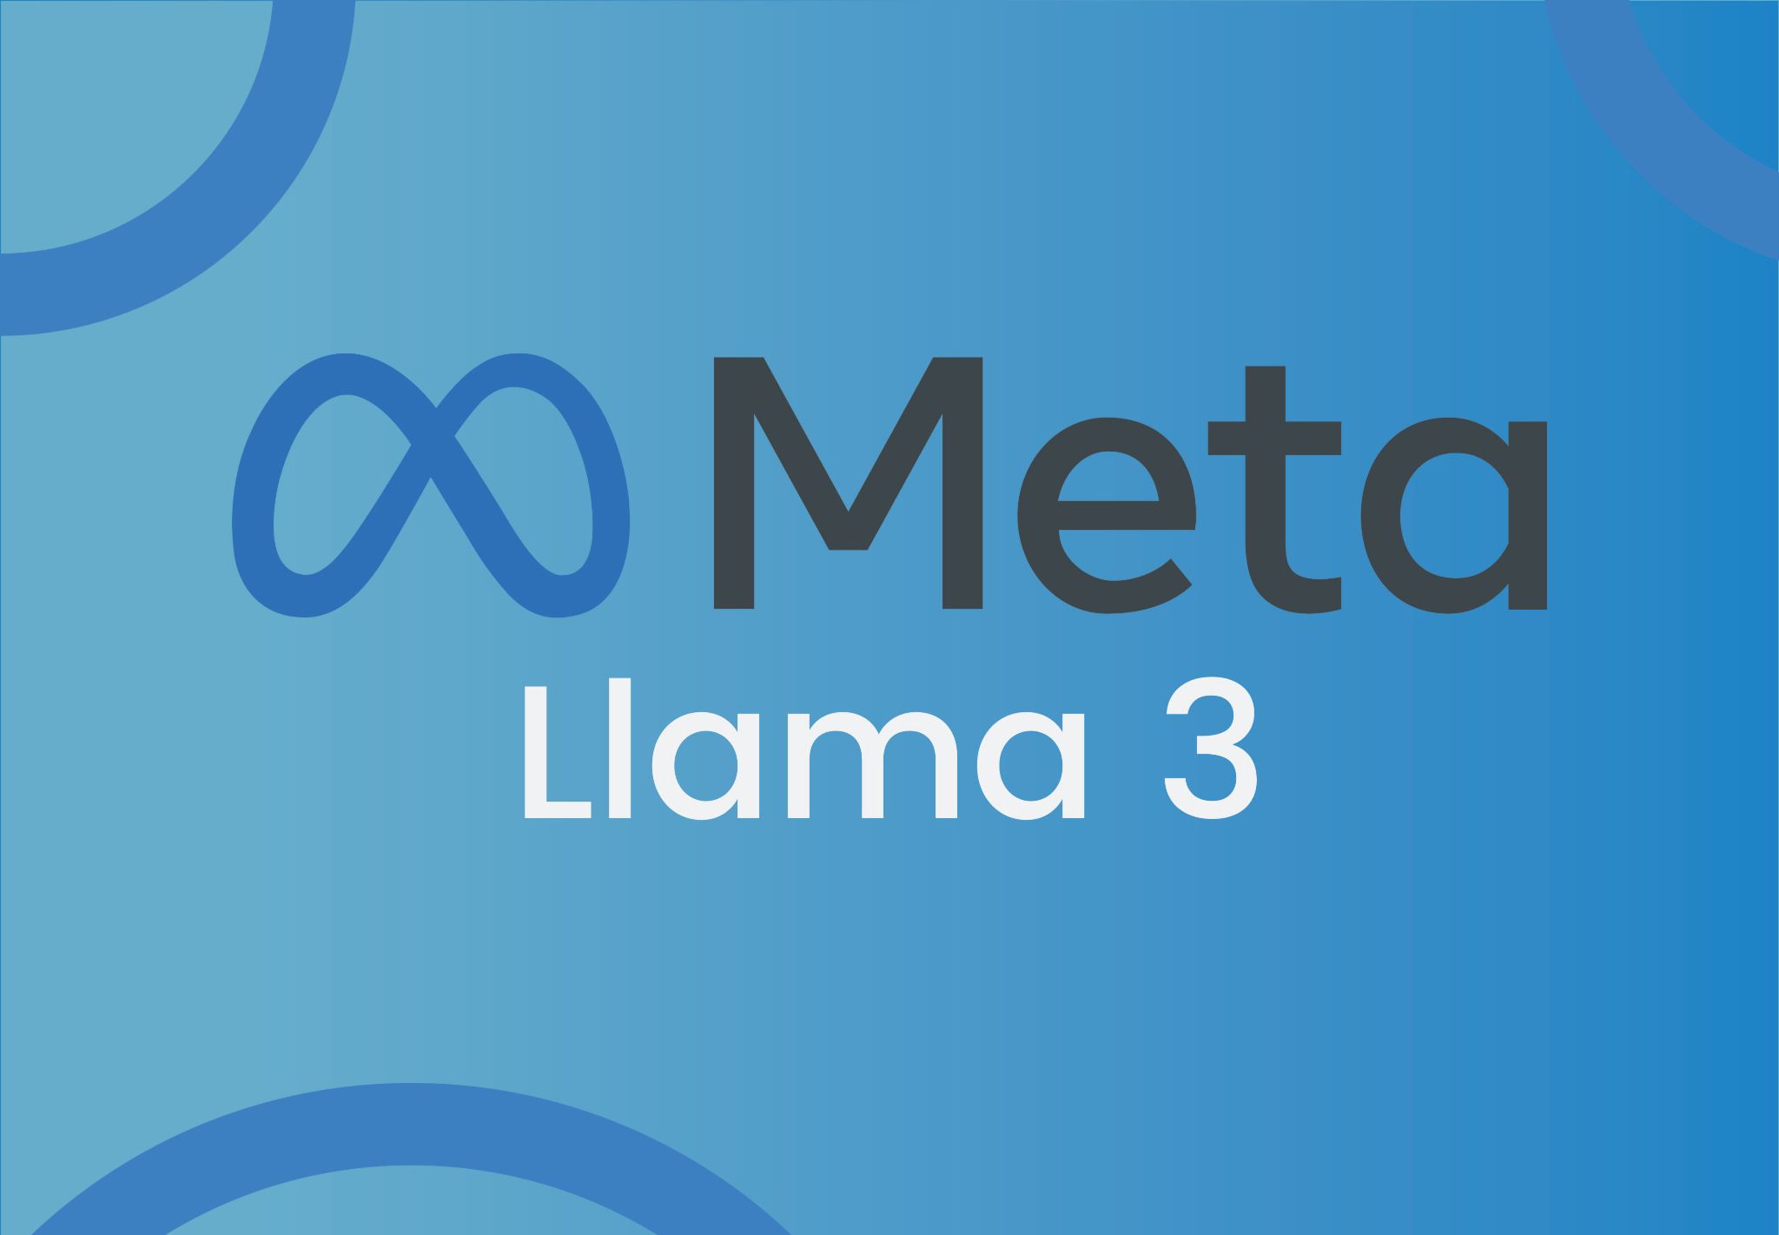

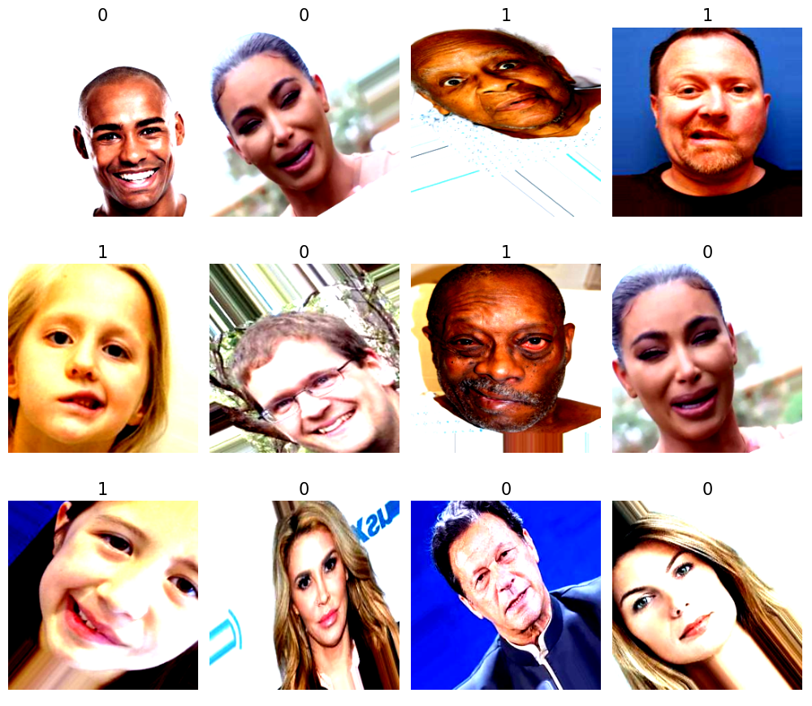
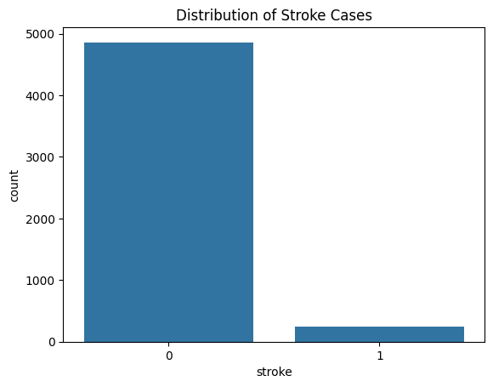
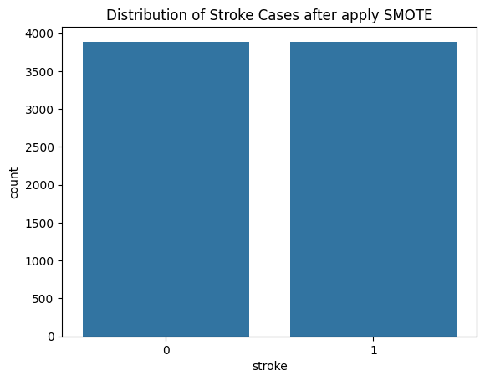
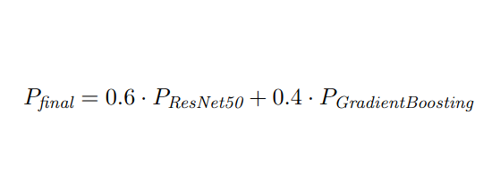
Multimodal for Stroke Detection
Long Dang and Chaitanya Padamata
Mentors: Yugyung Lee PhD
Abstract
Architecture
Continues & Conclusion
Motivation: Immediate action in stroke cases greatly improves survival rates and outcomes. Early recognition and quick access to emergency care can significantly reduce the risk of severe disability or death in stroke patients.
Problem Statement: Stroke is a critical medical emergency that requires prompt treatment, but many stroke victims face delays in care due to late recognition of symptoms and challenges in accessing emergency services. This lack of timely intervention remains a significant barrier to improving stroke outcomes.
Proposal: Leveraging recent advancements in AI and machine learning, we propose a platform for early stroke detection and fast emergency response. This platform uses AI-driven facial analysis and medical history data to detect potential stroke symptoms, alert users, and direct them to nearby emergency facilities, ensuring faster intervention and better patient outcomes.
Frontend
Model deploy
Model training
Backend
Multi-model LLM pretrained
Dataset
Database
Facial dataset: The dataset comprises 5029 images across two classes—acute stroke and non-stroke cases. Data augmentation techniques, such as flipping, rotation, and scaling, were applied to enhance model accuracy by diversifying and strengthening the dataset to more accurately reflect real-world scenarios.
Result
Limitation & Future Work
Facial stroke prediction
We study various CNN architectures—ResNet50, ResNet34, EfficientNet, and ConvNeXt—for facial stroke detection.
CNN architectures | Learning rate: 0.001 | Learning rate: 0.01 | # of iteration until converges
ResNet34
ResNet50 | 99.48% |  | 34
EfficientNet
ConvNeXt
Medical history dataset: This dataset contains 5110 observations with 12 features, and is used to predict whether a patient is likely to get a stroke based on input parameters like gender, age, various diseases, and smoking status
2. Stroke based medical history prediction
We used various Machine Learning algorithms – Random Forest, Gradient Boosting, XGBoost, and SVM – for stroke prediction-based medical history.
Categorical variables | Continuous variables
Gender Hypertension Heart disease Ever married (drop) Work type (drop) Residence type (drop) Smoking status Stroke | Age ID (drop) BMI Average glucose level
Note: Since the dataset consists of more non-stroke than stroke cases; hence, the data-balanced technique (SMOTE) was applied.
ML algorithms | Learning rate: 0.05 | Learning rate: 0.1 | N_estimators: 100 | N_estimators: 200
RandomForest | N/
Gradient Boosting
XGBoost
SVM
References
3. Total prediction
[1] Contactdoctor/Bio-Medical-MultiModal-Llama-3-8B-V1 · hugging face (no date) ContactDoctor/Bio-Medical-MultiModal-Llama-3-8B-V1 · Hugging Face. Available at: https://huggingface.co/ContactDoctor/Bio-Medical-MultiModal-Llama-3-8B-V1 (Accessed: 07 November 2024).
We combined the 2 best models with 60% of facial prediction and 40% of medical history prediction.

