Slide 1

Model Review Board
A small Flask web app to review model predictions
Server-rendered pages, one database table, tests for every rule, and a Render Blueprint on free plans. Reviews and notes are stored in a database, so they survive handovers.
pending
approved
rejected
Michel Mghames | neuefische MLE
Notes:
A small web app for an ML team to review model predictions. The three badges are the three decisions: pending, approved and rejected.

Slide 2


The scenario
A small ML team reviews model predictions before another department uses the decisions. Their spreadsheet is not enough.
The problem
The app
It is hard to see which cases are still pending.
Reviewer notes can be lost when the work is handed over.
Every review is stored in one relational database.
Everyone sees the same status, decision and notes.
Notes:
The spreadsheet makes it hard to see which cases are pending, and notes get lost at handovers. The app stores every review in one database.

Slide 3
The user journey
Five steps from the project description. All of them work in the browser.
1
Open the dashboard: all reviews and the status totals
2
Create a review: case reference, prediction, confidence and input summary
3
Decide: set approved or rejected, and add notes
4
Read it elsewhere: another browser session sees the saved decision
5
Delete with care: only through an explicit form: a question page, then a POST
Notes:
The five steps of the user journey. Every step was tried in the browser.

Slide 4


How it works
The browser talks to Flask routes. Flask-SQLAlchemy reads and writes the database. One setting chooses which database.
Browser
Flask routes
Review model
Database
pages and forms
dashboard, forms, health
one table and the rules
SQLite locally
Jinja templates
routes.py
models.py, validation.py
PostgreSQL on Render
Rendered on the server
One setting: DATABASE_URL
Plain HTML pages from Jinja templates. No JavaScript is needed.
SQLite is the local default. On Render it points to PostgreSQL.
Notes:
Browser, routes, model, database. The same code runs on SQLite locally and on PostgreSQL on Render. Only DATABASE_URL changes.

Slide 5
The data
One table, review, with nine columns. A new review starts as pending, and both dates are set by the app.
id
case_reference
prediction
whole number, set by the database
text, required
text, required
confidence
input_summary
decision
decimal from 0 to 1
text, required
pending, approved or rejected
notes
created_at
updated_at
text, optional
date and time (UTC)
changes at every update
Notes:
The review table. The decision is one of three values and starts as pending. The two dates are set by the app.

Slide 6
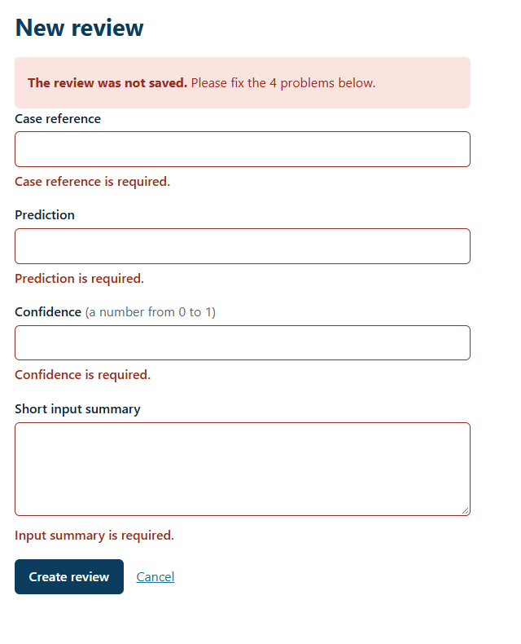




The rules
Every form is checked on the server. A wrong input comes back with a clear message, and nothing is saved.
Required
Case reference, prediction, confidence and input summary
Confidence
A number from 0 to 1. Anything else is rejected.
Decision
Only pending, approved or rejected
POST only
Create, update and delete never run on a page visit
Notes:
The server checks every form. The picture shows the create form sent empty: four messages, nothing saved.

Slide 7
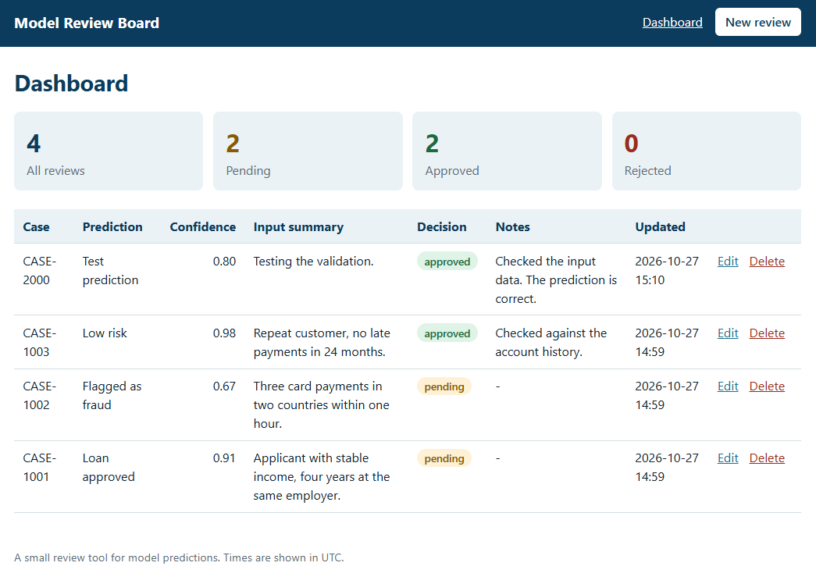
In the browser
The dashboard shows every review with the status totals. A decision saved in one session is read from the database in another.
Status totals
all, pending, approved and rejected, at the top
Newest first
every review with its decision, notes and update time
Edit and Delete
in every row. Delete asks first.
Notes:
The real dashboard, opened in a private window, which is a second session. It shows the same approved decision with its note.

Slide 8
The tests
99 tests guard the rules. They fail when the code is wrong: we broke it on purpose to check.
99
tests pass
99
pass in a fresh clone of the public repository
on purpose
we broke the code to check that the right tests fail
Notes:
The tests cover the model, the settings, the commands, every page, the validation and the health check. Eighteen tests also guard render.yaml, so a paid plan or a written secret cannot slip in.

Slide 9


Deployment
A Render Blueprint created the web service and the database. Both are on the free plan, the app is live, and the evidence is in the repository.
Live on free plans
It survived a redeploy
A Python web service and a PostgreSQL database, both Free. No card was added.
A review made on the public app was still there afterwards, because it lives in PostgreSQL.
A slow first load
No secret in the file
After 15 minutes of silence the service sleeps. The first load took 44.49 seconds.
Render wires DATABASE_URL from the database and generates the secret key.
Live until about 24 November 2026: model-review-board-pfo7.onrender.com
Notes:
The Blueprint created the service and the database on the free plan. A review made on the public app survived a redeploy. After 15 minutes of silence the service went to sleep, and the first load took 44.49 seconds. The app stays online until about 24 November 2026, then it is removed.

Slide 10


Reflection and status
Why a SQLite file is not enough on Render, what the deployment showed, and the one change before sensitive data.
SQLite
One change first
What we saw
Great for development: no server and one file. Not on a free Render service: its files are lost on every redeploy, restart or spin-down.
Authentication and access control. Today anyone with the address can read and change every review.
A review survived a redeploy. The first load after sleep took 44.49 seconds. Removal is planned for about 24 November.
Built, tested and deployed on Render's free plan
github.com/michobc205/model-review-board
Notes:
The reflection from the deployment notes. SQLite is for development. Before real review data, the app needs logins and access control. The deployment is done on the free plan, with evidence in the repository, and it is planned to be removed around 24 November.

