Slide 1

CSI 2132 Lab #5
Advanced SQL Queries
10 Feb 2020
uOttawa.ca
uOttawa.ca

Slide 2
Outline
Restore the database as it should be after done the queries of Lab 03
Review advanced queries that involve:
Join of Multiple Tables
Group By and Having keywords
Nested queries and IN keyword
Aggregate functions
GROUP BY and HAVING clauses
NOT EXISTS keyword
Using temporary tables in queries

Slide 3
Restore the Database
Delete all the tables within “laboratories” schema
Download from the course website the following file:
EndLab03.backup
This file contains the backup of the database as it should be after done all the queries presented in Lab 03
Restore the database (explained during previous lab).

Slide 4
Write the SQL Queries for the following
Note that these queries involve more than one table
1. List the names and customer ids of all customers who like Picasso
2. List the names of all customers who like Artists from the Cubism style and having an amount larger than 30000.

Slide 5
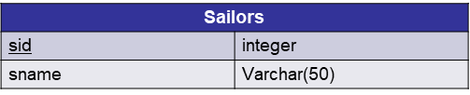
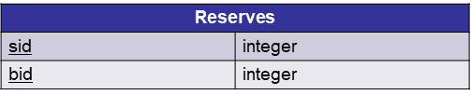
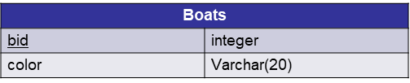
SAILORS Database PART A

Slide 6

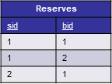

A nested Query using IN keyword in SAILORS DB
Find the names of sailors who have reserved both a red and a
green boat
SELECT * FROM Sailors S, Reserves R, Boats B

Slide 7
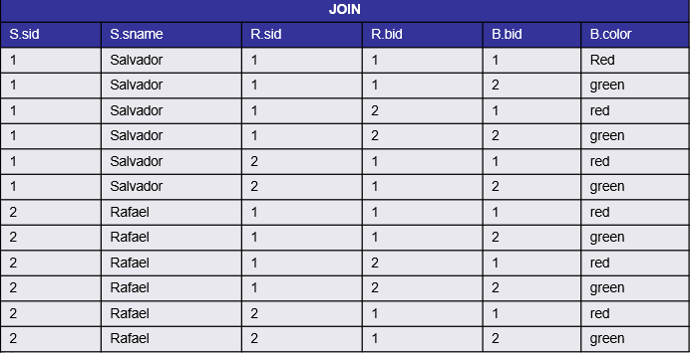
Output of above Query

Slide 8
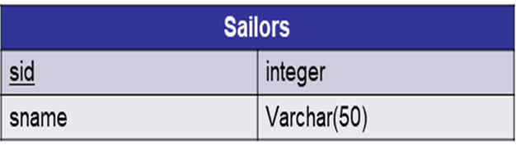
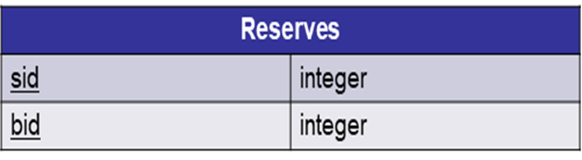
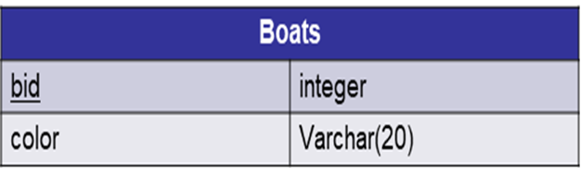
Using IN keyword in SAILORS DB
Find the names of sailors who have reserved both a red and a
green boat.
SELECT * FROM Sailors S, Reserves R, Boats B WHERE S.sid = R.sid AND R.bid = B.bid;

Slide 9
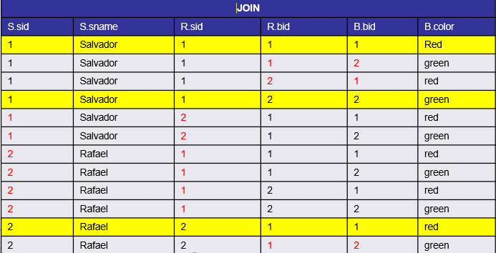
OUTPUT OF above Query

Slide 10


A nested Query using IN keyword in SAILORS Database
Find the names of sailors who have reserved both a red and a
green boat
SELECT * FROM Sailors, Reserves, Boats WHERE Sailors.sid = Reserves.sid AND Reserves.bid = Boats.bid AND….

Slide 11
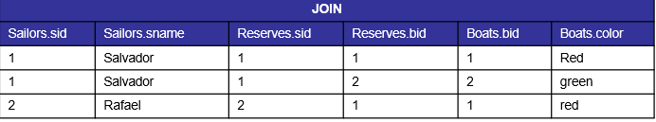
Output of above Query

Slide 12
Query using IN keyword in SAILORS DB
Find the names of sailors who have reserved both a red and a green boat.
SELECT S.sname FROM Sailors S, Reserves R, Boats B
WHERE S.sid = R.sid AND R.bid = B.bid AND B.color = ‘red’ AND S.sid IN (SELECT S2.sid FROM Sailors S2,Boats B2, Reserves R2 WHERE S2.sid = R2.sid AND R2.bid = B2.bid AND B2.color = ‘green’ );

Slide 13
Analysis of above Query
The query between () will return the sailor IDs who have reserved a green boat.
First three lines of the query will find sailors who reserved a red boat.
Thus, in the 4th line, we will have the ID of a sailor who reserved a red boat, and check if this same sailor also reserved a green boat by IN keyword

Slide 14
Your turn
Using our Artist database, find names of Customers who likes both an artist born in Malaga and an artist born in Florence.
You need the data that we inserted in Lab2 and Lab3.
Answer this question by writing a similar query that is described in previous slides.

Slide 15
SAILORS Database PART-B
Sailors
sid | integer
sname | Varchar(50)
age | integer
rating | Varchar(20) {good,fair,poor}
Reserves
sid | integer
bid | integer
Boats
bid | integer
color | Varchar(20)

Slide 16
More on Select statements
Remember (previous lab) the order and the syntax for GROUP BY and HAVING clauses
SELECT select-
list FROM from-list
WHERE record-
qualification GROUP BY
grouping-list HAVING
group-qualification

Slide 17
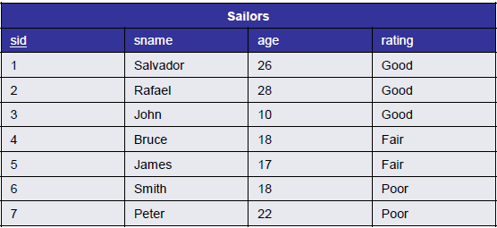
A Query using aggregate function AVG, and GROUP BY and Having clauses in Sailors DB
Find the average age of sailors who are at least 18 years old, for each rating level that has at least two such sailors.
SELECT * FROM Sailors S
WHERE S.age >= 18
WHERE clause eliminates all the sailors whose age is lesser than 18.

Slide 18
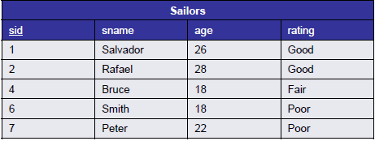
Output of above Query

Slide 19
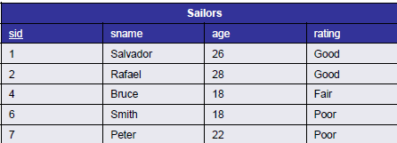
A Query using aggregate function AVG, and GROUP BY and Having clauses in Sailors DB
Find the average age of sailors who are at least 18 years old, for each rating level that has at least two such sailors.
SELECT S.rating, AVG(S.age) AS avgage, COUNT(*) numsailors FROM Sailors S WHERE S.age >= 18 GROUP BY S.rating

Slide 20
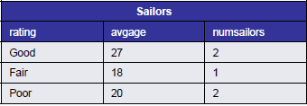
Output of above query
The remaining rows will be grouped by their rating using GROUP BY clause and we also obtain the average age and the number of sailors in each group.
Up to now, we have sailors who are older than 17 grouped by their rating.

Slide 21
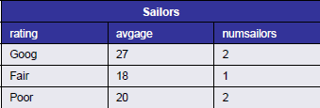
A Query using aggregate function AVG, and GROUP BY and Having clauses in Sailors DB
Find the average age of sailors who are at least 18 years old, for each rating level that has at least two such sailors.

Slide 22
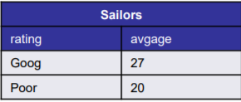
Solution
SELECT S.rating, AVG(S.age) AS avgage FROM Sailors S WHERE S.age >= 18 GROUP BY S.rating HAVING COUNT(*) > 1
HAVING clause allows us to specify a qualification (filter) for each group.
COUNT(*) >1 in the HAVING clause eliminates all the rating groups which do not have at least two sailors.
TIP: WHERE -> SELECT
HAVING -> GROUP BY

Slide 23
Another Query similar to previous one
Find the age of the youngest sailor with age > 18, for each rating level with at least 2 sailors (of any age)
SELECT S.rating, MIN(S.age) AS minage FROM Sailors S WHERE S.age >= 18 GROUP BY S.rating HAVING ( SELECT COUNT (*) FROM Sailors S2 WHERE S.rating=S2.rating ) >= 2
• All clauses except HAVING clause are similar to the previous query
• This time, since group qualification is having 2 sailors of any age, we get the total number of rows for that rating group with the query inside HAVING clause, and check if this number is at least 2.

Slide 24
Your turn
You need to insert following rows to Artwork table.
('Saints', 1470, 'Renaissance', 30000.00, 'Leonardo’)
('Hand of god', 1510, 'Renaissance', 52000.00, 'Michelangelo’)
('Murder', 1600, 'Baroque', 15000.00, 'Caravaggio’)
('Green', 1950, 'Modern', 5000.00, 'John’)
• Find the average price of artworks which are painted after 1490, for each artwork type that has at least two such artworks.
• And find the average price of artworks which are painted after 1490, for each artwork type that has at least two artworks (painted in any year)
• Write a query similar to what is described in previous slides to answer the question.

Slide 25
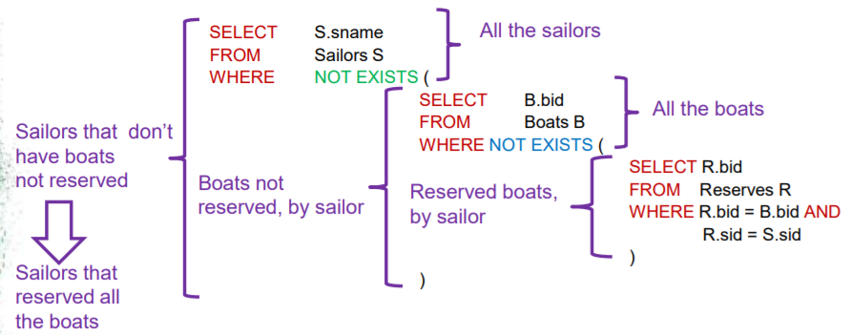
A nested Query using NOT Exists
Find name of the sailors who reserved all the boats.
The intuition behind this query is:
Find name of the sailors such that; there is no boat that he/she did not reserve.
Logically equivalent to ‘Find name of the sailors who reserved all the boats’ .

Slide 26
Your turn
You need the following values inserted into LikeArtist table first.
(2,'Caravaggio’)
(2,'Hans Hofmann’)
(2,'John’)
(2,'Josefa’)
(2,'Michelangelo’)
Find names of customers who like all the artists. You can answer this query using what you have learned in previous slide.

Slide 27
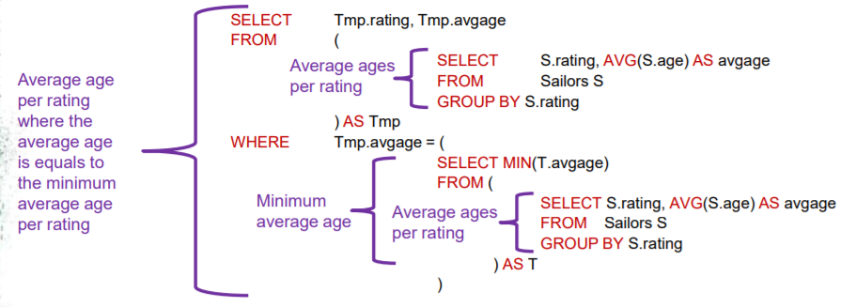
Using Temporary tables in queries
We can generate temporary tables and refer to their rows in our queries
Find those ratings for which the average age is minimum over all ratings.

Slide 28
Analysis of above Query
Table Tmp and T will store average ages for all the ratings.
• Query in WHERE clause will return a single value, which is the minimum of all the average ages.
• WHERE clause selects the rows where avgage equals to minimum average age.

Slide 29
Your turn
• First, delete a row that we have inserted in previous lab
DELETE FROM Artwork WHERE price = 4000.00;
Find those painting types for which the average price is the minimum over all types.

