Slide 1

CSI 2132 Lab #2
Basic SQL Programming
20 Jan 2020
uOttawa.ca
uOttawa.ca

Slide 2
Outline
Review the syntax of
Create a new Schema
CREATE TABLE
INSERT
SELECT
UPDATE
DELETE

Slide 3
Outline
Exercise
Create a new schema to work on it and set it as default
Creating tables from ER Diagrams
Inserting Data to tables
Querying the database
Updating Specific Data
Deleting Specific Data

Slide 4
How to create schema
A schema is a collection of database objects associated with one particular database username.
Right Click over Schemas Section and Select “New Schema”
Name the new schema (“laboratories”) and set the owner (your username)
In order to use this new created schema as the default one for the queries instead the “public” schema, first we need to execute the next sentence in the SQL tool
SET search_path = “new_schema”
This sentence has to be executed everytime we start the SQL tool

Slide 5
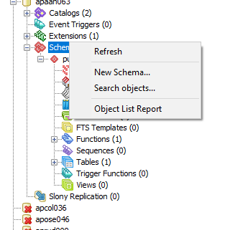
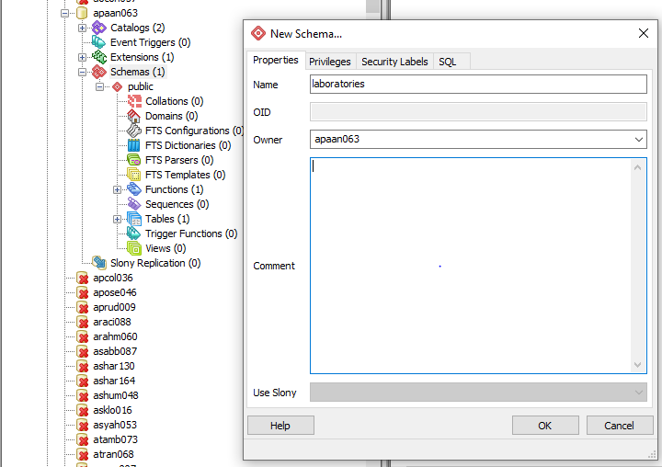
Create schema and set it to default

Slide 6
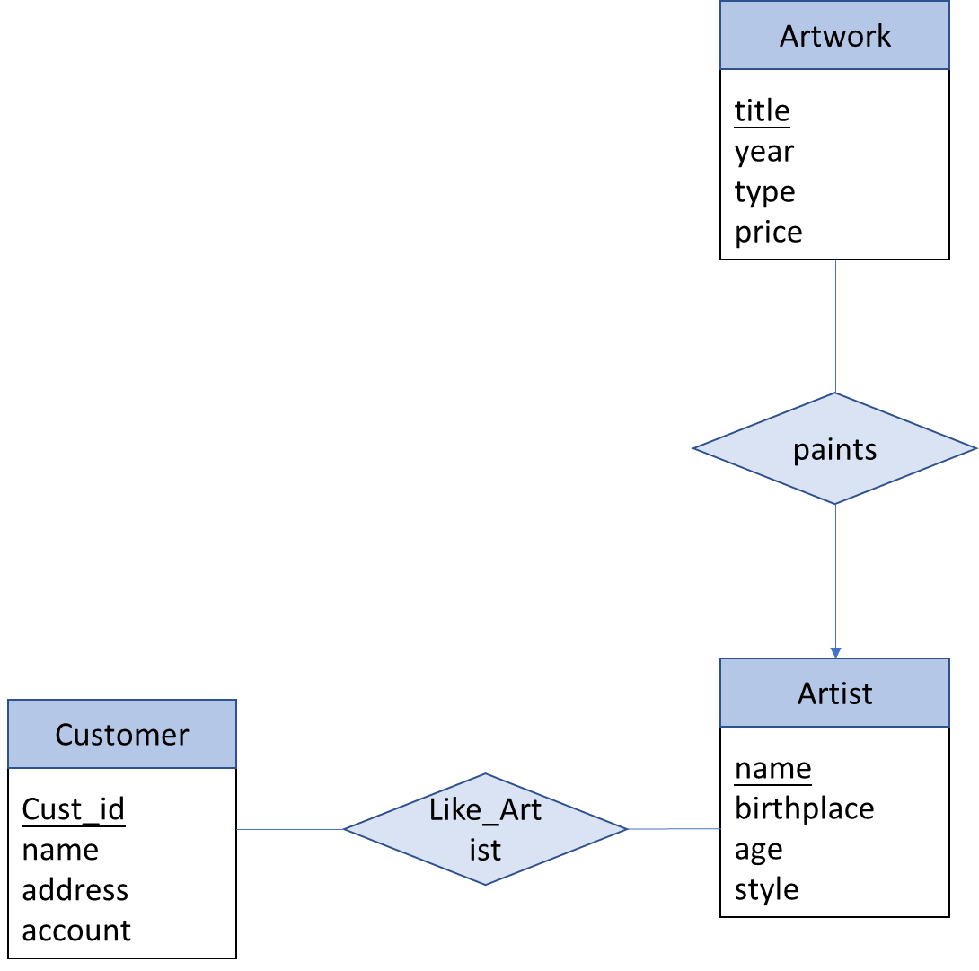
ER Diagram:
Tables Artist, Artwork, Customer, LikeArtist (Many to Many Relationship)
Remember the Primary key and Foreign key constraints.
A good convention is declaring the Primary Key(s) as the first attribute(s) in the tables

Slide 7
Data Types
INTEGER
VARCHAR(n)
DATE
TEXT
CHAR(n)
BOOLEAN
Refer - https://www.postgresql.org/docs/9.5/datatype.html

Slide 8
Create Table
Syntax:
CREATE TABLE TableName (
attributeName1 type1,
attributeName2 type2,
… attributeNameN typeN,
Constraint1,
Constraint2,
…,
ConstraintM
);
Example:
CREATE TABLE Artist (
AName VARCHAR(20), Birthplace VARCHAR(20),
Style VARCHAR(20), DateOfBirth DATE,
PRIMARY KEY (AName)
);

Slide 9
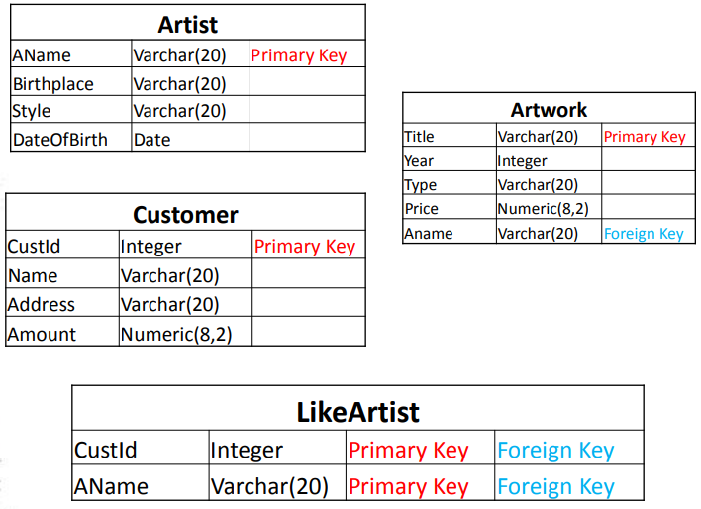
Tables to be created

Slide 10
Queries to create tables
CREATE TABLE Artist(
AName VARCHAR(20),
Birthplace VARCHAR(20),
Style VARCHAR(20),
DateOfBirth DATE,
PRIMARY KEY (AName));
CREATE TABLE LikeArtist(
CustId INTEGER,
AName VARCHAR(20),
PRIMARY KEY(Aname, CustId),
FOREIGN KEY (Aname) REFERENCES Artist,
FOREIGN KEY (CustId) REFERENCES Customer);
CREATE TABLE Artwork(
Title VARCHAR(20),
Year INTEGER,
Type VARCHAR(20),
Price NUMERIC(8,2),
AName VARCHAR(20),
PRIMARY KEY (Title),
FOREIGN KEY(AName)
REFERENCES Artist);
CREATE TABLE Customer(
CustId INTEGER,
Name VARCHAR(20),
Address VARCHAR(20),
Amount NUMERIC(8,2),
PRIMARY KEY (CustId));

Slide 11
Insertion
Syntax:
INSERT INTO TableName(attrName1,…,attrNameN)
VALUES (Value1,…, ValueN);
Example:
INSERT INTO Artist(AName,BirthPlace,Style,DateOfBirth) VALUES (‘Caravaggio’,’Milan’,’Baroque’,’1571-09-28’ );
Character values are quoted by ‘ ’, and numerical values are unquoted when inserting
Several inserts can be done consecutively in Query Tool.

Slide 12
Insert the following data
InTo Table Customer(CustId,Name,Address,Amount)
(1,’John’,’Ottawa’,8.5)
(2,’Amy’,’Orleans’,9.0)
(3,’Peter’,’Gatineau’,6.3)
InTo Table Artist(AName,Birthplace, Style, DateOfBirth)
(‘Caravaggio’,’Milan’,’Baroque’,’1571-09-28’ )
(‘Smith’, ‘Ottawa’, ‘Modern’, ‘1977-12-12’)
(‘Picasso’,’Malaga’,’Cubism’,’1881-10-25’)
InTo Table Artwork(Title,Year,Type,Price,AName)
(‘Blue’, 2000,‘Modern’,10000.00,‘Smith’)
(‘The Cardsharps’, 1594,’Baroque’,40000.00,’Caravaggio’)
Note: AName is a foreign key, value should exist in Artist

Slide 13
Selection
Syntax:
SELECT attr1,att2,…,attrN
FROM tableName
WHERE <CONDITIONS>
Example:
SELECT Style FROM Artist WHERE AName = 'Smith’;
or
SELECT A.Style FROM Artist AS A WHERE A.AName = 'Smith’;
or
SELECT A.Style FROM Artist A WHERE A.AName = 'Smith';

Slide 14
Create the following queries
List all artists that are born in Ottawa
List the titles and prices of all artworks painted in 2000.

Slide 15
Updating data
We can also modify certain data satisfying a condition from a table with UPDATE command. Condition is the same as WHERE clause of a SELECT query.
If you omit the WHERE clause, all records will be updated permanently
Syntax
UPDATE TableName SET Att1 = NewValueAtt1,
Att2 = NewValueAtt2 WHERE Condition
Example
UPDATE Customer SET Name = ‘Bruce’ WHERE CustId = 1

Slide 16
Create the following queries
Update Customer Name John to Bruce
Update the Amount value for all the Customers in the Database to be 9.8 and the address to be Gatineau.

Slide 17
Deletion
We can delete certain rows satisfying a condition from a table with DELETE command. Condition is the same as WHERE clause of a SELECT query. If you omit the WHERE clause, all records will be deleted permanently.
Syntax
DELETE FROM TableName WHERE Condition
Example
DELETE FROM Artist WHERE AName = ‘Smith’

Slide 18
Create the following queries
• Remove Customer Bruce from our Database
• Remove all the remaining Customers from the Database
• Suppose the artist ‘Smith’ moved to another gallery, and we have to remove him from our database. (Note that Artwork table has a foreign key to Artist table)

Slide 19
Reference
• About SQL Syntax:
http://www.faqs.org/docs/ppbook/c22759.htm

