Slide 1

CSI 2132 Lab #7
Simple Java Web Application Using Servlet, JSP and JDBC
11 Mar 2019
uOttawa.ca
uOttawa.ca

Slide 2
Outline
Web Applications
Model View Controller
Creation of a JSP application using JEE as JDK, Apache Tomcat as Server and Eclipse as IDE
View Layer: html and JSP pages
Definition of the Servlet
Logical / Controller Layer: Java code
Database Layer: Enterprise Java Beans

Slide 3
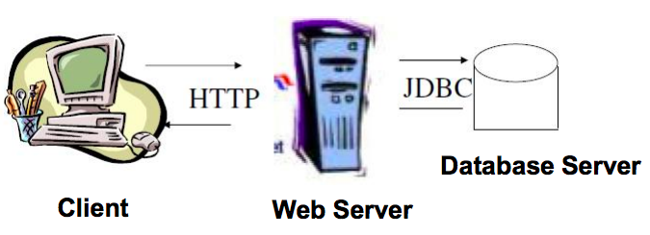
Web Applications
To add logic (program code) inside a web server, Sun Microsystems extended the Java language with the introduction of the API Java Servlets.
Notes:
A web application can be seen as a client-server program where the client runs in a web browser (such as firefox or google chrome) and the data is stored and retrieved from a database server (which in our case that is postgresql). Last week we learnt JDBC. This week, we’ll run a working sample web application that uses our database server PostgreSQL, uses an Apache Tomcat web server and displays information on the client machine using java servlets and client side programming languages such as html. The demo I showed you today is a login application.
Web Server -
Server on which your website is hosted. This server will have installed web servers such as IIS, apache, etc.
Application Server -
Server on which your created applications which are utilizing your database, web service, etc. This application server will host business layer (wrapped with web services), scheduled jobs, windows services, etc.
Database Server -
Database server will have your one or more database hosted such as Oracle, Sql Server, MySql, etc.

Slide 4
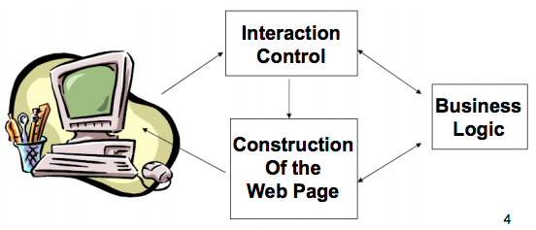
Model View Controller
Web applications are usually built following the three layers model.
According to this model three separate and perfectly defined process or modules are executed in different platforms.
Notes:
A Model View Controller is an is an architectural pattern that divides an application into three interconnected parts.
Components
The model is the central component of the pattern. It expresses the application's behavior in terms of the problem domain, independent of the user interface.[6] It directly manages the data, logic and rules of the application.
A view can be any output representation of information
The third part or section, the controller, accepts input and converts it to commands for the model or view.

Slide 5
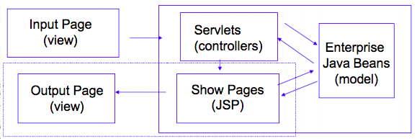
Model View Controller
An architecture that separates the application components:
Model: Represents the data
View: User Interface
Controller: Handles the user input and the application flow. It is implemented as a Java Servlet.

Slide 6
Configuring the runtime environment
The application needs to run on a WebServer
Tomcat Server
Download Apache Tomcat 9.0 from https://tomcat.apache.org/download-90.cgi
download the zip file and unzip it to a specific fold on the hard drive

Slide 7


Create a Web Project in Eclipse
File > New > Project
In the New Project Window Select Web > Dynamic Web Project > Click Next (NOTE: If you can’t see this option go to next slide)
Give the project a name
Under Target runtime, select New Runtime > Apache > Apache Tomcat v9.0 > Click Next
Under Tomcat installation directory click Browse > Browse to the location of the extracted the installation files of Apache Tomcat.
Remember to select

Slide 8
Install Web
Note: Implement the fix in this slide ONLY if you can’t see the Web option when creating a new Project.
Go to the Main toolbar in Eclipse and click on Help > Install New Software
In the Work with section select the name of your eclipse from the dropdown menu. Ex: Neon - http://download.eclipse.org/releases/neon

Slide 9
Install Web
Select Web, XML, Java EE….. option
Eclipse Java EE Developer Tools
Eclipse Java Web Developer Tools
Eclipse Web Developer Tools
Eclipse XML Editors and Tools
Click Next > Next > Accept the license agreement > click Finish
After the software installation, Eclipse will be restarted.
Now go back to the previous slide and create a new project.

Slide 10
Download Web Project to Work on
From the course website, download the file: lab7.rar
Decompress it.
In the Eclipse main toolbar, click on File > Open Projects from File System..
Click on the Directory button > Navigate to where lab 7 was saved.
If you have errors:
Right click on the project > select Properties > Java Build Path > Libraries > Add/Update JRE System Library
To add a runtime server:
Right click on the project > select Properties > Project Facets > Runtimes > Add / Select Apache Tomcat version you downloaded earlier.

Slide 11
Create a Web Application(View)
Login_success.jsp
Show success information
Index.html
Input
Employee_id
And
Employee_password
Login_failure.jsp
Show failure information

Slide 12
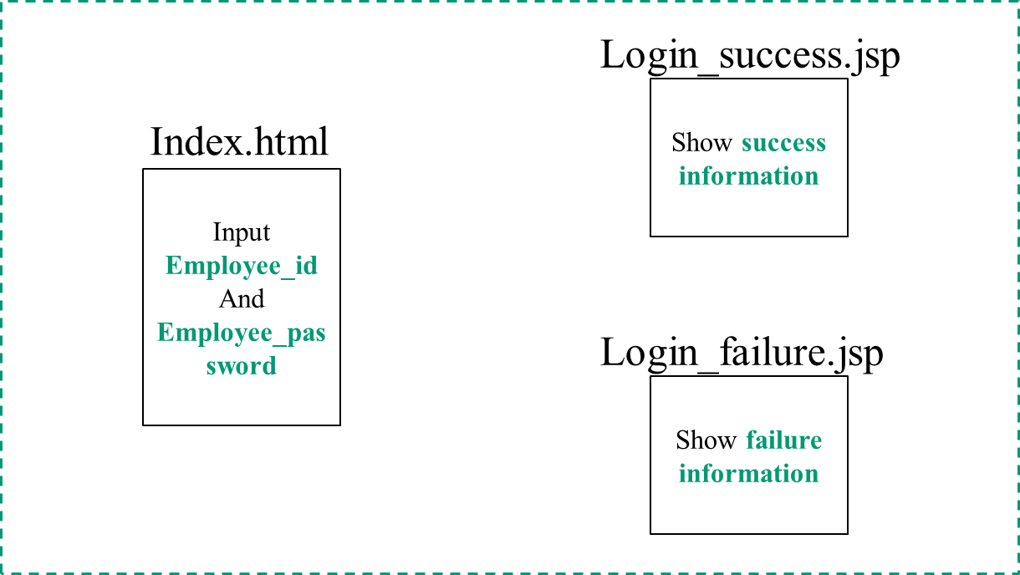
Create a Web Application(Controller)
view
calls
sends
EmployeeloginServlet.java
servlet
controller

Slide 13
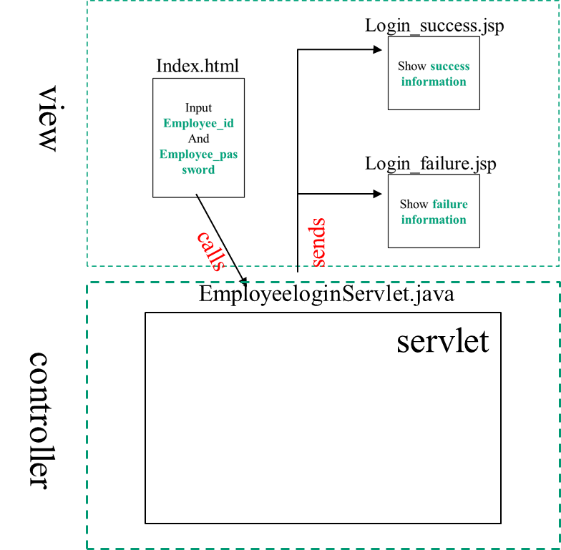
Create a Web Application(Model)
DB
model
PostgreSqlConn.java
connection
DB

Slide 14
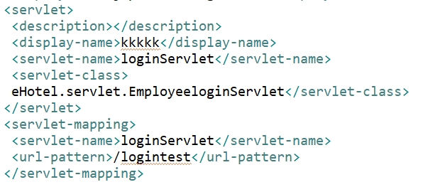
Process-login
Employee.html
EmployeeloginServlet.java
username
pwd
web.xml
4
action=
"logintest"
1
3
2

Slide 15
Process-login
Employee.html
EmployeeloginServlet.java
username
pwd
req.getParameter(“name attribute in form”)

Slide 16
Process-login
Employee.html
EmployeeloginServlet.java
username
pwd
req.getParameter(“username”)
PostgreSqlConn con = new PostgreSqlConn();
String pwdfromdb = con.getpwdbyUname(username);
PostgreSqlConn.java
public String getpwdbyUname(String param){
return pwd;}

Slide 17
Process-login
Employee.html
EmployeeloginServlet.java
username
pwd
req.getParameter(“username”)
PostgreSqlConn con = new PostgreSqlConn();
String pwdfromdb = con.getpwdbyUname(username);
If(pwd matches){login_success.jsp}
else{login_failure.jsp}
PostgreSqlConn.java
public String getpwdbyUname(String param){
return pwd;}
database

Slide 18
Process-customer register
cusreg.html
input infor: SSN,name,pwd(just example)
action=
“url"
web.xml
<servlet>
<description></description>
<display-name>anythinghere</display-name>
<servlet-name>Servletname</servlet-name>
<servlet-class>corresponding java file location</servlet-class>
</servlet>
<servlet-mapping>
<servlet-name> Servletname </servlet-name>
<url-pattern>/url</url-pattern>
</servlet-mapping>

Slide 19
Process-customer register
cusreg.html
CustomerRegisterServlet.java
input infor: SSN,name,pwd(just example)
action=
“url"
web.xml
<servlet>
<description></description>
<display-name>anythinghere</display-name>
<servlet-name>Servletname</servlet-name>
<servlet-class>.packagename.packagename…. CustomerRegisterServlet.java
</servlet-class>
</servlet>
<servlet-mapping>
<servlet-name> Servletname </servlet-name>
<url-pattern>/url</url-pattern>
</servlet-mapping>

Slide 20
Process-customer register
cusreg.html
CustomerRegisterServlet.java
input infor: SSN,name,pwd(just example)
Get register information
New postgresql object
Call function to register
PostgreSqlConn.java
Write a function to insert data into customer table and Return true/false(register success, failure)

Slide 21
Process-customer register
cusreg.html
CustomerRegisterServlet.java
input infor: SSN,name,pwd(just example)
Get register information
New postgresql object
Call function to register
if(register success){booking.html}
Else{register failure}
PostgreSqlConn.java
Write a function to insert data into customer table and Return true/false(register success, failure)

Slide 22
Process-customer register
Design a new html.
cusreg.html
Design corresponding servlet to process the request
CustomerRegisterServlet.java
Add function in PostgreSqlConn.java to do operation on database
Add new mapping information in web.xml

