Slide 1
CSI 2132 Lab#4
JDBC
Presented by: 03 Feb 2020

Slide 2
JAVA
JDK
Using ‘java’, ‘javac’, ‘java -version’ to check if you have installed

Slide 3
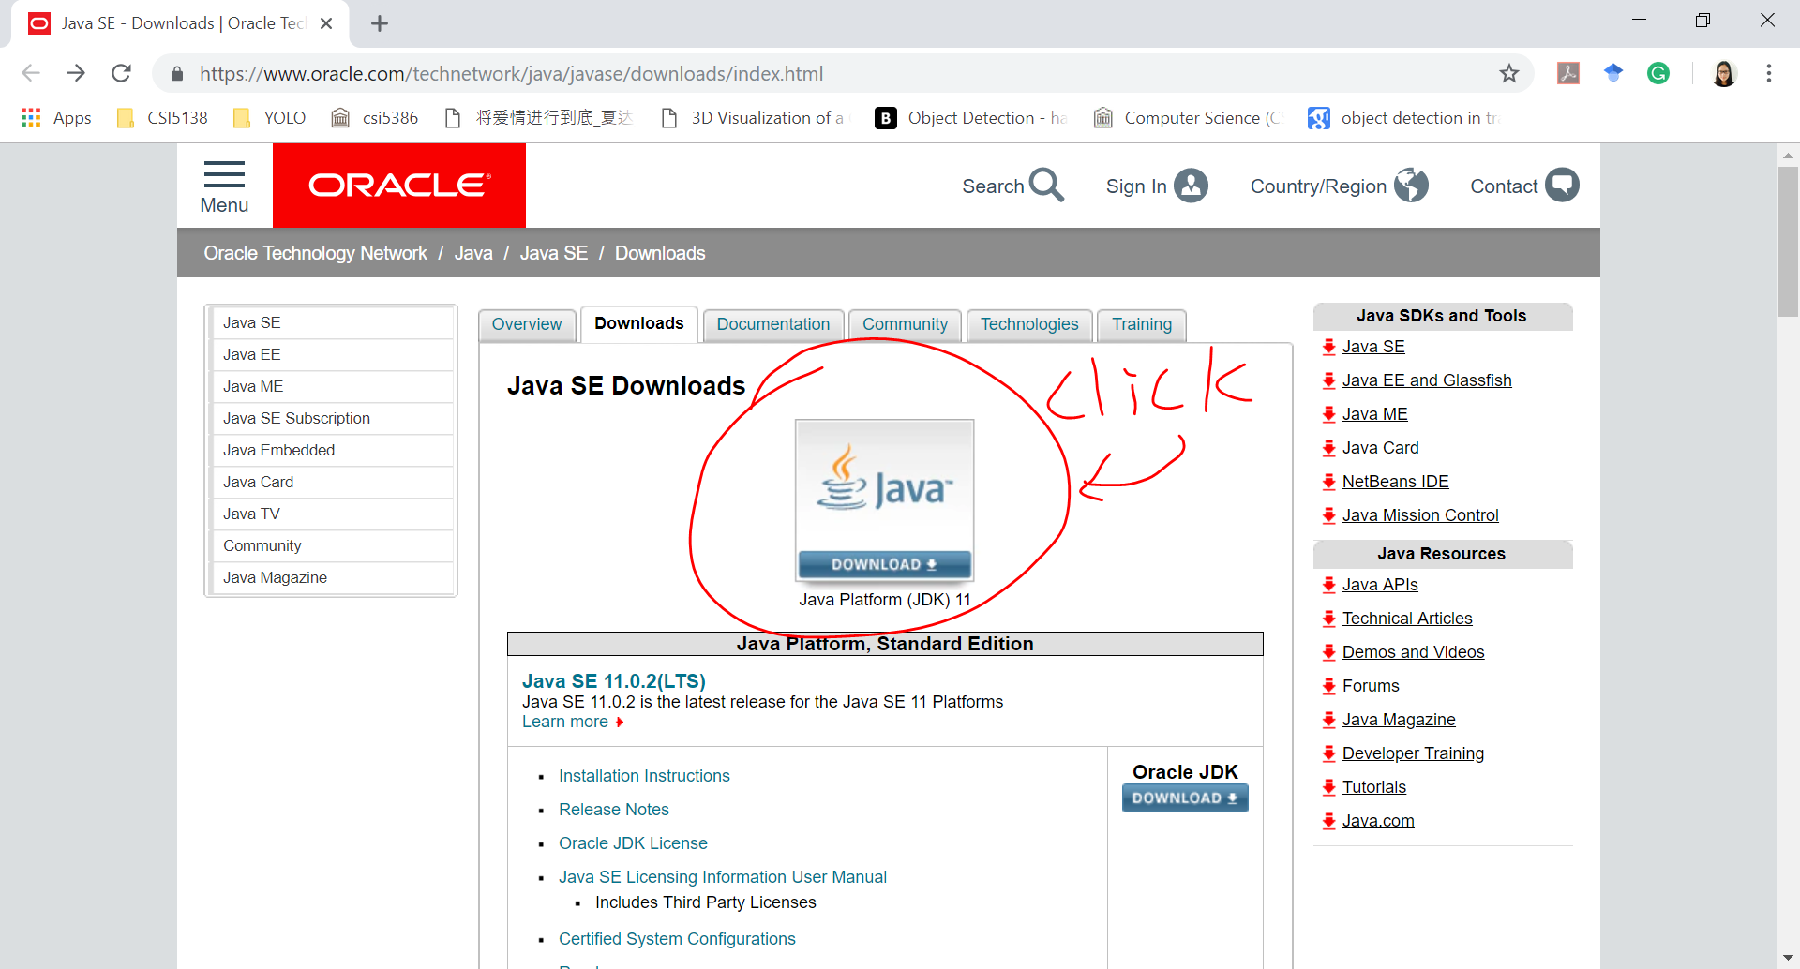
Install JDK(Java Development Kit)
Download JDK
https://www.oracle.com/technetwork/java/javase/downloads/index.html

Slide 4
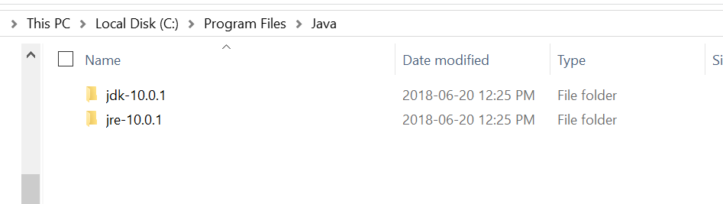
Install JDK(Java Development Kit)
Install Java (JDK)
Just click next and use default settings
both JDK and JRE will be installed

Slide 5
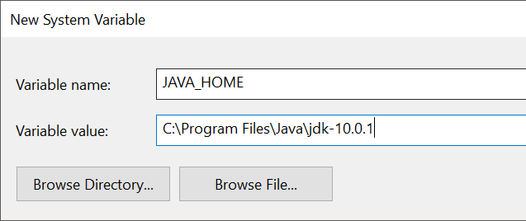
Install JDK(Java Development Kit)
Configuring Java environment variable
Right click ‘this pc’ -> properties -> advanced system settings -> Environment Variables
Create a new environment variable called JAVA_HOME.

Slide 6
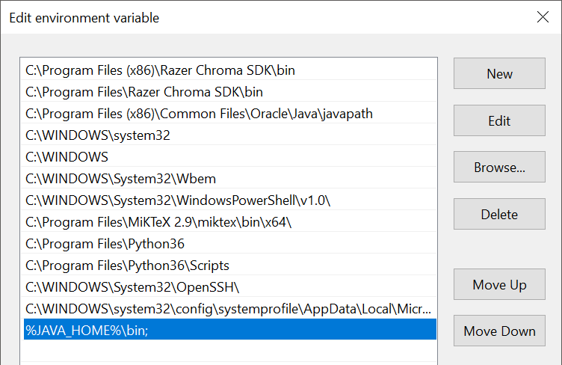
Install JDK(Java Development Kit)
Add ‘%JAVA_HOME%\bin;’ to path

Slide 7
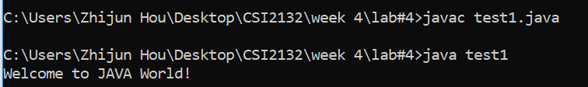
Let’s try to write 1st JAVA program
test1.java
public class test1 {
public static void main(String args[]) {
System.out.println("Welcome to JAVA World!");
}
}

Slide 8
Outline
What is JDBC?
JDBC Driver (download and use)
Java programming with JDBC
Dynamic SQL queries with Java

Slide 9
What is JDBC
Java Database Connectivity (JDBC)
It is an API(Application programming interface) by Sun Microsystems to allow Java programmers to access SQL databases
Available since JDK 1.1
JDBC is an API not a library. It needs to be implemented (as drivers) for a particular DB. i.e. PostgreSQL and MySQL have different JDBC drivers
In this course we use PostgreSQL so we download PostgreSQL JDBC driver

Slide 10
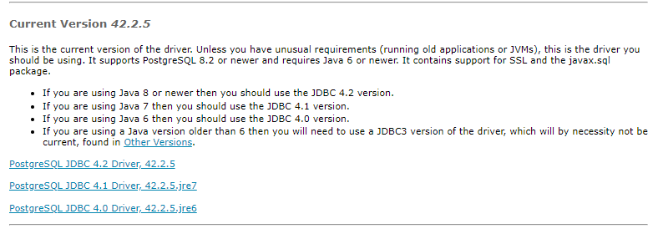
Download JDBC Driver
Download JDBC from:
https://jdbc.postgresql.org/download.html
JDBC4 PostgreSQL driver– version 9.0-801

Slide 11
JDBC Enabled Project in eclipse
1. Create a new Java Project in eclipse (jdbc)
2. From the Project Properties, click on
Java Build Path > Libraries > Add External JARs
3. Select the downloaded JAR file
4. Create a new package in your project (code)
5. Create a new class inside the package with a static main method (connection.java)
6. Write a try – catch structure inside the main method with a generic exception handler

Slide 12
JDBC Coding in JAVA
1.Import the JDBC driver
2.Load the driver
3.Connect to a Database
4.Issue a Query and process the result

Slide 13
JDBC Coding in JAVA
Import the JDBC driver
Import java.sql.*;
It is NOT appropriate to import org.postgresql directly
Remember the import lines go after the package line
Load the driver
Connect to a Database
Issue a Query and process the result

Slide 14
JDBC Coding in JAVA
Import the JDBC driver
Load the driver
Class.forName("org.postgresql.Driver");
You can check that this class actually exist under Referenced Libraries > postgresql-9.0-801.jdbc4 > org.postgresql > Driver.class
Connect to a Database
Issue a Query and process the result

Slide 15
JDBC Coding in JAVA
Import the JDBC driver
Load the driver
Connect to a Database
Connection db = DriverManager.getConnection(url, username, password);
URL is in the form of:
jdbc:postgresql:database
jdbc:postgresql://host/database
jdbc:postgresql://host:port/database
jdbc:postgresql://web0.site.uottawa.ca:15432/svale054
Username: your SITE username (svale054)
Password: your SITE password (XXXXXX)
Issue a Query and process the result

Slide 16
JDBC Coding in JAVA
Import the JDBC driver
Load the driver
Connect to a Database
Issue a Query and process the result
Statement st = db.createStatement();
ResultSet rs = st.executeQuery("SELECT * FROM laboratories.artist");
while (rs.next()) {
System.out.print("Column 1 returned: "); System.out.println(rs.getString(1));
}
rs.close();
st.close();

Slide 17
Example
Write a Java program (FirstExcercise.java) that connects to our own database and retrieves the name and birthday of all artists. Print the result as a 2D table using System.out.print

Slide 18
Dynamic Queries
String field = “aname, Style";
String cond = “aname";
String table = “laboratories.artist";
String value = “Caravaggio";
Statement st = db.createStatement();
ResultSet rs = st.executeQuery("SELECT " + field + " FROM " + table + " WHERE " + cond + " = ‘" + value + "‘;");

Slide 19
Dynamic Queries
To get number of columns returned by the query:
ResultSetMetaData rsMetaData = rs.getMetaData();
int numberOfColumns = rsMetaData.getColumnCount();

Slide 20
Exercises
Write Java code (SecondExcercise.java) that returns those fields of table Artist that are in an array named fields:
String[] fields = {“AName”, “Style”, ….};
Allow your program to retrieve information from more than one artist (hint: use keyword IN).
Try changing the fields array and recompile and run your code. It should work for all valid fields

