Slide 1

Project Apollo
Online Course Marketplace Platform
January 2026

Slide 2
What is Apollo?
An online course marketplace that connects instructors and learners.
Instructors publish and sell courses
Students discover, purchase, and track progress
Admins review content and ensure quality

Slide 3
The Problem
For instructors
For students
Reaching an audience is expensive
Building a platform takes time and capital
Quality is hard to judge before purchase
Progress is fragmented across tools

Slide 4
Our Solution
Launch-ready marketplace for instructors
Built-in Stripe checkout and payouts
Progress tracking and completion insights
Admin moderation and quality controls

Slide 5
How It Works
1. Create course
2. Review and approve
3. Enroll and learn

Slide 6
Key Features
Public catalog with search and filters
Secure payments via Stripe
Course progress and completion tracking
Role-based dashboards for students, instructors, and admins
Content review and moderation tools

Slide 7
User Roles
Role | Can Do
Student | Browse, purchase, learn, track progress
Instructor | Create courses, manage content, view sales
Admin | Approve courses, manage users, ensure quality

Slide 8
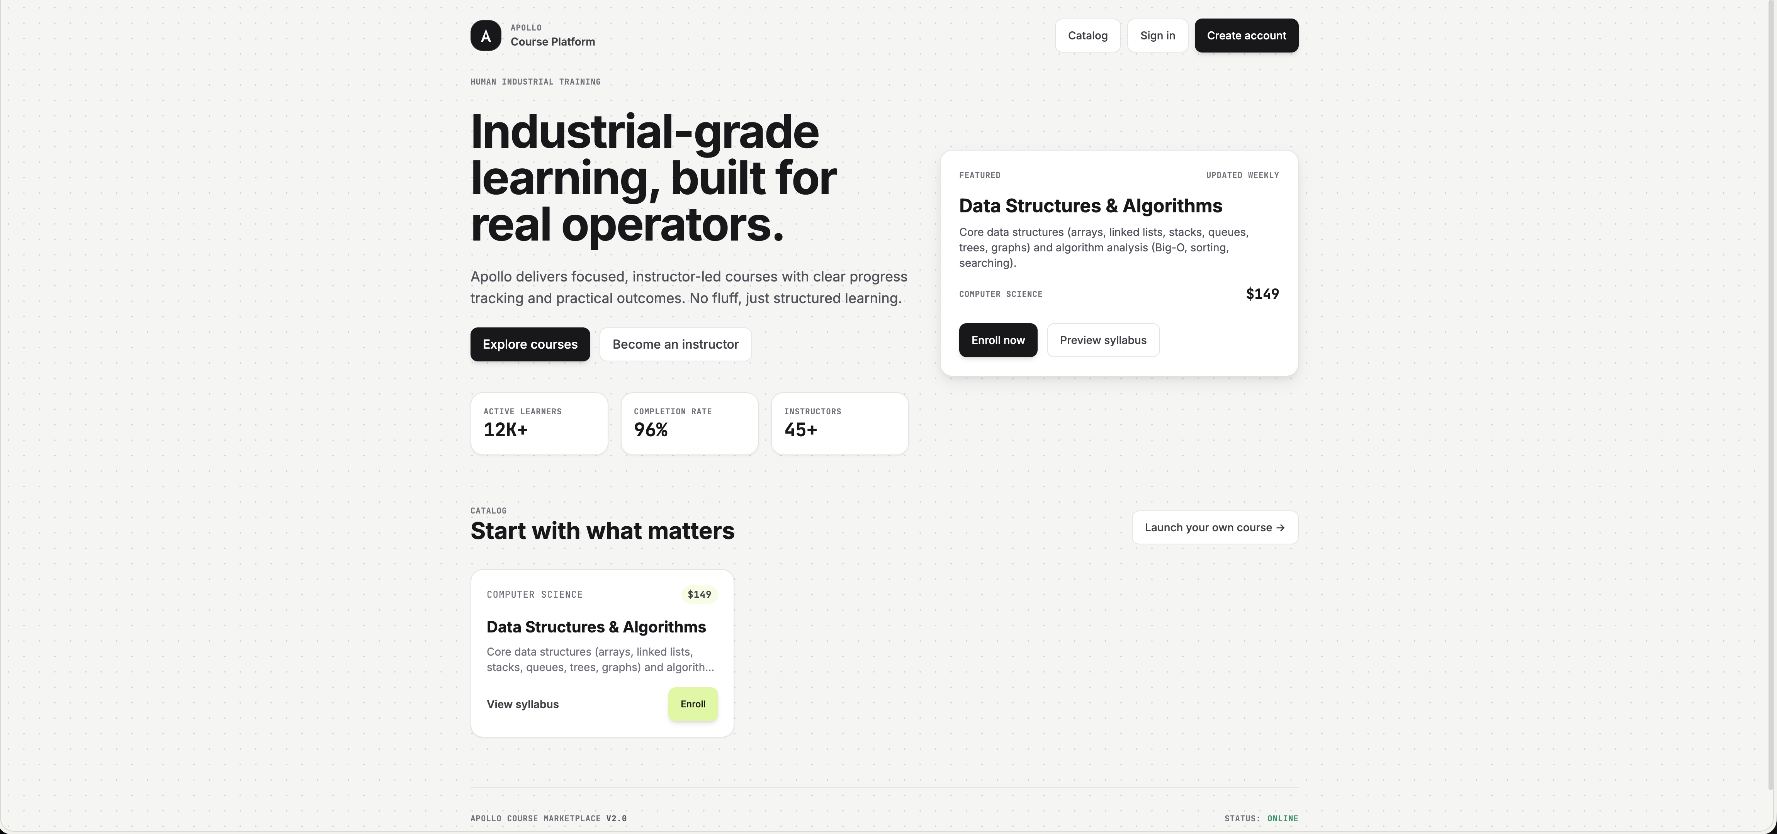
Demo: Landing Page

Slide 9
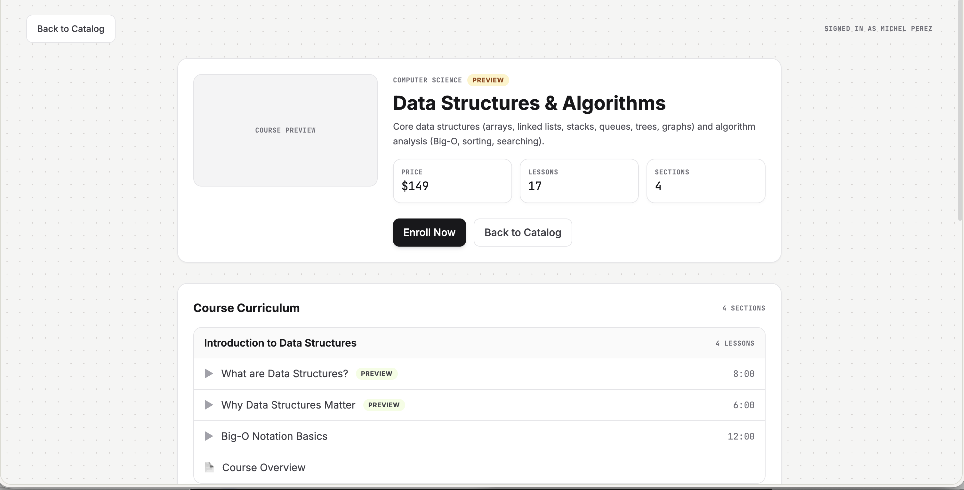
Demo: Course Detail

Slide 10
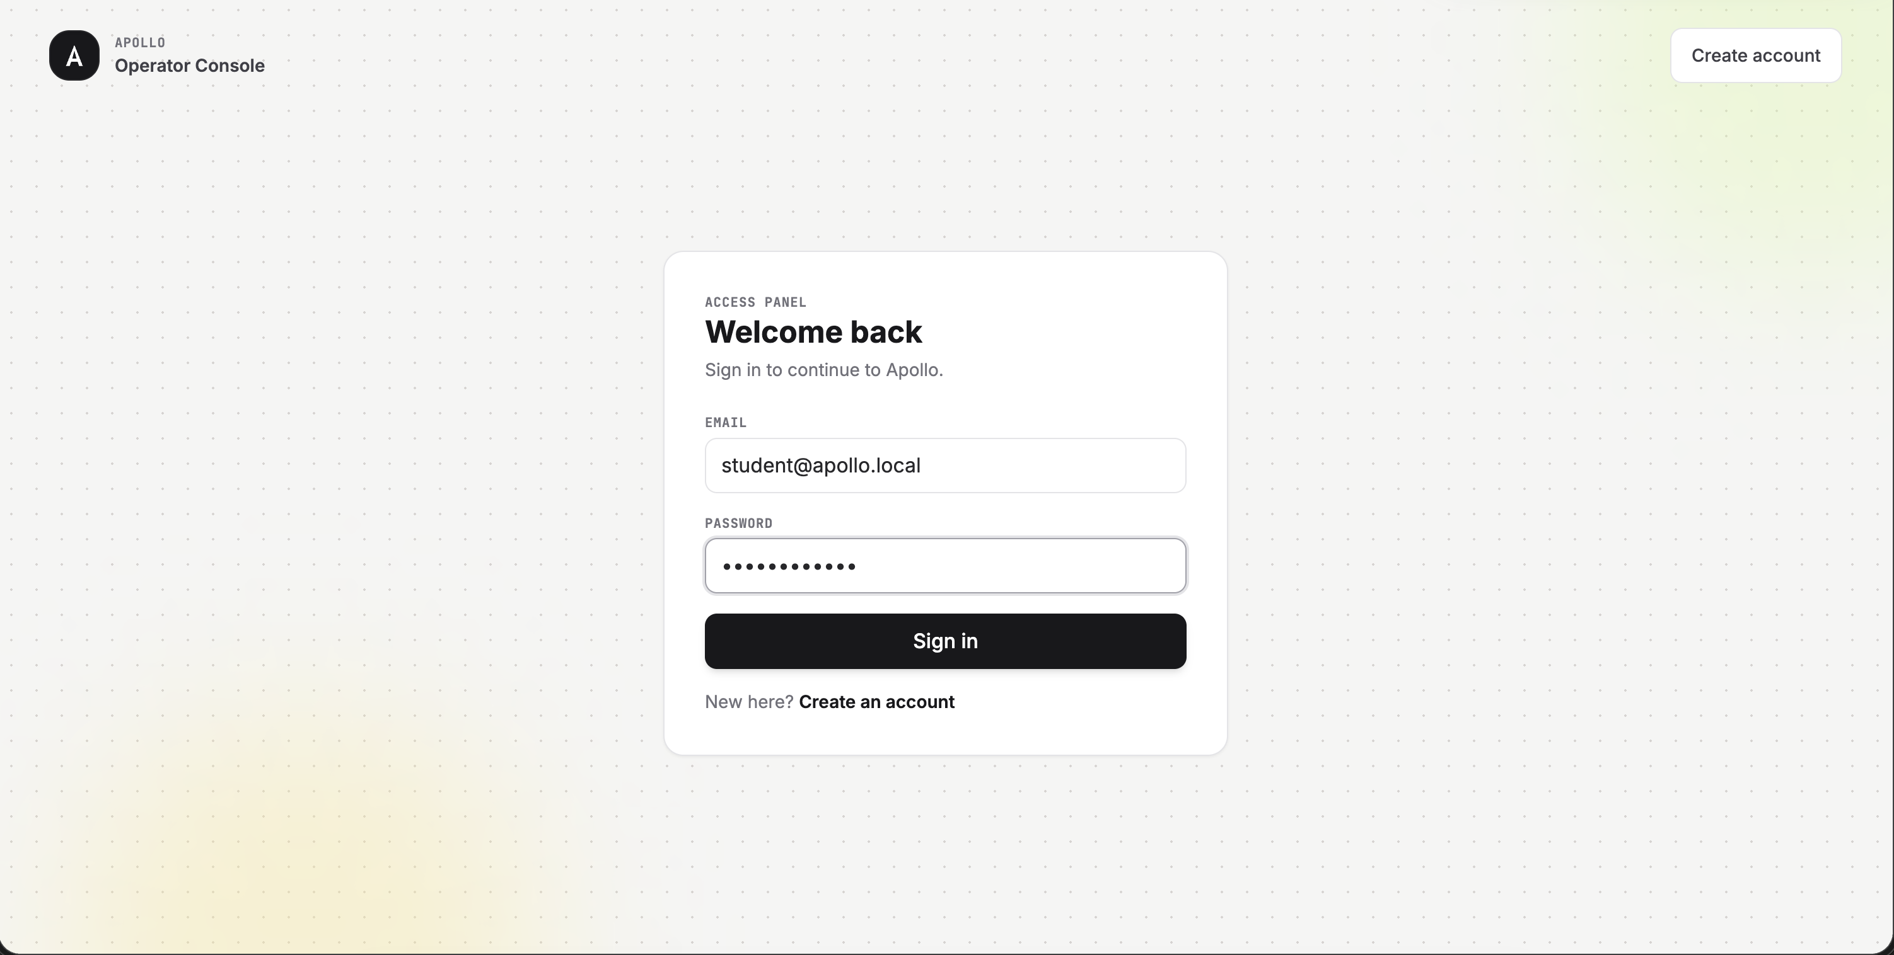
Demo: Login

Slide 11
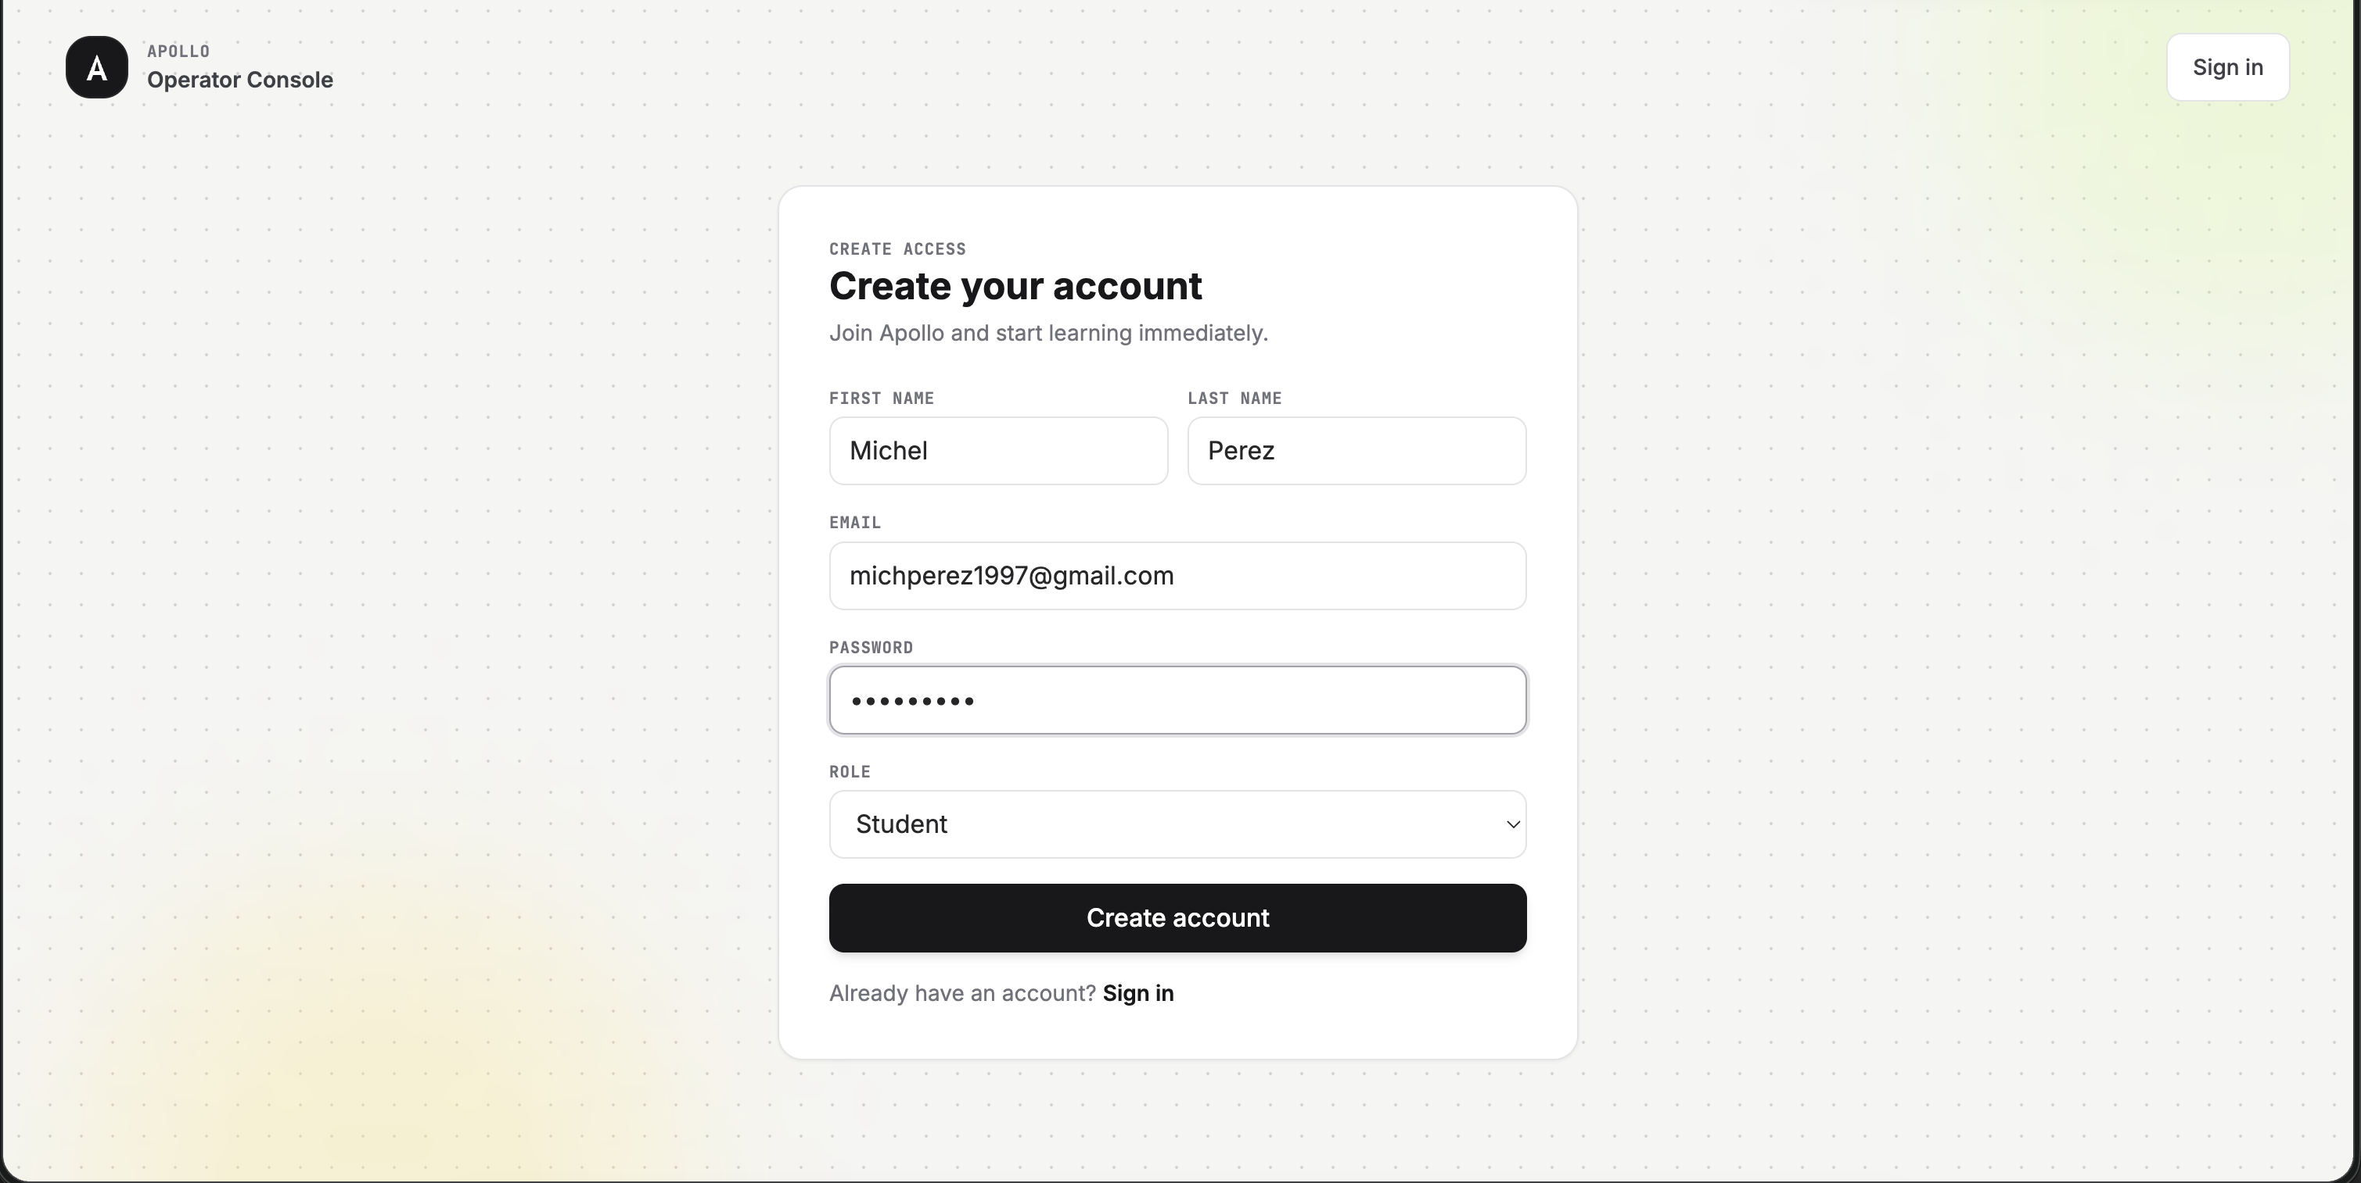
Demo: Register

Slide 12
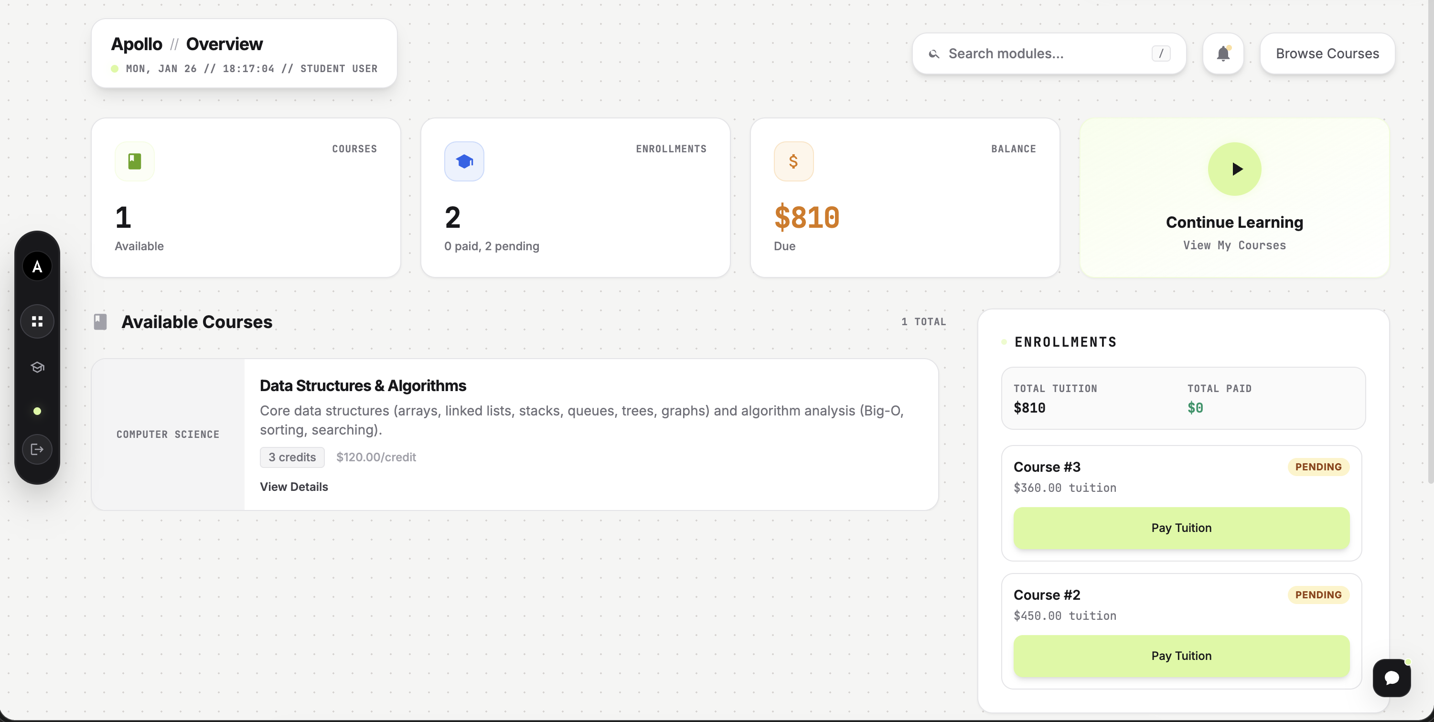
Demo: Student Dashboard

Slide 13
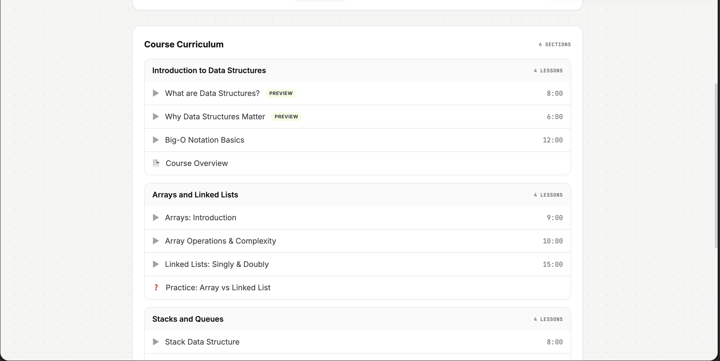
Demo: Course Curriculum

Slide 14
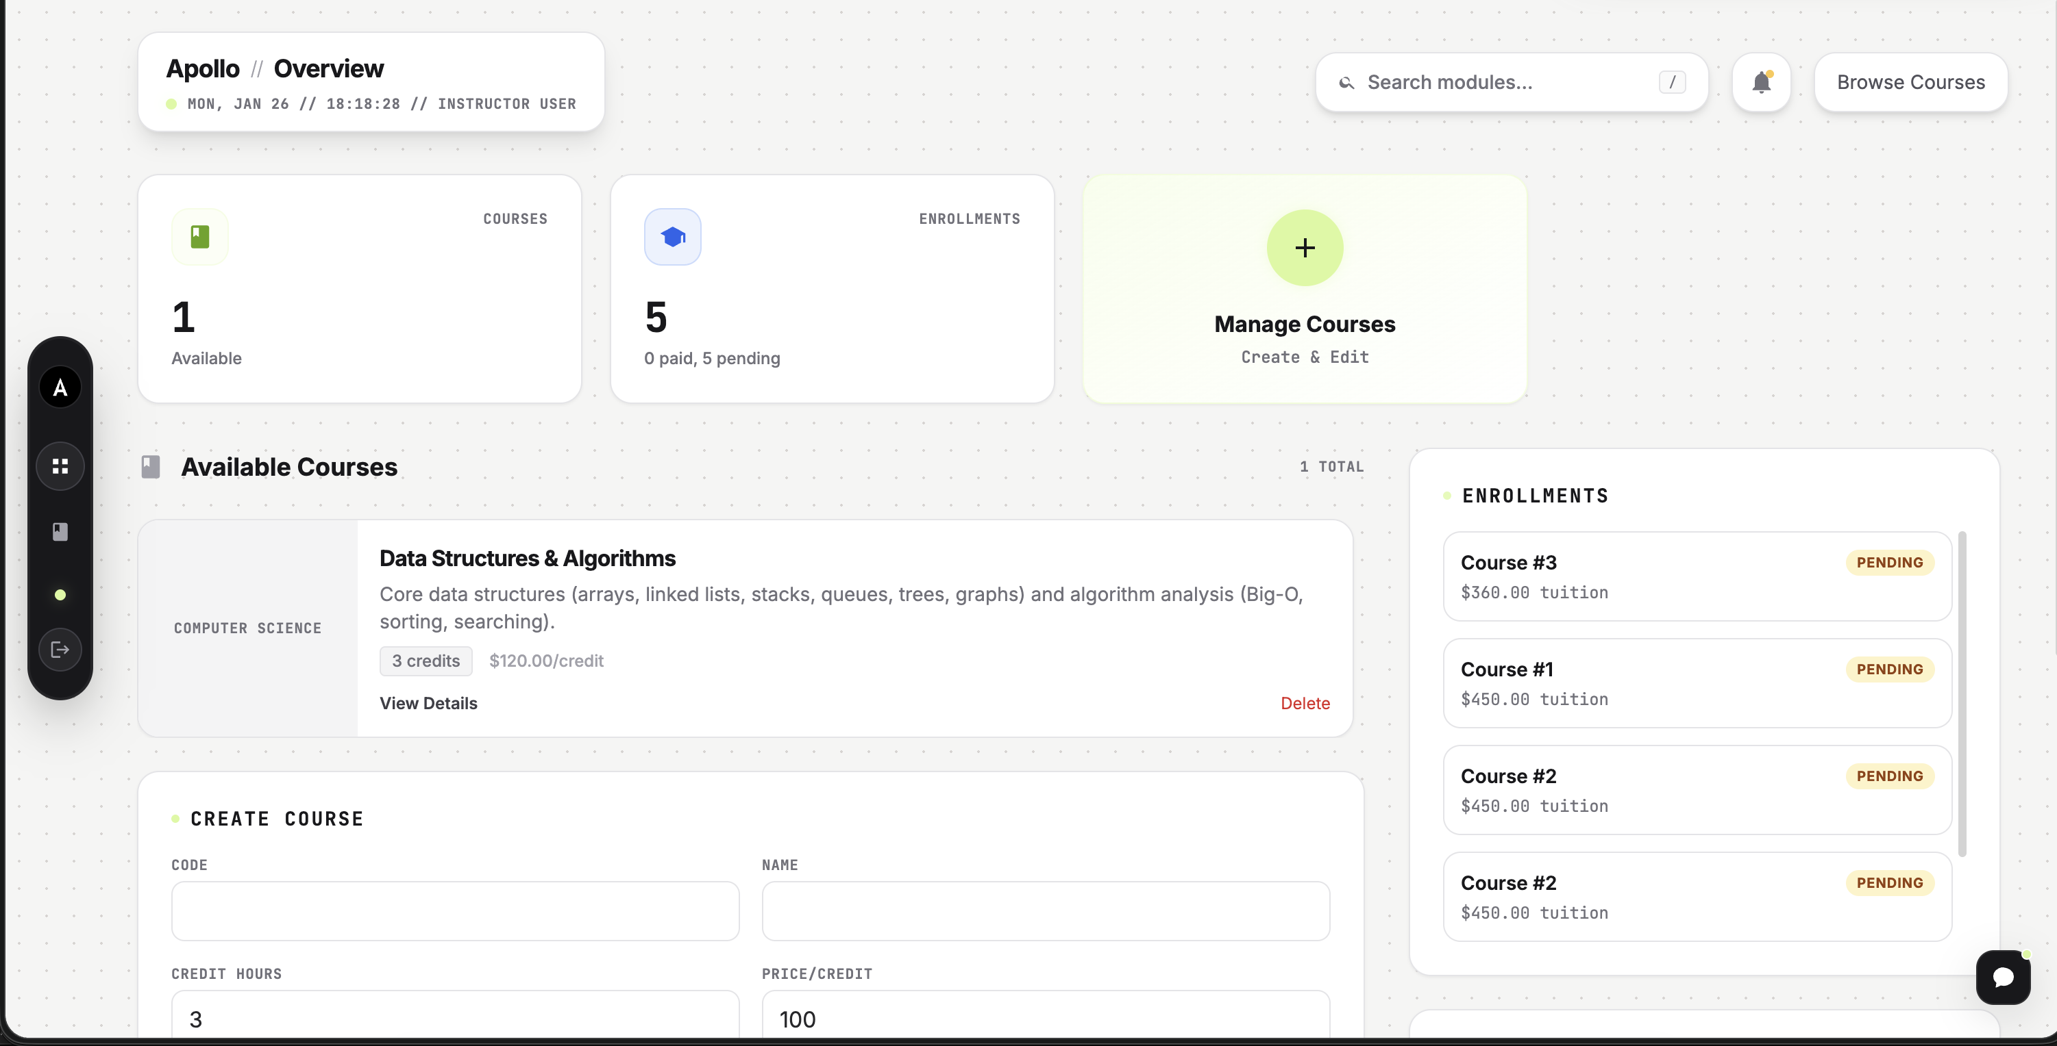
Demo: Instructor Overview

Slide 15
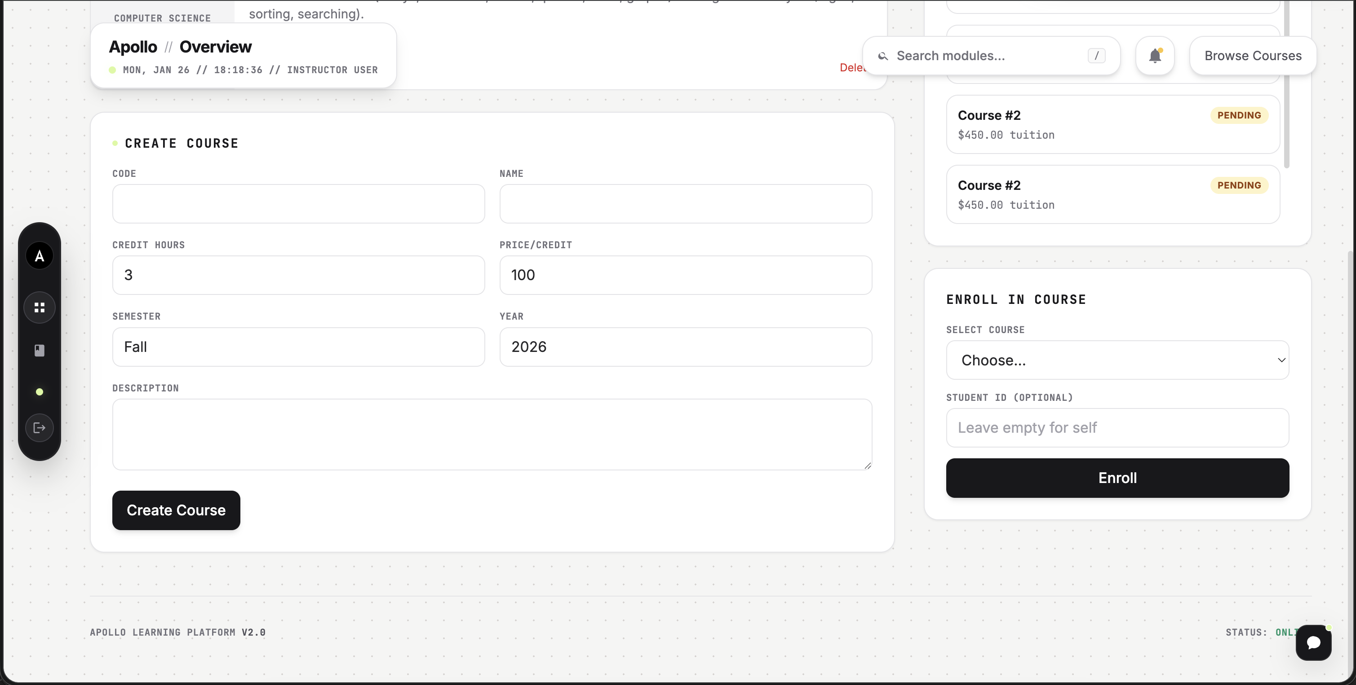
Demo: Instructor – Create Course

Slide 16
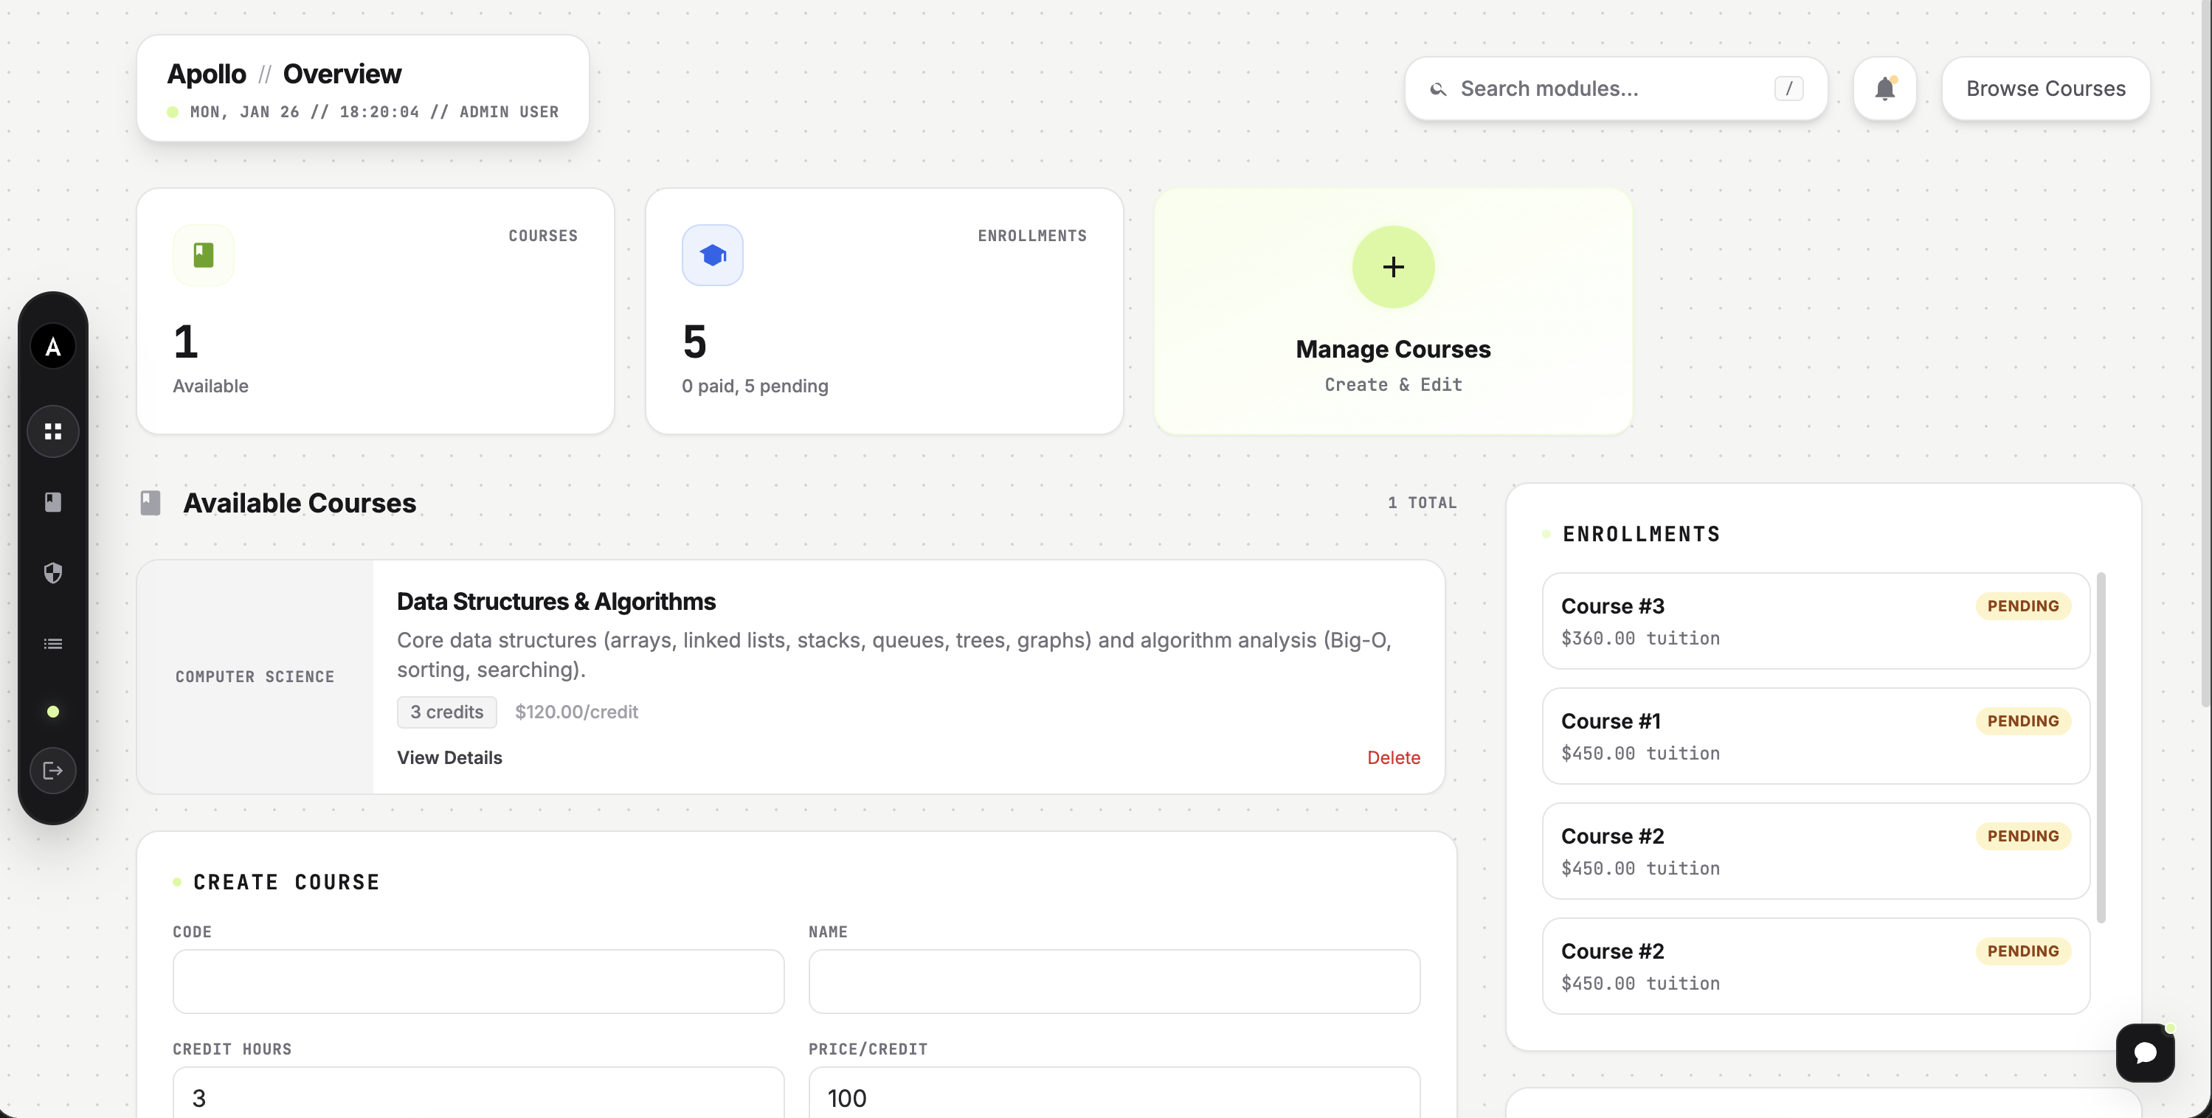
Demo: Admin Overview

Slide 17
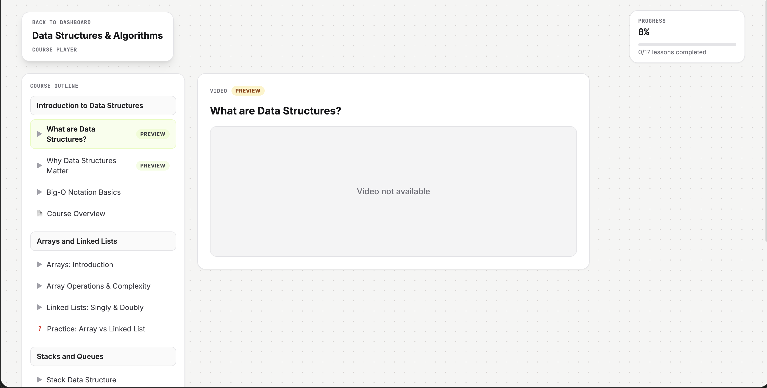
Demo: Course Player

Slide 18
Tech Stack
Layer | Technology
Frontend | React + TypeScript
Backend | Node.js + Express
Database | PostgreSQL
Payments | Stripe

Slide 19
Architecture
Frontend
Backend
PostgreSQL
Stripe
Cloudinary

Slide 20
Progress
Feature | Status
Authentication | Complete
Course management | Complete
Payments | Complete
Learning experience | Complete
Admin tools | Complete

Slide 21
What's Next
Short term
Long term
Video uploads
Quizzes and assessments
Certificates
Mobile app

Slide 22
Summary
Instructors can monetize knowledge with a ready marketplace
Students learn effectively with guided progress
Admins maintain quality and trust at scale

Slide 23
Questions?

Slide 24
Test Accounts
Role | Email
Admin | admin@apollo.local
Instructor | instructor@apollo.local
Student | student@apollo.local
Password: Password123!

