Slide 1
Unit Testing

Slide 2
Due this week
Homework 4
Write solutions in VSCode and paste in Autograder, Homework 4 CodeRunner.
Zip your .cpp files and submit on canvas Homework 4. Check the due date! No late submissions!!
No Quiz this week
3-2-1 due today

Slide 3
Today
Function prototype
Unit testing

Slide 4
Unit Testing

Slide 5
First C++ program
#include <iostream>
using namespace std;
int main()
{
cout << "Hello World\n";
return 0;
}
Good introduction:
program is short
logic is simple: direct inspection
New student: “testing is pointless and adds unneeded complexity”
Notes:
This is a good introduction for several reasons. One is that the program is short enough, and the logic of its execution simple enough that direct inspection can show whether it is correct in all use cases known to the new student programmer. If this were the complexity of all programming, there would be no need to test anything before using it. In programming as a new student experiences it, testing is pointless and adds unneeded complexity.

Slide 6
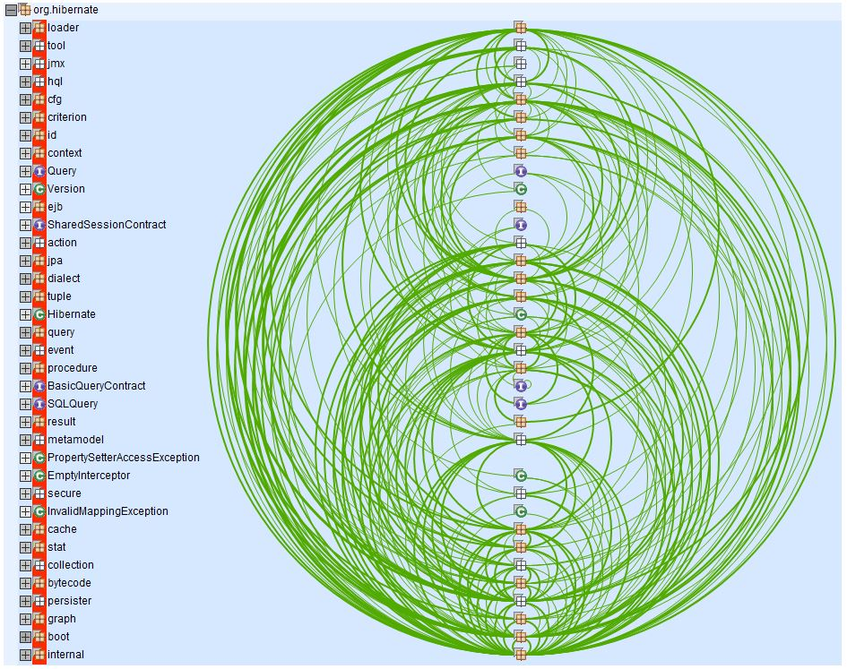
Real world programs
There are decisions to be made
multiple paths of execution
Decisions are based on:
user input,
data from streams, …
The programmer strives to control the inputs and the results of these decisions…
…but … once it gets too big …
Notes:
The programmer strives to control the inputs, and results of these decisions, but no one can keep all of them clearly in mind once the size of the project exceeds just a few hundred lines.

Slide 7
Testing approaches
Implement, then test:
develop test cases
run the program with different inputs
check output/performance
if it fails, fix it
Big improvement already. But …
..if the whole program is tested at once, it is nearly impossible to develop test cases that clearly indicate what the failure is.
Notes:
The system is too complex, and the programmer still needs to understand almost all of the possible outcomes to be able to develop tests. As always, when a problem is too big and complicated a good idea is to try splitting it into smaller and simpler pieces.

Slide 8
Testing approaches
Split and simplify
test small units
one unit tests one job or one concept
layered approach – goes hand in hand with the layered approach to the original development
Simplest layer: unit testing
A unit is the smallest conceptually whole segment of the program. Examples of basic units might be a single class or a single function.
Notes:
These simple units are composed into larger and more complicated algorithms by passing needed information into a unit and receiving the desired result out of it. The units are integrated to perform the whole task.

Slide 9
Unit testing
For each unit, the tester (who may or may not be the programmer) attempts to determine what states the unit can encounter while executing as part of the program.
determining the range of appropriate parameters to the unit,
determining the range of possible inappropriate parameters,
recognizing any ways the state of the rest of the program might affect execution in this unit.

Slide 10
Unit testing
White-box testing = taking into account the internal structure of the program.
→ are the variables what we think they should be?
Test functions in isolation:
write a short program, called a test harness, that calls the function to be tested and verifies that the results are correct.
When the program completes without an error message, then all the tests have passed.
If a test fails, then you get an error message, telling you which test failed.
Notes:
unit tests verify your code at the level of functions and classes

Slide 11
Unit testing
Example: a unit test for the removeWhitespace function might look like this:
int main()
{
assert(removeWhitespace(“ “) == "");
assert(removeWhitespace(“Hello“) == “Hello");
assert(removeWhitespace(“Oh Hello“) == “OhHello");
assert(removeWhitespace(“ Wo lo lo “) == “Wololo");
assert(removeWhitespace(““) == "");
}
Note: removeWhitespace()takes a string as a parameter and returns a string with all spaces removed
Notes:
int_name takes an integer and returns a string

Slide 12
What is an assert statement?
Assertions are statements used to test assumptions made by programmer.
#include <stdio.h>
#include <assert.h>
int main()
{
int x = 7;
/* Some big code in between and let's say x is accidentally changed to 9 */
x = 9;
// Programmer assumes x to be 7 in rest of the code
assert(x==7);
/* Rest of the code */
return 0;
}

Slide 13
assert
Assertions are statements used to test assumptions made by programmer.
What assumptions?
int main()
{
assert(int_name(19) == "nineteen");
}
Expected values:
if I pass 19 to the function, it should return the string “nineteen”

Slide 14
What to test?
Selecting test cases is an important skill.
test inputs (parameters) that a typical user might supply.
boundary cases (or edge cases).
Boundary cases for the removeWhitespace function are:
the smallest valid input (empty string)
White spaces at beginning and/or end
No whitespace
test coverage = You want to make sure that each part of your code is exercised at least once by one of your test cases.
look at every if/else branch
Notes:
test your program with inputs that a typical user might supply. Next, you should include boundary cases. Boundary cases are still legitimate inputs, and you expect that the function that is being tested will handle them correctly. If some code is never executed by any of your test cases, you have no way of knowing whether that code would perform correctly if it ever were executed by user input.

Slide 15
Jargon
test suite = collection of test cases
regression testing = testing against past failures
unit test framework = have been developed for C++ to make it easier to organize unit tests. These testing frameworks are excellent for testing larger programs, providing good error reporting and the ability to keep going when some test cases fail or crash.

Slide 16
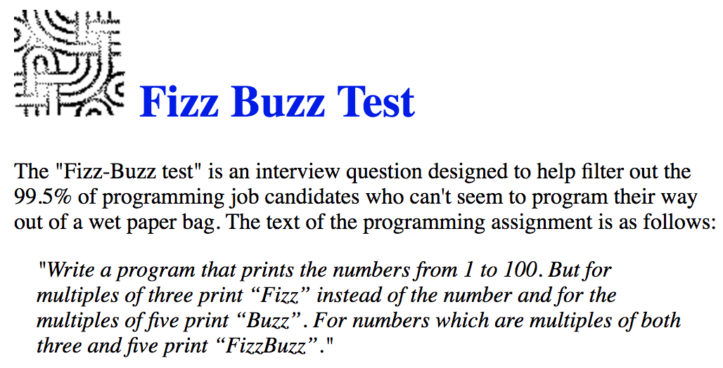
Example: fizzbuzz

Slide 17
Example: fizzbuzz
Give me examples of tests you need to run!
Can we call the function? Does it compile? Are there are syntax errors?
Output “1” when I pass 1
Output “2” when I pass 2
Output “Fizz” when I pass 3
Output “Buzz” when I pass 5
Output “Fizz” when I pass 9 (multiple of 3)
Output “Buzz” when I pass 10 (multiple of 5)
Output “FizzBuzz” when I pass 15 (multiple of 3 and of 5)
Notes:
Write the tests before you write the code.

Slide 18
Test-Driven Development
TDD: the practice of writing unit tests before you write your code
You know what your program should do, so you can write the unit tests first!
Benefits:
Every line of code is working as soon as it is written, because you can test it immediately
If there is a problem, it is easy to track down because you have only written a small amount of code since the last test

Slide 19
Test-Driven Development
TDD cycle:
For each test:
Write the test
It will probably initially fail
Fix the implementation (add to it/modify it)
Run the test again… and again and again…
Stop when the test passes

Slide 20
General Recommendations
Your test cases should only test one thing
Test case should be short
Test should run fast, so it will be possible to run it often
Each test should work independent of the other tests
Broken tests shouldn’t prevent other tests from running
Tests shouldn’t be dependent on the order of their execution

Slide 21
Debugging your functions -- your code runs but spits out garbage!
Typical debug session:
Run code
Code does not work
Print key variable values out at different points in the source code
Determine where the code breaks by comparing variable values to what you expect
Determine what might be going wrong and correct it
Return to Step 1

Slide 22
Debugging your functions -- your code does not even run!
Typical debug session:
Run code
Code won’t compile
Move the return statement closer and closer to the beginning of the function
Determine where the code breaks by finding out when the code actually compiles and runs
Determine what might be going wrong and correct it
Return to Step 1

Slide 23
Using the IDE Debugger
Your VS Code IDE can be set up to use a debugger that:
Allows execution of the program one statement at a time
Shows intermediate values of local function variables
Sets “breakpoints” to allow stopping the program at any line to examine variables
These features greatly speed up correcting your code.

Slide 24
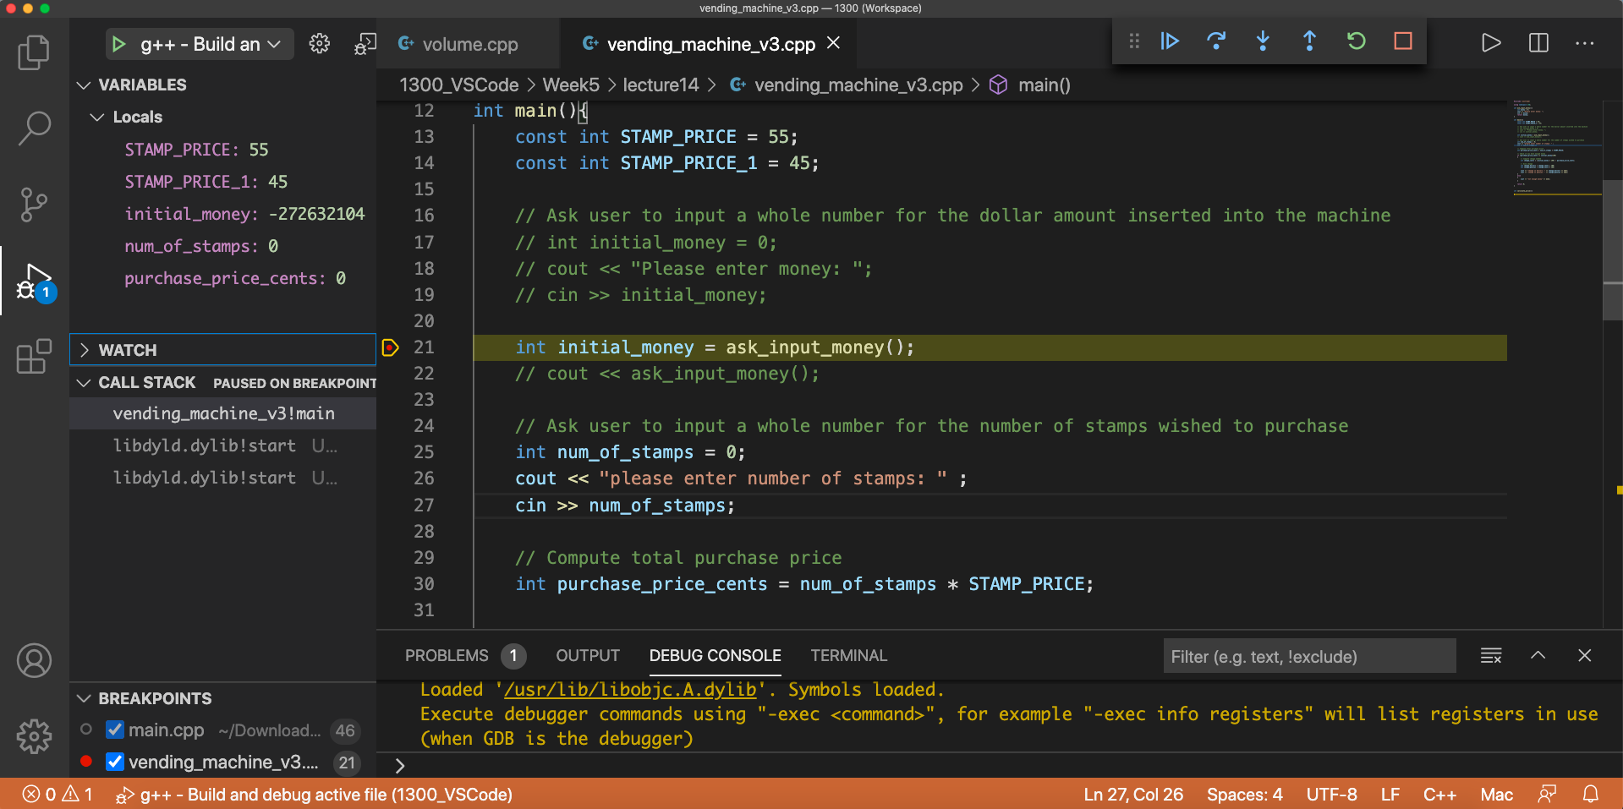
There is a breakpoint on line 21.
Next line to be executed is shown by yellow arrow in the Breakpoint margin at left.
The Debugger panel at right shows the Local Variables: STAMP_PRICE, STAMP_PRICE_1, num_of_stamps, purchase_price_cents
initial_money has not been initialized yet.

Slide 25
Using the IDE Debugger
Typical debug session:
Set a breakpoint early in the program, by clicking on a line in the source code
Start execution with the green “Run” triangle, from the Debug panel
When the code stops at the breakpoint, examine variable values in the variables window
Step through the code one line at a time or one function at a time, continuing to compare variable values to what you expected
Determine the error in the code and correct it, then go back to step 1

Slide 26
Best practice to avoid needing those last few slides
1. Start with the simplest possible case for your function
2. Add in layers of complexity incrementally
3. Test your work frequently
Do this as you are adding in these layers of complexity
4. Save your work frequently

