Slide 1
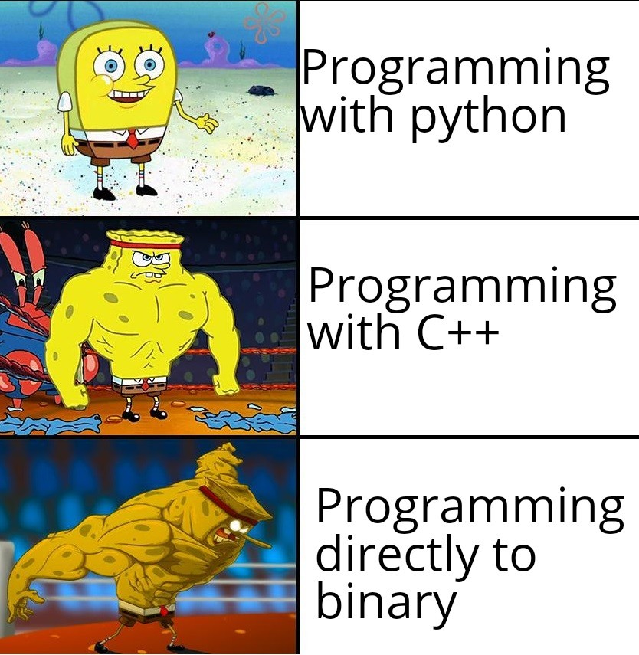

Slide 2
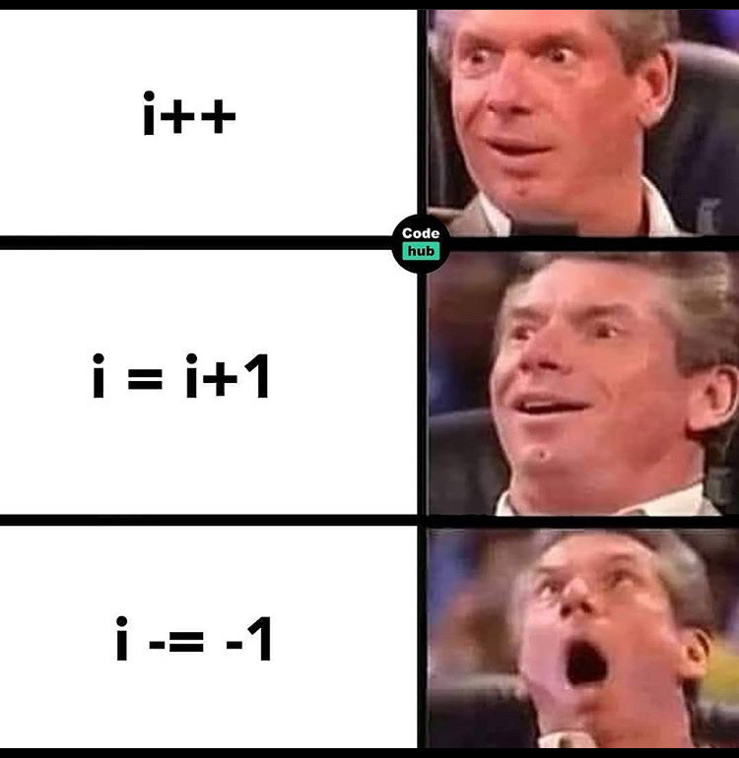

Slide 3
Arrays

Slide 4
Due this week
Project 1
Write solutions in VSCode and paste in Autograder, Project1-CodeRunner
Honor Code MCQ
Project1-CodeRunnerEC
Zip your .cpp files and submit on canvas Project 1. Check the due date! No late submissions!!
Mandatory Grading Interview next week!
Follow instructions from write-up
No Quiz this week
3-2-1 on Friday

Slide 5
Today
What are arrays?
Initializing arrays
Common array algorithms

Slide 6
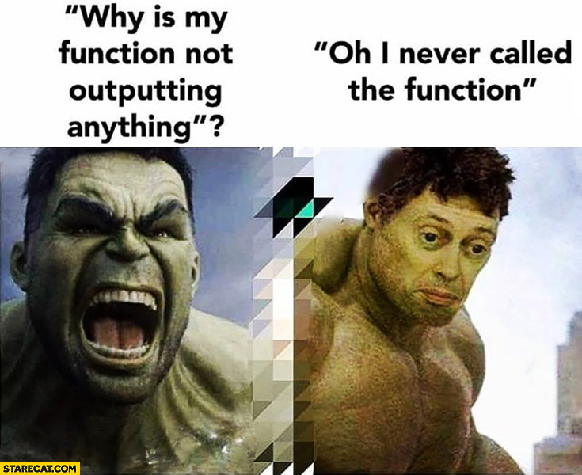

Slide 7
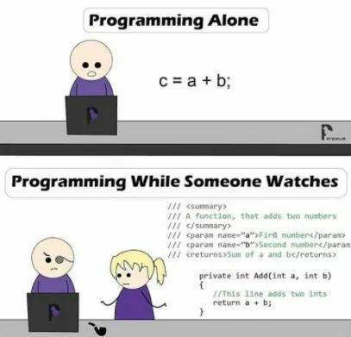

Slide 8
Arrays

Slide 9
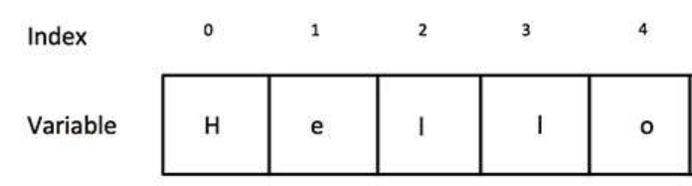
strings are nice because they store multiple characters (char)

Slide 10
strings are nice because they store multiple characters (char)
I want something that stores multiple integers (int)!

Slide 11
char is to string as
int is to _______________

Slide 12
char is to string as
int is to ______multi-int?______

Slide 13
char is to string as
int is to ______many-int?______

Slide 14
char is to string as
int is to ______list-of-int?______

Slide 15
char is to string as
int is to ______int[]______
Array of int!
(this isn’t a perfect analogy, but it’s close)

Slide 16
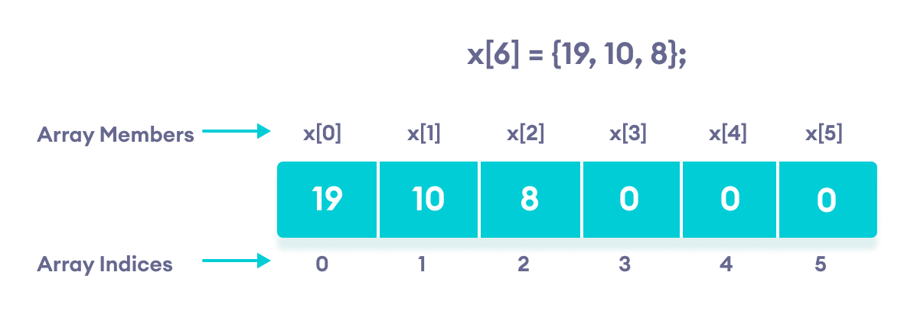
Array of integers

Slide 17

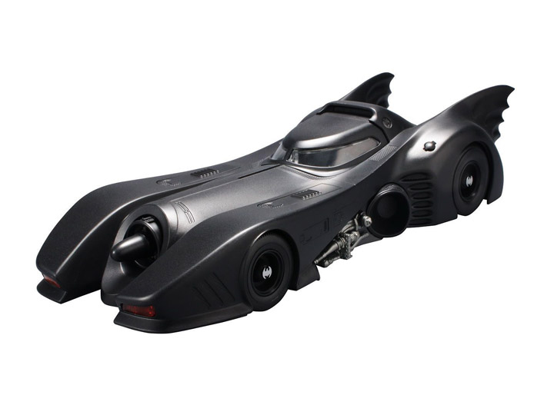


Code Time

Slide 18
Additional Explanation Below For those just reading the slides after class

Slide 19
Using Arrays
Think of a sequence of data:
32 54 67.5 29 35 80 115 44.5 100 65
(all of the same type, of course)
(storable as doubles)

Slide 20
Using Arrays
32 54 67.5 29 35 80 115 44.5 100 65
Which is the largest value in this set?
(You must look at every single value to decide.)

Slide 21
Using Arrays
32 54 67.5 29 35 80 115 44.5 100 65
So you would create a variable for each, of course!
double n1, n2, n3, n4, n5, n6, n7, n8, n9, n10;
Then what ???

Slide 22
Using Arrays
32 54 67.5 29 35 80 115 44.5 100 65
So you would create a variable for each, of course!
double n1, n2, n3, n4, n5, n6, n7, n8, n9, n10;
Then what ???
We discussed last time in class how to find the largest of 3 or more values. It is tedious and one can make mistakes.

Slide 23
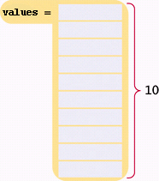
Using Arrays
Arrays - Advantage: You can easily visit each element in an array, checking and updating a variable holding the current maximum.
Hm. Is this the max, so far?
Brief C++ by Cay Horstmann
Copyright © 2017 by John Wiley & Sons. All rights reserved

Slide 24
Using Arrays
You can easily visit each element in an array, checking and updating a variable holding the current maximum.
Maybe this one?
Brief C++ by Cay Horstmann
Copyright © 2017 by John Wiley & Sons. All rights reserved

Slide 25
Using Arrays
You can easily visit each element in an array, checking and updating a variable holding the current maximum.
Or this one?
Brief C++ by Cay Horstmann
Copyright © 2017 by John Wiley & Sons. All rights reserved

Slide 26
Using Arrays
You can easily visit each element in an array, checking and updating a variable holding the current maximum.
Or this one?
Brief C++ by Cay Horstmann
Copyright © 2017 by John Wiley & Sons. All rights reserved

Slide 27
Using Arrays
You can easily visit each element in an array, checking and updating a variable holding the current maximum.
Or this one?
Brief C++ by Cay Horstmann
Copyright © 2017 by John Wiley & Sons. All rights reserved

Slide 28
Using Arrays
You can easily visit each element in an array, checking and updating a variable holding the current maximum.
How about here?
Brief C++ by Cay Horstmann
Copyright © 2017 by John Wiley & Sons. All rights reserved

Slide 29
Using Arrays
You can easily visit each element in an array, checking and updating a variable holding the current maximum.
Gotta check here too!
Brief C++ by Cay Horstmann
Copyright © 2017 by John Wiley & Sons. All rights reserved

Slide 30
Using Arrays
You can easily visit each element in an array, checking and updating a variable holding the current maximum.
Again, maybe this one?
Brief C++ by Cay Horstmann
Copyright © 2017 by John Wiley & Sons. All rights reserved

Slide 31
Using Arrays
You can easily visit each element in an array, checking and updating a variable holding the current maximum.
This one?
Will this never end?
Brief C++ by Cay Horstmann
Copyright © 2017 by John Wiley & Sons. All rights reserved

Slide 32
Using Arrays
You can easily visit each element in an array, checking and updating a variable holding the current maximum.
Or this one? Finally!
Brief C++ by Cay Horstmann
Copyright © 2017 by John Wiley & Sons. All rights reserved

Slide 33
Using Arrays
That would have been impossible with ten separate variables!
double n1, n2, n3, n4, n5, n6, n7, n8, n9, n10;
And what if there needed to be more double values in the set?
ARGH!

Slide 34
Defining Arrays
An “array of double”
Ten elements of double type can be stored under one name as an array.
double values[10];
type of each element
number of elements – the “size” of the array, must be a constant
Brief C++ by Cay Horstmann
Copyright © 2017 by John Wiley & Sons. All rights reserved

Slide 35
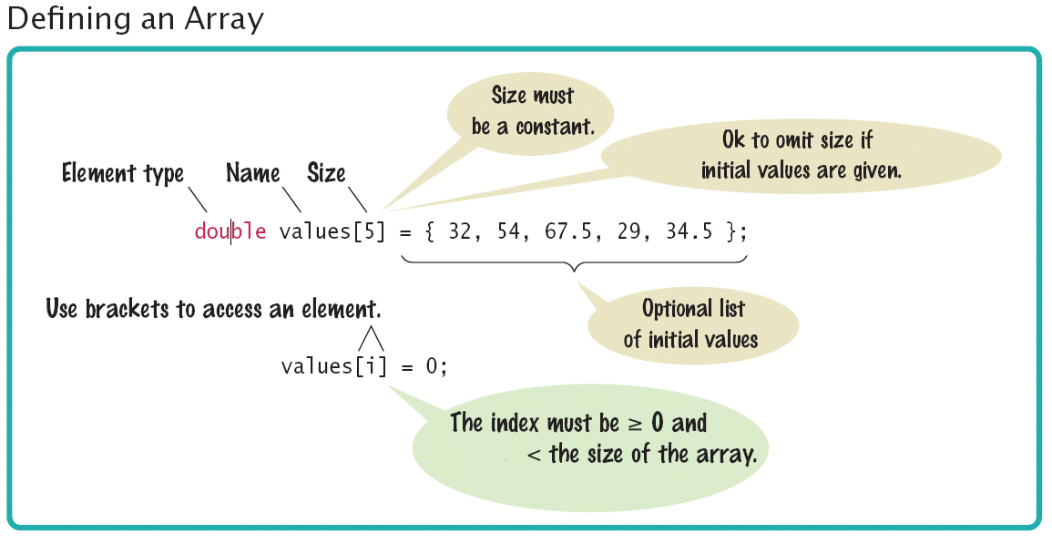
Array Syntax
Brief C++ by Cay Horstmann
Copyright © 2017 by John Wiley & Sons. All rights reserved

Slide 36
Coding time

Slide 37
Introduction to Arrays
Definition: An array is a collection of data of the same type, referenced as different elements of the same name.
First "aggregate" data type
Means "grouping"
int, float, double, char are simple data types
Used for lists of like items
Test scores, temperatures, names, etc.
Avoids declaring multiple simple variables
Can manipulate "list" as one entity

Slide 38
Declaring Arrays
Declare the array → allocates memory int score[5];
Declares array of 5 integers named "score"
Similar to declaring five variables: int score[0], score[1], score[2], score[3], score[4];
Individual parts can be called many things:
Indexed or subscripted variables
"Elements" of the array
Value in brackets is called index or subscript
Numbered from 0 to (size – 1)

Slide 39
Defining Arrays with Initialization
When you define an array, you can specify the initial values:
double values[] = { 32, 54, 67.5, 29, 35, 80, 115, 44.5, 100, 65 };
32.0
54.0
67.5
29.0
35.0
80.0
115.0
44.5
100.0
65.0
Brief C++ by Cay Horstmann
Copyright © 2017 by John Wiley & Sons. All rights reserved

Slide 40
Accessing Arrays
Access using index/subscript
cout << score[3];
Note two uses of brackets:
In declaration, specifies SIZE of array
Anywhere else, specifies a subscript
Size, subscript need not be literal
int score[MAX_SCORES];
score[n+1] = 99; --> If n is 2, identical to: score[3]

Slide 41
Accessing an Array Element
The same notation can be used to change the element.
double values[10];
...
cout << values[4] << endl;
32.0
54.0
67.5
29.0
35.0
80.0
115.0
44.5
100.0
65.0
The output will be 35.0.
Brief C++ by Cay Horstmann
Copyright © 2017 by John Wiley & Sons. All rights reserved

Slide 42
Accessing an Array Element
To access the element at index 4 using this notation: values[4]
4 is the index.
values[4] = 17.7;
cout << values[4] << endl;
32.0
54.0
67.5
29.0
35.0 17.7
80.0
115.0
44.5
100.0
65.0
The output will be 17.7.
Brief C++ by Cay Horstmann
Copyright © 2017 by John Wiley & Sons. All rights reserved

Slide 43
Accessing an Array Element
That is, the legal elements for the values array are:
values[0], the first element
values[1], the second element
values[2], the third element
values[3], the fourth element
values[4], the fifth element
...
values[9], the tenth and last legal element recall: double values[10];
The index must be >= 0 and <= 9.
0, 1, 2, 3, 4, 5, 6, 7, 8, 9 is … 10 numbers.

Slide 44
Array Usage
Powerful storage mechanism
Can issue commands like:
"Do this to i^{th} indexed variable”, where i is computed by program
"Display all elements of array score"
"Fill elements of array score from user input"
"Find highest value in array score"
"Find lowest value in array score”
Disadvantages: size MUST BE KNOWN at declaration

Slide 45
Demo
largest.cpp
Brief C++ by Cay Horstmann
Copyright © 2017 by John Wiley & Sons. All rights reserved

Slide 46
Common Array Algorithms

Slide 47
Common Algorithms – Filling
This loop fills an array with zeros:
for (int i = 0; i < size; i++) { values[i] = 0; }
To fill an array with squares (0, 1, 4, 9, 16, ...). for (int i = 0; i < size; i++) { squares[i] = i * i; }
Brief C++ by Cay Horstmann
Copyright © 2017 by John Wiley & Sons. All rights reserved

Slide 48
Common Algorithms – Copying
Consider these two arrays:
int squares[5] = { 0, 1, 4, 9, 16 };
int lucky_numbers[5];
How can we copy the values from squares to lucky_numbers?
Let’s try what seems right and easy…
squares = lucky_numbers; …and wrong!
You cannot assign arrays!
The compiler will report a syntax error.
Brief C++ by Cay Horstmann
Copyright © 2017 by John Wiley & Sons. All rights reserved

Slide 49
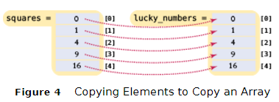
Common Algorithms – Copying Requires a Loop
/* you must copy each element individually using a loop! */
int squares[5] = { 0, 1, 4, 9, 16 };
int lucky_numbers[5];
for (int i = 0; i < 5; i++) { lucky_numbers[i] = squares[i]; }
Brief C++ by Cay Horstmann
Copyright © 2017 by John Wiley & Sons. All rights reserved

Slide 50
Common Algorithms – Sum and Average Value
You have already seen the algorithm for computing the sum and average of a set of data. The algorithm is the same when the data is stored in an array.
double total = 0;
for (int i = 0; i < size; i++)
{
total = total + values[i];
}
The average is just arithmetic:
double average = total / size;
Brief C++ by Cay Horstmann
Copyright © 2017 by John Wiley & Sons. All rights reserved

Slide 51
Common Algorithms – Maximum
To compute the largest value in a vector, keep a variable that stores the largest element that you have encountered, and update it when you find a larger one.
double largest = values[0]; for (int i = 1; i < size; i++) { if (values[i] > largest) { largest = values[i]; } }
Brief C++ by Cay Horstmann
Copyright © 2017 by John Wiley & Sons. All rights reserved

Slide 52
Common Algorithms – Minimum
For the minimum, we just reverse the comparison.
double smallest = values[0]; for (int i = 1; i < size; i++) { if (values[i] < smallest) { smallest = values[i]; } }
These algorithms require that the array contain at least one element.
Brief C++ by Cay Horstmann
Copyright © 2017 by John Wiley & Sons. All rights reserved

Slide 53
Common Algorithms – Linear Search
Find the position of a certain value, say 100, in an array:
int pos = 0;
bool found = false;
while (pos < size && !found)
{
if (values[pos] == 100) // looking for 100
{
found = true;
}
else
{
pos++;
}
}
Brief C++ by Cay Horstmann
Copyright © 2017 by John Wiley & Sons. All rights reserved

Slide 54
Common Algorithms – Swapping Elements
Suppose we need to swap the values at positions i and j in the array. Will this work?
values[i] = values[j];
values[j] = values[i];
Look closely! In the first line you lost – forever! – the value at i, replacing it with the value at j.
Then what?
Put’ j’s value back in j in the second line?
We end up with 2 copies of the [j] value, and have lost the [i]
Brief C++ by Cay Horstmann
Copyright © 2017 by John Wiley & Sons. All rights reserved

Slide 55
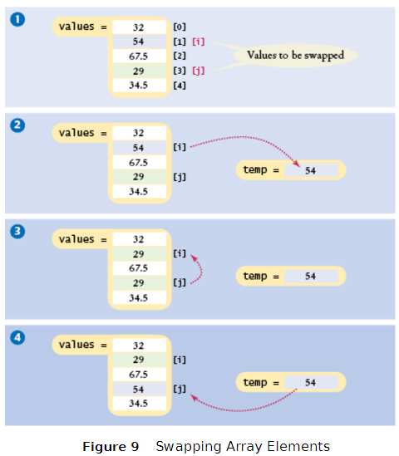
Code for Swapping Array Elements
//save the first element in
// a temporary variable
// before overwriting the 1st
double temp = values[i];
values[i] = values[j];
values[j] = temp;
Brief C++ by Cay Horstmann
Copyright © 2017 by John Wiley & Sons. All rights reserved

Slide 56
Common Algorithms – Reading Input
If the know how many input values the user will supply, you can store them directly into the array:
double values[NUMBER_OF_INPUTS];
for (i = 0; i < NUMBER_OF_INPUTS; i++)
{
cin >> values[i];
}
Brief C++ by Cay Horstmann
Copyright © 2017 by John Wiley & Sons. All rights reserved

Slide 57
Common Algorithms – Reading Unknown # of Inputs
When there will be an arbitrary number of inputs, things get more complicated. But not hopeless. Add values to the end of the array until all inputs have been made. Again, the current_size variable will have the number of inputs.
double values[CAPACITY];
int current_size = 0;
double input;
while (cin >> input) //cin returns true until
// invalid (non-numeric) char encountered
{
if (current_size < CAPACITY)
{
values[current_size] = input;
current_size++;
}
}
Brief C++ by Cay Horstmann
Copyright © 2017 by John Wiley & Sons. All rights reserved

Slide 58
Complete Program to Read Inputs and Report the Maximum
#include <iostream>
using namespace std;
int main() //read inputs, print out largest
{
const int CAPACITY = 1000;
double values[CAPACITY];
int current_size = 0;
cout << "Please enter values, Q to quit:" << endl;
double input;
while (cin >> input)
{
if (current_size < CAPACITY)
{
values[current_size] = input;
current_size++;
}
}
Brief C++ by Cay Horstmann
Copyright © 2017 by John Wiley & Sons. All rights reserved

Slide 59
Complete Program to Read Inputs and Report the Maximum Part 2
double largest = values[0];
for (int i = 1; i < current_size; i++)
{
if (values[i] > largest)
{
largest = values[i];
}
}
for (int i = 0; i < current_size; i++)
{ //print each element, highlighting largest
cout << values[i];
if (values[i] == largest)
{
cout << " <== largest value";
}
cout << endl;
}
return 0;
}
Brief C++ by Cay Horstmann
Copyright © 2017 by John Wiley & Sons. All rights reserved

