Slide 1
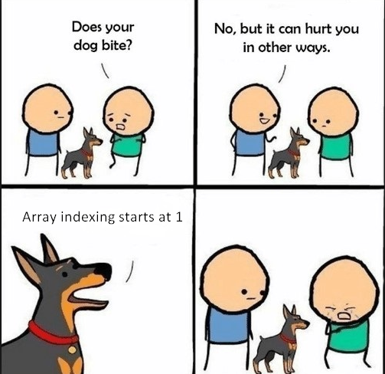

Slide 2
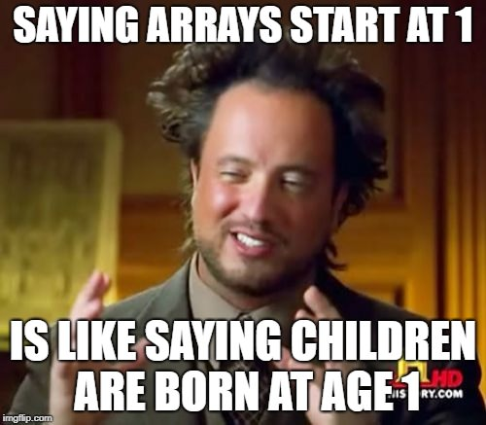

Slide 3
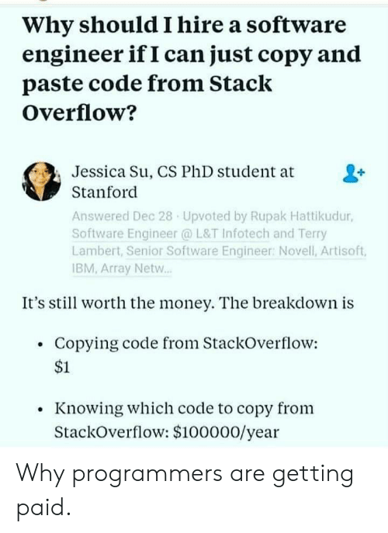

Slide 4


Slide 5
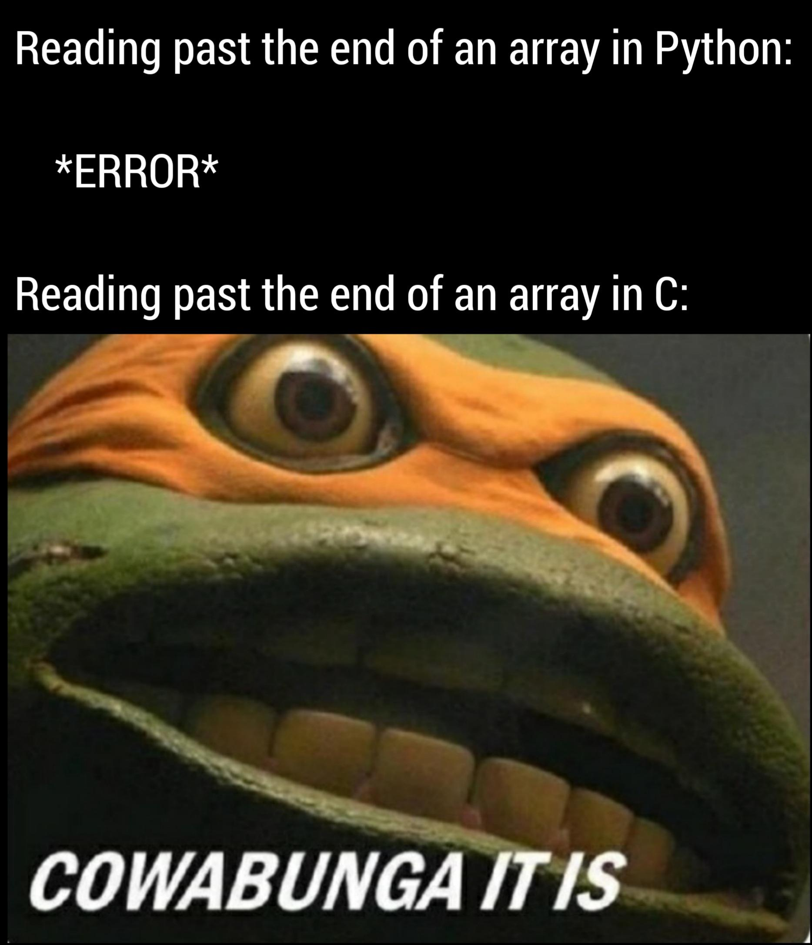

Slide 6
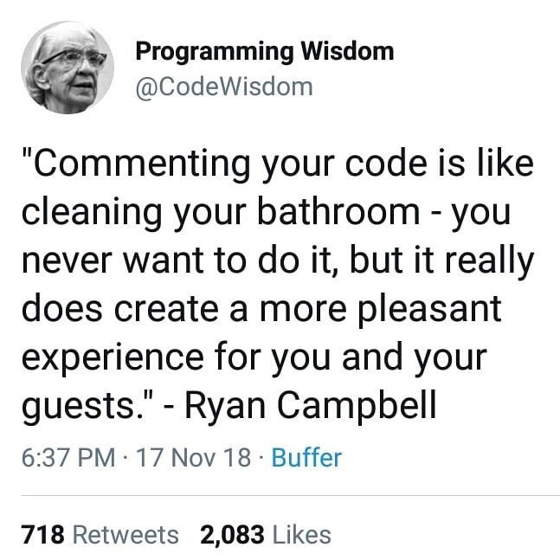

Slide 7
Due this week
Project 1
Write solutions in VSCode and paste in Autograder, Project1-CodeRunner
Honor Code MCQ
Zip your .cpp files and submit on canvas Project 1. Check the due date! No late submissions!!
Mandatory Grading Interview next week (and following week)!
Sign up delayed to Oct 3
Follow instructions from write-up
No Quiz this week

Slide 8
Arrays as Parameters in Functions

Slide 9
Arrays as Parameters in Functions
Recall that when we work with arrays we use a companion variable.
The same concept applies when using arrays as parameters:
You must pass the size to the function so it will know how many elements to work with.

Slide 10
Array as function argument
What does the computer know about an array?
– The base type
– The address of the first indexed variable
– The number of indexed variables
What does a function know about an array argument?
– The base type
– The address of the first indexed variable

Slide 11
Entire Arrays as Arguments
Formal input parameter argument can be an entire array!
– argument passed in function using array name
– called array parameter
Send size of array as well
– typically done as second parameter
– simple int type formal parameter

Slide 12
Arrays as function argument
In some main() function definition, consider this call:
int score[5], numberOfScores = 5;
fillup(score, numberOfScores);
1st argument is entire array
2nd argument is integer value
No brackets on the array argument
Passing in score → provides fillup() with the data type (int) and address of score[0]
knowing the type helps us retrieve the 2nd-last elements
Passing in numberOfScores → provides size of array

Slide 13
Arrays as function argument
In some main() function definition, consider this call:
int score[5], numberOfScores = 5;
fillup(score, numberOfScores);
Must send in size of array separately
Fun fact: This means we can use the same function to fill any sized array!
Exemplifies nice “re-use” properties of functions
int score[5], time[10];
fillup(score, 5);
fillup(time, 10);
Notes:
When writing an array parameter variable, you place an empty[] behind the parameter name. Do not specify the size of the array inside the brackets. When you call the function, supply both the name of the array and the size

Slide 14
Array as function argument: How?
What’s really passed?
Think of array as 3 "pieces"
Address of first indexed variable (arrName[0])
Array base type (int or double or float or …)
Size of array
Only 1st piece is passed!
Just the beginning address of array (the 1st element)
Knowing the type helps us retrieve the (2nd – last) elements

Slide 15
Array Parameters in Functions Require [] in the Header
You use an empty pair of square brackets after the parameter variable’s name to indicate you are passing an array.
double sum(double data[], int size)

Slide 16
Array Function Call Does NOT Use the Brackets
When you call the function, supply both the name of the array and the size, BUT NO SQUARE BRACKETS!!
double NUMBER_OF_SCORES = 10;
double scores[NUMBER_OF_SCORES] = { 32, 54, 67.5, 29, 34.5, 80, 115, 44.5, 100, 65 };
double total_score = sum(scores, NUMBER_OF_SCORES);
You can also pass a smaller size to the function:
double partial_score = sum(scores, 5);
This will sum over only the first five doubles in the array.

Slide 17
Array Parameter Function Example
Here is the sum function with an array parameter:
Notice that to pass one array, it takes two parameters.
double sum(double data[], int size) { double total = 0; for (int i = 0; i < size; i++) { total = total + data[i]; } return total; }

Slide 18
double sum(double data[], int size) { double total = 0; for (int i = 0; i < size; i++) { total = total + data[i]; } return total; }
int main()
{
const int CAPACITY = 5;
int numbers[CAPACITY] = {1,2,3,4,5};
cout << “Sum of array values: “ << sum(numbers,CAPACITY) << endl;
return 0;
}
Brief C++ by Cay Horstmann
Copyright © 2017 by John Wiley & Sons. All rights reserved

Slide 19
Array Parameters Always are Reference Parameters
When you pass an array into a function, the contents of the array can always be changed. An array name is actually a reference, that is, a memory address:
//function to scale all elements in array by a factor
void multiply(double values[], int size, double factor) { for (int i = 0; i < size; i++) { values[i] = values[i] * factor; } }

Slide 20
Arrays as Parameters but No Array Returns
You can pass an array into a function but you cannot return an array.
However, the function can modify an input array, so the function definition must include the result array in the parentheses if one is desired.

Slide 21
Arrays as Parameters and Return Value
If a function can change the size of an array, it should let the caller know the new size by returning it:
int read_inputs(double inputs[], int capacity)
{
//returns the # of elements read, as int
int current_size = 0;
double input;
while (cin >> input)
{
if (current_size < capacity)
{
inputs[current_size] = input;
current_size++;
}
}
return current_size;
}

Slide 22
Array Parameters in Functions: Calling the Function
Here is a call to the read_inputs function:
const int MAXIMUM_NUMBER = 1000;
double values[MAXIMUM_NUMBER];
int current_size = read_inputs(values, MAXIMUM_NUMBER);
After the call, the current_size variable specifies how many were added.

Slide 23
Function to Fill or Append to an Array
Or it can let the caller know by passing and returning the current size:
int append_inputs(double inputs[], int capacity, int current_size)
{
double input;
while (cin >> input)
{ if (current_size < capacity)
{
inputs[current_size] = input;
current_size++;
}
}
return current_size;
}
Note this function has the added benefit of either filling an empty array or appending to a partially-filled array

Slide 24
Array Functions Example Code
score_v2.cpp
score_v3.cpp
Brief C++ by Cay Horstmann
Copyright © 2017 by John Wiley & Sons. All rights reserved

Slide 25
Constant Array Parameters
When a function doesn’t modify an array parameter, it is considered good style to add the const reserved word, like this:
double sum(const double values[], int size)
The const reserved word helps the reader of the code, making it clear that the function keeps the array elements unchanged.
If the implementation of the function tries to modify the array, the compiler issues a warning.

Slide 26
The const Parameter Modifier
Recall: array parameter actually passes address of 1st element
Function can then modify array!
Often desirable, sometimes not!
Protect array contents from modification
Use "const" modifier before array parameter
Called "constant array parameter"
Tells compiler to "not allow" modifications

Slide 27
Example – function definition
// Takes 2 arrays of the same size as input parameters and outputs an array
// whose elements are the sum of the corresponding elements in the 2 input arrays.
void addarray(int size, // IN size of arrays
const float A[], // IN input array
const float B[], // IN input array
float C[]) // OUT result array
{
int i;
for (i = 0; i < size; i++)
C[i] = A[i] + B[i];
} // End of function addarray

Slide 28
Example – function call
The function addarray could be used as follows:
In main():
int one[50], two[50], three[50];
. . .
addarray(50, one, two, three);
// but also:
addarray(20, one, two, three);
// it will only do the addition on the first 20 elements of each array

Slide 29
Common Error – Copying
Consider these two arrays:
int squares[5] = { 0, 1, 4, 9, 16 };
int lucky_numbers[5];
How can we copy the values from squares to lucky_numbers?
Let’s try what seems right and easy…
squares = lucky_numbers; …and wrong!
You cannot assign arrays!
The compiler will report a syntax error.

Slide 30
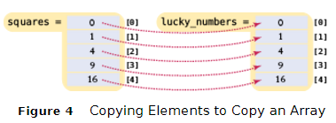
Common Algorithms – Copying Requires a Loop
/* you must copy each element individually using a loop! */
int squares[5] = { 0, 1, 4, 9, 16 };
int lucky_numbers[5];
for (int i = 0; i < 5; i++) { lucky_numbers[i] = squares[i]; }
Brief C++ by Cay Horstmann
Copyright © 2017 by John Wiley & Sons. All rights reserved

