Slide 1
File I/O

Slide 2
Recap

Slide 3
Reading and Writing Disk Files
You can also read and write files stored on your hard disk:
plain text files
binary information (a binary file)
Such as images or audio recording
To read/write files, you use variables of the stream types:
ifstream for input from plain text files.
ofstream for output to plain text files.
fstream for input and output from binary files.
You must #include <fstream>

Slide 4
Code for opening a stream
ifstream in_file;
in_file.open("input.txt"); //filename is input.txt
An alternative shorthand syntax combines the 2 statements:
ifstream in_file(“input.txt”);
string name;
int number;
in_file >> name >> number;

Slide 5
Closing a Stream
When the program ends, all streams that you have opened will be automatically closed.
You can manually close a stream with the close member function:
in_file.close();
Create variable
Open file (provide filename)
Check if file opened successfully
Read from file
Close file

Slide 6
Reading from a stream
The >> operator returns a “not failed” condition, allowing you to combine an input statement and a test.
A “failed” read yields a false and a “not failed” read yields a true.
if (in_file >> name >> number)
{
// Process input
}

Slide 7
Reading from a stream
You can even read ALL the data from a file because running out of things to read causes that same “failed state” test to be returned:
while (in_file >> name >> number)
{
// Process input
}

Slide 8
Reading A Whole Line: getline
The function getline() reads a whole line up to the next '\n', into a C++ string.
The '\n' is then deleted, and NOT saved into the string.
string line;
ifstream in_file("myfile.txt");
getline(in_file, line);

Slide 9
Reading A Whole Line in a Loop: getline
The getline function, like the others we’ve seen, returns the “not failed” condition.
To process a whole file line by line:
string line;
while( getline(in_file, line)) //reads whole file
{
// Process line
}

Slide 10
Writing to Files

Slide 11
Writing to a Stream
Here’s everything:
create output stream variable
open the file
write to file
close file!
ofstream out_file;
out_file.open("output.txt");
if (in_file.fail()) { return 0; }
out_file << name << " " << value << endl;
out_file << "CONGRATULATIONS!!!" << endl;

Slide 12
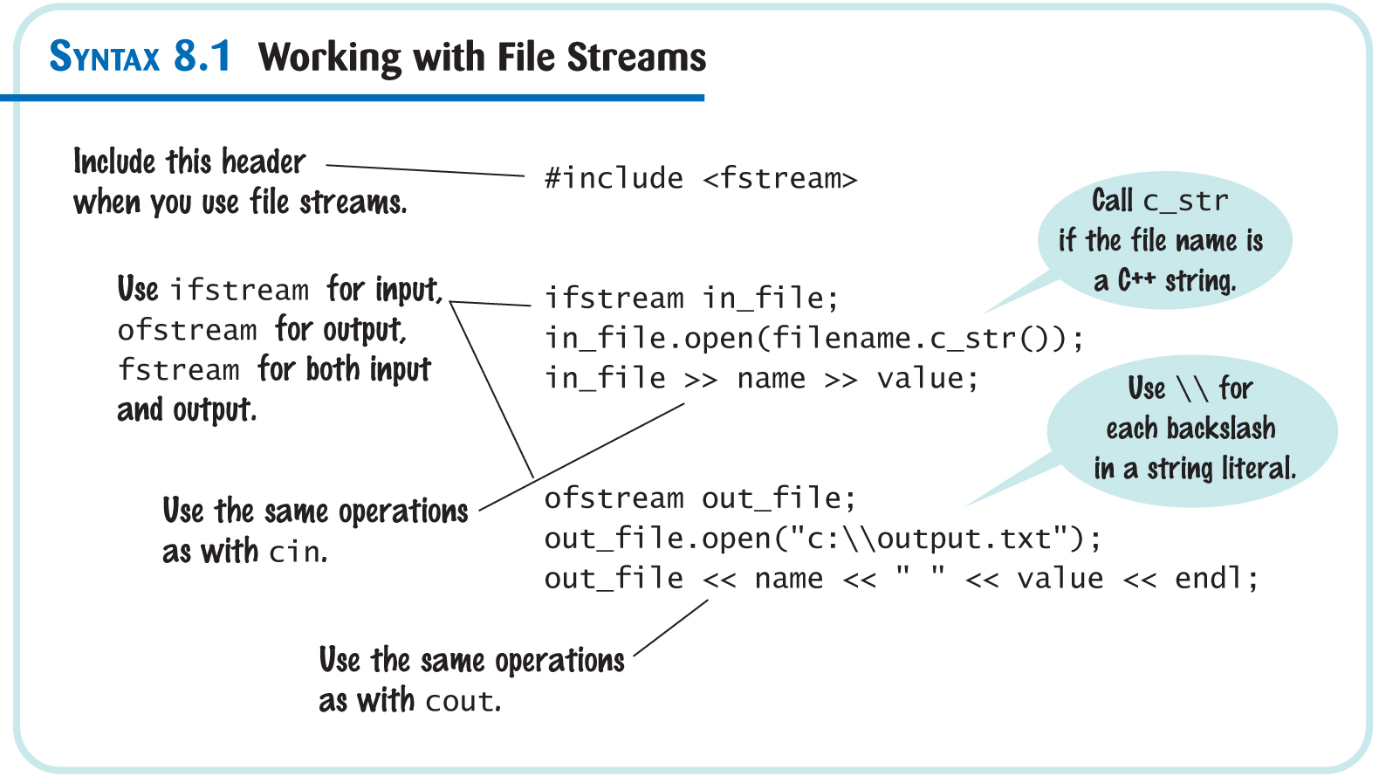
Working with File Streams

Slide 13
When the File Name is in a C++ string variable
If the filename comes from the user, you will store it in a string.
If you use a C++ string, some older library versions require you to convert it to a C-string using c_str() as the argument to open():
cout << "Please enter the file name:";
string filename;
cin >> filename;
ifstream in_file;
in_file.open(filename.c_str());

Slide 14
Opening a Stream, Filename is a char[] array
cout << "Please enter the file name:";
char filename[80];
cin >> filename;
ifstream in_file;
in_file.open(filename);

