Slide 1
Object Oriented Programming

Slide 2
Due this week
HW 6
Write solutions in VSCode and paste in CodeRunner.
Extra-credit – start early bonus only
Zip your .cpp files and submit on canvas. Check the due date! No late submissions!!
Quiz 6. Check the due date! No late submissions!!
3-2-1
Practicum next Monday! See Canvas for more info

Slide 3
H6_zip Reminder
Please read carefully the homework write-up and all the associated files.
You need to have a working .cpp file for each function
In the main() function, you need to call the function, in order to test it.
There is a sample submission file on Canvas
If your .cpp file does not compile you can’t get points for that file.
If you develop your solution on CodeRunner, you won’t have the main() and the tests.

Slide 4
Practicum 2 – 100 points
Coming up next week: October 17th in class
Covers material from weeks 1 - 6
New material:
Loops
Functions
Strings
Arrays

Slide 5
Object Oriented Programming

Slide 6
Object-oriented programming… why?
As programs get large, increasingly difficult to maintain lots of functions and variables
different functions need access to different variables
becomes sooooooo tempting to turn to the Dark Side and use
GLOBAL VARIABLES
Notes:
Functions need information, need parameters. You have to pass values and return values constantly.

Slide 7
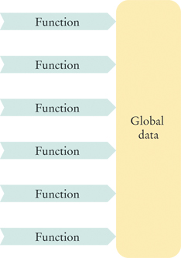
Object-oriented programming… why?
global variables are defined outside of any function
everyone knows their business
#include..
int var1 = 12;
double var2 = 20.5;
function1..
function2..
function3..
main()..
Notes:
Sometimes we have the need to update multiple values, but function can only return one value. So we need more functions

Slide 8
Object-oriented programming… why?
When some part of the global data needs to be changed:
to improve performance or to add new capabilities
a large number of functions may be affected
– you will have to rewrite them –
and hope everything still works!
Notes:
Sometimes we have the need to update multiple values, but function can only return one value. So we need more functions

Slide 9
Object-oriented programming… why?
Example: Keep track of characteristics of two players, and a function for them to do battle!
Luke:
hit_points_luke = 10;
mana_luke = 100;
attack_strength_luke = 3;
defense_strength_luke = 6;
Vader:
hit_points_vader = 13;
mana_vader = 80;
attack_strength_vader = 7;
defense_strength_vader = 8;
int battle(hit_points_luke, mana_luke, attack_strength_luke, defense_strength_luke, hit_points_vader, mana_vader, attack_strength_vader, defense_strength_vader)

Slide 10
Object-oriented programming… why?
Example: Keep track of characteristics of two players, and a function for them to do battle!
int battle(hit_points_luke, mana_luke, attack_strength_luke, defense_strength_luke, hit_points_vader, mana_vader, attack_strength_vader, defense_strength_vader)
Wouldn’t this be simpler?
int battle(luke, vader)
and have all of luke and vader’s attributes stored in the luke and vader variables?
objects to the rescue!

Slide 11
Object-oriented programming (OOP)
“A programming style in which tasks are solved by collaborating objects.”
… way to use the definition in the name! What is an object?
Objects have their own data associated with them, and their own functions.
No more global variables – Hurray!
Notes:
Think about the world as objects with their attributes
Programming with objects is what defines OOP

Slide 12
Example: Points
Point (2D)
attributes:
Point (3D)
attributes:

Slide 13
Objects to the rescue
The data stored in an object are called:
data members (attributes/fields)
The functions that work on data members are:
member functions
(Instead of “variables” and “functions” – separately)
Notes:
Think about the world as objects with their attributes
Different files, modifying data

Slide 14
Example: Objects
int battle(luke, vader)
luke could be an object
data/attributes: hit_points, mana, attack_strength, defense_strength…. (data members)
functions: train(), rest(), push_ups() … (member functions)

Slide 15
Example: Objects
int battle(luke, vader)
luke could be an object
data/attributes: hit_points, mana, attack_strength, defense_strength…. (data members)
functions: train(), rest(), push_ups() … (member functions)
and vader could be another object (with its own data and functions)

Slide 16
Object-oriented programming (OOP)
both luke and vader have the same kinds of data and functions associated with them!
wouldn’t it be nice if there was a type of variable with all that info built into it?

Slide 17
Object-oriented programming (OOP)
both luke and vader have the same kinds of data and functions associated with them!
wouldn’t it be nice if there was a type of variable with all that info built into it?
there is! We call it a class. And we call the variables of that class an object.

Slide 18
Example: Objects
Car object
Data Members:

Slide 19
Example: Objects
Car object
Data Members:
color
make
num_doors
model
year
electric

Slide 20
Class
A class describes a set of objects with the same behavior
Variables of a class are called objects
Every class has:
Data members
Member functions
Notes:
Think about the world as objects with their attributes
Different files, modifying data

Slide 21
Class
[define a class of objects called jedi]
jedi luke;
luke.train(); // luke trains by running through the
swamp with a muppet on his back; increases his
attack_strength and defense_strength
luke.rest(); // luke rests and increases his hit_points and mana
functions: train(), rest(), push_ups()..
are part of the class’s public interface,
Notes:
which are the parts of the object that we can access from the rest of our program

Slide 22
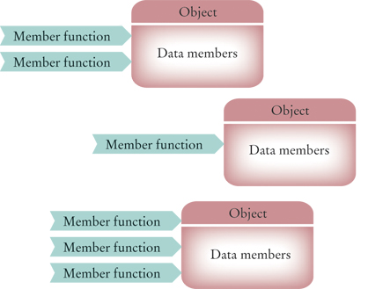
Objects to the rescue
Notes:
Think about the world as objects with their attributes
Different files, modifying data

Slide 23
Classes
A class describes a set of objects with the same behavior.
To define a class, we must specify the behavior
… defining the member functions (and what they do)
… and defining the data members (types of variable, size, etc)

Slide 24
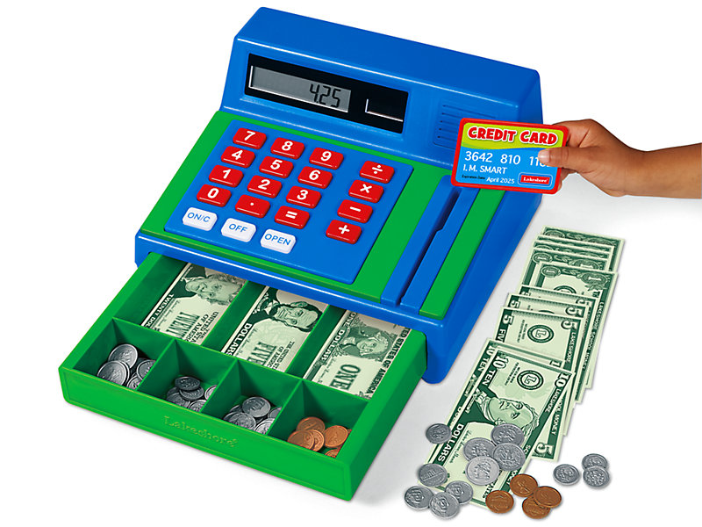
Designing a class: cash register
By observation we would need member functions to…
Clear the cash register
Start a new sale
Add the price of an item to a running total
Get the total amount owed
Count the number of items purchased
Notes:
Assume the items are added one at a time. We basically want to be able to print at the end: “you bought x items and the total bill is …”

Slide 25
Member Functions
Member functions will be our public interface
specify through a function declaration (prototype) in our class definition
But we also need data members too! They will be private, only for the member functions
running total, number of items, … ?
Notes:
Remember function declaration, or prototype. Not the whole definition, just the header which tells us what parameters the function needs and what it will return.

Slide 26
Encapsulation and Interface
public:
accessible outside the class definition
member functions
private:
not accessible outside the class definition
data members
Notes:
Some users really want to know the details of the implementation. But some people are into mischief (hacking, diverting money, …)

Slide 27
Encapsulation and Interface
The data members are said to be encapsulated because:
they are hidden from other parts of the program
accessible only through the class’s member functions.
hides all the nitty-gritty details so people using the class don’t have to worry about it
makes using and modify our classes more manageable

Slide 28
Encapsulation and Interface
Now when we want to change the way that an object is implemented, only a small number of functions need to be changed, and they are the ones in the object.
Because most real-world programs need to be updated often during their lifetime, this is an important advantage of object-oriented programming.
Program evolution becomes much more manageable.

Slide 29

Encapsulation and Interface
The interface for a car is similar -- you can successfully (usually…) interact and use a car object without necessarily knowing all the details about how each thing on the dashboard works.
… because they have a nice interface
Notes:
Some users really want to know the details of the implementation. But some people are into mischief (hacking, diverting money, …)

Slide 30
Example
We have used the string class, but we didn’t have to deal with how str.substr(6) works, or what str[6] is actually doing.
We had access to the public interface to the string class, and just got to use that
Protects the class from us accidentally messing it up

Slide 31
A generic class interface
class NameOfClass
{
public:
// the public interface
private:
// the data members
};

Slide 32
A generic class interface
Use CamelCase for the names of classes
class NameOfClass
{
public:
// the public interface
private:
// the data members
};

Slide 33
A generic class interface
Use CamelCase for the names of classes
class NameOfClass
{
public:
// the public interface
private:
// the data members
};
Any part of our program should be able to call the member functions.
→ they go in the public interface

Slide 34
A generic class interface
Use CamelCase for the names of classes
class NameOfClass
{
public:
// the public interface
private:
// the data members
};
Any part of our program should be able to call the member functions.
→ they go in the public interface
Data members are defined in the private section of the class. Only member functions (within our class) can access the data members. They’re hidden from
the rest of the program
→ they go in the private section of the class

Slide 35
Common Error: Missing Semicolon
class CashRegister
{
public:
[public interface goes here]
private:
[data members go here]
}
int main()
{
// Many compilers report that error here in main!
...
}
Don’t forget the semicolon!
Notes:
Be careful when you read where the error is. On VSCode it clearly says missing semicolon after }, but some other compilers have different behavior

Slide 36
Designing a class: cash register
class CashRegister
{
public:
void clear();
void add_item(double price);
double get_total() const;
int get_count() const;
private:
// data members will go here
};
Notes:
The last activity got split into two: get Total and getCount

Slide 37
Designing a class: cash register
class CashRegister
{
public:
void clear();
void add_item(double price);
double get_total() const;
int get_count() const;
private:
// data members will go here
};
These are function prototypes.
We’ll define them later.
Notes:
The last activity got split into two: get Total and getCount

Slide 38
What are the data members?
class CashRegister
{
public:
void clear();
void add_item(double price);
double get_total() const;
int get_count() const;
private:
int item_count;
double total_price;
};
Always think carefully about what the values we might need to access from our class could be!
Notes:
not mandatory, but good practice

Slide 39
Member Functions
Two types:
Mutators / setters
Accessors / getters

Slide 40
Mutators / Setters
Mutators are member functions that modify the data members
Increment the item count
Add price to the total bill
Clear all data members (reset total bill and item count to 0)
Notes:
Clear is: clear all data members (start a new transaction) It resets both data members
add_item updates both the item count and the total price.

Slide 41
Accessors / Getters
Accessors are member functions that query a data member(s) of the object, and returns the value(s) to the user
Get the total bill
Get the item count

Slide 42
Designing a class: cash register
class CashRegister
{
public:
void clear();
void add_item(double price);
double get_total() const;
int get_count() const;
private:
// data members will go here
};
Question: Which member functions are getters (accessors) and which are setters (mutators)?
Notes:
Accesors/getters functions return values. Mutators do not

Slide 43
Designing a class: cash register
class CashRegister
{
public:
void clear();
void add_item(double price);
double get_total() const;
int get_count() const;
private:
// data members will go here
};
setters because they change the value of data members
Question: Which member functions are getters (accessors) and which are setters (mutators)?
Notes:
Accesors/getters functions return values. Mutators do not

Slide 44
Designing a class: cash register
class CashRegister
{
public:
void clear();
void add_item(double price);
double get_total() const;
int get_count() const;
private:
// data members will go here
};
setters because they change the value of data members
getters because they simply report the values of data members
Question: Which member functions are getters (accessors) and which are setters (mutators)?
Notes:
Accesors/getters functions return values. Mutators do not

Slide 45
What is const?
class CashRegister
{
public:
void clear();
void add_item(double price);
double get_total() const;
int get_count() const;
private:
// data members will go here
};

Slide 46
What is const?
class CashRegister
{
public:
void clear();
void add_item(double price);
double get_total() const;
int get_count() const;
private:
// data members will go here
};
getters only report the values of data members, and never alter them
→ we declare these functions to be const so they can’t mess our stuff up

Slide 47
Dot Notation
You call the member functions by first creating a variable of type CashRegister and then using the dot notation:
CashRegister register1;
...
register1.clear();
register1.add_item(1.95);
...
int count = register1.get_count();
cout << “Number of items: “ << count << endl;

Slide 48
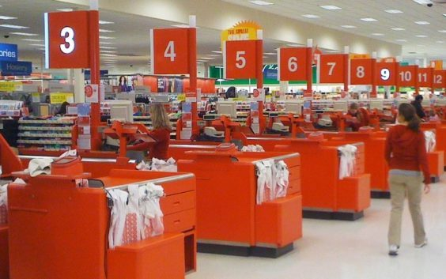
Encapsulation
Every CashRegister object has its own copy of these data members
CashRegister register1;
CashRegister register2;
… [use setter functions] ...
…. …..
register1
item_count = 1
total_price = 1.95
register2
item_count = 1
total_price = 1.95
Notes:
Creating many objects as different instances of the same class

Slide 49
Encapsulation
The private data members are only accessible via member functions:
Won’t work: CashRegister register1;
… [use setter functions] ...
cout << register1.total_price << endl;

Slide 50
Encapsulation
The private data members are only accessible via member functions:
Won’t work: CashRegister register1;
… [use setter functions] ...
cout << register1.total_price << endl;
Will work! CashRegister register1;
… [use setter functions] ...
cout << register1.get_total() << endl;

Slide 51
Encapsulation
You can move data members to the public interface and make it accessible
DON’T! It is not good practice
Will keep things tidier and easy to debug!

Slide 52
Encapsulation
We might want to change how data members are computed and/or manipulated, but the important details (data members) shouldn’t necessarily change.
Example:
We can write the mutator for item_count so it can never be negative
On the other hand, if item_count were public, we could just straight up set it to be negative.

Slide 53

The Interface
The interface should not change even if the details of how they are implemented change.
A driver switching to an electric car does not need to re-learn how to drive.

Slide 54
Class Implementation

Slide 55
Class Implementation
class CashRegister
{
public:
void clear();
void add_item(double price);
double get_total() const;
int get_count() const;
private:
int item_count;
double total_price;
};
Now that we have the interface, we
need to actually define the prototypes!
→ start by implementing the member functions

Slide 56
Implementing member functions
Start with the add_item() member function:
void add_item( double price ) {
item_count++; // added an item, so increment item counter
total_price = total_price + price; // added item price too
}
One more thing to add: as written, there is no connection to the CashRegister class!

Slide 57
Implementing member functions
void CashRegister::add_item( double price ) {
item_count++; // added an item, so increment item counter
total_price = total_price + price; // added item price too
}
One more thing to add: as written, there is no connection to the CashRegister class!
so we specify for our member functions:
CashRegister::[member function name]
Notes:
Remember. This one updated two data members

Slide 58
Implementing member functions
We do not need the CashRegister:: declaration when defining the class:
class CashRegister {
public:
...
void add_item( double price );
…
private:
...
};
void CashRegister::add_item( double price ) {
item_count++;
total_price = total_price + price;
}

Slide 59
Implementing member functions
We do not need the CashRegister:: declaration when defining the class:
class CashRegister
{
public:
...
void add_item( double price );
...
private:
...
};
void CashRegister::add_item( double price ) {
item_count++;
total_price = total_price + price;
}
Big C++ by Cay Horstmann
Copyright © 2017 by John Wiley & Sons. All rights reserved

Slide 60
Implicit Parameters
When we call add_item( 1.95 ), how does it know which item_count to increment, or which total_price to increase?
CashRegister register1, register2;
… [stuff happens] …
register1.add_item( 1.95 );
register1 → pass as an implicit parameter into the add_item() function
Big C++ by Cay Horstmann
Copyright © 2017 by John Wiley & Sons. All rights reserved

Slide 61
Implicit Parameters
register1.add_item( 1.95 );
void CashRegister::add_item( double price ) {
item_count++;
total_price = total_price + price;
}
Big C++ by Cay Horstmann
Copyright © 2017 by John Wiley & Sons. All rights reserved

Slide 62
Implicit Parameters
register1.add_item( 1.95 ) knows to add 1 item with price $1.95 to register1 the same way str1.length() knows to take the length of str1
register1.add_item( 1.95 );
void CashRegister::add_item( double price ) {
register1.item_count++;
register1.total_price = register1.total_price + price;
}
Big C++ by Cay Horstmann
Copyright © 2017 by John Wiley & Sons. All rights reserved

Slide 63
Constructors
A constructor is a member function that initializes the data members of an object.
The constructor is automatically called whenever an object is created.
CashRegister register1;
(You don’t see the function call nor the definition in the class, it but it’s there.)
Big C++ by Cay Horstmann
Copyright © 2017 by John Wiley & Sons. All rights reserved

Slide 64
Motivation
By supplying a constructor, by writing our own implementation, you can ensure that all data members are properly set before any member functions act on an object.
To understand the importance of constructors, consider:
CashRegister register1;
register1.add_item(1.95);
int count = get_count(); // May not be 1
Notice that the programmer forgot to call clear before adding items.
Big C++ by Cay Horstmann
Copyright © 2017 by John Wiley & Sons. All rights reserved
Notes:
Why might the value of count not be 1?

Slide 65
Constructor Code
You declare constructor functions in the class definition. There must be no return type, not even void.
The name of the constructor must be the same as the class:
class CashRegister
{
public:
CashRegister(); // A constructor
...
};
The constructor definition resembles other member functions:
CashRegister::CashRegister()
{
item_count = 0;
total_price = 0;
}

Slide 66
Default Constructors
If you do not write a constructor for your class, the compiler automatically generates one for you, which does nothing but allocate memory space for the data members.
The compiler does NOT provide safe initial data values, EXCEPT that string members are initialized to “”.
Default constructors are called when you define an object and do not specify any parameters for the construction.
CashRegister register1;
Big C++ by Cay Horstmann
Copyright © 2017 by John Wiley & Sons. All rights reserved

Slide 67
Parameterized Constructors
Constructors can have parameters, and can be overloaded :
class CashRegister
{
public:
// “Default” constructor: Sets item_count & total_price = 0
CashRegister();
// Sets item_count = count and total_price = price
CashRegister(int count, double price);
private:
int item_count;
double total_price;
};

Slide 68
Overloaded Constructors
When the same name is used for more than one function, then the functions are called overloaded. The compiler determines which to use, based on the parameter list of the call.
When you construct an object, the compiler chooses the constructor that matches the parameters that you supply:
CashRegister(); // Uses default constructor
CashRegister(10,2.25); // uses parameterized // constructor CashRegister(int count, int price)
Big C++ by Cay Horstmann
Copyright © 2017 by John Wiley & Sons. All rights reserved

Slide 69
Common Error: Resetting objects
You cannot call a constructor with dot notation to “reset” an object.
CashRegister register1;
...
register1.CashRegister(); // Syntax Error
The correct way to reset an object is to construct a new one and assign it to the old:
register1 = CashRegister(); //creates an
// unnamed object, then copies it to register1
Big C++ by Cay Horstmann
Copyright © 2017 by John Wiley & Sons. All rights reserved
Notes:
or use the clear() function to reset the values

