Slide 1

Iterative and agile principles applied to code generation
Mickael Istria, EclipseCon 2012, CC-BY 2.0
@mickaelistria for Tweeters

Slide 2
Code Generation
Generated Code
Generation
Generator
Config
$
$$$$$

Slide 3

Reminds me something
Grace Hopper, Inventor of the first compiler (A-0 compiler, 1952)

Slide 4

Compilation
“Binary” code
Compilation
Source
Code
$
$$$$$

Slide 5
Code Generation follows the same patterns, rules and principles as Compilation

Slide 6
This is what you want to maintain
Generated Code
Generation
Generator
Config
By the way, yes, configuration is source code

Slide 7
Iterations
Generated Code v1
Generation
Generator
Config v1
Generated Code v2
Generation
Generator
Config v2
Generated Code v3
Generation
Generator
Config v3
Notes:
Demo figures avec modifs successives

Slide 8
You need something not supported by the generation framework...

Slide 9
You do not really own the generated code.
It's internals are owned by the generation framework.

Slide 10
Modifying generated code does not scale
Forces you to maintain generated classes, reduce benefits of generation.
Can cause conflicts between configuration and modified code.
About @generated NOT: Do you trust your generation framework reconcilier? I don't.
Does not scale through generator upgrades.
Notes:
* Reconciliers are very difficult pieces of code. And they are only a “workaround”, it is not very agile

Slide 11
Generation framework usually guarantee conformance to an API, to a specification to patterns.
GMF Tooling guarantees results conform to GMF Runtime API and generated classes follow patterns
Runtime API
Generated Code
Generation
Generator
Config

Slide 12
Use generated code as an API for your custom code
The “generation-gap pattern”
http://heikobehrens.net/2009/04/23/generation-gap-pattern/

Slide 13
Runtime API
Generated Code
Generation
Generator
Config
Clazz
$
$$$$$
MyClass
$
Notes:
* Advantage over modifying generated code
→ Less lines to maintain
→ Default behavior still works/customization is isolated
→ if Generator changes drastically, default still work, customization will show you compile errors => easier to debug

Slide 14
Runtime API
Generated Code
Generation
Generator
Config
Clazz
$
$$$$$
FavoriteFramework
(not supported by generator)
MyClass

Slide 15
How can I consume custom in generated without customizing all code depending on custom?
How to re-inject your custom code to your generated noodle-plate ?
Leverage underlying APIs.

Slide 16
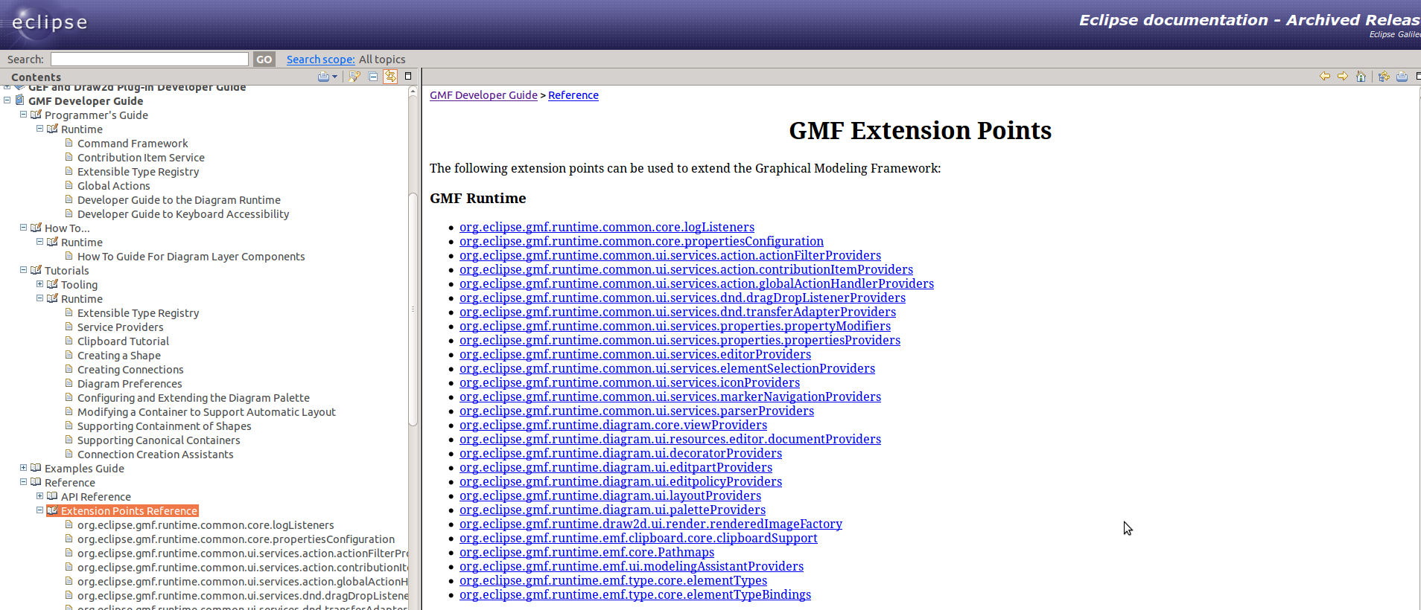
GMF
GMF editors follows a declarative “component-based” architecture. Most of default behavior classes can be replaced by custom via Eclipse extensions.

Slide 17
XText

Slide 18
IN CASE OF EMERGENCY
CUSTOMIZE GENERATOR ITSELF
GMF Tooling has extendible Xpand templates.
Xtext has a smart MWE workflow and Xtend templates
EMF has overridable JET templates

