Slide 1

presents
SOA made Open
Notes:
Hello, Thank you
Mickael Istria,
Eclipse RCP/Plugin Developer at PetalsLink.
3 years commitment on Eclipse
committer on GMF-Tooling
User and contributor to lots of Eclipse project(modeling et al)

Slide 2

Modeling with Eclipse
Mickael Istria @ {{ softshake }} 2011 - CC BY 2.0

Slide 3

Some theory

Slide 4
What is a model ?
A model is a description of any thing (entities, issues, domains...)
You describe and manipulate your model with a metamodel or a metalanguage.

Slide 5
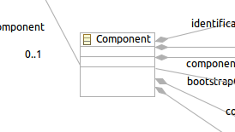
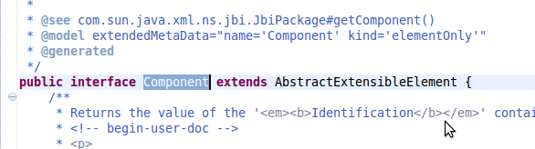
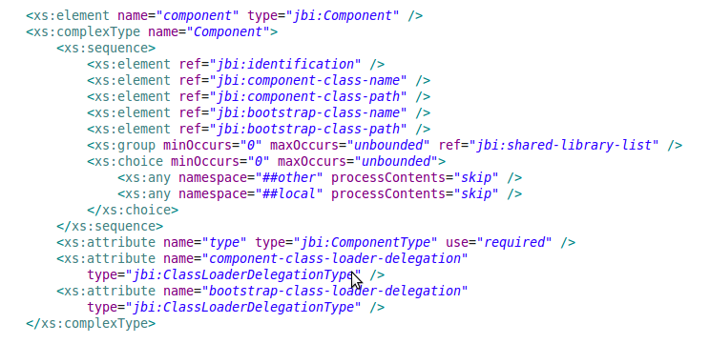
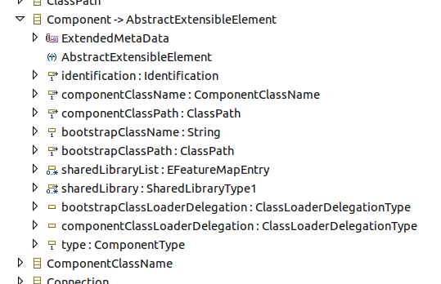
What does a metalanguage look like ?
Here are some representation of the JBI « Component » class.
Java
UML
XSD
Ecore
If we have the model of a Component :
A « Component » class is its metamodel
These representation are its meta-meta-model
Notes:
* On choisit son « meta » en fonction du use-case
* On est toujours le meta d'un autre
* « meta » est un mot relatif a la ou on observe.

Slide 6
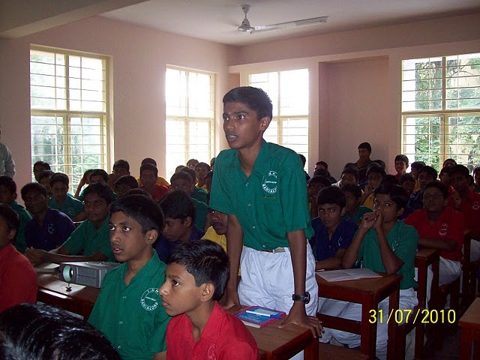

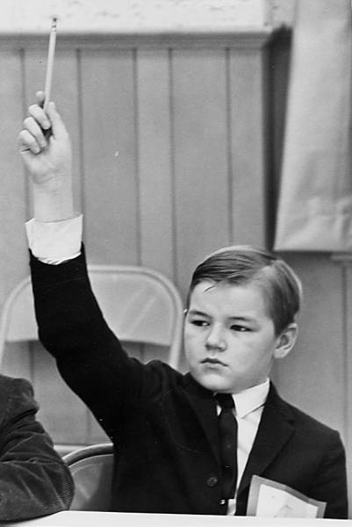

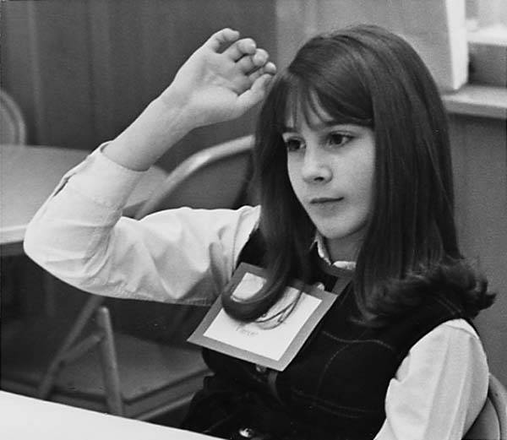
What can you do with your models ?
Transform/Convert !
CRUD !
...To be continued...
Use them to
generate stuff.
Visualize.
Store !
Version !
Notes:
* Validate, serialize, compare...

Slide 7

Model-Driven...
Architecture
Software Developm^{t}
Development
Engineering

Slide 8
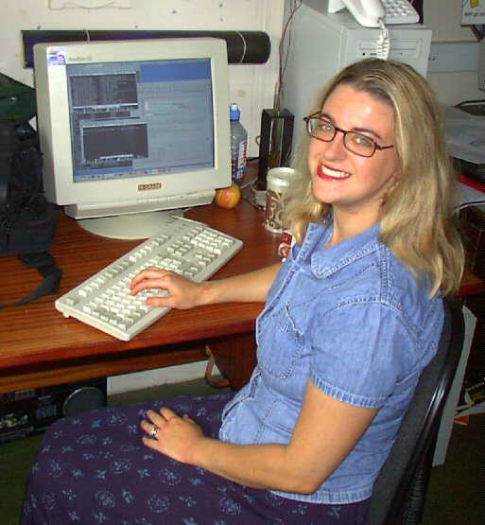
« As a software developer/architect, I understand the issues. But what about concrete solutions ? Methodologies ? Technologies ? »

Slide 9

« The Eclipse Modeling Project focuses on the evolution and promotion of model-based development technologies within the Eclipse community by providing a unified set of modeling frameworks, tooling, and standards implementations. »
72 projects at Eclipse.org

Slide 10

Can generate Java API for models.
Provides powerful introspection and code genericity thanks to its meta-comprehension and its « EObject ».
Provides (de)serialization of your models to files, transactional edition, notification support...
At runtime, your EMF models do not require Eclipse.
Generates and provides Eclipse-based editors for your models.
Generates and provides GWT-based editors for your models.

Slide 11









EMF Facts
EMF can run on :
EMF is lightweight
EObjectImpl is just 12 bytes
bigger than java.lang.Object

Slide 12
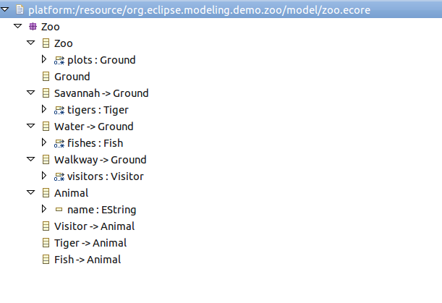
Demo 1 : EMF
Ecore
Notes:
* Show model
* Show ecore_diag
* Generate .model
* Show generated classes

Slide 13
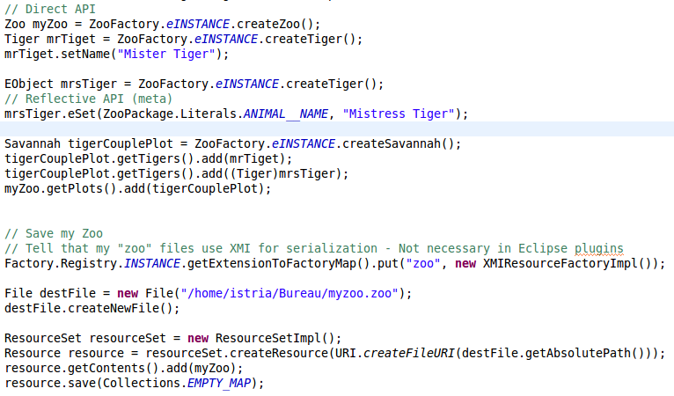
Demo 1 : EMF
Generated Java API + EObject API
Notes:
* Show client
* Show code
* Run → Does not depend on Eclipse, pure POJO
* show generated file

Slide 14

EMF can be a piece of solution for various use-cases

Slide 15

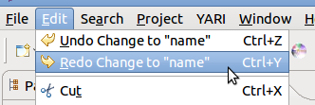

Editors
EMF provides extensions to create efficiently Eclipse editors for your models with (among others) :
  Validation
  Transactions/Commands
  Databinding
myObject.eGet(field) / myObject.eSet(field, value) ;
Notes:
* EEF : project dedicated to create model editors efficiently – just in a declarative way.

Slide 16
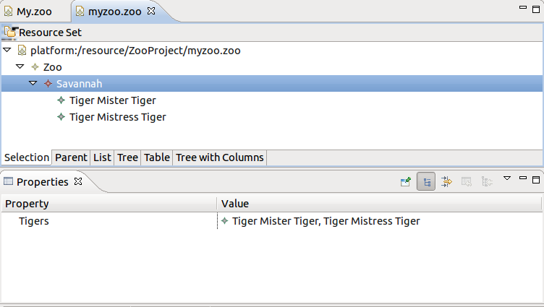

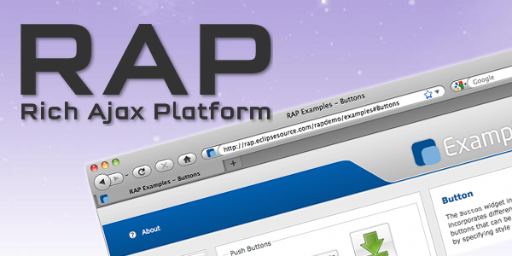
Demo 2 : Editors
Generated by EMF
Available for
Notes:
* Eclipse RCP, RAP, GWT
* Generate .edit
* Generate .editor
* Open new Eclipse
* Create a project, a file, edit Zoo
* Import previous file, show zoo

Slide 17
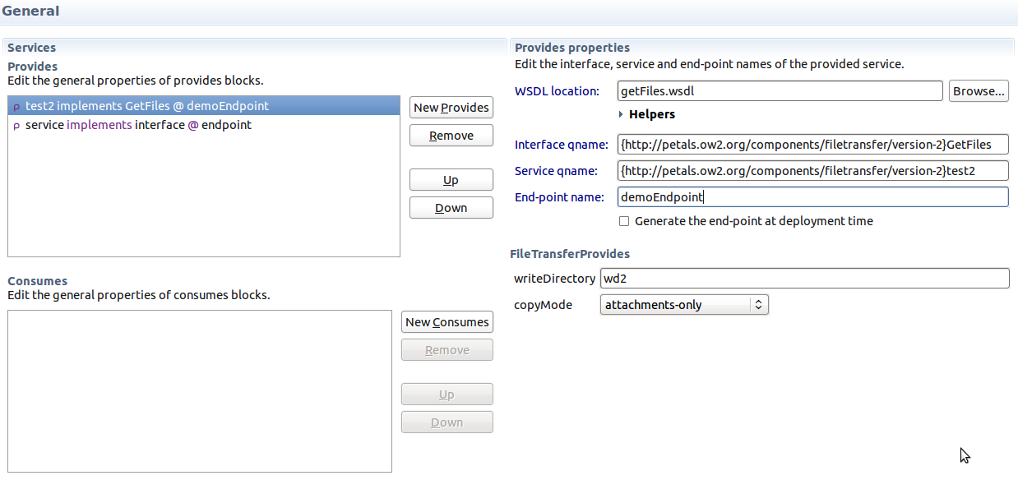
Demo 2 : Editors
Home-made editor
Notes:
* Open Editor + XML editor
* Edit « endpoint », Save, Show XML
* Ctrl-Z, Ctrl-Y
* Show Eclipse « Demo » task with the databinding line
* EEF : a new Eclipse project dedicated to this use case

Slide 18

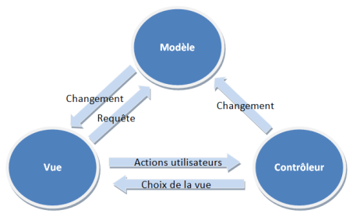

Graphical Editing – Runtime APIs
« Classical » MVC
MyDomainObject
(extends EObject)
« Runtime »
Draw2d Figure
GMF
IGraphicalEditPart

Slide 19
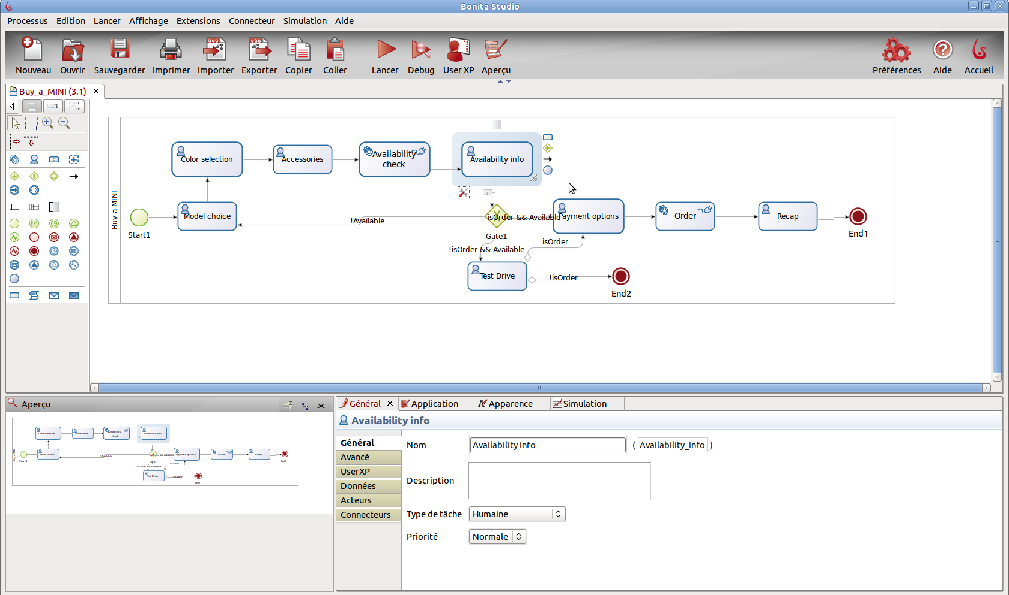

Demo 3 : GMF Editor
Notes:
* GMF customization thanks to high level APIs
* Best modeling product

Slide 20
Graphical Editing - Generators
Semantic Model (ecore)
GMF Diagram Model
Mapping
GMF codegen
Diagram code
« Tooling »
Notes:
* Writing a whole editor can be long and difficult
* Use generators to generate a first version, and customize after

Slide 21
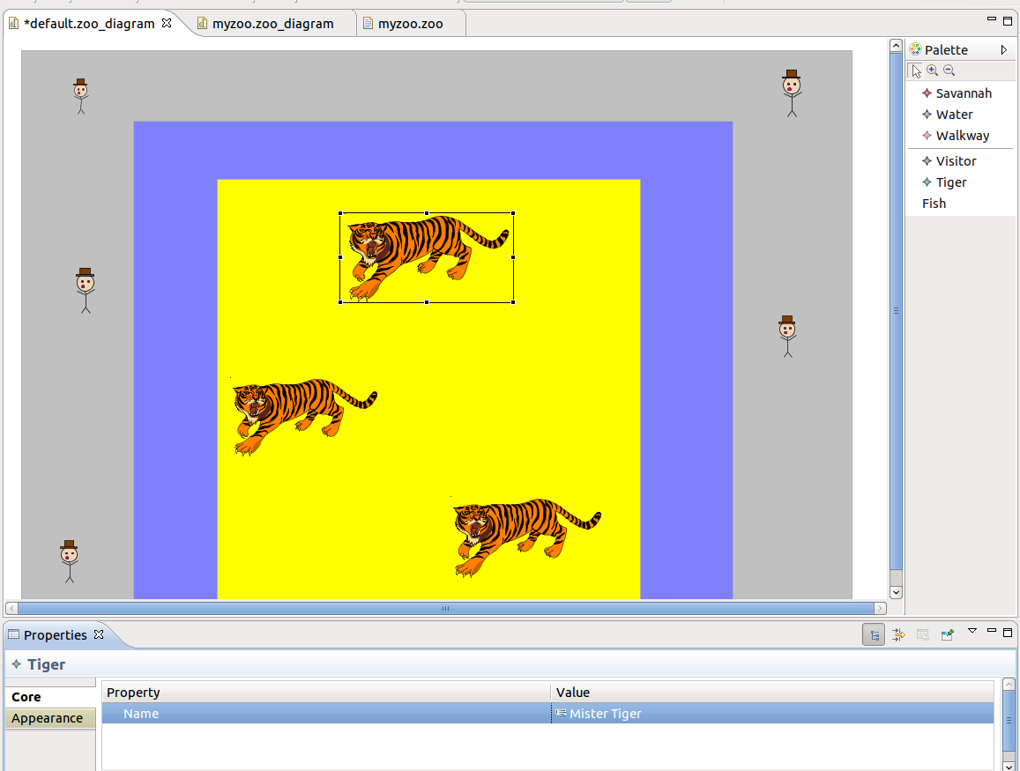
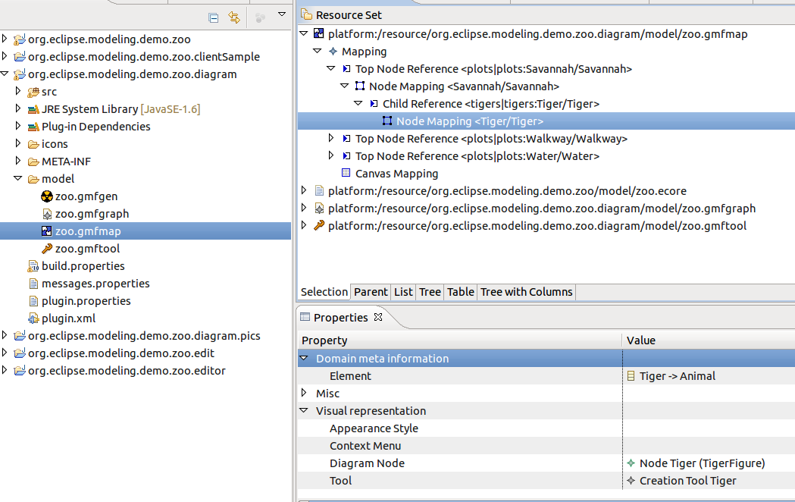
Demo 4 : GMF Tooling
Notes:
* Show GMFMap
* Add Top Node Water/child Fish
* Show GMFGraph → Figures desc
* Show GMFTool → Palette desc
* Generate GMFGen (add org.eclipse.gmf.runtime.lite.svg)
* Generate Code
* Show

Slide 22

Textual editing - DSL
Semantic Model (ecore)
Xtext grammar
(Implicit) Mapping
Xtext codegen (MWE)
DSL parser
DSL text editor
Notes:
* Generates a (de)serializer for your DSL
* Can be embedded in any Java App where EMF runs
* Think about a language grammar : Model is AST, Xtext offers parsing, only execution need to be implemented

Slide 23
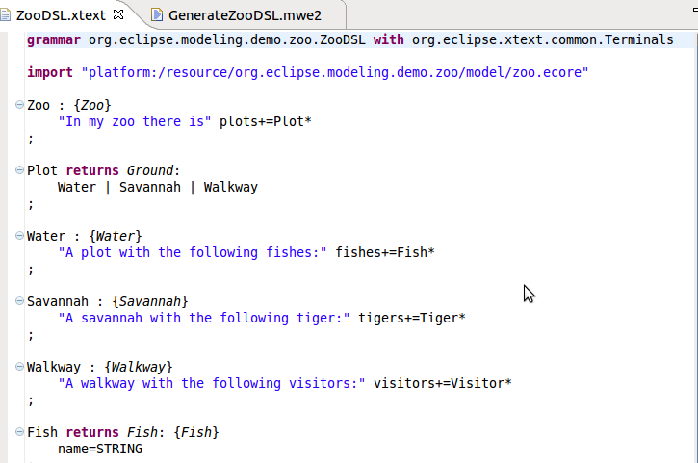
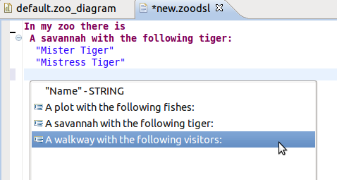
Demo 5 : XText
Notes:
5min30.
* File > New > Xtext Project from Ecore Model
→ org.eclipse.modeling.demo.zoo.dsl
→ org.eclipse.modeling.demo.zoo.ZooDSL
→ zoodsl
* Show default grammar ~ Json
* Replace with my Grammar
→ Show mapping : implicit based on name and {...}
* generate editor for « zoodsl » : May ask for ANTLR
* Create file « myzoo.zoodsl » - Show completion, validation
* Think about a java grammar

Slide 24
All this uses EMF !
Whatever representation you use, you are still using EMF to manipulate your models...
Then...

Slide 25
Screencast : synchro GMF-Xtext
http://koehnlein.blogspot.com/2009/06/synchronized-editors-with-tmfxtext-and.html
Notes:
* Diagram already exists
* Synchronization on « save »
* Still work in progress
* UML dream become true.
* Think about Java grammar + UML class diagram

Slide 26


M2T : Model To Text
Genereate Doc
Generate Code
Generate any kind of text
Meta A
Blah-blah
<%model.name%>
M2T
A1
Blah-blah A1
Just apply
Xpand
JET
A2
Blah-blah A2
Notes:
* Use case : generate web page
* « One-way » Xtext
* Batch
* 2 different styles : Template ( ~jsp/php ) ; Rules

Slide 27
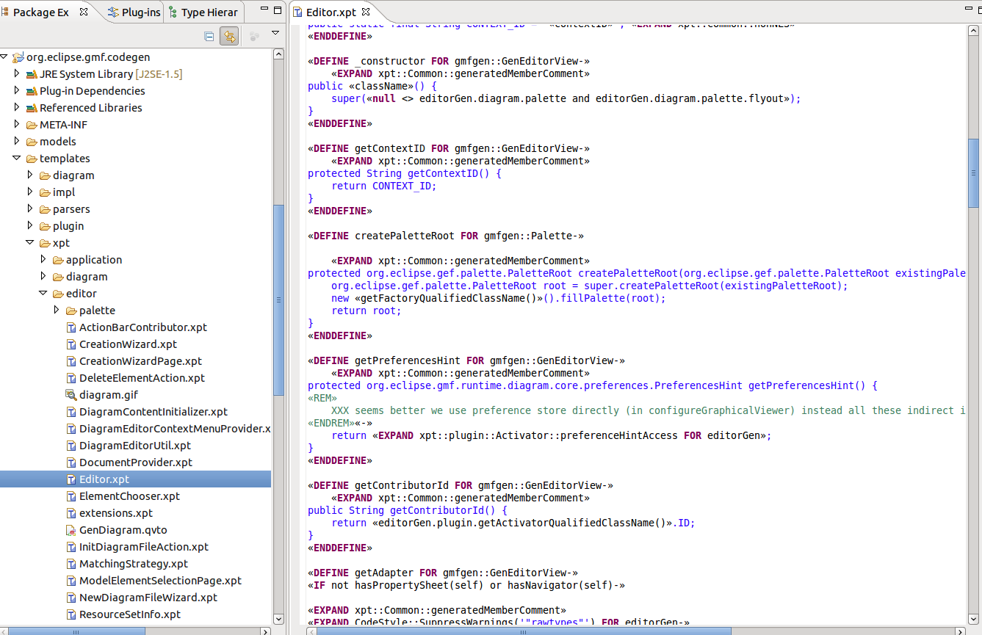
Example : GMF Tooling uses XPand
Notes:
* Go to plugins view
* Import as source « org.eclipse.gmf.codegen »
* Show Editor.xpt
→ Show how easy it is to navigate in EMF objects with « :: »
Xpand is not the best ! Acceleo is better but I don't know it enough to demo it ; and you understood the point;)

Slide 28

M2M : Model to Model
Tools to convert and transform models between different metamodels.
Meta A
Meta B
M2M
A1
B1
QVT,
Just apply
A2
B2
Notes:
* Use cases :
→ Assuse Meta1 is zoo, and Meta2 is XHTML => generate XHTML page
→ Assume Meta1 is Zoo from Berlin and Meta2 represents Zoo from Lyon. A european law says « everyone must work like Lyon' s zoo ». Then just transform/convert

Slide 29
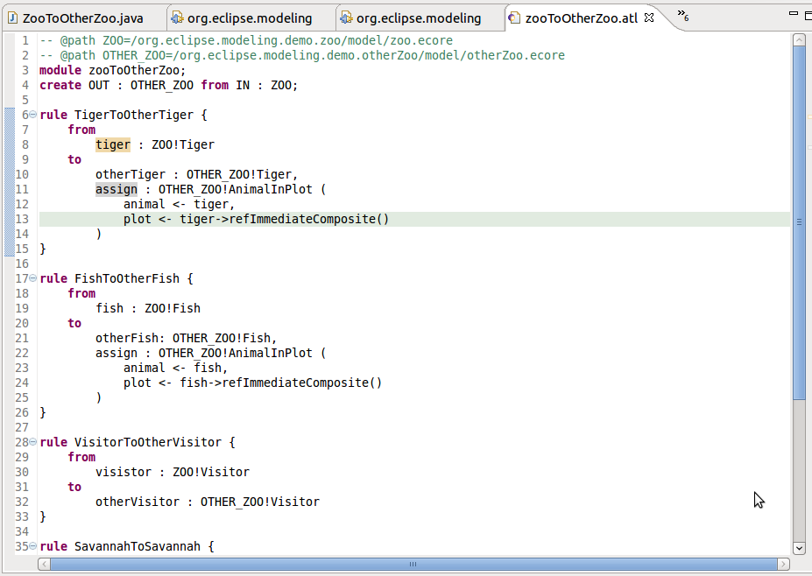
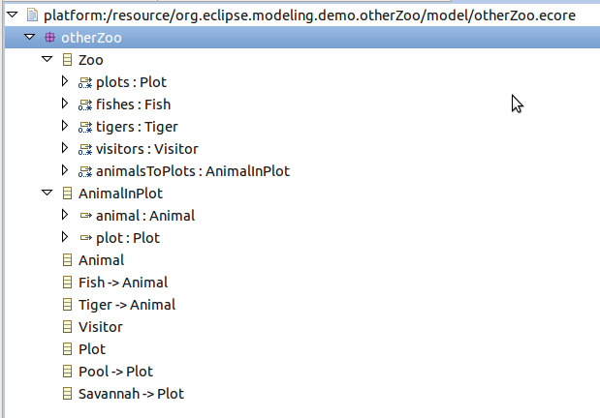
Demo 6 : ATL
Convert
Notes:
* Show metamodel
* Highlight difference
→ Containement is not the same
→ Class name are different
→ No more name
→ Containement of plots using a specific type
* Show transfo : Rules → For each element, apply a rule
* Execute transfo, show results
* Say that this transfo applies on models, not on files ! Then you can transform Xtext-based models as well.

Slide 30

Not Yet !
Notes:
* Only a few use-cases were presented

Slide 31




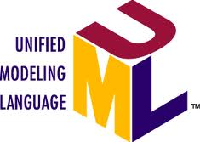

Teneo
EMF Search
...
EMF Compare
XSD
Notes:
* CDO-Dawn → Collaborative
* Teneo → JPA, Hibernate pour les modeles (Eobject)

Slide 32
What to remember ?
You already use Model-Driven approaches
EMF is a very powerful library to create your (meta)models
For all Modeling issues, « There is an Eclipse project for that ».

Slide 34
Credits
Produced by :
Directed by : Mickael Istria
Presented by : Mickael Istria
Reviewed and improved by : Ed Merks (content), Mathieu Lebreton (design)
Licensed under : CC BY 2.0
Inspired from a presentation of Aurelien Pupier & Mickael Istria @Eclipse DemoCamp Grenoble 2011 (CC BY 2.0) - http://www.slideshare.net/BonitaSoft/modeling-with-eclipse
Pics : Student Answering Question (Bernie Noble)
See also
Twitter : http://twitter.com/mickaelistria
Blog : http://mickaelistria.wordpress.com
Linkedin : http://fr.linkedin.com/in/mickaelistria

