Slide 1
Ideas....
Machinist for data generation.
(http://github.com/notahat/machinist/tree/master)

Slide 2
IronRuby

Slide 3
Agenda
Why Ruby (5 Mins)
Introduction To Ruby (5 Mins)
Introduction To IronRuby (3 Mins)
Introduction To The DLR (3 Mins)
Practical: Cucumber with WPF (5 Mins)
Practical: Creating a DSL (3 Mins)
Practical: Scripting an Application with IronRuby (5 Mins)
Summary (5 Mins)
Q & A

Slide 4
Why Ruby
Ruby Community Innovative In Testing, e.g. Cucumber, RSpec, Shoulda
Very easy to write internal DSL’s in Ruby, e.g. ActsAs...., ActiveRecord, Rails??
Ruby & IronRuby makes it easy to extend applications through scripting

Slide 5
Ruby Is Object Orientated
Every object is an instance of a particular class
An objects behavior is determined by its methods
Objects can hold/contain data
obj = Object.new

Slide 6
A ruby method
dot operator
object method
belongs to
start
method
method name
def obj.do_something
puts “I am an obj”
puts “do you object?”
end
end
method
method body

Slide 7
Ruby Method Lookup
class BasicObject
(built-in)
module Kernel
(built-in)
class Object
(built-in)
Include Kernel
class Person
module ORM
class Employee
Include ORM
Modules searched in reverse of inclusion:
1st DSL
2nd ORM
Include DSL
emp = Employee.new
emp.Save

Slide 8
Ruby Is Message Orientated
Message Passing
Method Missing
Object.send(:message), where :message can be a method.

Slide 9
Ruby Is A Dynamic Language

Slide 10
Ruby Examples:
Ruby Basics
Ruby Classes
Ruby Modules/Mixins
Ruby Metaprogramming

Slide 11
Introduction To IronRuby
Ruby for .Net

Slide 12
The DLR
Fast
Clean
Fresh Air
Not that packed.....

Slide 13
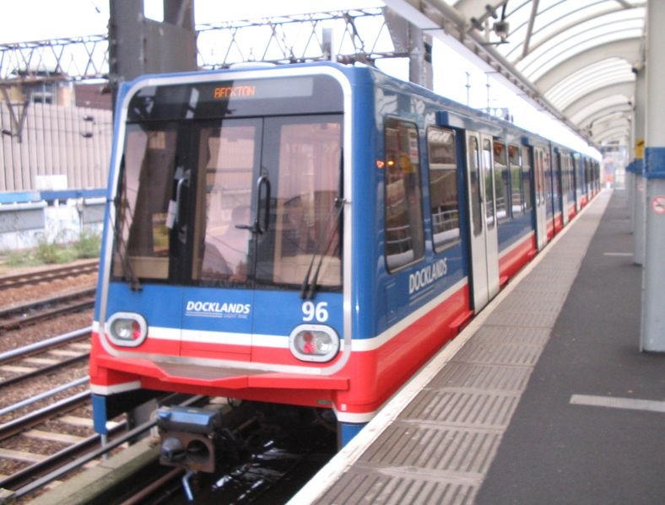

Slide 14
The DLR
App on top of CLR
Shared Objects with other Dynamic
Method Dispatch caching etc

Slide 15
Practical: Cucumber with WPF

Slide 16
Practical: Creating a DSL

Slide 17
Practical: Scripting an Application with IronRuby

Slide 18
Summary

