Slide 2
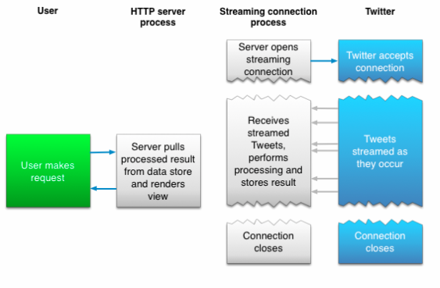
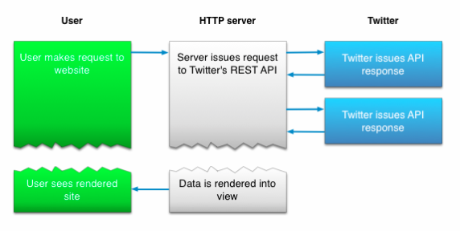
Twitter
Well described API at https://dev.twitter.com/overview/documentation
Two different approaches:
Search for Tweets
Stream Tweets in real time

Slide 3
Search
Search Tweets - relevance and not completeness
Data from the last week
Uses REST standard
Example request: https://api.twitter.com/1.1/search/tweets.json?q=%23Uppsala&src=typd
Returns something like:
{"errors":[{"code":215,"message":"Bad Authentication data."}]}
This is because your application needs to be authenticated, described in the API… xD

Slide 4
Stream
Tweet volume can change rapidly. The best practice for ingesting Tweets and other streaming messages is to decouple collection and processing of high volume streams
Need to think about how to effectively store and process the data
Example stream request: https://stream.twitter.com/1.1/statuses/filter.json?track=uppsala

Slide 5
Limitations
Rate limit. Limited number of requests per user and 15 minutes
Geographic Data. You will not (and will not allow others to) aggregate, cache, or store location data and other geographic information contained in the Content, except in conjunction with a Tweet to which it is attached. You may only use such location data and geographic information to identify the location tagged by the Tweet. Any use of location data or geographic information on a standalone basis or beyond the license granted herein is a breach of this Agreement.
What does this mean??

