Slide 1
Generating Power for Remote Applications in Extreme Environments
Nathan Rich
Supervisor: Pat Bodger
Acknowledgments: Alan Wood, Bill Heffernan
Notes:
3sec

Slide 2
Aim
This project intends to find a novel way of powering a device without the use of battery power
Investigate an extreme environment
Find a suitable way to power a device and design a solution
The goal upon completion is to have a well thought out design that could be built and used in the real world
Notes:
30sec

Slide 3
Extreme Environment: The Sea
The sea cover approximately ¾ of the earths surface
Relatively unexplored due to harsh environment: Temperatures, pressures, no oxygen
A robot could be used
If no batteries then it could stay underwater for indefinite periods!
Notes:
30sec

Slide 4
Specification
A robot that is able to move under its own power while:
Withstanding temperatures: 3 - 21 ̊C
Withstanding pressures: 1 atmosphere for every 10m underwater
Withstanding corrosion from salt water
Notes:
30sec

Slide 5
Simplifications
No turning functionality
No control ie. goes forward when has power, idle otherwise
These things to be added after initial design proven
Notes:
15sec

Slide 6
Undersea Challenges
To stop water from getting in, it must be water tight but to stop the pressure from crushing it, the robot must be filled with a non-compressible, non-conducting liquid, a good choice is therefore oil.
To avoid rust the exterior of the robot will be made from plastic
Tank tracks will be used to give maximum traction and to spread weight to stop sinking occurring in the soft sediment
Notes:
30sec

Slide 7
Theory of Operation
Notes:
30sec

Slide 8
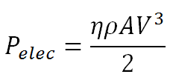
Turbine
Size of turbine determines the power available:
Robot will require 25W of power including power loss to power converter inefficiency
Diameter of turbine is 23.8 cm
Notes:
20sec

Slide 9
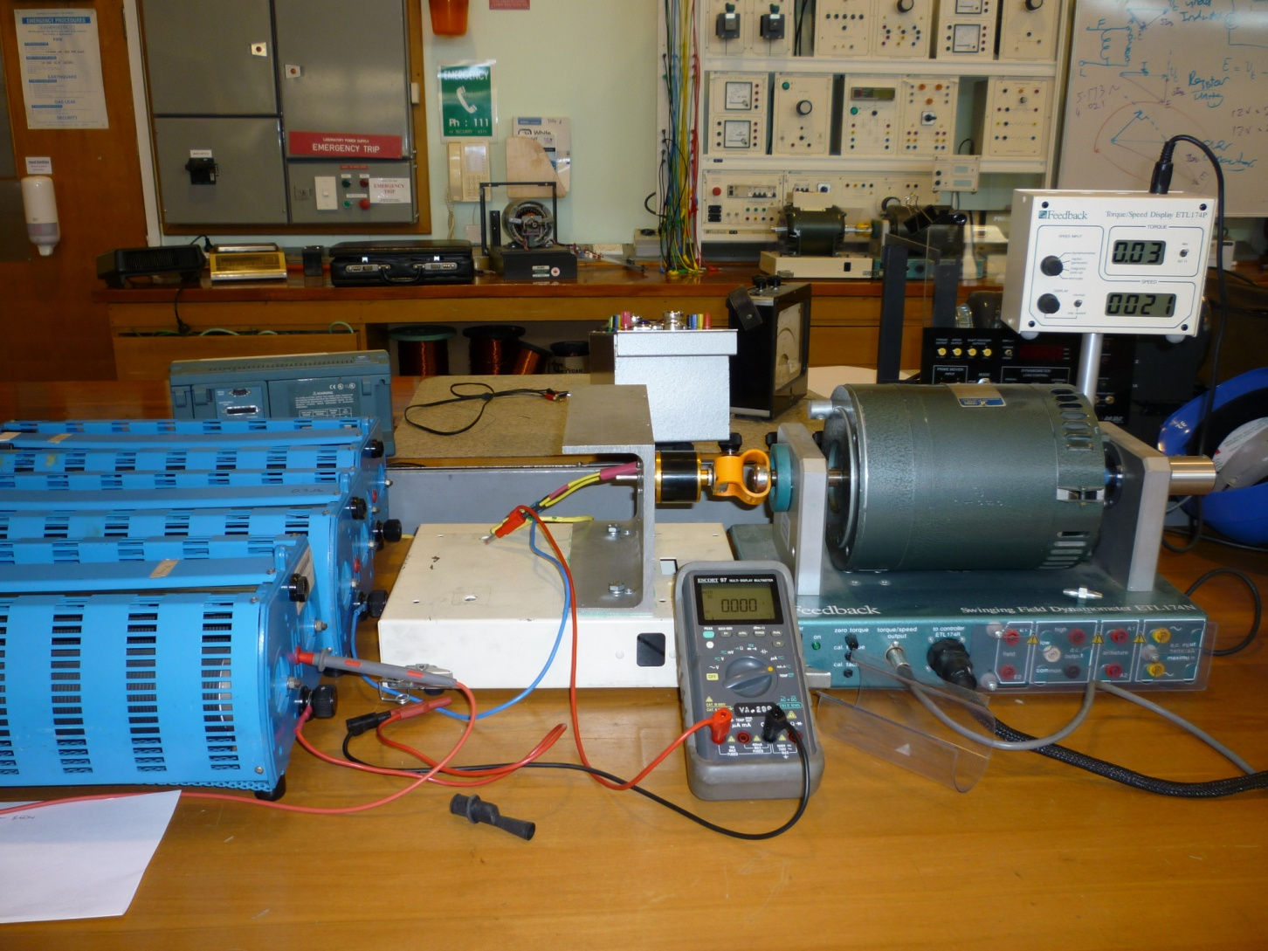
Testing – Generator

Slide 10
Testing – Generator
Notes:
20sec

Slide 11
Testing – Generator
R = 0.034 Ω
L = 0.000478 H
E
Notes:
10sec

Slide 12
Generator Test Results
Maximum Power Output at 0.5Ω = 70W
Speed required for 25W = 2400rpm
Voltage given at 2400rpm = 4.7 V
Current given at 2400 rpm = 5.4 A
Gearbox required is 19:1
Parallel output motors to decrease resistance seen by generator
Notes:
30sec

Slide 13
Power Converter
Power converter must convert from 4.7V, 5.4A AC to 5V, 2A DC
Notes:
20sec

Slide 14
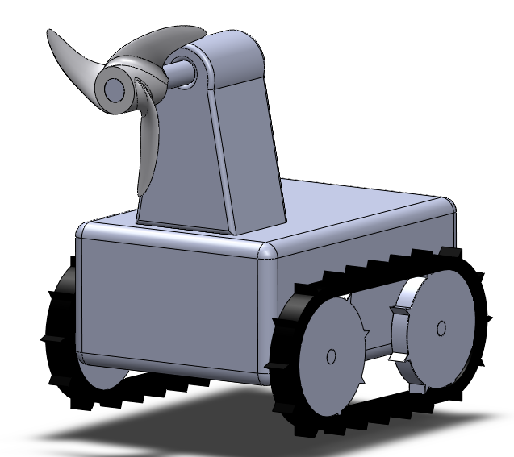
Design Concept
Notes:
10sec

Slide 15
Cost
Item | Cost
Generator | $180
Motor (x2) | $51
Turbine | $25
Tank tracks and wheels | $50
Enclosure | $50
Oil | $10
Total | $366
Notes:
10sec

Slide 16
Future Steps
Build tank tracks and use with motors to find exact characteristics
Choose and purchase power converter
Slowly build and test
Final test in water tunnel with current coming through
Notes:
25sec

Slide 17
Conclusions
Extreme Environment Investigated
Novel method of power generation found
A preliminary design made with future work in mind
Different Generator may be required.
Notes:
15sec

Slide 18
Questions?

