Slide 1
Prototype_Link
TASK 1 : Brief Explanation of the problem we’re solving
India has over 600,000 villages, yet virtually none of them exist in the training data that powers today's AI vision models. These models can identify the Eiffel Tower in milliseconds but fail to recognize a Durga Puja pandal, a kuchcha house, or a hand-pump in rural Rajasthan — not because the technology is weak, but because the data was never collected.
The root cause is structural: existing datasets are dominated by urban, western imagery scraped from the internet. Rural India doesn't have a strong internet-image footprint, so it simply doesn't appear. The result is AI that's blind to the everyday visual reality of 65% of India's population.This happens because: Existing datasets are urban-biased or Data is often poorly labeled or noisy.
Gramin Drishya solves this by turning communities into data contributors — enabling field agents, NGO workers, and local residents to capture 1,000 image-description pairs per village, building a dataset that reflects India as it actually is.

Slide 2
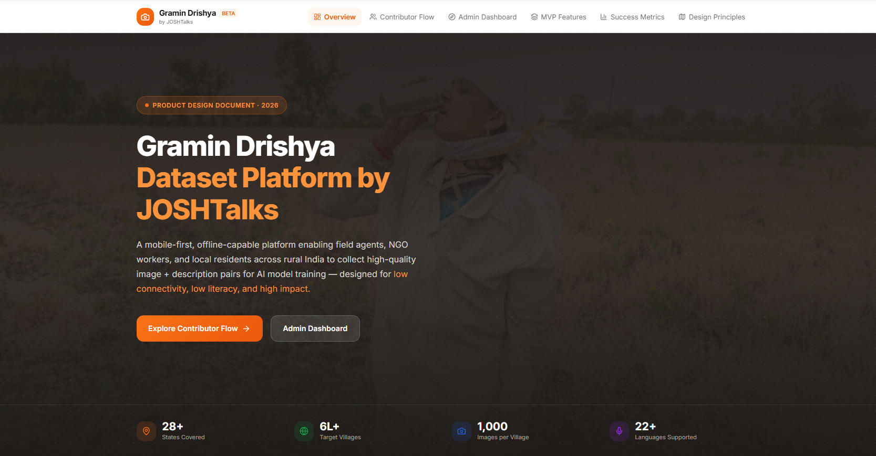
Prototype_Link

Slide 3
Key goals of our product :
The product has three interconnected goals.
First, geographic coverage at scale — we need to reach every district, not just the accessible ones, because an AI model trained on 40% of India will still be 60% blind.
Second, data quality that meets enterprise standards — every image-description pair needs to be accurate enough that an AI company can use it directly for training without additional cleaning, which means our approval rate needs to stay above 85%.
Third, contributor inclusivity — if the platform only works for educated, smartphone-savvy users, we'll recreate the same urban bias we're trying to fix. The product must work for a first-generation smartphone user which is even on a ₹7,000 Android with a 3G connection.
These three goals create natural tension: quality is easier to achieve with fewer, better-trained contributors, but coverage requires volume. The platform is designed to resolve that tension through automated quality checks at the device level, so we're not choosing between scale and quality.
Some of the success metrics that could be adopted:
Images per village (coverage)
Approval rate (quality signal)
District completion %
Avg. review turnaround time
Contributor retention rate

Slide 4
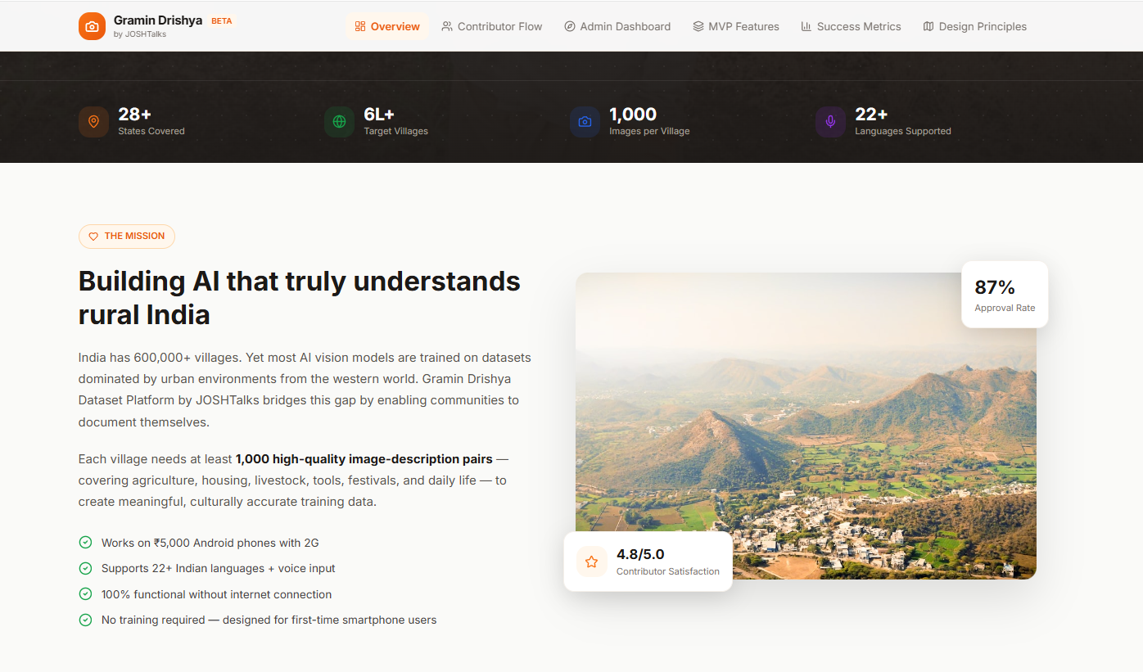

Slide 5
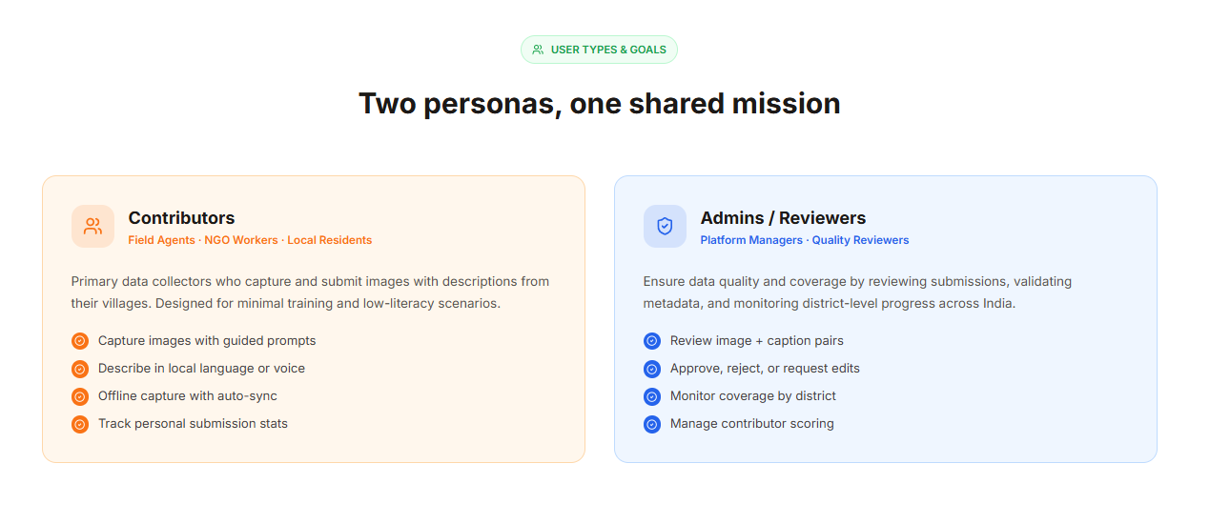
Our key users :
We are designing for two distinct user groups, and the product must effectively serve both.
Contributors are on-ground participants such as local residents, NGO workers, and volunteers. Their primary constraints are limited digital literacy, low connectivity, and language barriers. The product should therefore be mobile-first, visual, multilingual, and offline-capable, with simple guidance and instant feedback. It should feel intuitive and engaging—more like documenting their community than completing a formal task.
Admins are internal, tech-savvy users focused on quality control and coverage tracking. Their key need is efficiency at scale. The platform should provide fast filtering, clear approval workflows, and geographic insights to help them review large volumes of data consistently and identify gaps in coverage.

Slide 6
Walk through of the core user flow :
The contributor experience is designed to minimize effort and decision-making while ensuring valid submissions.
Users open the app (with offline support) and confirm their location via GPS or manual selection, ensuring accurate dataset tagging. They then capture or upload an image, supported by basic quality checks (e.g., blur detection).
Next, contributors add a description via voice or text, with multilingual support and prompts to encourage meaningful input. A final review screen allows users to verify image, location, and description before submission.
Submissions are uploaded instantly if online, or stored locally and synced later in low-connectivity scenarios. Users receive immediate feedback or rewards to encourage continued participation.
The admin flow enables efficient review through a centralized queue, with image, caption, and location details. Admins can approve/reject quickly, while a coverage dashboard highlights geographic gaps to guide contributor efforts.

Slide 7
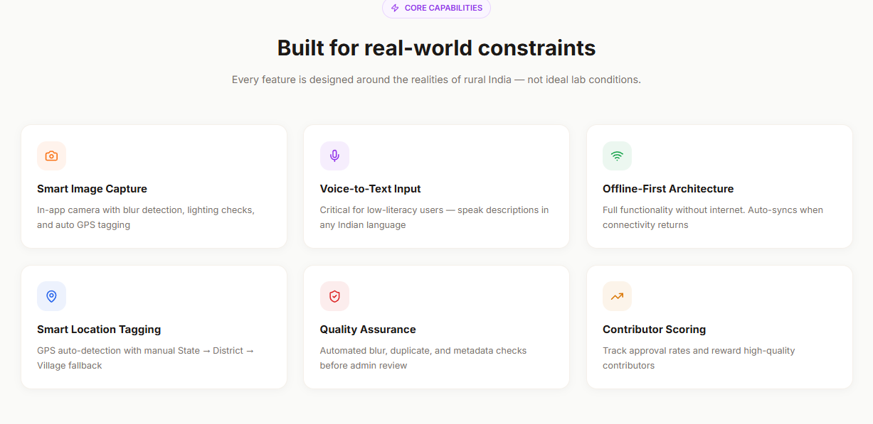

Slide 8
Contributor Core Flow
Login & Language Selection
User logs in via OTP and selects preferred language.
Location Confirmation
GPS auto-detects location; user confirms or manually selects (State → District → Village).
Capture / Upload Image
User takes a photo or uploads from gallery with basic quality validation.
Add Description
User provides a short description via voice or text (with prompts for completeness).
Review Submission
User reviews image, location, and description before final submission.
Submit & Sync
  Online: Instant upload
  Offline: Saved locally and auto-synced later
Feedback & Incentive
User receives confirmation, progress update, or reward points.
Admin / Reviewer Core Flow
Login to Dashboard
Admin accesses centralized review interface.
View Submission Queue
Submissions sorted by status (pending, flagged, recent).
Review Entry
Admin views image, caption, and location details.
Quality Check
Evaluate for relevance, clarity, and correct tagging.
Approve / Reject
  Approve: Submission added to dataset
  Reject: Reason selected (mandatory)
Monitor Coverage
Dashboard shows district-wise progress and gaps.
Take Action
Redirect contributor efforts to low-coverage areas.

Slide 9
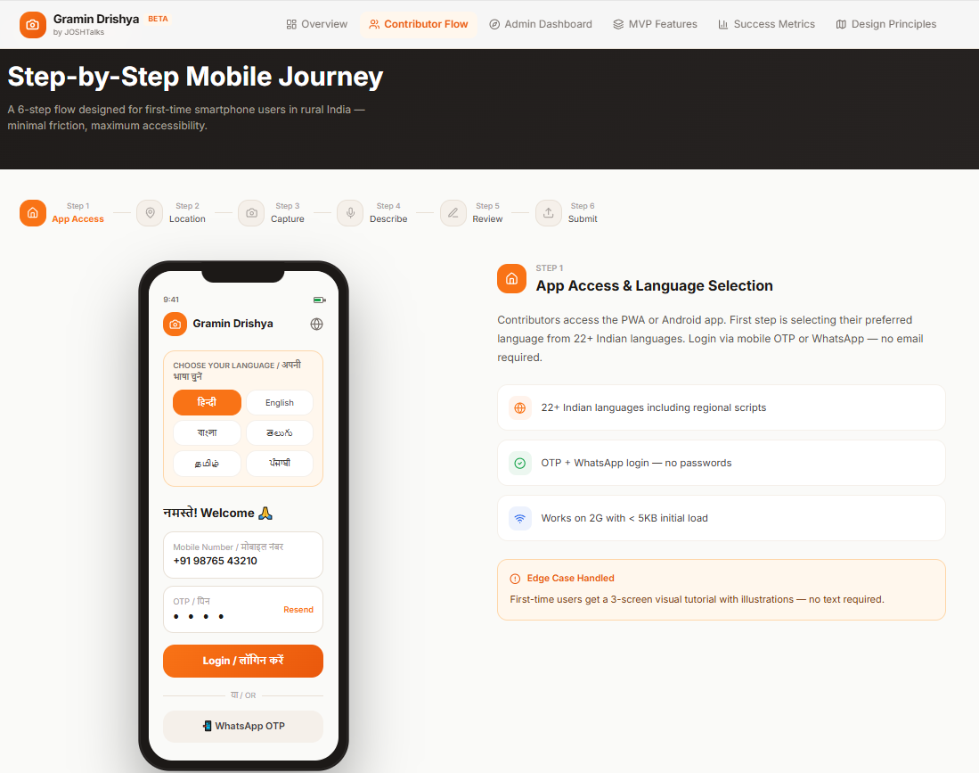

Slide 10
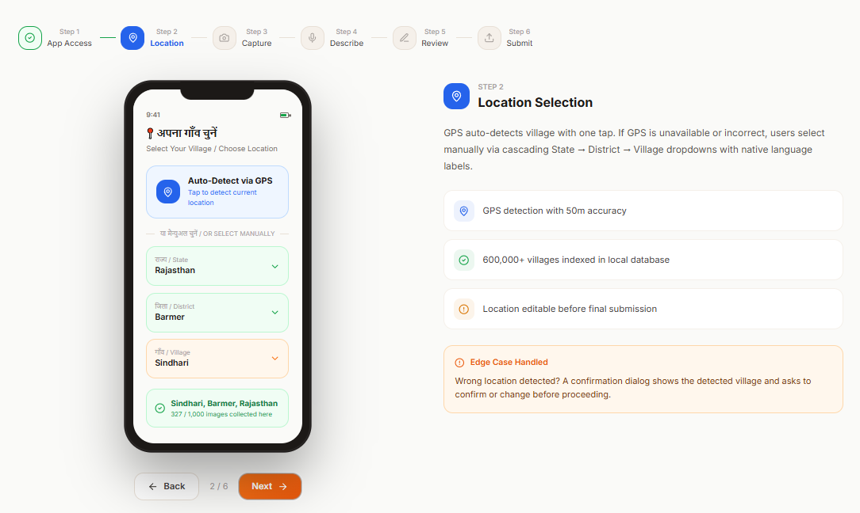

Slide 11
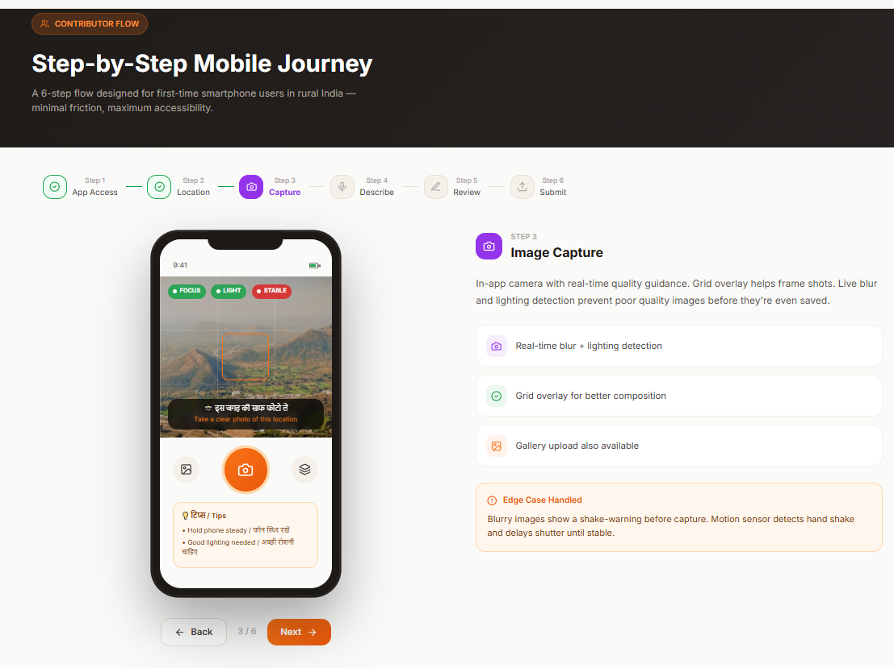

Slide 12
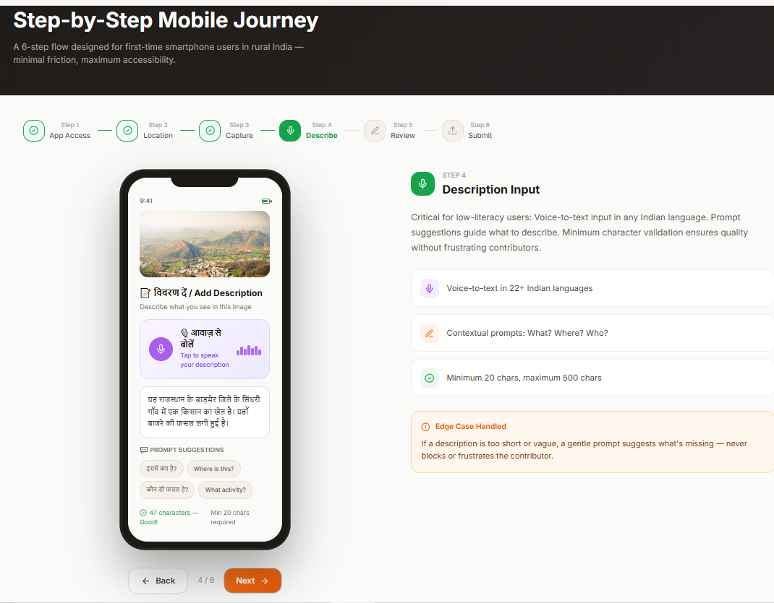

Slide 13
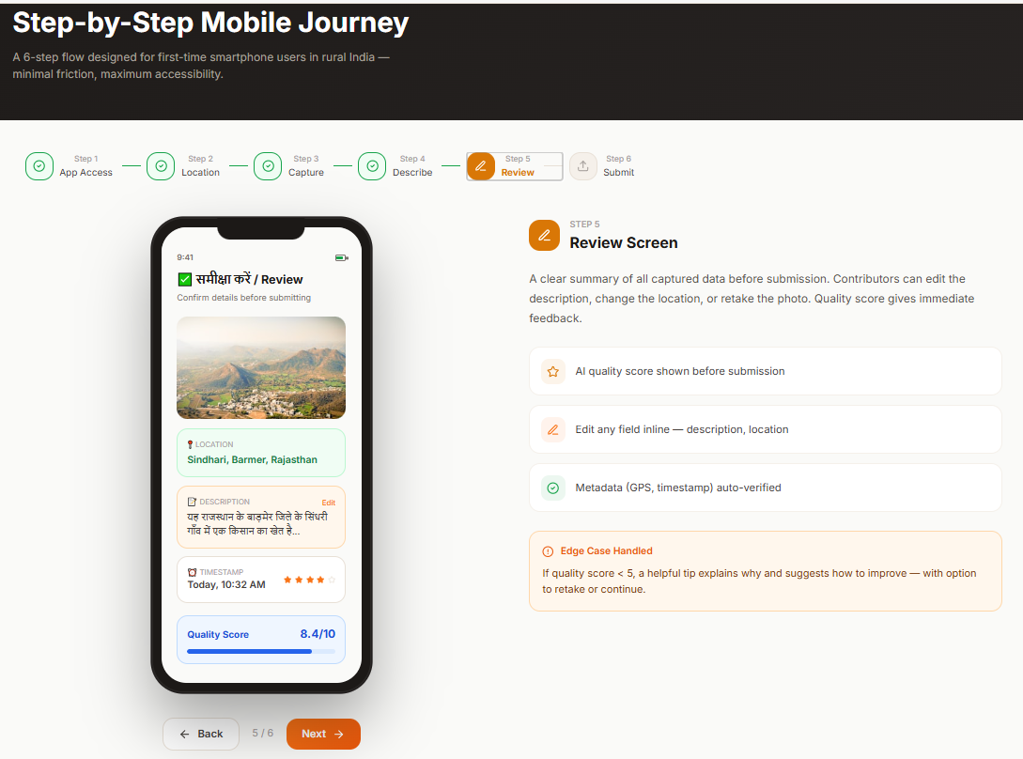

Slide 14
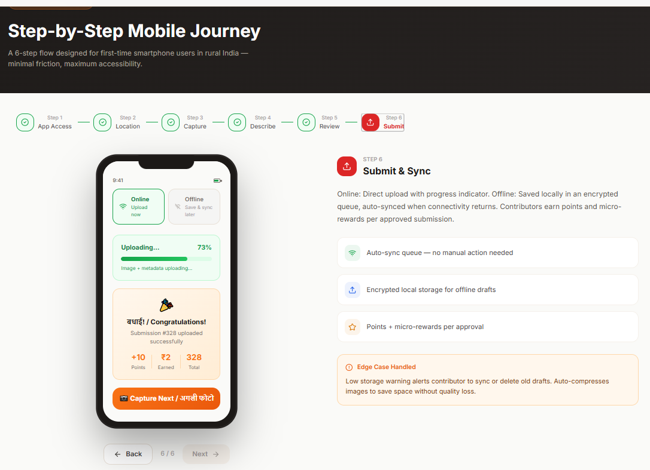

Slide 15
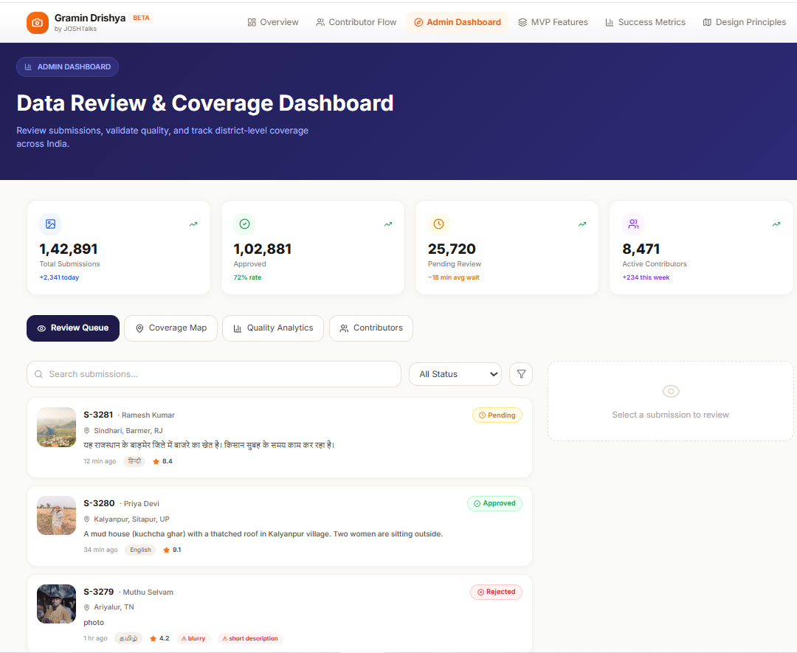

Slide 16
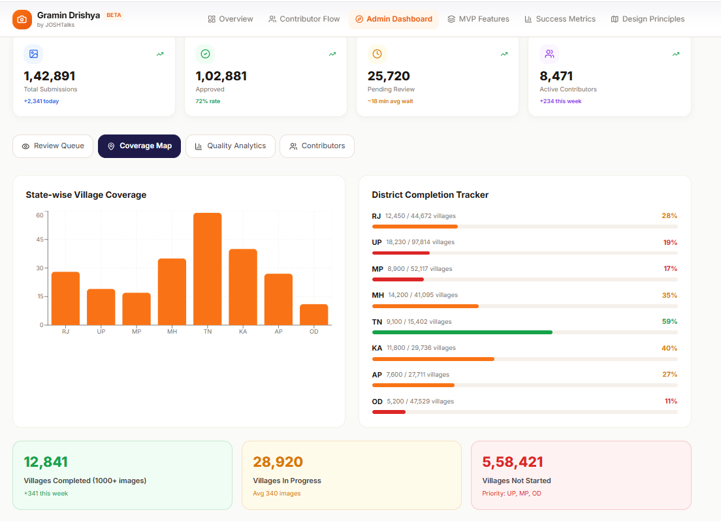

Slide 17
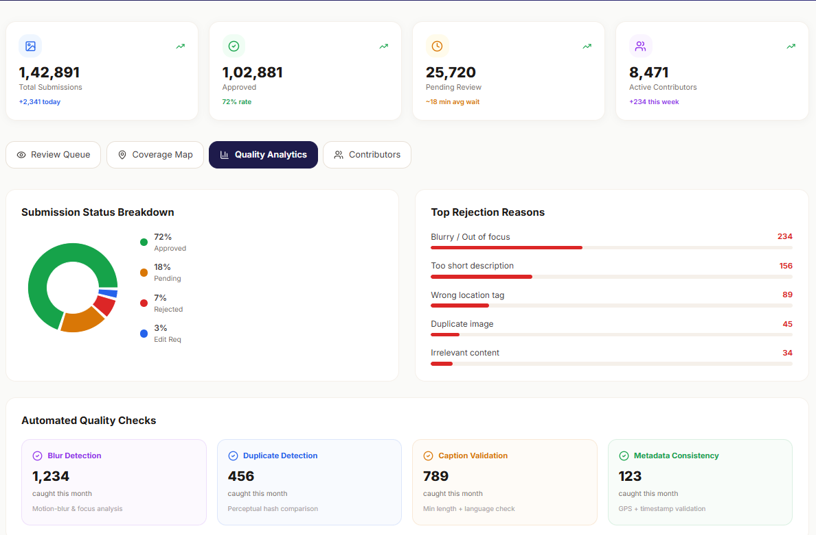

Slide 18
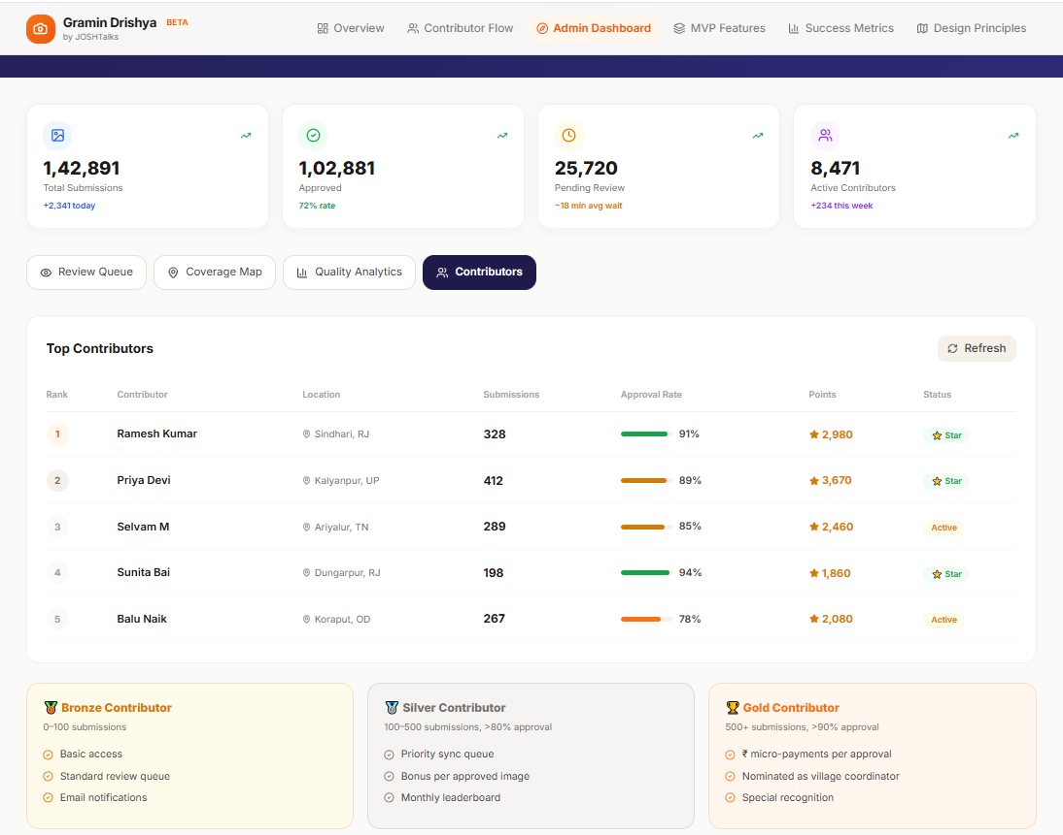

Slide 19
Key Challenges and Solutions
Connectivity Constraints
  Contributors often operate in low or no internet environments, making real-time uploads unreliable.
  Challenge extends beyond offline access to handling bulk uploads, partial syncs, retry failures, and device storage limits.
  Solution:
    Implement an offline-first system with encrypted local storage
    Enable auto-compression of images before saving
    Introduce retry logic and sync queues
    Provide low-storage alerts prompting users to sync
Data Quality Assurance
  Data quality is primarily a human judgment challenge, not just a technical one.
  Automated checks (e.g., blur detection, minimum caption length) can only catch surface-level issues.
  Contextual errors (e.g., incorrect descriptions) require manual validation.
  Solution:
    Maintain a mandatory human review layer (admin verification) in MVP
    Introduce a contributor quality scoring system based on approval rates
    Gradually prioritize high-quality contributors to reduce review load over time
Location Accuracy
  Small GPS inaccuracies can result in incorrect village tagging, compromising dataset integrity.
  Sole reliance on GPS is insufficient for precise labeling.
  Solution:
    Add a manual confirmation step displaying village name and submission count
    Create a user verification checkpoint to ensure correct location tagging

Slide 20
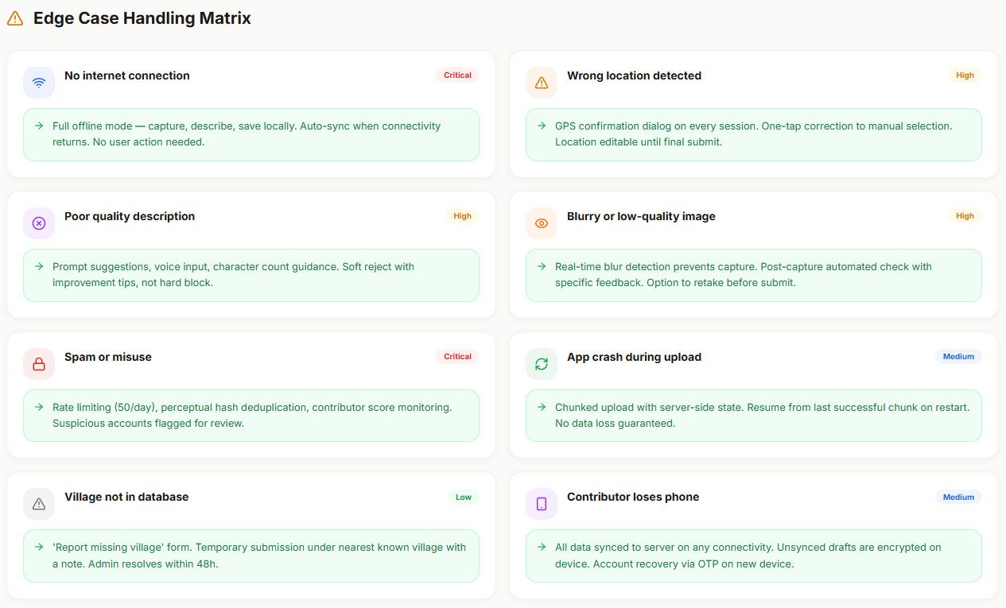

Slide 21
What features would you include in the MVP ?
Guiding Principle:Define the minimum features required to collect valid, high-quality image–description pairs.
Contributor-Side Features
Language-Aware Onboarding
  Problem: Users may not understand instructions due to language barriers
  Solution: Multilingual onboarding ensures accessibility and usability
GPS-Assisted Location Selection (with Manual Override)
  Problem: Incorrect location tagging can corrupt dataset quality
  Solution: GPS + manual confirmation ensures accurate geographic labeling
In-App Camera with Basic Quality Checks
  Problem: Low-quality or unusable images reduce dataset value
  Solution: Real-time checks (e.g., blur detection) improve input quality
Voice & Text Description Input
  Problem: Low literacy limits ability to provide descriptions
  Solution: Voice input enables broader participation and richer data
Offline-First Storage with Background Sync
  Problem: Poor connectivity disrupts submission flow
  Solution: Local storage and delayed sync ensure uninterrupted usage
Admin-Side Features
Review Queue (Image + Caption + Location)
  Problem: Need for efficient validation of large submission volumes
  Solution: Centralized queue enables structured review
Approve / Reject with Reason
  Problem: Lack of feedback and quality control
  Solution: Ensures dataset integrity and contributor learning
Coverage Dashboard (State/District Level)
  Problem: Uneven data collection across regions
  Solution: Visibility into gaps enables targeted data collection

Slide 22
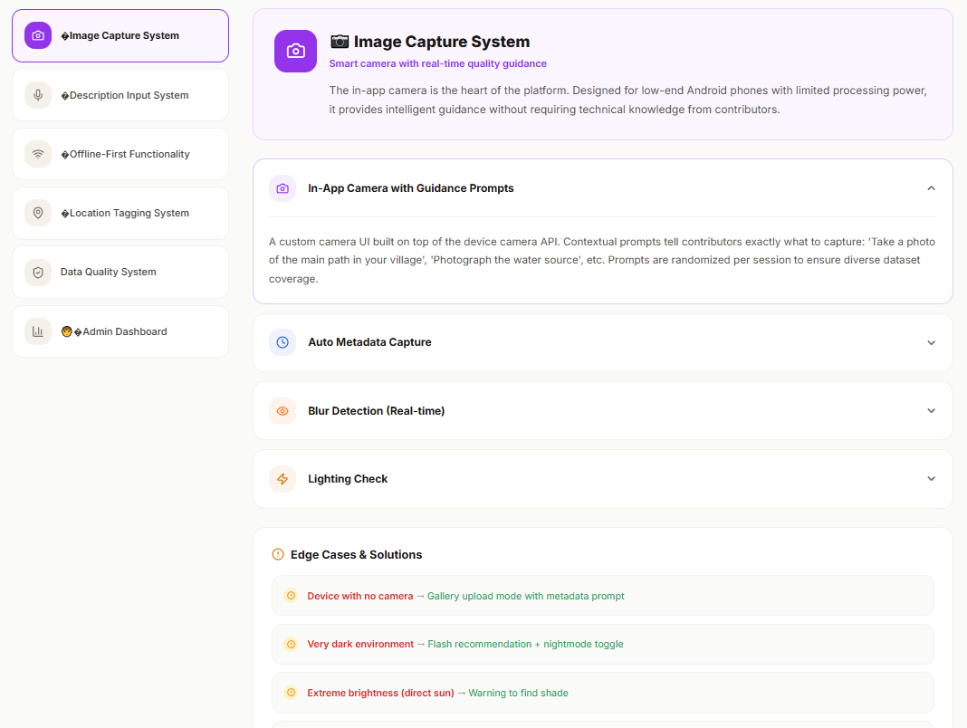

Slide 23
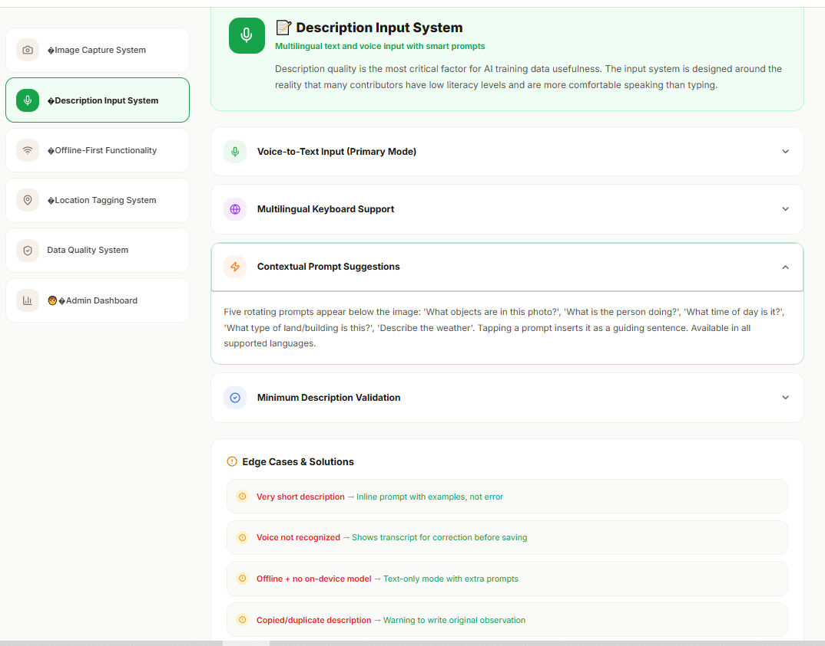

Slide 24
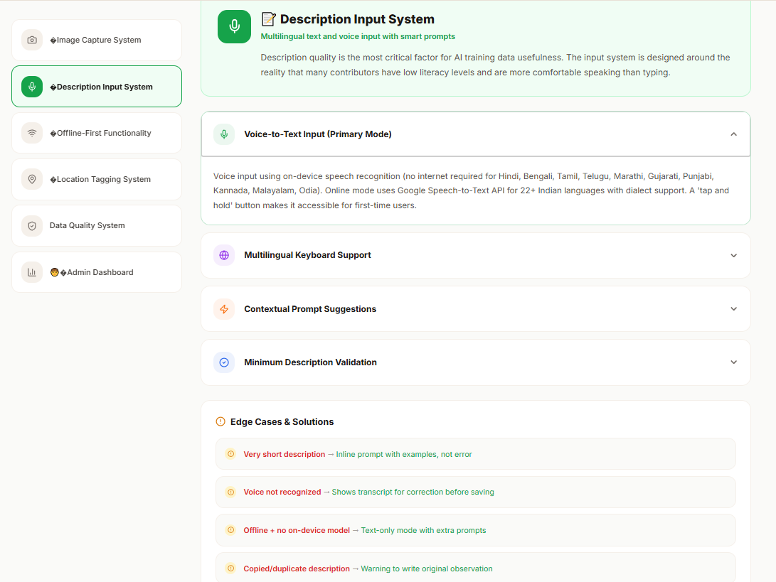

Slide 25
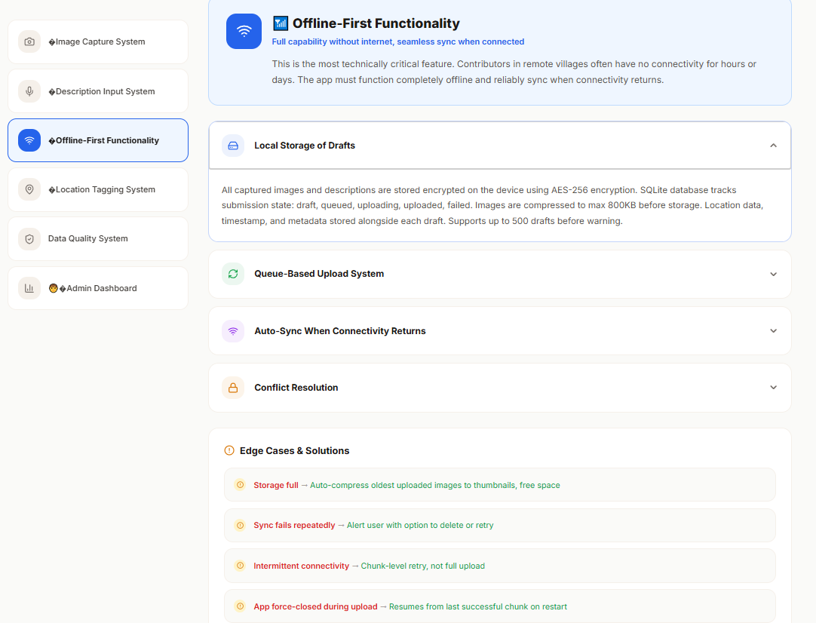

Slide 26
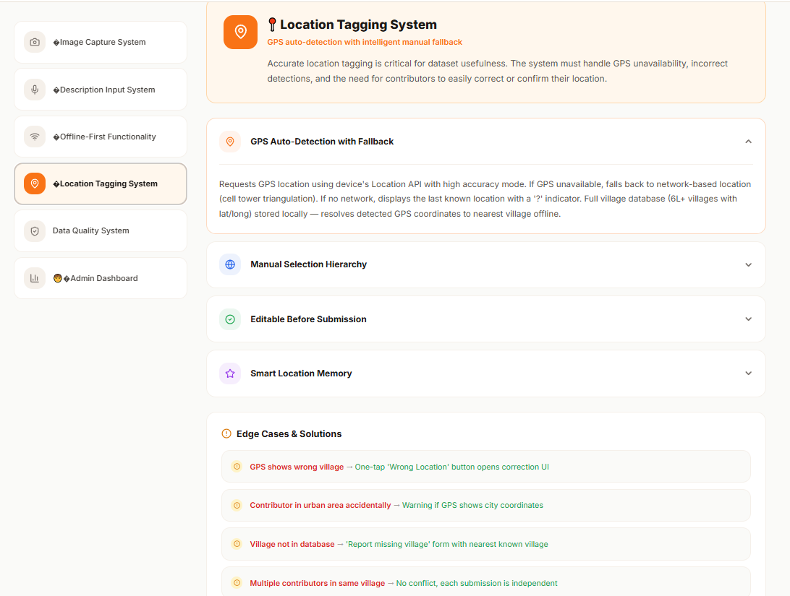

Slide 27
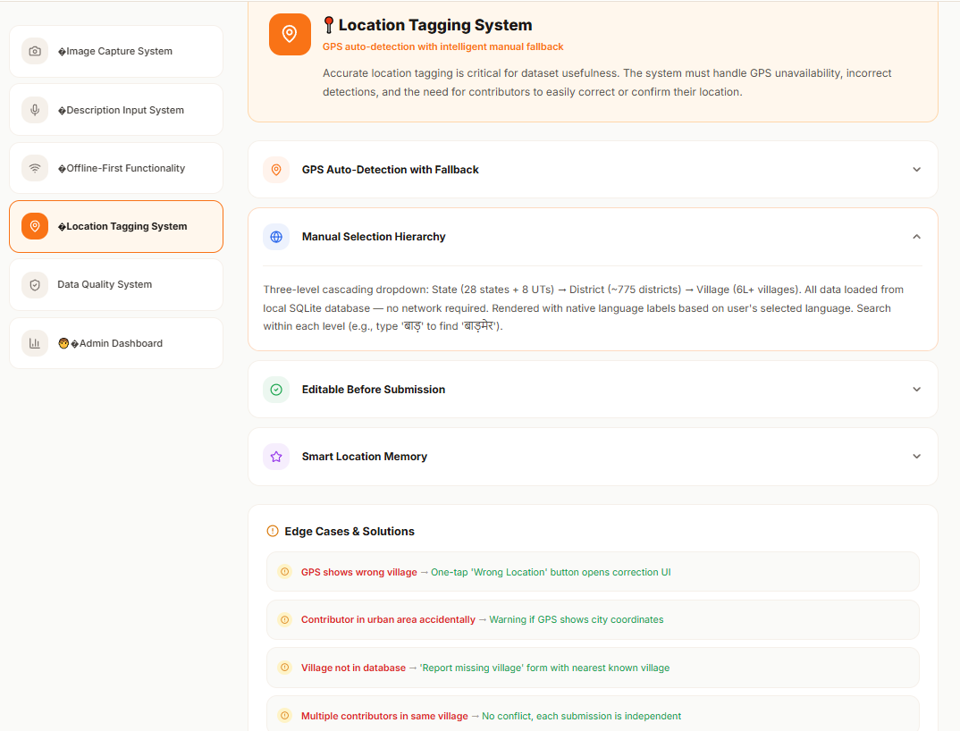

Slide 28
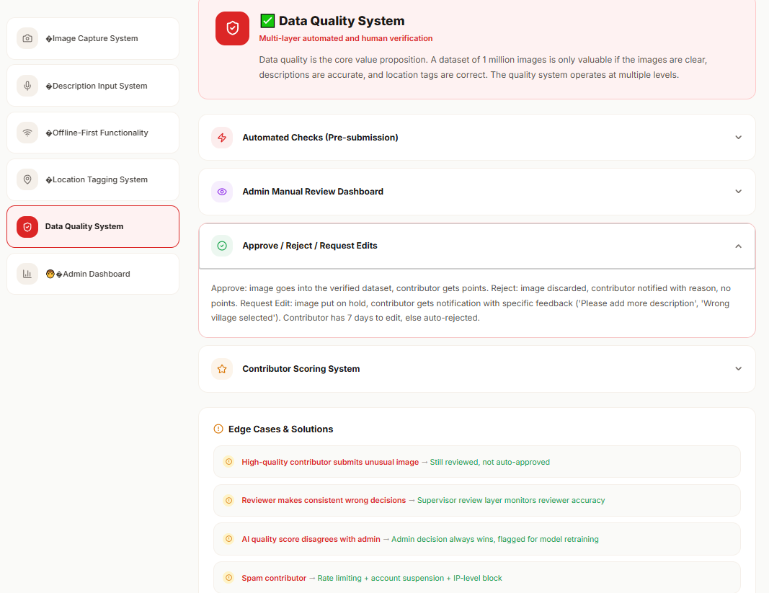

Slide 29
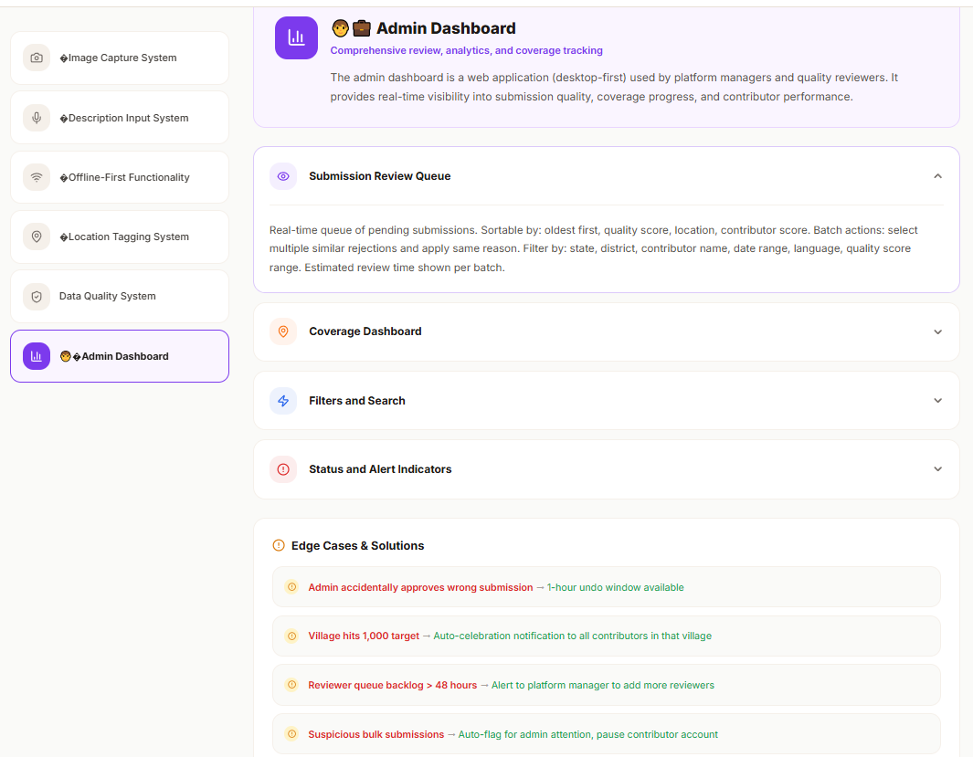

Slide 30
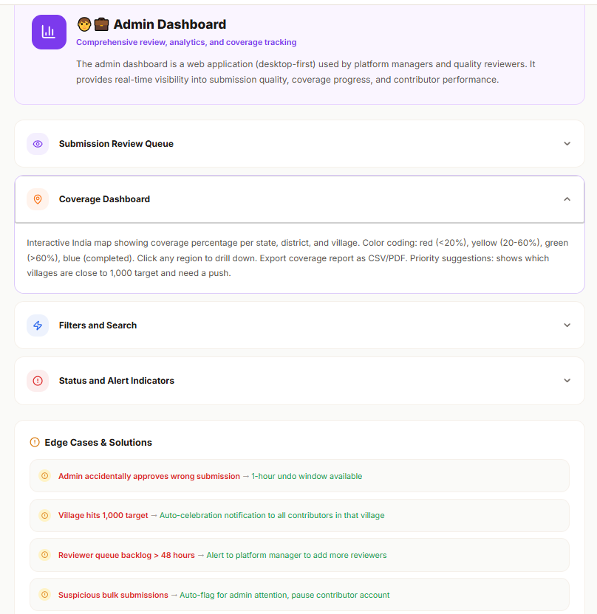

Slide 31
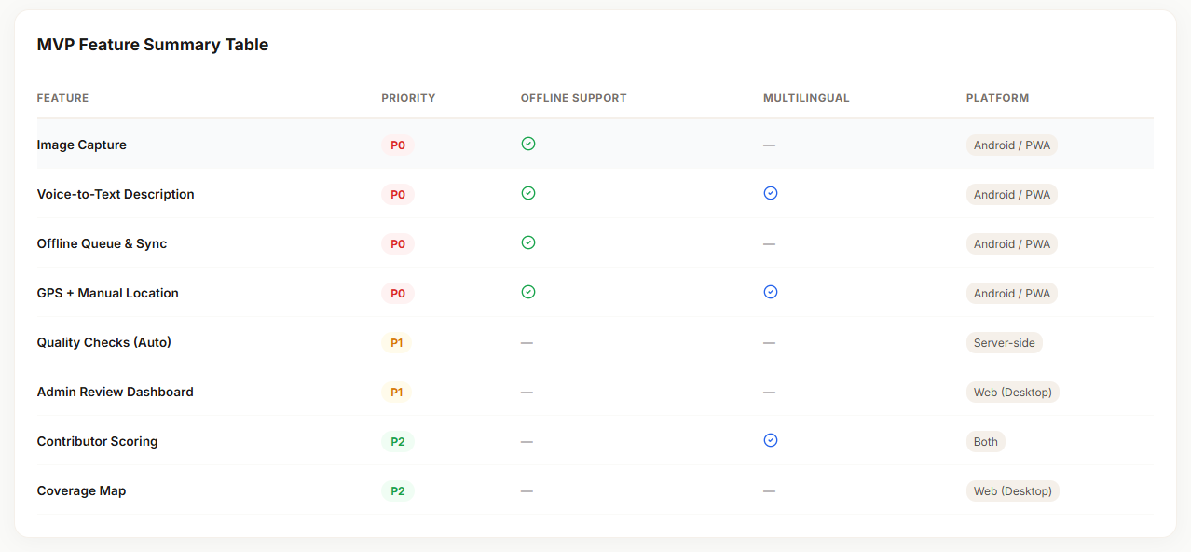

Slide 32
How will you ensure data quality?
Quality is enforced at three key stages:
At Capture:
On-device checks for blur and lighting → prevents low-quality images before submission.
At Submission:
Automated validation (caption length, duplicates, GPS data) →
  Invalid entries are blocked
  Uncertain cases are flagged for review
Post-Review:
Contributor quality scoring based on approval rate →
  High performers get fast-tracked (trusted badge)
  Low performers receive guidance and improvement tips

Slide 33
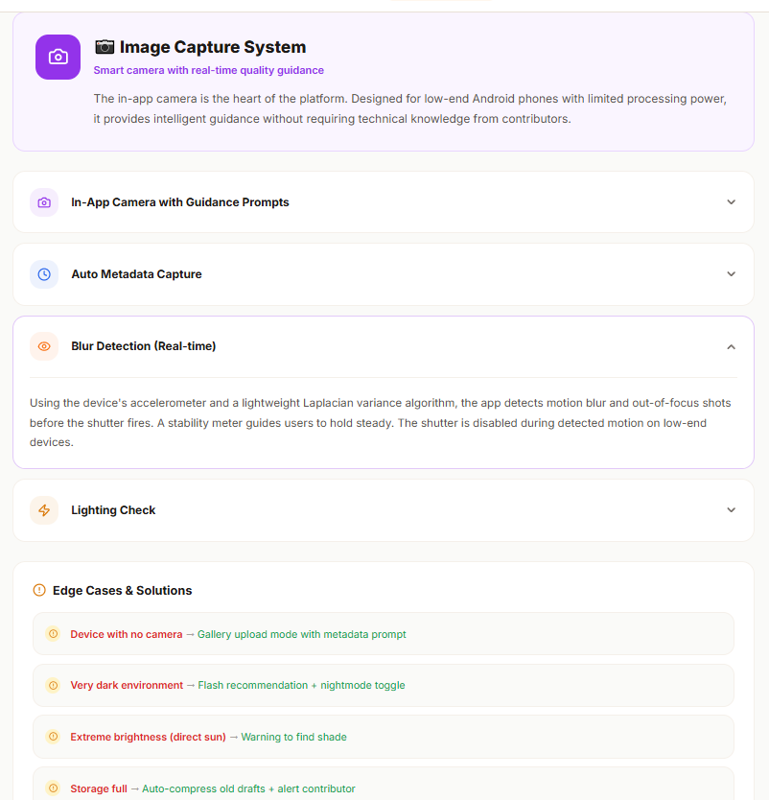

Slide 34
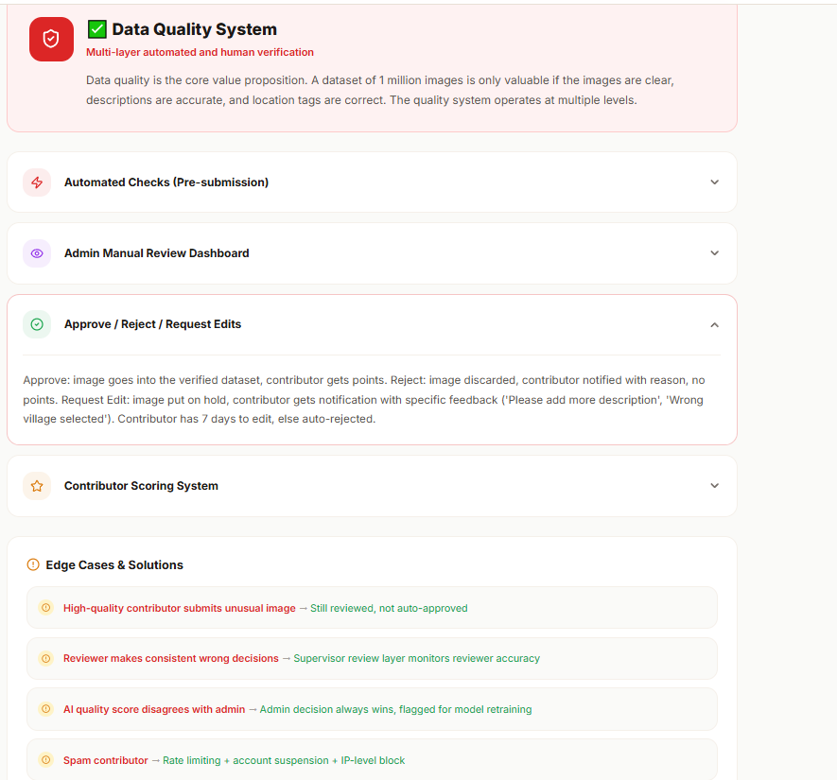

Slide 35
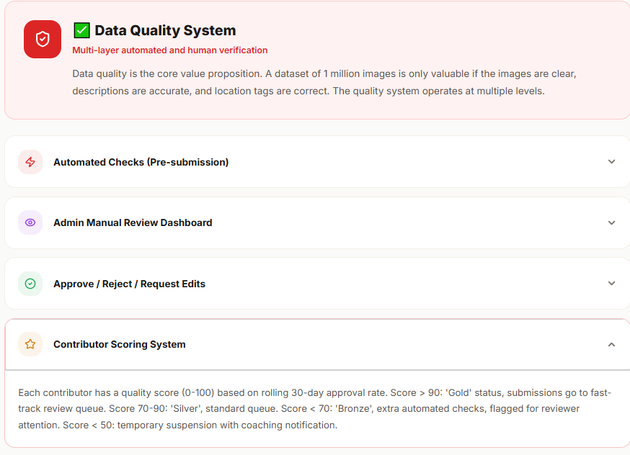

Slide 36
How would you measure success?”
Villages Completed
  Definition: Number of villages with ≥1000 approved image–description pairs
  Purpose: Directly measures progress toward building a complete and usable dataset
Quality Metrics
Approval Rate (>85% target)
  Problem: Ensures collected data is usable and meets quality standards
Average Quality Score
  Problem: Measures overall dataset reliability and consistency
Rejection Reason Distribution
  Problem: Identifies recurring issues in submissions (e.g., poor images, wrong descriptions)
Efficiency Metrics
Review Turnaround Time
  Problem: Delays in validation slow down dataset creation
Cost per Approved Image
  Problem: Ensures operational scalability and cost efficiency
Contributor Retention Rate
  Problem: High churn reduces long-term scalability and increases acquisition cost
Geographic Diversity Index
  Problem: Risk of over-representation from easily accessible regions
  Purpose: Ensures balanced data collection across all states, preventing regional bias

Slide 37
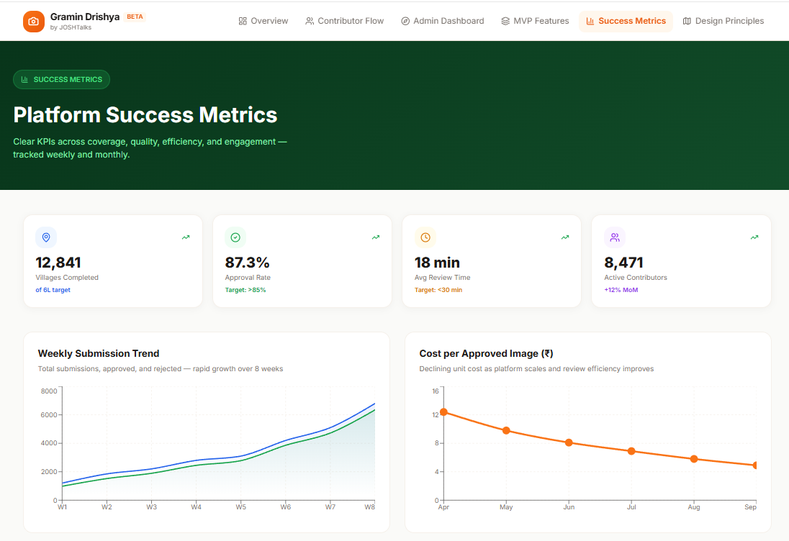

Slide 38
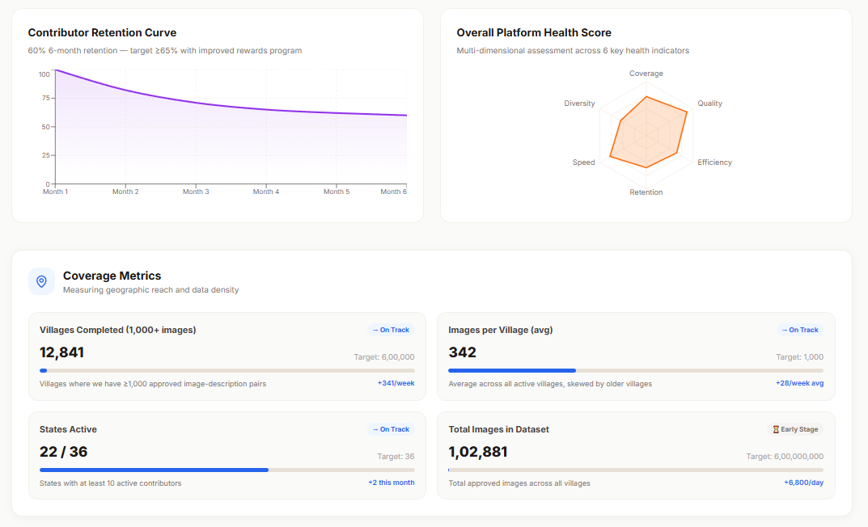

Slide 39
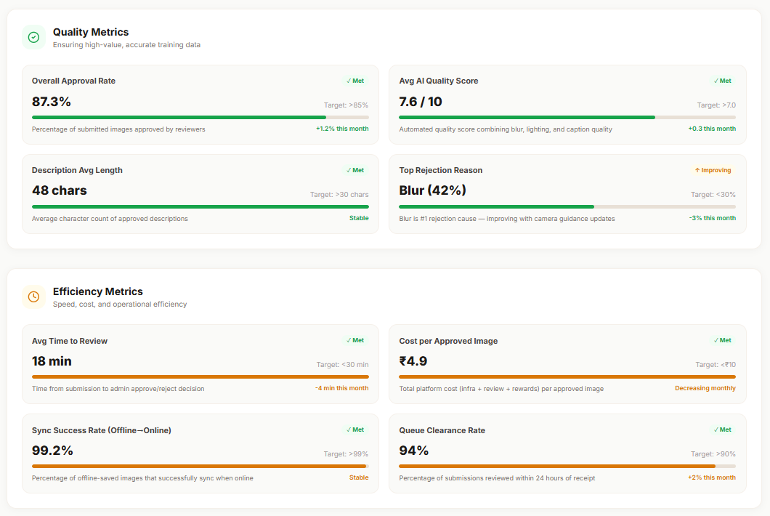

Slide 40
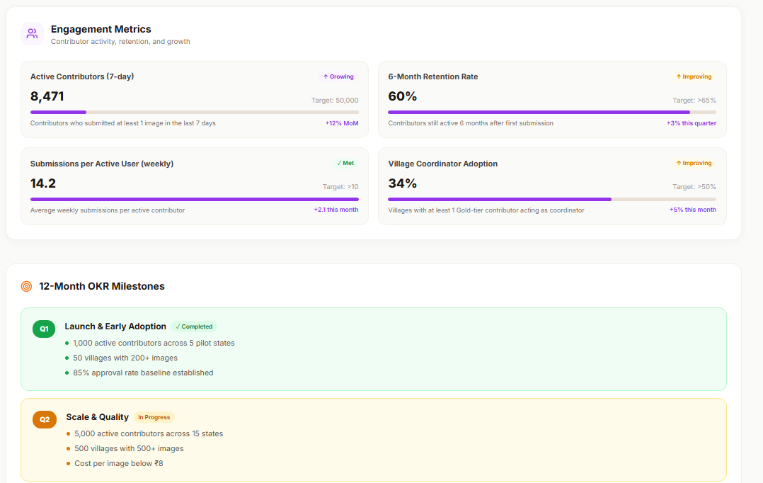

Slide 41
Post MVP features :
AI-Assisted Quality Scoring
  Purpose: Prioritize review queue by predicting approval likelihood
  Benefit: Enables admins to focus on edge cases, improving efficiency
Contributor Reputation & Incentive System
  Purpose: Reward contributors based on performance and behavior
  Benefit: Improves quality, motivation, and retention through targeted incentives
NGO & Institutional Partnerships
  Purpose: Leverage existing field networks for data collection
  Benefit: Ensures scalable, reliable contributor acquisition compared to individuals
These enhancements aim to improve efficiency, scalability, and contributor quality post-MVP.
Strengths of the Approach
Designed for Real-World Constraints
Built for users with low digital literacy and poor connectivity
Features like offline support, voice input, and simple UI ensure accessibility
Strong Quality Feedback Loop
Incorporates a contributor reputation system to track performance over time
Ensures continuous improvement in data quality
This approach ensures scalability, inclusivity, and long-term data quality.

Slide 42
Task 2: Identifying Low-Quality Transcribers
Part I — Warning Signs from Data Patterns
The detection system is built on three types of signals: time-based, behavior-based, and output-based. No single signal is conclusive on its own — but when multiple converge, the evidence becomes strong enough to act on. This multi-dimensional approach makes the system hard to game.

Slide 43
Warning Sign 1: Suspiciously Fast Task Completion (Time-Based)
What it tells us:
Transcription requires listening before editing. If someone completes a task faster than the audio takes to play, they physically couldn't have listened to it — making accurate transcription impossible.
How to measure it: Listen Ratio = time_taken_by_user / duration
A ratio below 1.0 means the user spent less time on the task than the clip's length. Aggregate per user:
Avg Listen Ratio = mean (time_taken / duration) across all tasks
Red flag thresholds:
Single task: Listen Ratio < 0.8 → flag task, hold payment
User-level: Avg Listen Ratio < 1.1 across 15+ tasks → warning trigger
Hard signal: Avg Listen Ratio < 0.8 across 20+ tasks → block consideration
False alarms: Expert native speakers on simple clips may work faster than average — but even they need the audio to finish playing. Apply only to clips longer than 10 seconds to avoid load-time distortion on very short clips.

Slide 44
Warning Sign 2: Near-Zero Editing Rate (Behavior-Based)
What it tells us:
Whisper makes errors — especially on regional Indian languages, accents, and noisy environments. A transcriber who never edits is either accepting AI output blindly or not engaging with the task at all. When edit rate approaches zero across many tasks, it's statistically implausible that Whisper was always correct.
How to measure it:
Edit Rate = tasks where is_edited = Yes / total tasks
Also check segment_character_per_second for users with low edit rates. High output speed combined with no editing is a strong combined signal.
Red flag thresholds:
Edit Rate < 10% across 20+ tasks → suspicious
Edit Rate = 0% across 15+ tasks + regional language audio → high concern
segment_character_per_second > 10 with Edit Rate < 10% → strong combined flag
False alarms: Clean audio batches — clear speakers, quiet backgrounds, standard dialect — can legitimately produce low edit rates for a session. Require 20+ tasks before triggering, and exclude onboarding tasks which are designed to be easier.

Slide 45
Warning Sign 3: High Text Similarity to Whisper Output (Output-Based)
This is the most direct quality signal of the three. All other signals are behavioral proxies — but this one measures the actual output. If a user's submitted text is nearly identical to Whisper's draft, they added no real value. The entire purpose of human review is to improve on what the AI produced. A user who consistently returns output that looks like Whisper's original is functionally indistinguishable from someone who submitted without reading.
How to measure it:
Use character-level similarity (Levenshtein distance normalized to 0–1 scale) comparing whisper_text vs user_text for each task:
Similarity Score = 1 - (edit_distance / max_length of the two strings)
Aggregate per user:
Avg Similarity Score = mean(similarity) across all tasks
Red flag thresholds:
Single task: Similarity > 98% with is_edited = No → flag
User-level: Avg Similarity > 95% across 20+ tasks → strong warning signal
Combined: Avg Similarity > 95% + Edit Rate < 5% + Listen Ratio < 1.1 → block consideration
Why this matters most: Every other signal asks "how did they behave?" — this one asks "did they actually improve the output?" That's the core job. A fast transcriber who genuinely improves accuracy is valuable. A slow transcriber who changes nothing is not. This signal directly connects to the product's core goal: reducing Word Error Rate.
False alarms: Whisper is occasionally near-perfect on a clip. A single high-similarity task means nothing. The threshold requires 20+ tasks and looks at the average across all of them, making accidental false positives statistically unlikely.

Slide 46
Warning Sign 4: Abnormally High Characters-Per-Second (Speed-Based)
What it tells us:
The segment_character_per_second field is a built-in behavioral fingerprint. Legitimate transcription — listening, reading, comparing, typing edits — has a natural speed ceiling. Consistently exceeding that ceiling suggests copy-pasting, auto-filling, or scripted submission.
How to measure it:
Flag if: segment_character_per_second > 10 AND time_taken < duration
Red flag thresholds:
segment_character_per_second > 10 on more than 25% of tasks → investigate
segment_character_per_second > 15 on any task → immediate task-level flag
False alarms: Very short clips with pre-known phrases can skew this. Filter to clips longer than 10 seconds.

Slide 47
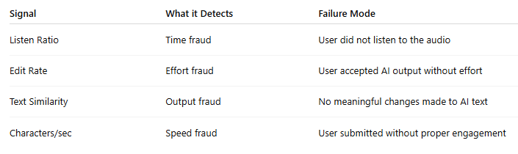
Why These Signals Work Together
Each signal is designed to capture a different type of low-quality or fraudulent behavior in the transcription process:
Individually, each signal can be manipulated. However, gaming all signals simultaneously while maintaining genuine transcription quality is highly unlikely, making the system robust.

Slide 48
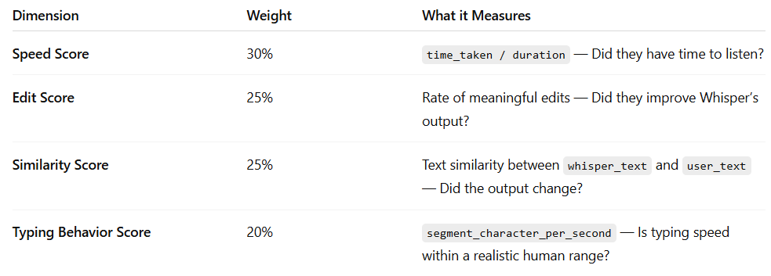
Part II — Automated System to Detect & Block Low-Quality Transcribers
The system is built on three principles: catch bad actors early, never block a good contributor on a single signal, and maintain the platform's stated goal of keeping annotation error below 2%. Every design decision traces back to one of these three.
Step 1: User Quality Score (Dynamic, 0–100)
Every contributor maintains a running quality score, updated after each task submission. The score is composite — no single dimension can cause a block alone, but all dimensions reflect a different aspect of genuine transcription work.
The similarity score is the most direct quality signal because it measures output, not just behavior. A transcriber can game speed and edit rate by making trivial one-character changes — but consistently high similarity to Whisper across 20+ tasks is nearly impossible to fake while doing real work.

Slide 49
Step 2: Three-Stage Response System
Stage 1 — Task-Level Flagging (Silent, No User Impact)
For every submitted task, compute automatically:
Listen Ratio = time_taken_by_user / duration
Similarity Score = character similarity between whisper_text and user_text
Speed Flag = segment_character_per_second > 10
Edit Flag = is_edited = No
Flag a task if two or more conditions are true:
Listen Ratio < 0.8
Similarity Score > 98%
Speed Flag = true
Edit Flag = true AND Similarity > 95%
Flagged tasks are held from payment and added to a priority human review queue. The contributor sees no disruption and continues working normally. This stage generates zero visible false positives.

Slide 50
Step 2: Three-Stage Response System
Stage 2 — Warning (Quality Score drops below 65)
Triggered when any two of the following persist across 10+ tasks:
Avg Listen Ratio < 1.1
Avg Text Similarity to Whisper > 95%
Edit Rate < 8%
CPS > 10 on more than 25% of tasks
Action On warning: Contributor sees an in-app message — "We noticed some submissions may not meet quality standards. Please ensure you're listening to the full audio before submitting." Their next 5 tasks go into mandatory human review regardless of content.
If 4+ of 5 pass review → warning cleared, contributor returns to normal flow
If 3+ of 5 fail review → escalate to Stage 3

Slide 51
Stage 3 — Account Block (All Signals Must Converge)
A block is triggered only when all three core conditions are simultaneously met across 20+ tasks:
Avg Listen Ratio < 0.8
AND Avg Similarity Score > 95%
AND Edit Rate < 5%
AND Suspicious Task Rate > 40%
. A contributor who is fast but edits meaningfully is probably just efficient. A contributor who rarely edits but takes their time probably got clean audio. Only when all signals converge does the evidence justify blocking.
On block:
Account suspended (not permanently deleted)
Earnings from flagged tasks withheld pending review
Contributor sees: "Your account has been temporarily suspended due to quality concerns. Contact support to appeal."
Ops team notified to complete human review within 48 hours before suspension becomes permanent

Slide 52
Step 3: Admin Dashboard
The system surfaces the following for internal ops teams ( ref images added earlier) :
Contributor quality score — current rolling score (0–100) per user, color-coded by risk tier
Flagged users list — sorted by severity, with breakdown of which signals triggered
Behavior trend charts — Avg Listen Ratio, Edit Rate, Similarity Score, and CPS distribution across the contributor population over time
Review queue — tasks awaiting human verification, prioritized by flag severity and time in queue
The dashboard serves two functions: operational (review flagged cases) and strategic (identify if thresholds need recalibration as contributor behavior or Whisper accuracy evolves).

Slide 53
Step 4: Safeguards Against False Positives
Given that this system affects contributor livelihoods, fairness is a hard requirement, not a nice-to-have.
Minimum task count: No warning or block triggers before 15 completed tasks. New contributors should not be penalized on insufficient data.
Onboarding exclusion: First 5 tasks — typically clean, controlled training samples — are excluded from all score calculations. These clips are designed to be easier and would artificially inflate similarity scores.
Normalization: All metrics are normalized by audio length and, where possible, language complexity. A 90-second clip in Bhojpuri and a 10-second clip in standard Hindi should not be evaluated on the same raw thresholds.
Never block on a single metric: No individual signal — however extreme — triggers a block without corroboration from at least one other signal, except for the three hard block rules listed above.
Appeal window: Any blocked contributor can appeal within 7 days. A human reviewer samples 10 of their tasks and makes the final determination. Appeal outcomes are logged and used to recalibrate thresholds quarterly.

Slide 54
Task 3: Designing a System to Evaluate Voice AI Conversations
Evaluation Criteria
A good evaluation framework uses criteria that are non-overlapping, independently measurable, and collectively cover the full scope of what makes a Voice AI conversation successful. Four criteria meet that bar.
Criterion 1: Task Completion
Definition:
Measures whether the AI successfully achieved the intended objective of the conversation (e.g., booking completed, information retrieved).
Why it Matters:
  Directly reflects the core purpose of the system
  A conversation may sound natural but is ineffective if the goal is not achieved
  Outcome is prioritized over conversational quality
Evaluation Scale (1–5):
  5: Task fully and correctly completed
  3: Partially completed with minor gaps
  1: Task not completed
.Weight in final score: 40% — highest weight because it directly reflects product value.
✅ Criterion 2: Understanding Accuracy
📌 What it measures
How well the AI:
Interprets user intent
Responds correctly to inputs
💡 Example
Human says: “I need a room for 2 nights”
AI correctly understands duration
🎯 Why it matters
Misunderstanding leads to:
Wrong actions
Frustrating conversations
✅ Criterion 3: Conversational Quality (Naturalness)
📌 What it measures
Fluency of speech
Tone, pauses, interruptions
Human-likeness
💡 Example
Smooth vs robotic responses
Proper turn-taking
🎯 Why it matters
Impacts:
User trust
Adoption of AI systems
✅ Criterion 4: Error Handling & Recovery
📌 What it measures
How well AI handles:
Confusion
Misunderstandings
Unexpected responses
💡 Example
Asking clarifying questions
Recovering from wrong assumptions
🎯 Why it matters
Real-world conversations are messy.
Good systems recover gracefully, not just perform in ideal cases.

Slide 55
Criterion 2: Understanding Accuracy
Definition:
Measures how accurately the AI interprets user intent, including correct recognition of entities (e.g., dates, names, preferences).
Why it Matters:
  Misunderstanding is a primary cause of conversation failure
  Errors in comprehension can compound across the conversation
  Separates understanding quality from task execution issues
Evaluation Scale (1–5):
  5: Fully accurate understanding across conversation
  3: Minor misunderstandings with limited impact
  1: Major misinterpretations affecting outcome
Weight:
  30% — critical for ensuring correct and reliable interactions

Slide 56
Criterion 3: Conversational Naturalness
Definition:
Evaluates the AI’s fluency, tone, pacing, and interaction style, including smooth turn-taking and absence of robotic responses.
Why it Matters:
  Impacts user trust and engagement
  Poor naturalness creates friction even if responses are correct
  Critical for user adoption in real-world applications
Evaluation Scale (1–5):
  5: Highly natural, smooth, human-like interaction
  3: Moderately natural with minor issues
  1: Robotic, awkward, or disruptive interaction
Weight:
  20% — supports overall user experience and adoption

Slide 57
Criterion 4: Error Handling and Recovery
Definition:
Measures how effectively the AI handles misunderstandings, ambiguity, or unexpected inputs during the conversation.
Why it Matters:
  Real-world conversations are unpredictable
  Strong systems recover gracefully through clarification and context retention
  Ensures robustness beyond ideal scenarios
Evaluation Scale (1–5):
  5: Effectively identifies issues and recovers smoothly
  3: Partial recovery with some gaps
  1: Fails to recover or produces incorrect responses
Weight:
  10% — emphasizes system robustness and reliability

Slide 58
2. Evaluator Interface Design
The interface should help evaluators work quickly, consistently, and without confusion — everything on screen must support this goal.
Task Description Panel:
Always visible goal of the conversation → keeps evaluation aligned and prevents personal interpretation of success.
Audio Player:
Main tool with playback controls (pause, rewind, speed) → enables efficient and flexible review.
Synchronized Transcript:
Highlights speech in real time with clear speaker distinction → helps spot errors and review faster without replaying audio.
Rating Panel:
Fixed criteria with clearly defined score labels → ensures consistent scoring and reduces subjectivity.
Comments Field:
Required for low scores (1–2), optional otherwise → ensures justification for poor performance.
Flag Control:
Allows marking critical issues (e.g., AI failure, bad audio) → routes cases for special review instead of normal processing.

Slide 59
Evaluator Workflow (End-to-End)
Task Review
  Evaluator reads task description to understand objective
Initial Listening (Orientation Pass)
  Plays full conversation once without rating
Detailed Evaluation
  Rates each criterion
  Rewinds specific segments for verification
Feedback Submission
  Adds mandatory comments for low scores (≤2)
  Optional comments for additional context
Review & Submit
  Reviews all ratings on summary screen
  Submits evaluation
System Logging
  Captures time spent, timestamps, and scores
Performance Benchmark
Target Evaluation Time: 2–4 minutes per conversation
Quality Check:
  Evaluations completed in <60 seconds flagged for review

Slide 60
3. Reducing Rating Inconsistency
Inconsistency comes from system design, not people — so the goal is to reduce subjectivity at every step.
Anchored Rubrics:
Every score point is clearly defined (not just high/low). Evaluators don’t guess — they follow precise guidelines available during rating.
Gold Standard Examples:
Evaluators train on pre-rated conversations with explanations, helping them understand what each score actually looks like in practice.
Calibration Rounds:
Regular shared evaluations ensure everyone stays aligned. Large deviations → flagged for retraining and feedback.
Hidden Benchmark Tasks:
Some tasks have known answers to track evaluator performance over time and measure reliability objectively.
Structured UI Constraints:
The system enforces complete ratings and required comments, preventing low-effort or incomplete evaluations.
Weighted Composite Scoring:
Final scores are calculated automatically using fixed weights, so evaluators focus only on individual criteria, not subjective overall judgment.

Slide 61
4. Measuring System Quality
The evaluation system itself must be assessed using four key metric categories:
1. Consistency Metrics
Inter-rater agreement (IRA): % of cases where evaluators score within ±1 point
→ Target: >80% (Task completion: >90%)
Evaluator variance: Measures scoring consistency of each evaluator
→ High variance = unstable understanding of rubric
2. Speed Metrics
Avg. time per evaluation: 2–4 minutes
Throughput: Tasks per hour per evaluator
Queue wait time: Should be <24 hours
→ Longer = insufficient evaluation capacity
3. Reliability Metrics
Benchmark accuracy: Agreement with gold-standard scores
→ Target: >85% (Retrain if <70%)
Re-evaluation rate: % needing a third review
→ Target: <15% (Higher = unclear rubrics)
4. System Health
Evaluator drop-off rate: Indicates friction in workflow
Flag rate: % of unusable conversations
→ High rates = interface or data quality issues

Slide 62
Bonus question - answer
When volume is high, the goal is not to replace human evaluators but to make their time count more. AI assists in :
Pre-Scoring
  AI generates initial scores for all criteria
  Evaluators validate or adjust after first listen
  Reduces effort and improves evaluation speed
Smart Prioritization
  AI ranks conversations by complexity or uncertainty
  High-risk cases → experienced evaluators
  Routine cases → standard evaluators
  Optimizes resource allocation
Automated Issue Highlighting
  Flags potential problem areas (e.g., silences, repetition, topic shifts)
  Enables targeted review instead of full replays
Transcript Summary Generation
  Provides concise summary of conversation and key issues
  Helps evaluators quickly orient context
A reliable evaluation system is built on clear criteria, intuitive interface, continuous calibration, and strong metrics. At scale, AI improves efficiency by handling routine tasks and highlighting complex cases, while human judgment remains essential for final quality decisions.

Slide 63
THANK YOU
By – Ravi Vinayak

