Slide 1

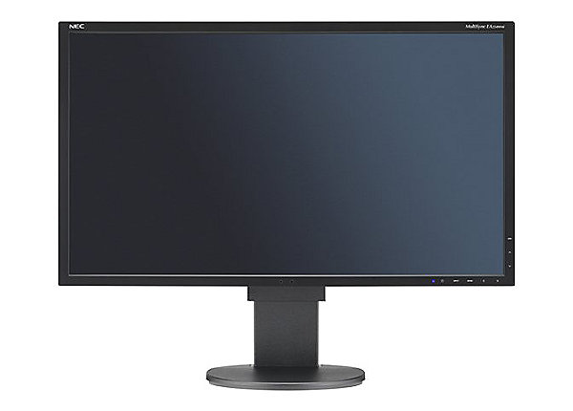
Client
Server
Startup
Begin game
join request
Assign client ID, register as new player
join response
keystate
Player actions
Update state
All player actions
Calculate state
worldstate
quit
timeout
Shutdown
Player removed
from game

