Slide 1

Extending the Set of Models Used In an Existing Return Prediction Exercise
Group 7
Baiyu Lu (02324852) , Dmitry Tertychnyy (02333891) , Gus Lee (01705898), Patrik Kovac (02283242)

Slide 2
Content
1. Project Objective
2. Expectations, Importance and Applications
3. Methodology 3.1. Ordinary Least Squares 3.2. Gradient Boosting Machine 3.3. RandomForest 3.4. Artificial Neural Network 3.5. LASSO
4. Analysis and Results
5. Conclusion

Slide 3
We have extended the set of models used for the data used by Gu, Kelly and Xiu and seen how they perform in comparison to the ANN (NN3) and LASSO models constructed in the exercise. We specifically focused on exploring the top 10 most important variables across all models.
Project Objective
Models
OLS (Ordinary Least Squares)
RandomForest
GBM (Gradient Boosting Machine)
ANN (Artificial Neural Network)
LASSO
Data
Dataset from Gu, Kelly, Xiu (2019) paper with stock returns from 1957 to 2016
94 stock characteristics + 8 macro variables
Notes:
*For value we lag the earnings yield by a quarter or 3 months due to publication lags - as usually the accounts are published 2-3 months after the quarter end. By lagging by 3 months, we remove the risk of any hindsight bias.

Slide 4
Expectations, Importance, and Applications
What do we expect?
Different lists of top 10 most important features for each model OLS model performing worse than more complex ML methods An overlap of most important variables across models
Why is it important?
By applying different ML techniques you can assess the robustness of your predictions A more comprehensive understanding of the feature importance that can be used for portfolio management strategies Minimizes bias and overfitting

Slide 5
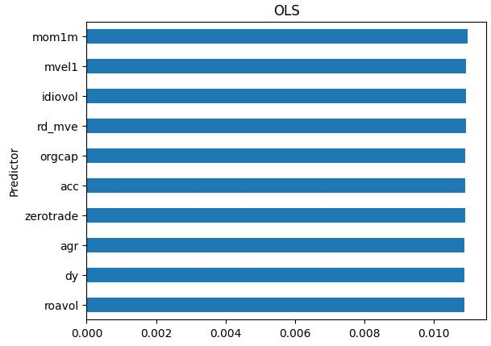
Methodology I. OLS - All Features
All features
Using rolling window validation to test model performance
No hyperparameters
Baseline model
Accuracy:

Slide 6
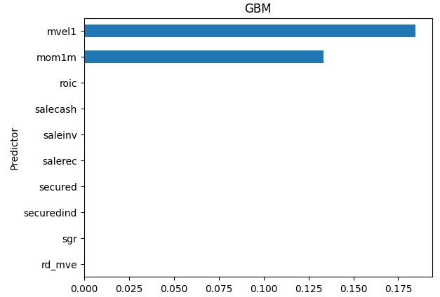

Methodology II. GBM
Ensemble learning method
Using only one fold (no rolling window), where:
Training set: 1957-03 to 2015-03
Test set: 2015-03 to 2016-12
Hyperparameters:
n_estimators = 100
max_depth = 2
Learning_rate = 0.01
Accuracy:
Notes:
Explain weird GBM results

Slide 7
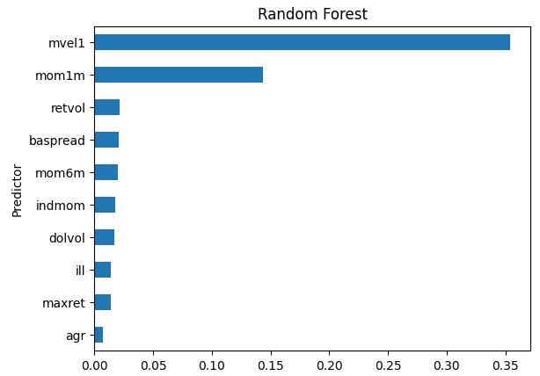
Methodology III. RandomForest
Using only one fold (no rolling window), where:
Training set: 1957-03 to 2015-03
Test set: 2015-03 to 2016-12
Hyperparameters:
n_estimators = 300
max_depth = 3
max_features = 10
Accuracy:

Slide 8
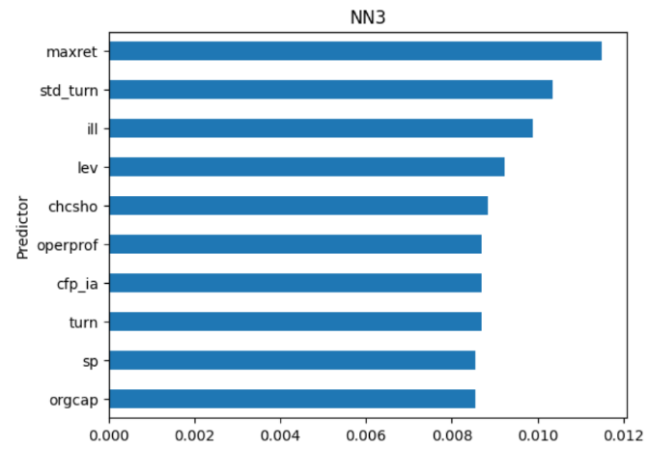

Methodology IV. ANN
Using NN3, as it was the best across three ANN models and were the closest to the paper’s results
Parameters:
Units per layer - NN3 (32, 16, 8, 1)
Activation function - ReLU
Batch size - 10,000
Epochs - 100
Early stopping regularization - patience = 5
Learning rate optimizer - ‘Adam’
Regularization - Batch normalization
Accuracy:

Slide 9
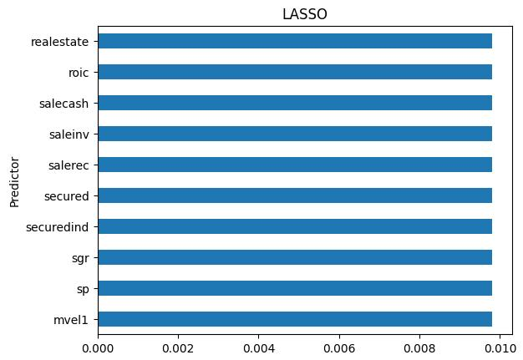
Methodology V. LASSO
Rolling window validation
No hyperparameters
Best Lambda = 0.01, obtained from coursework
Accuracy:

Slide 10
Analysis and Results
Model | Accuracy Score (OOS R2)
ANN | 0.00482
OLS | 0.00149
LASSO | 0.00126
RandomForest | 0.00016
GBM | -0.00066
Notes:
Accuracy in descending order
Explain why ANN was the best and OLS was the 2nd best

Slide 11
Analysis and Results
Feature | Occurrence
mvel1 | 4
mom1m | 3
rd_mve | 2
orgcap | 2
agr | 2
roic | 2
salecash | 2
Feature | Occurrence
saleinv | 2
salerec | 2
secured | 2
securedind | 2
sgr | 2
ill | 2
maxret | 2
Notes:
The rest of the features occur once

Slide 12
Conclusion
Best Model
ANN was the best performing model
Unexpectedly, OLS was the 2nd best performing model
Most Important Features
mvel1 and mom1m were the most frequent features across 5 models
1-month momentum captures the short-term trend and investor sentiment, providing valuable insights into price movements
Size reflects the company’s market cap, which influences liquidity, risk, and growth potential

Slide 13
Any Questions?

