Slide 1

ICBS Big Data
Team 4
Qinling Wu, Siyi Chen, Shukun Xing, Arman Sharifi, Patrik Kovac
Machine Learning in Currency Trading POC

Slide 2
Introduction
Carry Trade?
A currency carry trade is an investment strategy in which an investor takes advantage of the interest rate spread of two countries to generate excess profit
How does it Work?
The underlying concept of the carry trade involves buying the high interest-bearing asset and selling the low interest-bearing one, profiting on the difference
The Forward Premium Puzzle?
FPP states that countries that have higher interest rates tend to have their currency appreciate instead of depreciate against the lower interest rate currencies
Are Opportunities Scarce?
The violations of uncovered Interest rate parity have only become more egregious since the 2008 financial crisis, potentially creating more profitable trading opportunities.
1 March 2023
Machine Learning in Currency Trading
Notes:
What are they?
Zero-knowledge proofs
They are methods which allow one party to prove to another party whether a statement is true without divulging any other information to the secondary party
They are interactive as they require interaction between the parties e.g a person and a computer system as one has to validate and one has to prove
The three conditions for ZKP are
Completeness
"if the statement is true, an honest verifier (that is, one following the protocol properly) will be convinced of this fact by an honest prover." Wikipedia
Zero Knowledge
"if the statement is false, no cheating prover can convince an honest verifier that it is true, except with some small probability." Wikipedia
Soundness
" if the statement is true, no verifier learns anything other than the fact that the statement is true." Wikipedia
From this we can clearly see that ZK relies on a combination of Randomness and Interaction
What Problems do they Solve?
Benefits of Zero Knowledge
The main benefit is that of transferring information between parties without revealing any information about the data or about the knowledge of the parties
Thus we get a lot more privacy
Drawbacks of Zero Knowledge
The problems with Zero Knowledge arise due to the need for interaction and randomness. Since two parties are communicating with one another they need to interact multiple times to decrease the chance that proof is provided due to randomness.
Every new interaction requires this Interaction.
Two parties are not always available etc. And Hence Non-Interactive Zero Knowledge was Introduced.
Non-Interactive Zero-Knowledge Proofs
These are Zero-Knowledge proofs which require only one Iteration of communication between the two parties.
More will be explained later in the presentation.
Why should we care?
"Non-interactive proving reduces communication between prover and verifier, making ZK-proofs more efficient. Moreover, once a proof is generated, it is available for anyone else (with access to the shared key and verification algorithm) to verify." Etherium.org
What are ZK-SNARKs?
Zero-Knowledge Succinct Non-Interactive Argument of Knowledge
A type of Zero-Knowledge Non-Iteractive Knowledge Proof introduced in Zcash
Zero-knowledge - Able to verify the truthfulness of the statement without having any additional information
Succinct – Short and Can be verified Quickly
Non-Interactive – No need for the users to Communicate with one another more than once
Argument – Same as soundness - if the statement is true, no verifier learns anything other than the fact that the statement is true."
Knowledge – Just information

Slide 3
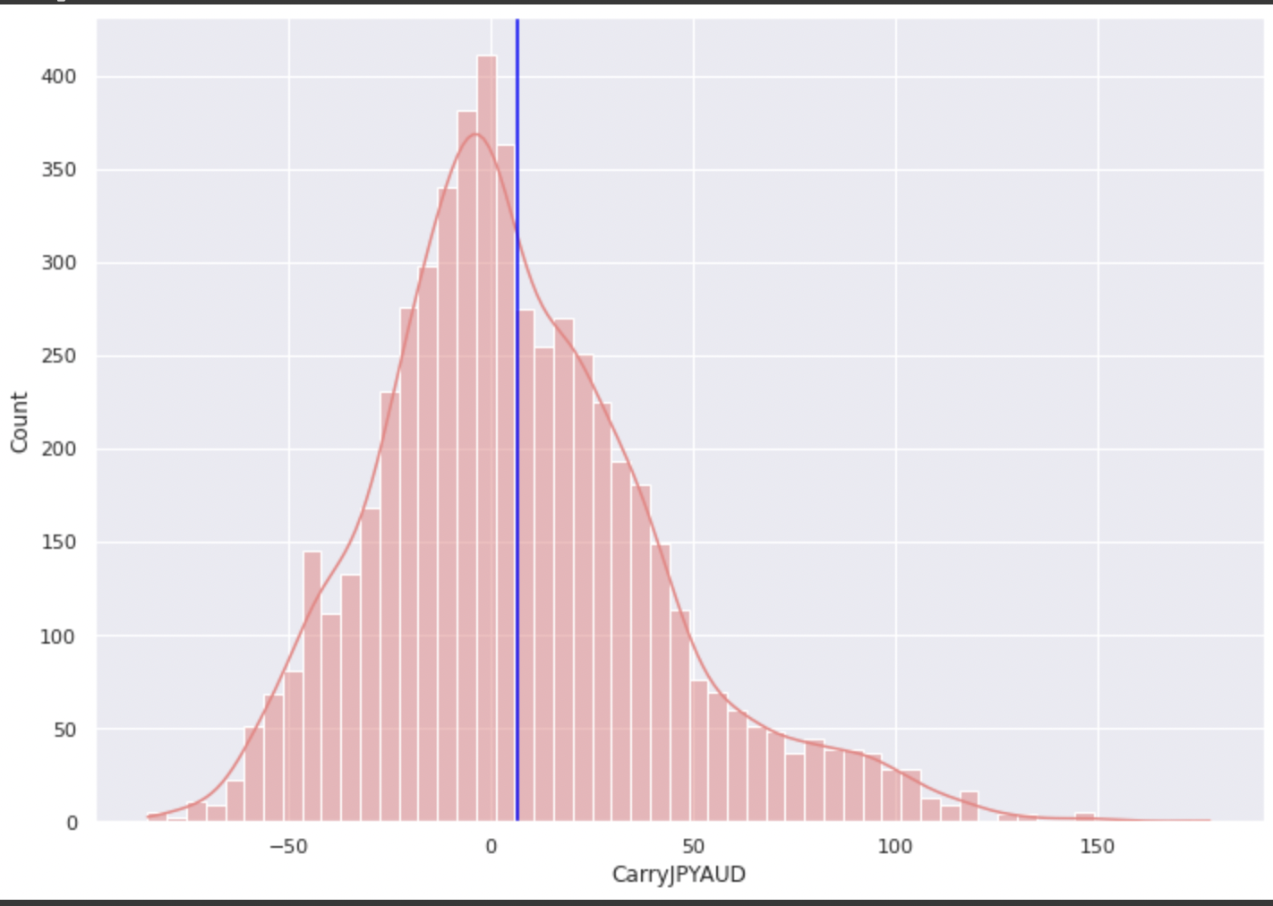
CCT Returns for AUD and JPY
Annualized Returns of 3 Month Currency Carry Trades for Japan and Australia
1 March 2023
Machine Learning in Currency Trading

Slide 4
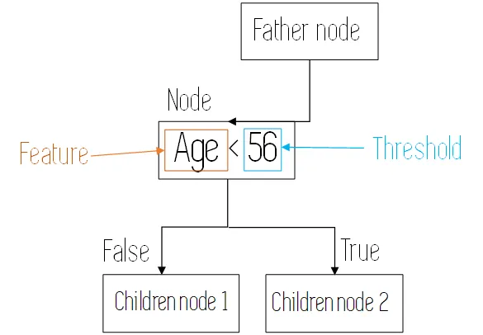
What are Gradient Boosted Decision Trees
Decision Trees
Image Source: https://towardsdatascience.com/decision-trees-explained-3ec41632ceb6
16 February 2023
Machine Learning in Currency Trading

Slide 5
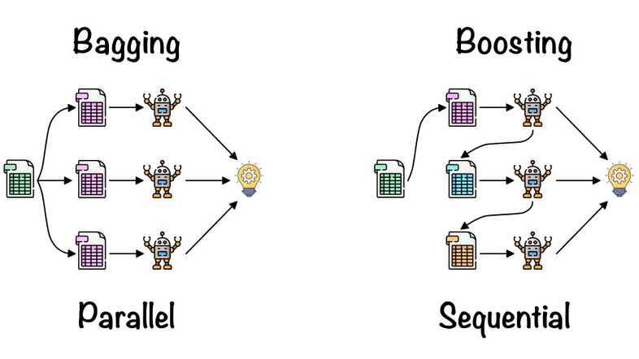
What are Gradient Boosted Decision Trees
Gradient Boosting
Image Source: https://www.ayush-mandowara.in/PredictiveAnalysis/14-Boosting/
1 March 2023
Machine Learning in Currency Trading

Slide 6
What is our Model
What are we Predicting?
Our strategy is to identify which currency carry trades have the highest returns. We then try to predict which currency carry trade will have the highest returns in the future
Why not predict returns?
Trying to predict returns is difficult. Trying to identify which currency pair will outperform another is less so, as the magnitude or direction of the performance does not matter only that its returns are higher than the rest of the set
1 March 2023
Machine Learning in Currency Trading
Notes:
What are they?
Zero-knowledge proofs
They are methods which allow one party to prove to another party whether a statement is true without divulging any other information to the secondary party
They are interactive as they require interaction between the parties e.g a person and a computer system as one has to validate and one has to prove
The three conditions for ZKP are
Completeness
"if the statement is true, an honest verifier (that is, one following the protocol properly) will be convinced of this fact by an honest prover." Wikipedia
Zero Knowledge
"if the statement is false, no cheating prover can convince an honest verifier that it is true, except with some small probability." Wikipedia
Soundness
" if the statement is true, no verifier learns anything other than the fact that the statement is true." Wikipedia
From this we can clearly see that ZK relies on a combination of Randomness and Interaction
What Problems do they Solve?
Benefits of Zero Knowledge
The main benefit is that of transferring information between parties without revealing any information about the data or about the knowledge of the parties
Thus we get a lot more privacy
Drawbacks of Zero Knowledge
The problems with Zero Knowledge arise due to the need for interaction and randomness. Since two parties are communicating with one another they need to interact multiple times to decrease the chance that proof is provided due to randomness.
Every new interaction requires this Interaction.
Two parties are not always available etc. And Hence Non-Interactive Zero Knowledge was Introduced.
Non-Interactive Zero-Knowledge Proofs
These are Zero-Knowledge proofs which require only one Iteration of communication between the two parties.
More will be explained later in the presentation.
Why should we care?
"Non-interactive proving reduces communication between prover and verifier, making ZK-proofs more efficient. Moreover, once a proof is generated, it is available for anyone else (with access to the shared key and verification algorithm) to verify." Etherium.org
What are ZK-SNARKs?
Zero-Knowledge Succinct Non-Interactive Argument of Knowledge
A type of Zero-Knowledge Non-Iteractive Knowledge Proof introduced in Zcash
Zero-knowledge - Able to verify the truthfulness of the statement without having any additional information
Succinct – Short and Can be verified Quickly
Non-Interactive – No need for the users to Communicate with one another more than once
Argument – Same as soundness - if the statement is true, no verifier learns anything other than the fact that the statement is true."
Knowledge – Just information

Slide 7
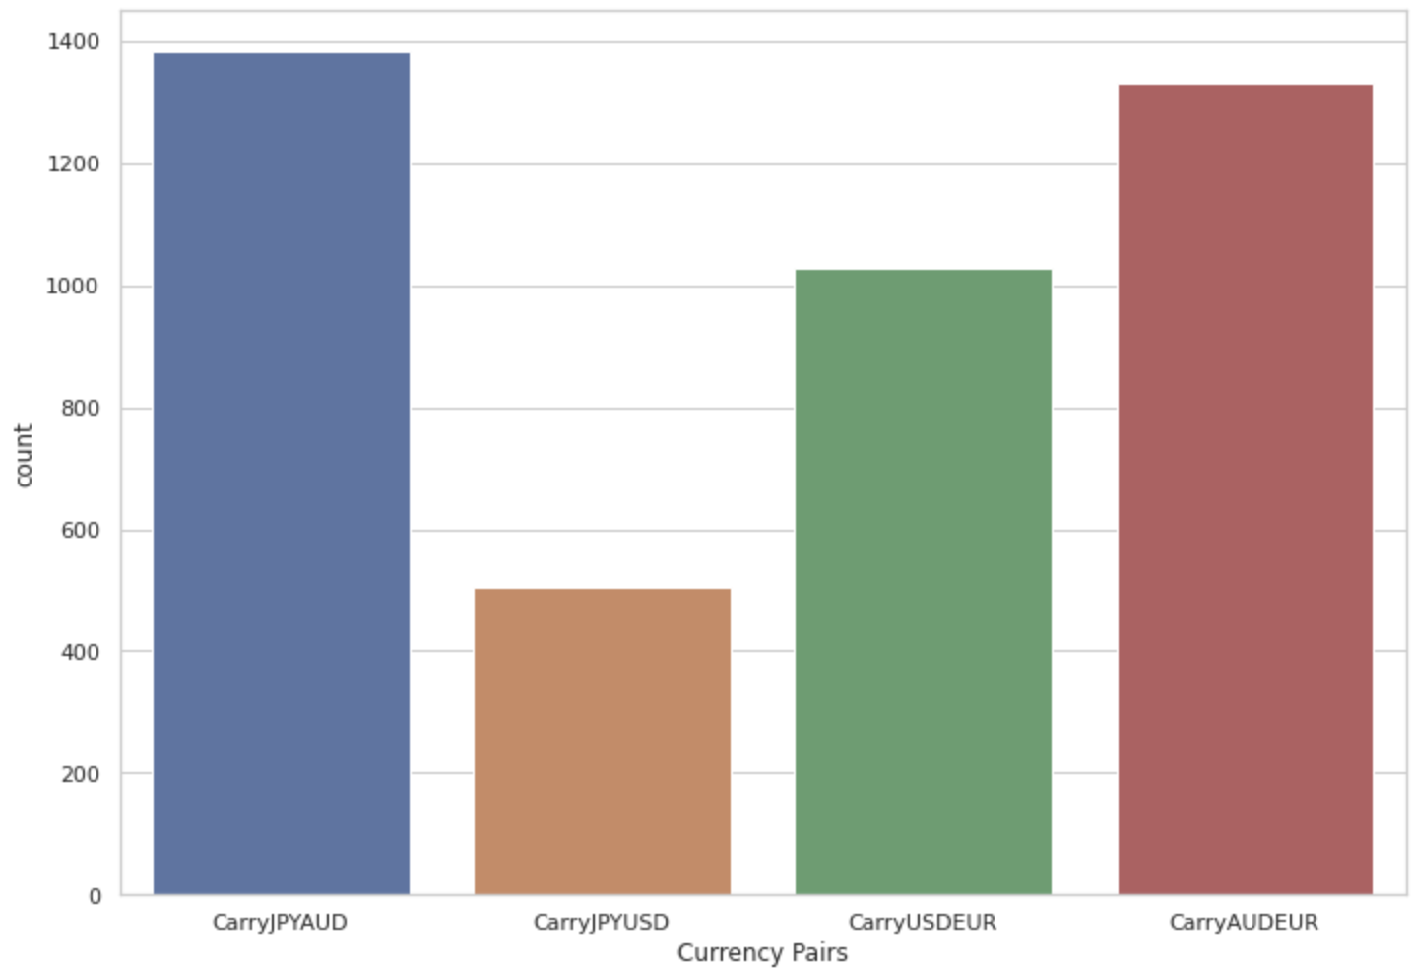
Classification
Counts of Periods for which X was best performing currency carry trade pair
1 March 2023
Machine Learning in Currency Trading
Notes:
What are they?
Zero-knowledge proofs
They are methods which allow one party to prove to another party whether a statement is true without divulging any other information to the secondary party
They are interactive as they require interaction between the parties e.g a person and a computer system as one has to validate and one has to prove
The three conditions for ZKP are
Completeness
"if the statement is true, an honest verifier (that is, one following the protocol properly) will be convinced of this fact by an honest prover." Wikipedia
Zero Knowledge
"if the statement is false, no cheating prover can convince an honest verifier that it is true, except with some small probability." Wikipedia
Soundness
" if the statement is true, no verifier learns anything other than the fact that the statement is true." Wikipedia
From this we can clearly see that ZK relies on a combination of Randomness and Interaction
What Problems do they Solve?
Benefits of Zero Knowledge
The main benefit is that of transferring information between parties without revealing any information about the data or about the knowledge of the parties
Thus we get a lot more privacy
Drawbacks of Zero Knowledge
The problems with Zero Knowledge arise due to the need for interaction and randomness. Since two parties are communicating with one another they need to interact multiple times to decrease the chance that proof is provided due to randomness.
Every new interaction requires this Interaction.
Two parties are not always available etc. And Hence Non-Interactive Zero Knowledge was Introduced.
Non-Interactive Zero-Knowledge Proofs
These are Zero-Knowledge proofs which require only one Iteration of communication between the two parties.
More will be explained later in the presentation.
Why should we care?
"Non-interactive proving reduces communication between prover and verifier, making ZK-proofs more efficient. Moreover, once a proof is generated, it is available for anyone else (with access to the shared key and verification algorithm) to verify." Etherium.org
What are ZK-SNARKs?
Zero-Knowledge Succinct Non-Interactive Argument of Knowledge
A type of Zero-Knowledge Non-Iteractive Knowledge Proof introduced in Zcash
Zero-knowledge - Able to verify the truthfulness of the statement without having any additional information
Succinct – Short and Can be verified Quickly
Non-Interactive – No need for the users to Communicate with one another more than once
Argument – Same as soundness - if the statement is true, no verifier learns anything other than the fact that the statement is true."
Knowledge – Just information

Slide 8
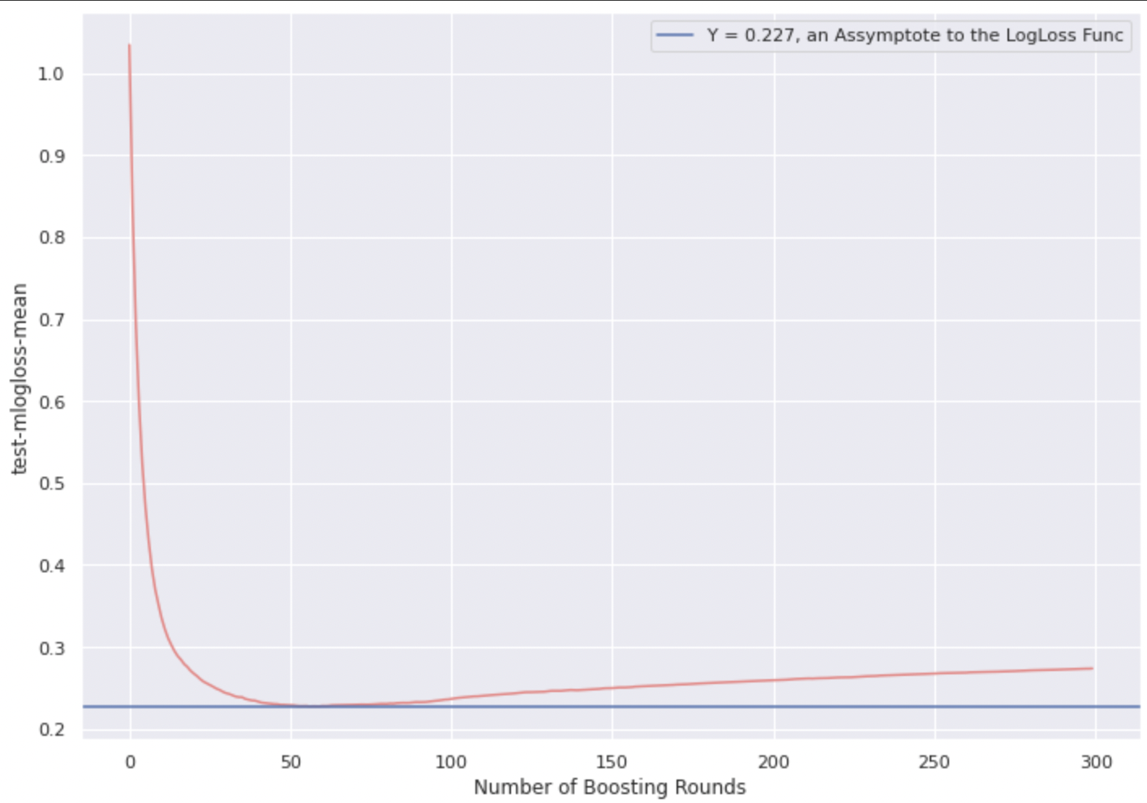
Results and Conclusion
Cross Validated Log Loss function
1 March 2023
Machine Learning in Currency Trading
Notes:
Min Log Loss = 0.0558052
Random if each have equal proability is 1.38

Slide 9
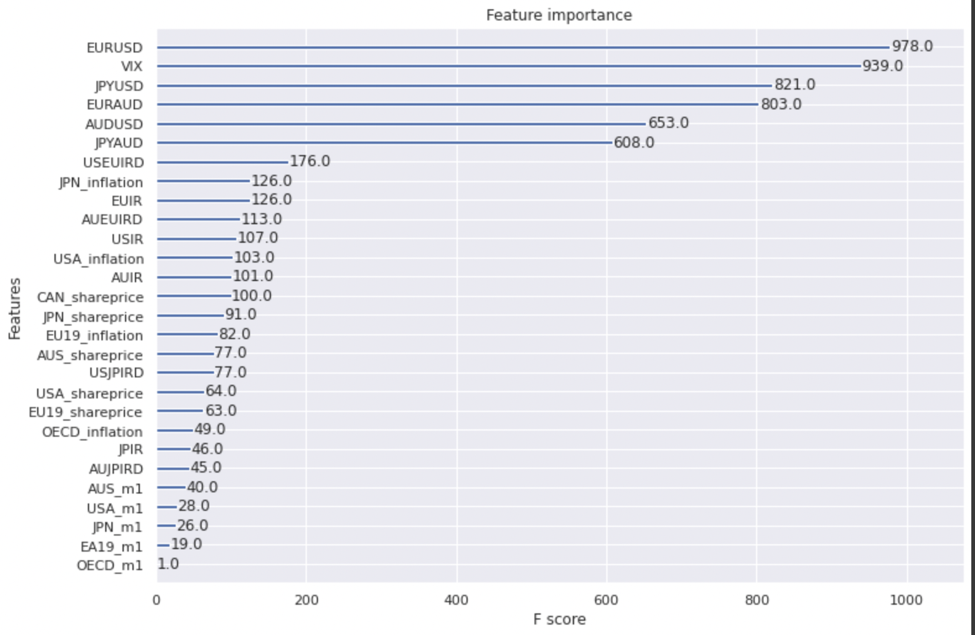
Results and Conclusion
1 March 2023
Machine Learning in Currency Trading
Notes:
Min Log Loss = 0.0558052
Random if each have equal proability is 1.38

Slide 10
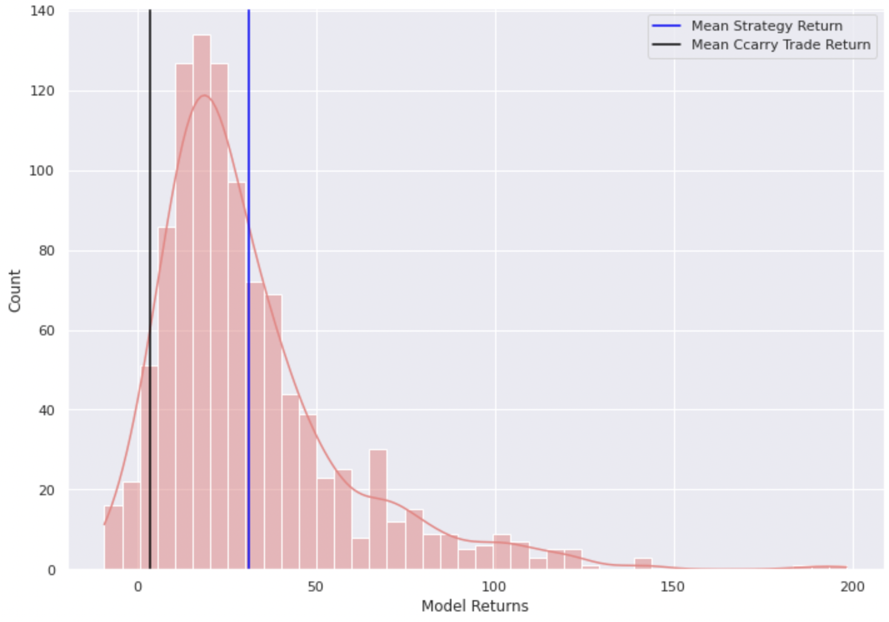
Results and Conclusion
Strategy Returns for 3 month periods Annualized
1 March 2023
Machine Learning in Currency Trading
Notes:
Min Log Loss = 0.0558052
Random if each have equal proability is 1.38

