Slide 1

School Management Information System
CHANDIGARH
UNIVERSITY
RITIK KATOCH-17BCS1629
VISHAL SHARMA-17BCS1610

Slide 2
School Management Information System
☺
Introduction
Snapshot
System Development
Conclusions
LAUGHING COLOURS – SCHOOL MANAGEMENT SYSTEM

Slide 3
Introduction
A School Management System is a large database system which can be used for managing school's daily work.
It is configurable and can be configured to meet most individual school's needs.
It is a multi-user system and can be used by hundreds of users at same time.
General speaking, it is platform running on a Local Area Network (LAN).
LAUGHING COLOURS – SCHOOL MANAGEMENT SYSTEM

Slide 4
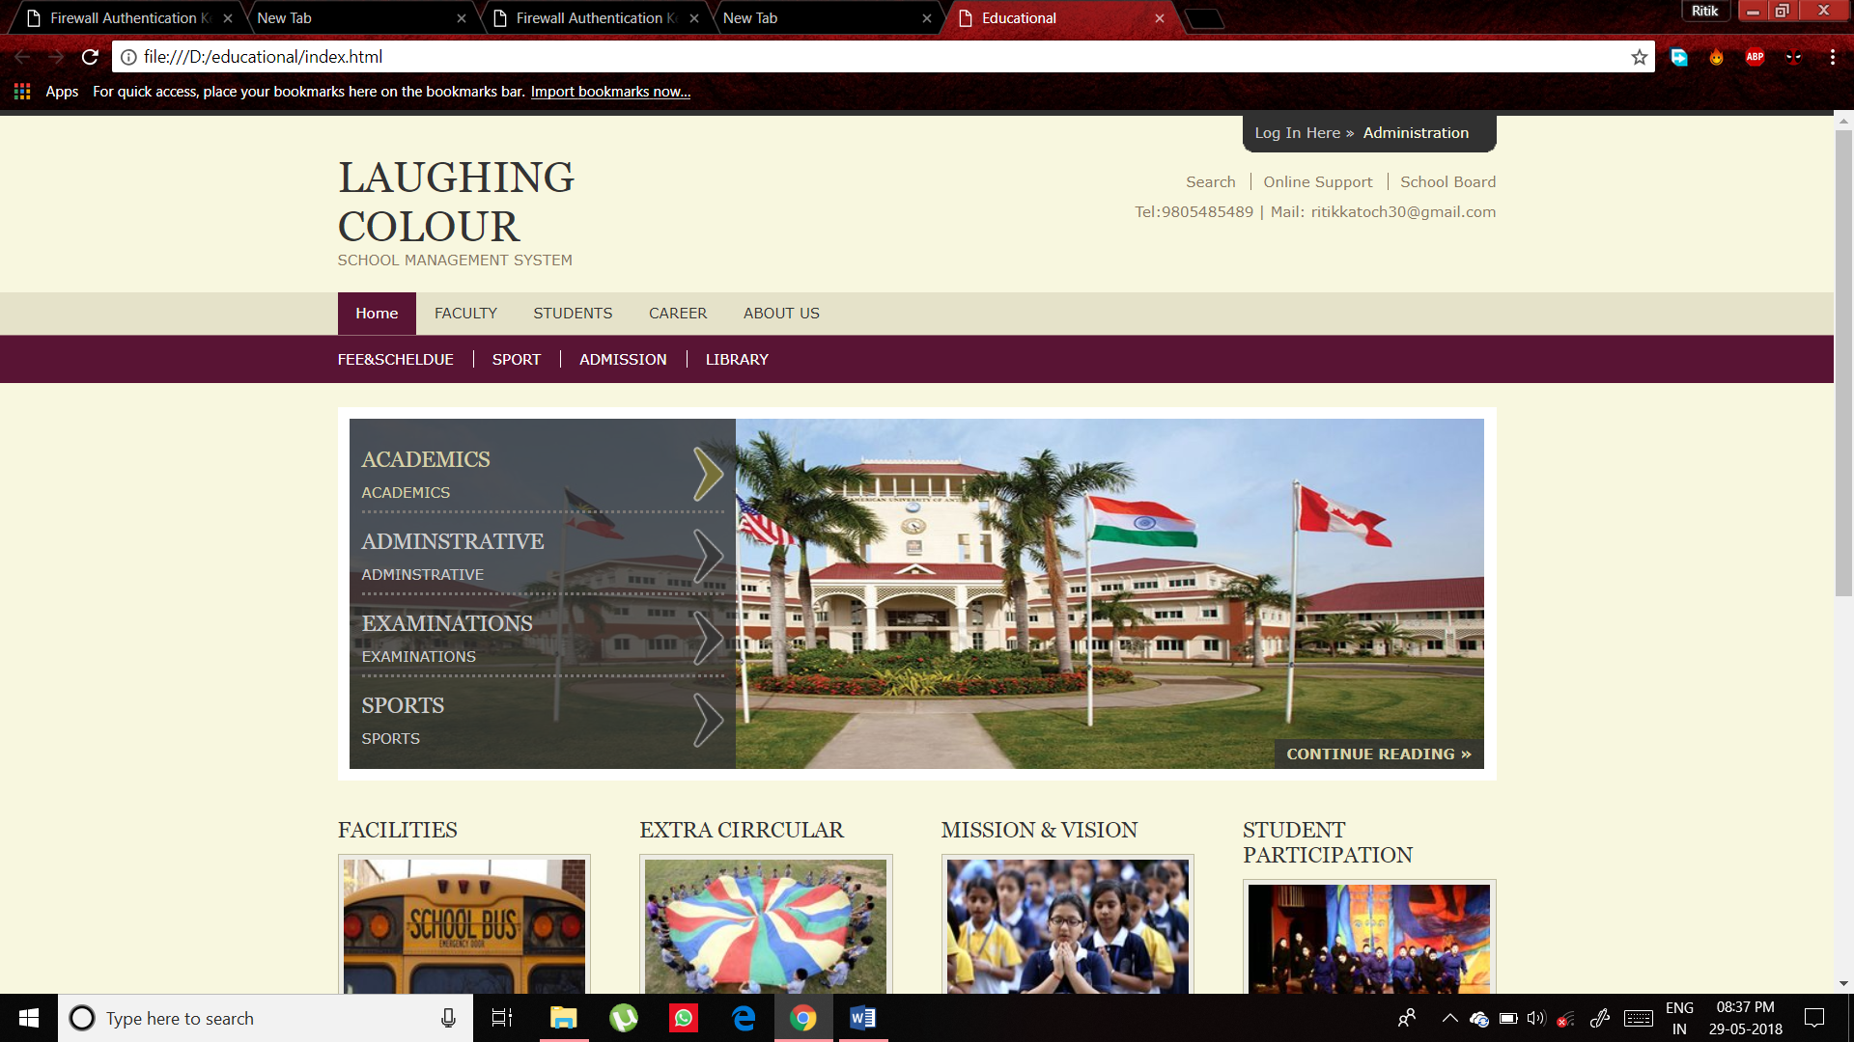
HOME PAGE
LAUGHING COLOURS – SCHOOL MANAGEMENT SYSTEM

Slide 5
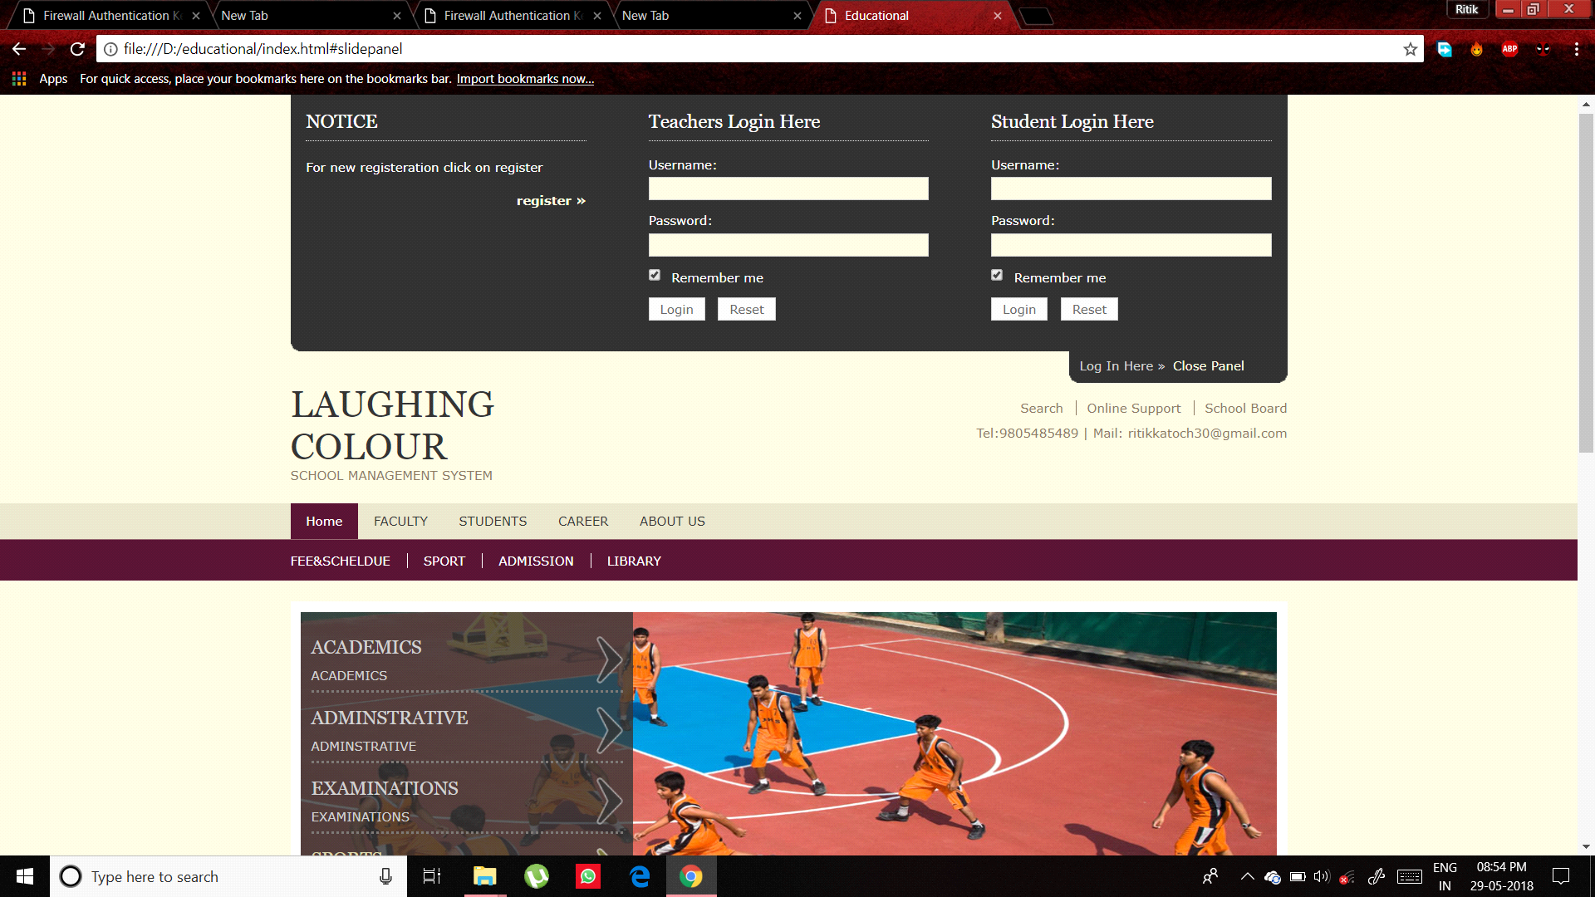
LOG-IN PAGE
LAUGHING COLOURS – SCHOOL MANAGEMENT SYSTEM

Slide 6
System Development
☺
Analysis and Definition
Base on
  HTML,CSS
  JAVA SCRIPT
Implementation
LAUGHING COLOURS – SCHOOL MANAGEMENT SYSTEM

Slide 7
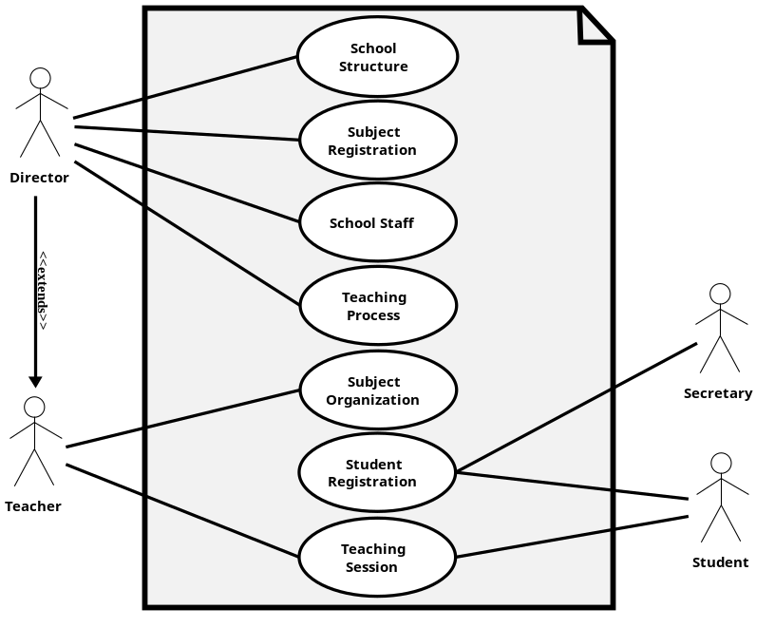
Analysis & Definition
The requirements specification document was created.
Existing documents were a good reference.
LAUGHING COLOURS – SCHOOL MANAGEMENT SYSTEM

Slide 8
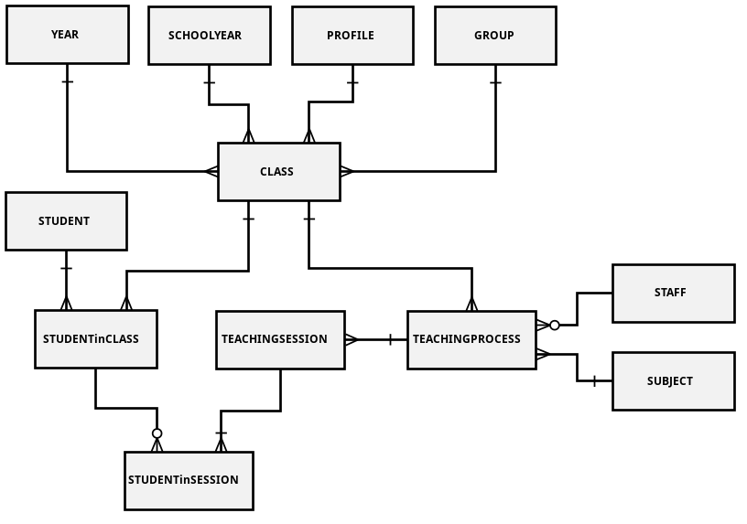
Design (Data Model)
We made decisions regarding how best to take the system in the real world and model it in a database.
A well-designed database takes time and effort to conceive, build and refine.
LAUGHING COLOURS – SCHOOL MANAGEMENT SYSTEM

Slide 9
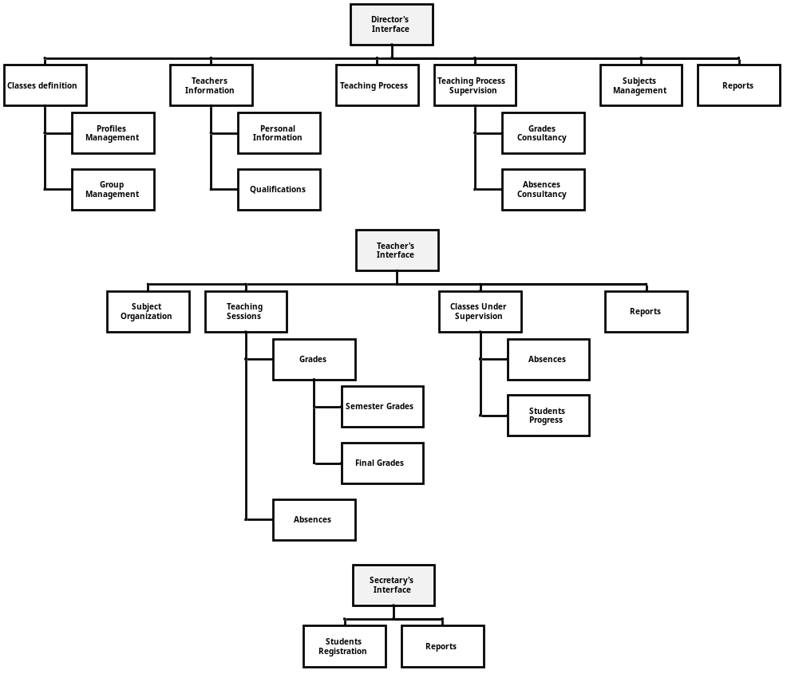
Implementation
2 levels of users with different rights upon the data/information that can be stored, retrieved or modified:
  Teachers
  Students
LAUGHING COLOURS – SCHOOL MANAGEMENT SYSTEM

Slide 10
Conclusions
The need of managing the information electronically is growing rapidly in all important areas .
School Management Systems are being identified as an appropriate method for managing information in schools.
SMIS was built based on real life situations in laughing colours high school, taking into consideration all possible situations and functionalities of the daily work in these schools.
This system maybe considered as a good first step in implementing performing electronic based information management in schools.
LAUGHING COLOURS – SCHOOL MANAGEMENT SYSTEM

Slide 11
Thank You!
☺

