Slide 1







Collaborative Filtering Recommendation Algorithm on Apache Spark
Liu Xingbang & Gao Yuan

Slide 2


Introduction
What can Collaborative Filtering Recommendation Algorithm do?
  Use information about a user's preferences to make
personalized predictions about content, that they might
find relevant.
Challenge of the traditional recommendation algorithm
  Difficult to compute recommendations quickly and accurately
over a large dataset.
Solution --- Parallel computation of neighborhood-based collaborative filtering algorithm on Spark
  Allow the algorithm to scale linearly with a growing number of users, i.e. O(n).
  Include two recommendation approaches-- User-based and Item-based
Perspective
  Effective at increasing engagement and purchasing
  Many of the most heavily trafficked websites employ recommender systems, such as LinkedIn, Amazon, and Twitter

Slide 3
Sequential Algorithm of Collaborative Filtering
Problem Statement
A list of n items I = {i1,i2,…,in} and a list of k users U = {u1,u2,…,uk}.
Let M be a n × k matrix, where each M(u,i) represents the rating score
of a user u about an item i.
M(u,i) can either be a real number or missing
Predict the items that will have the top N rating for a given user
u ∈ U
Based on u's rating scores and the preferences of users with similar
interaction histories to u
Assuming users with similar preferences will have the same rating for
the same items

Slide 4
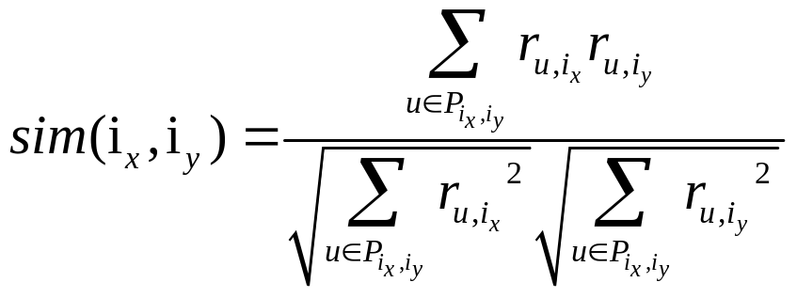
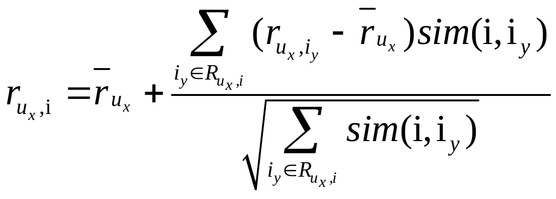

Sequential Algorithm of Collaborative Filtering --- Item-based
Mathematical Formulation
Step one: Obtain M, user-item ratings matrix.
Step two: Calculate the similarities between items by
Formula 1 .
Step three: Calculate the predicted rating for each item that a given user u ∈ U has not yet rated by Formula 2.
Formula 1
Formula 2
represents the subset of items iy ∈ I other than i that the given user ux have rated

Slide 5
Sequential Algorithm of Collaborative Filtering --- Item-based
Stages of Coding
1.Obtain the sparse user-item matrix:
user_id -> [(item_id_1, rating_1), (item_id_2, rating_2), ...]
2.Get all item-item pair combos:
(item1,item2) -> [(item1_rating,item2_rating), (item1_rating,item2_rating), ...]
3.Calculate the cosine similarity for each item pair and select the top-N nearest neighbors:
①(item1,item2) -> similarity
②item1 ->[(item2,similarity), (item3,similarity), ...]
4.Calculate the top-N item recommendations for each user:
user_id -> [item1, item2, item3, ...]

