Slide 1
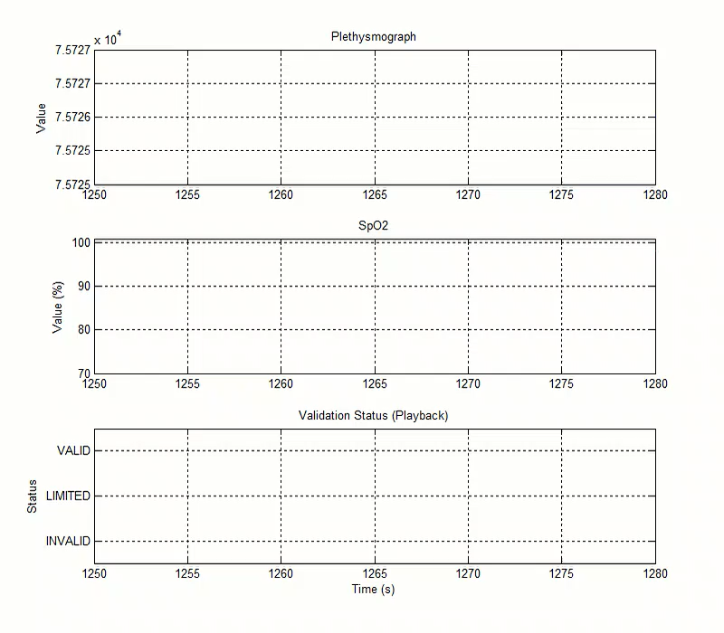
3-Level Automatic PPG Validation

