Slide 1
INTERNATIONAL BANKING DEPARTMENT
Refresher
Presented on July, 16, 2008
Sebhat Belayneh

Slide 2
Training Objective:
F
O
F O C U S
U
S

Slide 3
FOCUS
ON ZEMEN BANKS INTERNATIONAL
BANKING SERVICES AND PRODUCTS
Proprietary and Confidential – Zemen Bank S.C.
Prepared by: Sebhat Belayneh

Slide 4
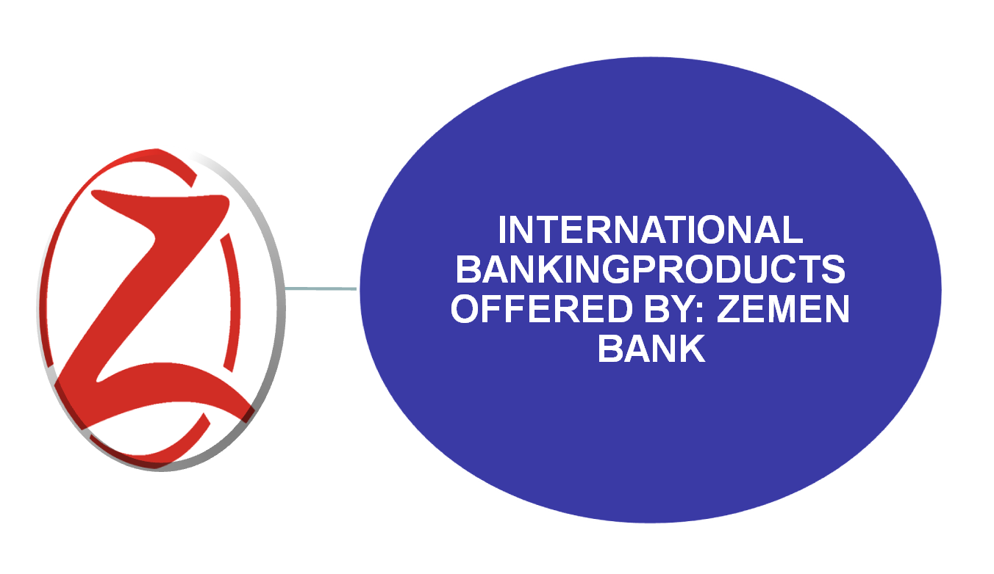
MAJOR INTERNATIONAL BANKING PRODUCTS
Proprietary and Confidential – Zemen Bank S.C.
Prepared by: Sebhat Belayneh

Slide 5
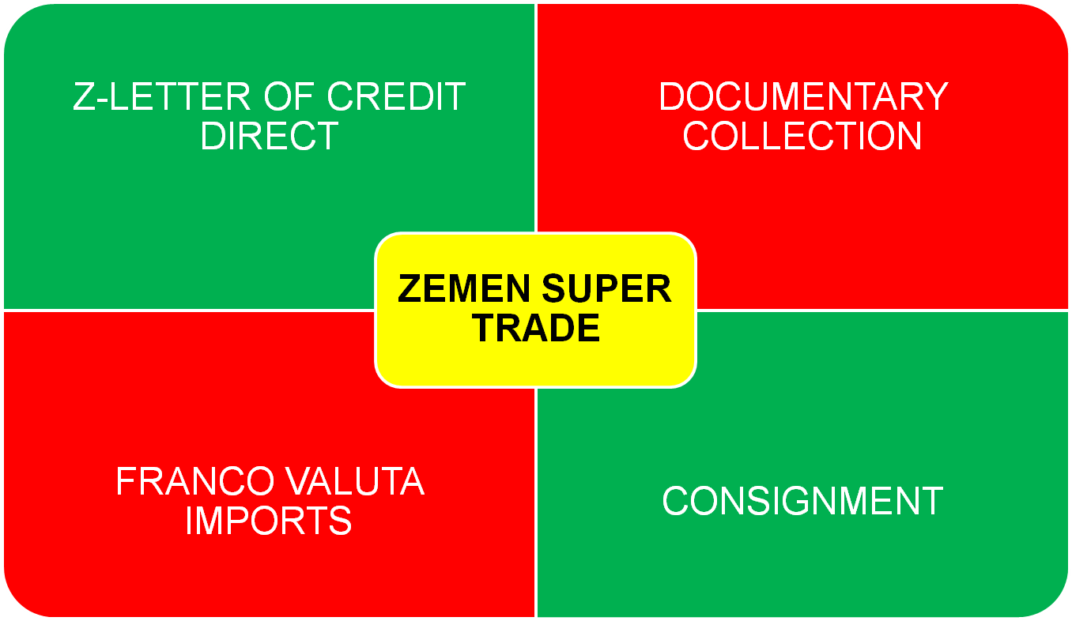
MAJOR INTERNATIONAL BANKING PRODUCTS
Proprietary and Confidential – Zemen Bank S.C.
Prepared by: Sebhat Belayneh

Slide 6
MAJOR INTERNATIONAL BANKING PRODUCTS
INTERNATIONAL WIRES AND TRANSFER PAYMENTS
Z-Money-In-minute = INCOMING where you would receive your transfers and wires instantly
Z-Instant Multi–Currency Transfer = OUT GOING for Your personal and business transfers to almost any where in the world via our vast network of first class international banks
Proprietary and Confidential – Zemen Bank S.C.
Prepared by: Sebhat Belayneh

Slide 7
MAJOR INTERNATIONAL BANKING PRODUCTS
FOREIGN EXCHANGE SERVICES
Z-Money Changer: we buy and sell major convertible currencies including travelers’ cheques over the counter.
Z-Accommodation Exchange: We offer accommodation exchanges for big institutions of sizable transaction volumes at your premises at request
Proprietary and Confidential – Zemen Bank S.C.
Prepared by: Sebhat Belayneh

Slide 8
MAJOR INTERNATIONAL BANKING PRODUCTS
CHEQUE SERVICES
  Bank Cheques
  Personal Cheques
    All well entertained at Zemen Bank via automated applications
Foreign Drafts
Proprietary and Confidential – Zemen Bank S.C.
Prepared by: Sebhat Belayneh

Slide 9
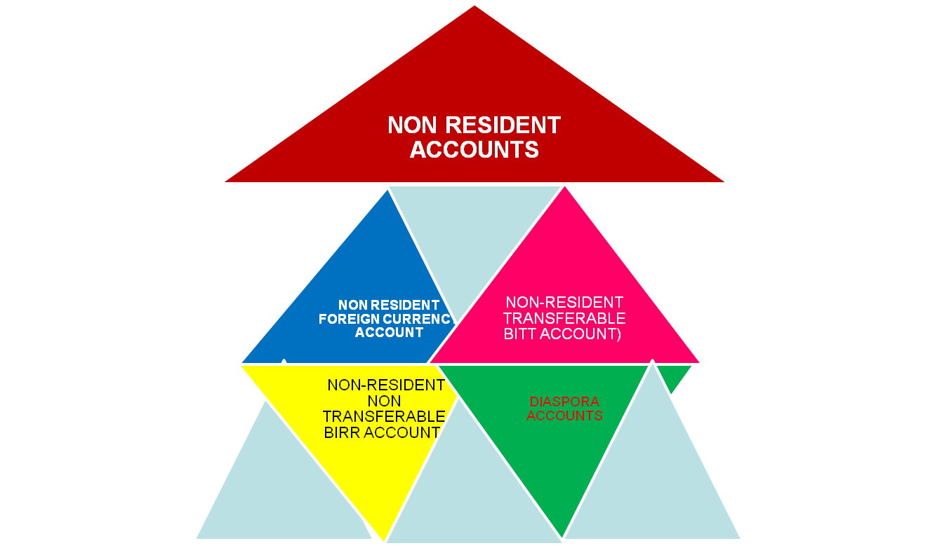
MAJOR INTERNATIONAL BANKING PRODUCTS
Proprietary and Confidential – Zemen Bank S.C.
Prepared by: Sebhat Belayneh

Slide 10
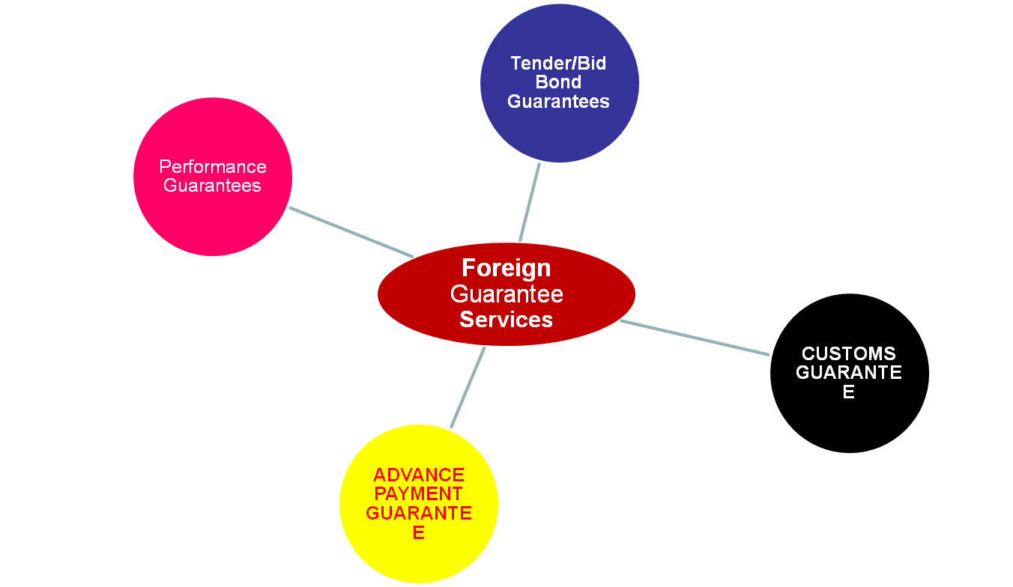
MAJOR INTERNATIONAL BANKING PRODUCTS
Proprietary and Confidential – Zemen Bank S.C.
Prepared by: Sebhat Belayneh

Slide 11
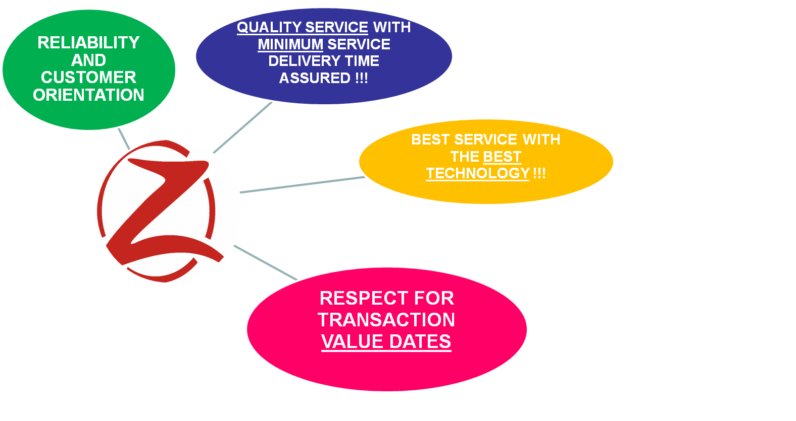
INTERNATIONAL BANKING AT ZEMEN BANK WOULD MEAN:
Proprietary and Confidential – Zemen Bank S.C.
Prepared by: Sebhat Belayneh

Slide 12
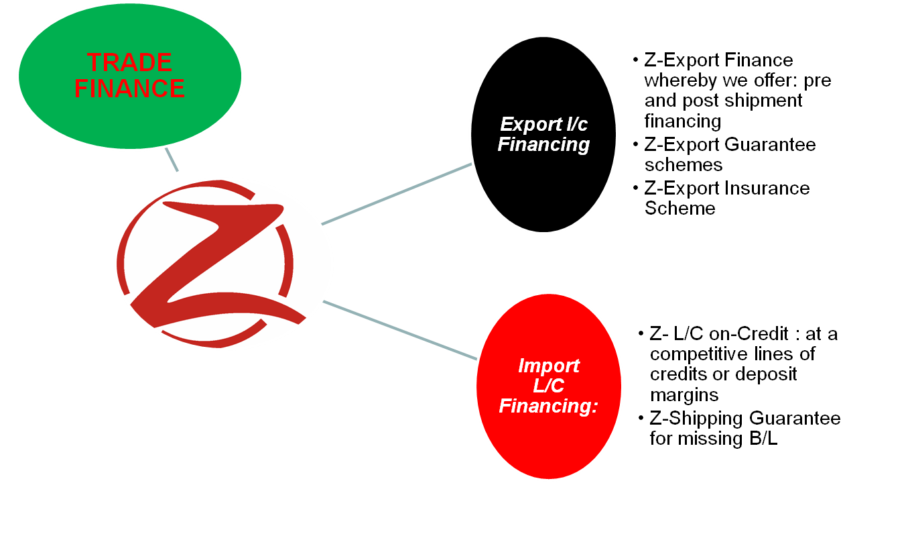
INTERNATIONAL BANKING AT ZEMEN BANK WOULD MEAN:
Proprietary and Confidential – Zemen Bank S.C.
Prepared by: Sebhat Belayneh

Slide 13
INTERNATIONAL BANKING AT ZEMEN BANK would also mean…
AUTOMATED PROCESSING OF TRANSACTIONS:
  ON-LINE IMPORT LETTER OF CREDIT APPLICATIONS AND PROCESSING
  ON-LINE ADVICE OF EXPORT L/C
  ON-LINE RECEIPT OF EXPORT DOCUMENTS FOR NEGOTIATION
VIA: INTERNET BANKING
  CISTOMER ID AND LOG-IN
  CUSTOMERS ACCPTANCE OF TERMS
Proprietary and Confidential – Zemen Bank S.C.
Prepared by: Sebhat Belayneh

Slide 14
INTERNATIONAL BANKING AT ZEMEN BANK would also mean…
ADVISORY & SUPPORT TO:
  MINIMIZE PAYMENT RISK FOR ACCESS BANK’S CUSTOMERS
  PROTECT ACCESS BANK CUSTOMERS FROM INTERNATIONAL FRAUDS
  PROVIDE ACESS BANK CUSTOMERS WHAT IS BEST @ EVERY STAGE OF THE PROCESS
Proprietary and Confidential – Zemen Bank S.C.
Prepared by: Sebhat Belayneh

Slide 15
WHAT You Should Focus as Business Development Officers
FOREIGN EXCHANGE EARNING BUSINESSES such as :
    EXPORT
    TRANSFERS
      International Organizations and NGOs
      Foreign Exchange Deposit Mobilization
Proprietary and Confidential – Zemen Bank S.C.
Prepared by: Sebhat Belayneh

Slide 16
WHAT we do at IBD to enhance your Business Endeavors ?
We would Facilitate Relationship with desired Correspondent Banks for High Net worth Customers
We would advise l/cs through convenient banks for their business counter parties
Facilitate Transactions in Major Convertible currencies
Proprietary and Confidential – Zemen Bank S.C.
Prepared by: Sebhat Belayneh

Slide 17
Question and Answer

Slide 18
End

