Slide 1
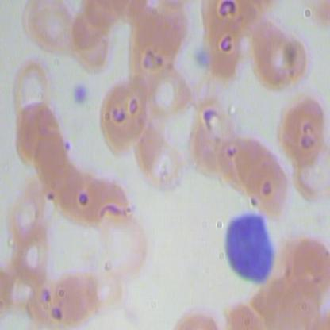
Machine Learning
Model Comparison
YOLO vs CNN/Faster R-CNN for blood cell detection
Storyline: start with an imbalanced medical-image detection problem, compare the measured candidates on the same test split, then select the model that generalizes best.
WINNER
BEST F1
MAP50
Held-out test split
YOLO v26m
83.9%
89.2%
36 images / 471 cells
150 epochs checkpoint
+6.9 pts over CNN
+4.0 pts
Platelets, RBC, WBC detection
Generated from local research artifacts under C:\Users\usEr\Downloads\Research

Slide 2
01
EXECUTIVE TAKEAWAY
The decision in one slide
Both approaches detect the same three cell classes. On the same 36-image test split, YOLO leads every shared aggregate metric.
Interpretation
- YOLO is the safer primary detector: better precision without sacrificing recall.
- CNN tuning reduced false positives, but its best F1 remains lower.
- Longer YOLO training did not automatically win; the best held-out result is a 150-epoch run.
- Next decision should add latency and per-class YOLO metrics before deployment.
PRECISION GAIN
RECALL GAIN
+10.2 pts
+2.2 pts
YOLO 79.4% vs CNN 69.2%
YOLO 89.0% vs CNN 86.8%
F1 GAIN
MAP50 GAIN
+6.9 pts
+4.0 pts
YOLO 83.9% vs CNN 77.0%
YOLO 89.2% vs CNN 85.2%
Recommendation: present YOLO as the main model and CNN/Faster R-CNN as a transparent baseline.
Source: CNN/outputs/eval_test_metrics.json; YOLO/test/runs/best_pt_validation_summary_20260513_005420.csv

Slide 3
02
DATA CONTEXT
The problem is imbalanced
The test set is small but dense: RBC dominates the object count, so false-positive control matters.
RBC
398 (85%)
IMAGES
OBJECTS
RBC SHARE
36
471
84.5%
held-out test
total labels
398 labels
A single image can contain many overlapping RBC objects plus rare WBC/Platelets.
Source: blood-cell-detection-datatset/README.md; CNN/outputs/eval_test_metrics.json

Slide 4
03
EXPERIMENT SETUP
Two detector strategies were tested
YOLO family
CNN/Faster R-CNN baseline
- 12 best.pt checkpoints evaluated.
- Families: yolo26m, yolo11m, yolov8m, yolov8l.
- Groups: 150 epochs, 500 epochs, 500 epochs with optimizer.
- Ranking metric: held-out test mAP50-95, with precision/recall/F1/mAP50 reported.
- One trained Faster R-CNN checkpoint.
- Test evaluation on the same dataset split.
- Threshold sweep searched score threshold and NMS IoU.
- Best tuning objective: micro F1.
Best: train_results_150_epochs(yolov26m)
Best: score 0.65, NMS IoU 0.18
Source: YOLO/README.md; CNN/README.md; CNN/outputs/sweep_results.csv

Slide 5
04
HEAD-TO-HEAD METRICS
YOLO wins the shared test scoreboard
Shared aggregate metrics on the same 36-image test split
100
YOLO best
89.0%
89.2%
CNN tuned
86.8%
83.9%
85.2%
79.4%
77.0%
69.2%
50
0
Precision
Recall
F1
mAP50
The largest gap is precision: YOLO reduces the practical risk of extra false detections while still holding slightly higher recall.
Source: YOLO/test/runs/best_pt_validation_summary_20260513_005420.csv; CNN/outputs/eval_test_metrics.json

Slide 6
05
YOLO MODEL SEARCH
The best YOLO was not the longest run
150_epochs(yolov26m)
61.1%
500epochs(yolov8m)
60.1%
Pattern
500epochs+opt(yolov8m)
60.1%
- Top held-out model: yolo26m at 150 epochs.
- 500-epoch runs did not exceed the top 150-epoch result.
- Optimizer-labeled duplicates matched their paired 500-epoch runs in this summary.
150_epochs(yolov11m)
59.7%
150_epochs(yolov8m)
59.6%
150_epochs(yolov8l)
59.2%
500epochs(yolov11m)
59.2%
BEST MAP50-95
BEST EPOCH
61.1%
73
500epochs+opt(yolo11m)
59.2%
strict YOLO metric
within run
Source: YOLO/test/runs/best_pt_validation_summary_20260513_005420.csv

Slide 7
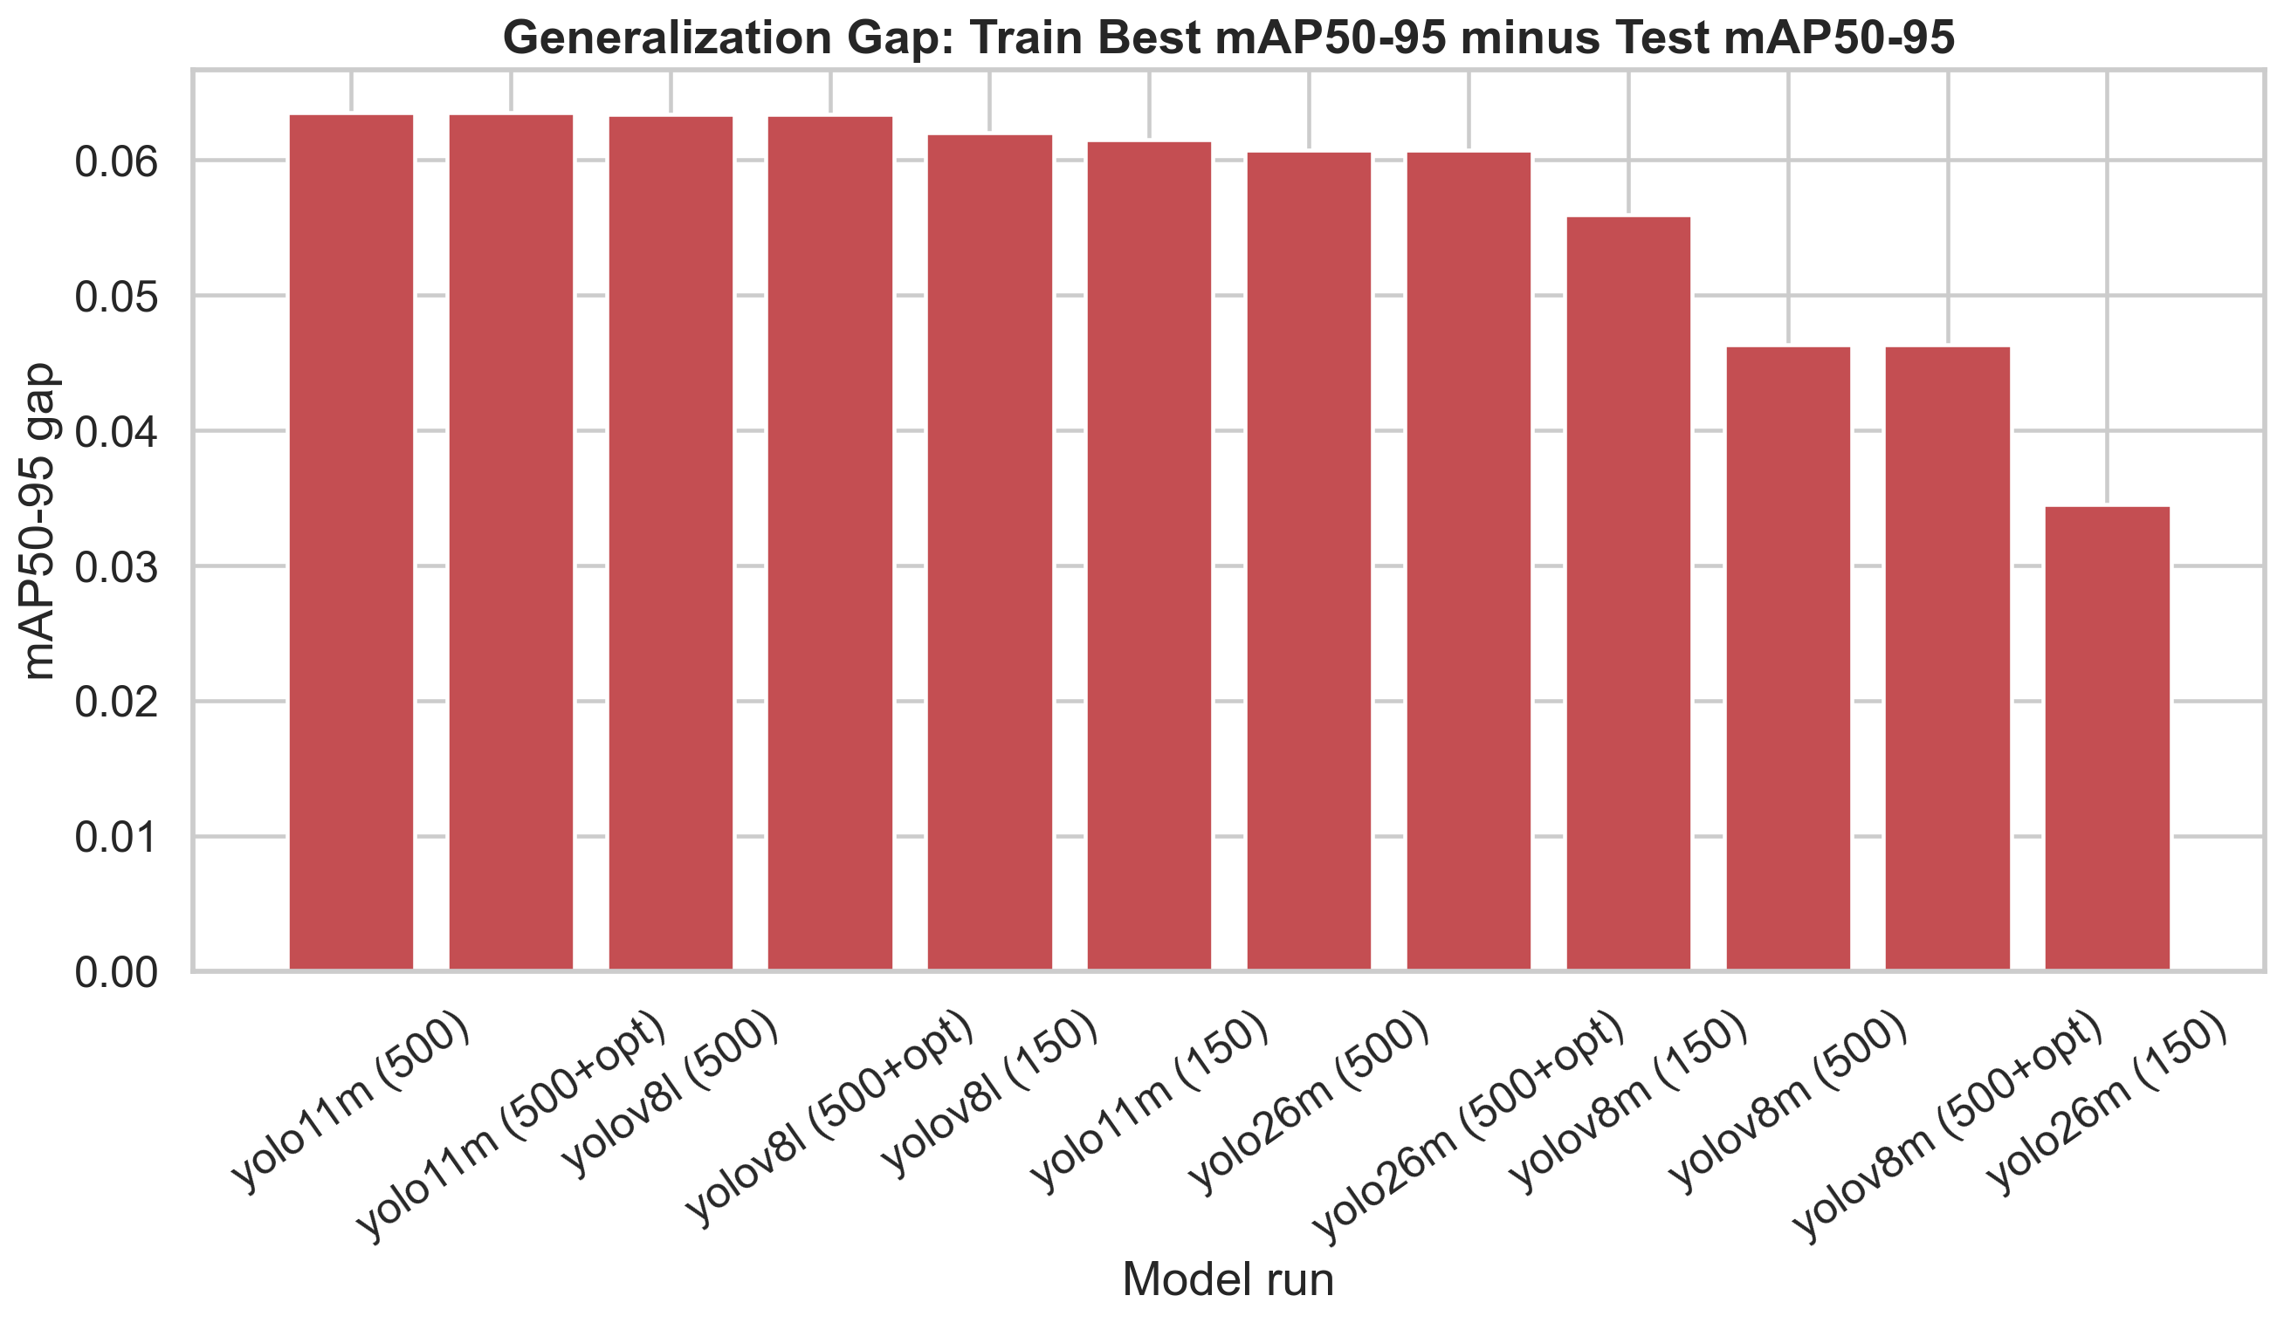
100
TRAIN VS TEST
06
Generalization separates the contenders
Train best
65.8%
65.2%
65.4%
64.6%
64.7%
64.7%
Test
61.1%
60.1%
60.1%
59.7%
59.6%
59.2%
50
Every YOLO run shows a higher training best than held-out test mAP50-95. The winning yolo26m 150 run also has the smallest top-model gap.
0
yolo26m (150)
yolov8m (500)
yolov8m (500+opt)
yolo11m (150)
yolov8m (150)
yolov8l (150)
Source: YOLO/evaluation/outputs/train_test_comparison_20260513_010742.csv

Slide 8
07
THRESHOLD SWEEP
CNN tuning helped, but not enough
score 0.65, NMS 0.18
77.0%
Best CNN tradeoff
score 0.64, NMS 0.18
77.0%
score 0.65, NMS 0.25
76.8%
PRECISION
RECALL
F1
69.2%
86.8%
77.0%
score 0.65, NMS 0.2
76.8%
micro
micro
micro
score 0.65, NMS 0.205
76.8%
- Best sweep: score 0.65, NMS IoU 0.18.
- Errors at best: 182 FP and 62 FN.
- Tuning moved CNN toward cleaner predictions, but YOLO still has the stronger combined score.
score 0.65, NMS 0.21
76.8%
Story point: CNN improves through threshold discipline; YOLO starts from a stronger detector ranking.
Source: CNN/outputs/sweep_results.csv; CNN/outputs/eval_test_metrics.json

Slide 9
08
CLASS BEHAVIOR
Class risk is concentrated in RBC and Platelets
Precision
What this means
100
97.3%
97.3%
97.3%
88.9%
85.7%
Recall
F1
75.3%
75.5%
- WBC is almost solved by CNN on this split: 97.3% precision and recall.
- RBC drives most of the operational risk: 398 of 471 objects and 164 CNN false positives.
- Platelets are rare, so one or two misses move the percentage noticeably.
65.3%
67.5%
50
0
Platelets
RBC
WBC
Before deployment, collect per-class YOLO precision/recall from the best checkpoint for an apples-to-apples class-risk review.
CNN per-class metrics after best threshold sweep
Source: CNN/outputs/eval_test_metrics.json

Slide 10
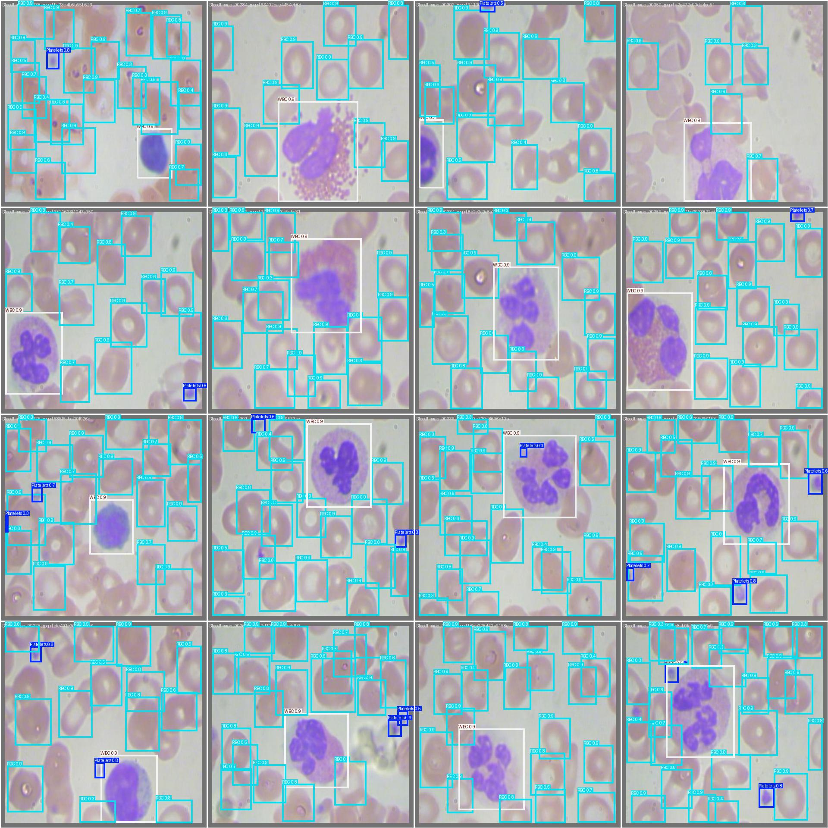
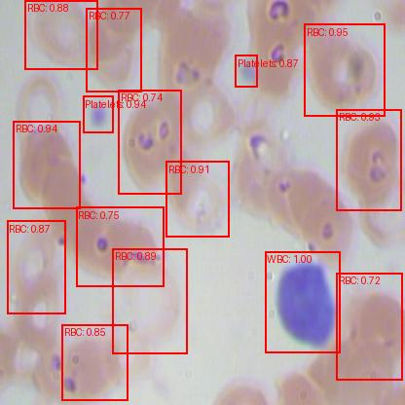
09
VISUAL EVIDENCE
Qualitative check: what the models draw
YOLO best checkpoint prediction batch
CNN/Faster R-CNN single-image prediction
From validation output folder for train_results_150_epochs(yolov26m)
Generated prediction.jpg from the tuned CNN project
Source: YOLO/test/runs/train_results_150_epochs_yolov26m; CNN/prediction.jpg

Slide 11
10
STORY CONCLUSION
Recommendation and next steps
Decision
Before deployment
Use YOLO v26m from `train_results_150_epochs(yolov26m)` as the primary model candidate for the current evidence package.
1. Export per-class YOLO metrics for the winning checkpoint.
2. Add inference latency and model size to compare speed vs accuracy.
3. Validate on more external blood-smear images.
4. Decide the operating point by cost of FP vs FN, especially for RBC.
Keep CNN/Faster R-CNN as a benchmark because its threshold sweep provides useful FP/FN tradeoff insight.
Source: Synthesis of local YOLO and CNN test reports

Slide 12
11
SOURCE ARTIFACTS
Reproducibility map
Files inspected and used
- Dataset: blood-cell-detection-datatset/README.md and test images/labels
- YOLO ranking: YOLO/test/runs/best_pt_validation_summary_20260513_005420.csv
- YOLO train-vs-test: YOLO/evaluation/outputs/train_test_comparison_20260513_010742.csv
- YOLO visuals: YOLO/evaluation/outputs/*.png and YOLO/test/runs/train_results_150_epochs_yolov26m/*.jpg
- CNN metrics: CNN/outputs/eval_test_metrics.json
- CNN tuning: CNN/outputs/sweep_results.csv
- CNN visual: CNN/prediction.jpg
Assumption: YOLO and CNN numbers are comparable because both report on the local held-out test split of 36 images.
Raw artifacts were not modified by this presentation builder.

