Slide 1
Tableau Feature Parity
Tableau Cloud vs Desktop
Feature Parity Overview
Scope
Issue #12
Issue #22
Issue #27
Choosing the right work environment from real operation gaps
Message
Feature gaps are not just availability differences. They change how teams choose where to work.
Source: presentation script, README.md, Issue #12/#22/#27 local articles
1 / 7

Slide 2
Purpose and Background
Turn feature gaps
into decision material
Future view
Accumulate these gaps as knowledge
so generative AI can support
Tableau Dashboard Builders
more accurately.
This project began from issues found while supporting users
who work across both Cloud and Desktop.
The goal is not only today's decisions, but also better future support quality.
Some actions are available only in Cloud, others only in Desktop.
Even when names are similar, scope and operation feel can differ.
REASON
Source: presentation script, README.md, Issue #12/#22/#27 local articles
2 / 7

Slide 3
Three Differences Covered Here
Cloud vs Desktop
The three examples map to dashboard structure, precise visual tuning, and workbook maintenance.
Feature
Tableau Cloud
Tableau Desktop
#12 Layout hierarchy drag & drop
Available
Cloud-only
Unavailable
#22 Tooltip sliders and rulers
Unavailable
Available
Desktop-only
#27 Replace References
Unavailable
Available
Desktop-only
Implication
Cloud is strong for intuitive browser editing.
Desktop is strong for precise tuning and maintenance.
Source: presentation script, README.md, Issue #12/#22/#27 local articles
3 / 7

Slide 4
#12 Cloud-only: Organize layout hierarchy
Dashboard layout
Cloud-only
In Cloud, dashboard items can be reordered directly
inside the layout hierarchy panel by drag and drop.
What changes
Operational value
You can adjust item order and container placement while viewing the hierarchy.
This reduces placement errors and rework in complex dashboards.
Cloud: move items in the hierarchy
Desktop limitation
Desktop does not support direct movement inside the hierarchy panel;
items must be adjusted on the dashboard canvas.
Desktop: no direct hierarchy movement
Source: presentation script, README.md, Issue #12/#22/#27 local articles
4 / 7

Slide 5
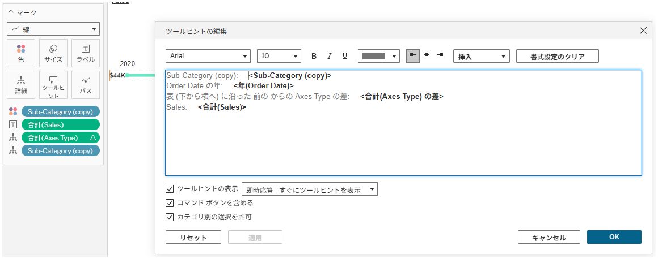
#22 Desktop-only: Tune tooltip layout precisely
Tooltip layout
Desktop-only
In Desktop, sliders and rulers help fine-tune field placement
while editing tooltips.
Best fit
Operational note
Align tooltip information for reports, presentations, and dashboards that users inspect frequently.
If precise tuning is needed after publishing, finish it in Desktop before publishing to Cloud.
Desktop: adjust with sliders and rulers
Decision point
Cloud is enough for light edits;
Desktop is better when tooltip readability must be polished.
Cloud: no precise placement UI
Source: presentation script, README.md, Issue #12/#22/#27 local articles
5 / 7

Slide 6
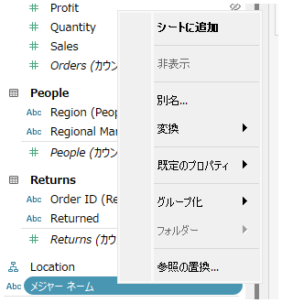
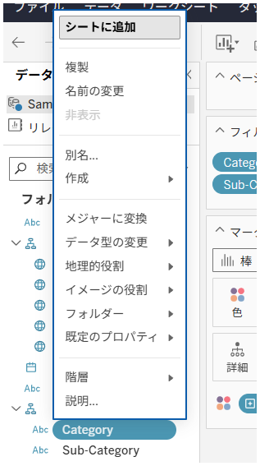
#27 Desktop-only: Replace field references in bulk
Replace References
Desktop-only
Desktop's Replace References command can swap a field used
in calculations and worksheets with another field in bulk.
Use cases
Effect
Datasource changes, field renaming, and consolidating fields with similar roles.
It improves maintenance efficiency for workbooks with many calculations and sheets.
Desktop: Replace References is available
Risk
Because the impact is broad, backup the workbook
and confirm data types before replacement.
Cloud: basic context menu only
Source: presentation script, README.md, Issue #12/#22/#27 local articles
6 / 7

Slide 7
Summary: Choose by task type
Decision guide
Feature gaps affect efficiency, maintainability, and the cost of post-publish fixes.
Use Cloud for
Use Desktop for
Operating principle
Post-publish edits, dashboard structure cleanup, and browser-based collaboration.
Pre-publish precision, large-scale changes, and workbook maintenance.
Separate what Cloud can handle from work that should return to Desktop before starting.
Knowing these gaps reduces backtracking and rework.
Source: presentation script, README.md, Issue #12/#22/#27 local articles
7 / 7

