Slide 1
SoPC Edge Detector
Example
Kim Bjerge
(kbe@iha.dk)

Slide 2
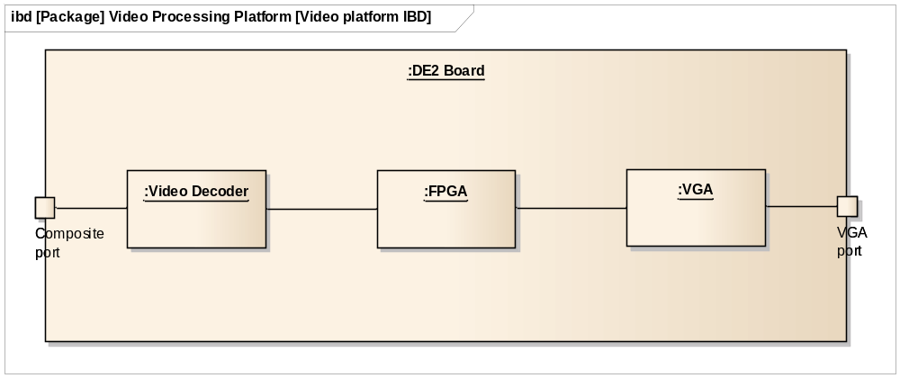
Video Edge Detector

Slide 3
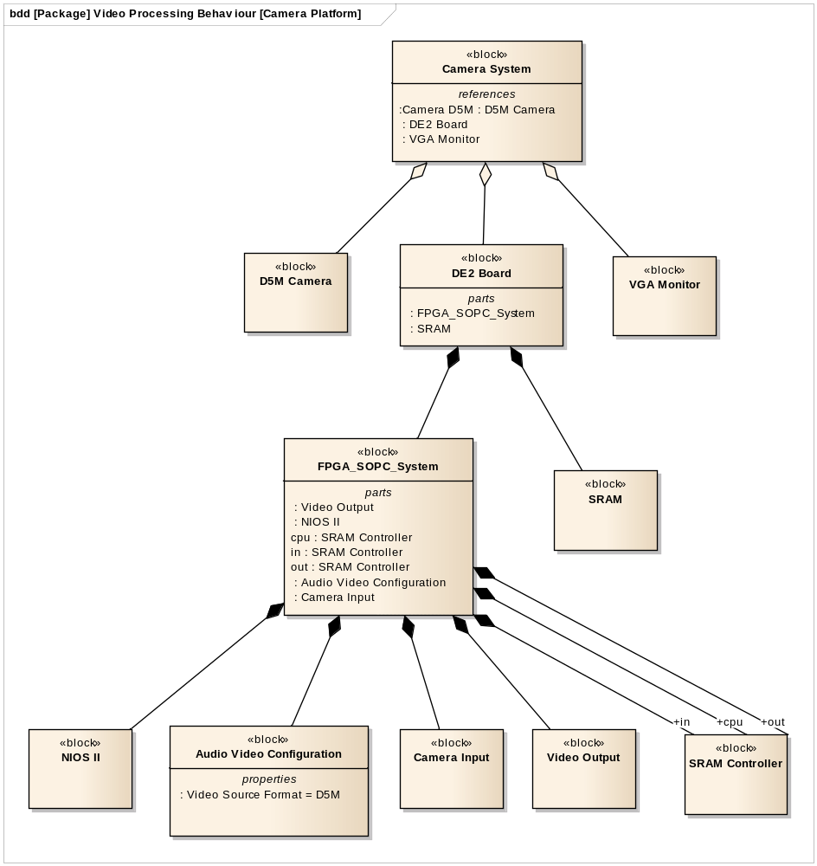
Video System

Slide 4
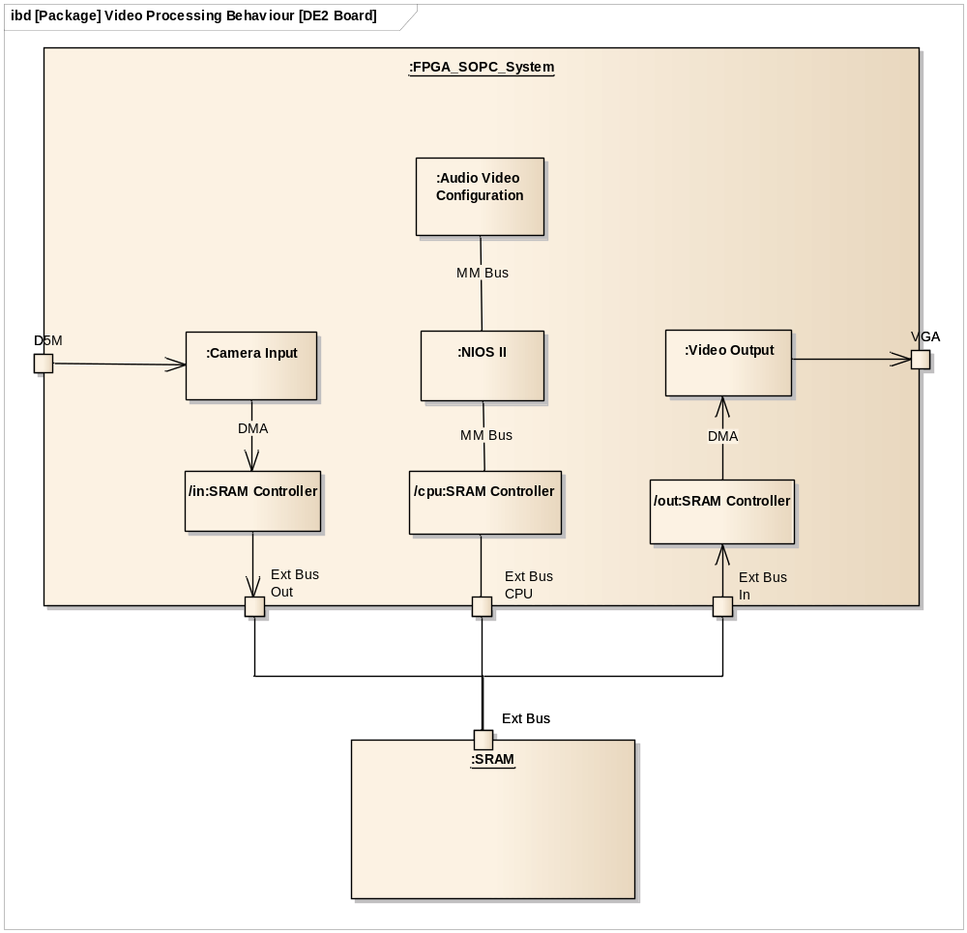
SOPC
System

Slide 5
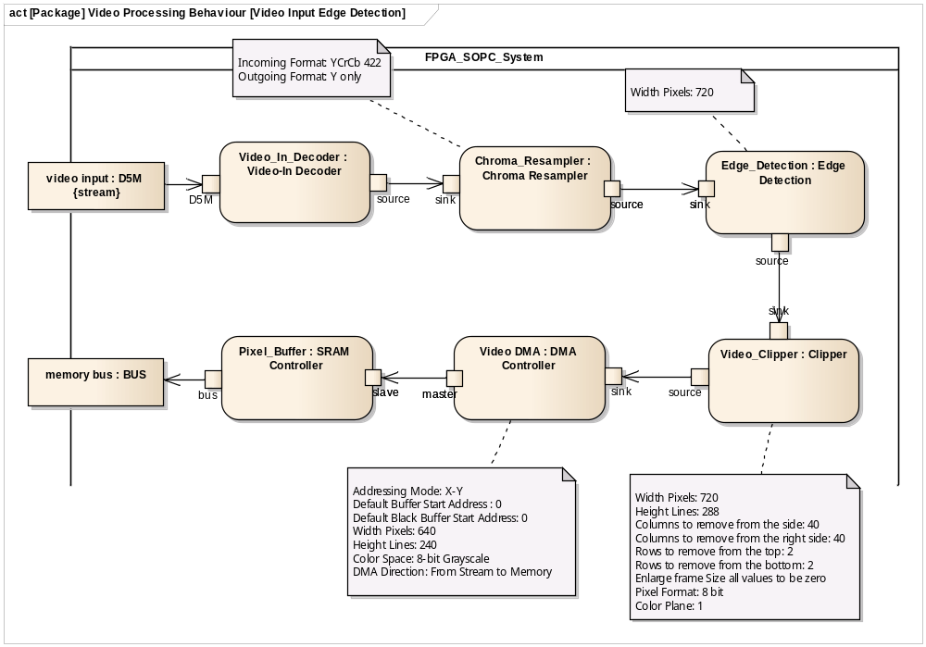
Edge Detector – Video Input Part (Activity)

Slide 6
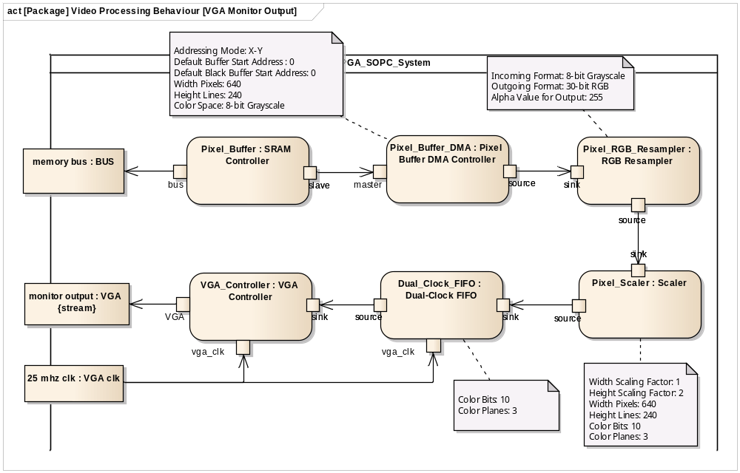
Edge Detector – Video Output Part (Activity)

Slide 7
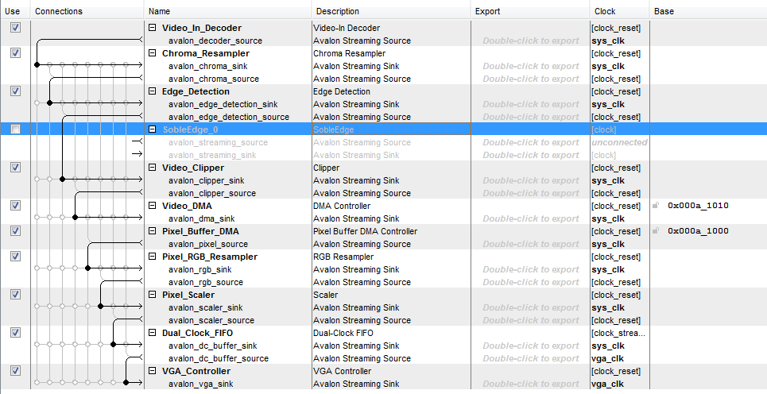
Quartus - Qsys with final design

Slide 8
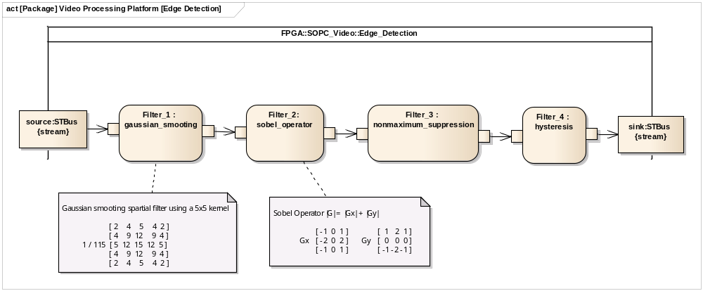
Edge Detector – Composition (Activity)

Slide 9
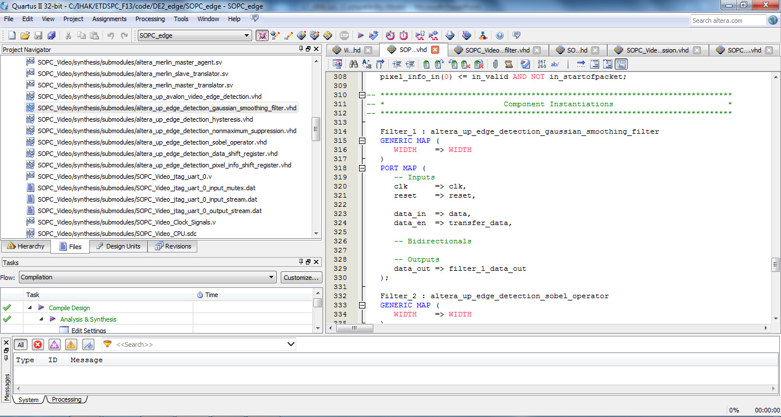
Quartus – Edge_detector VHDL

Slide 10
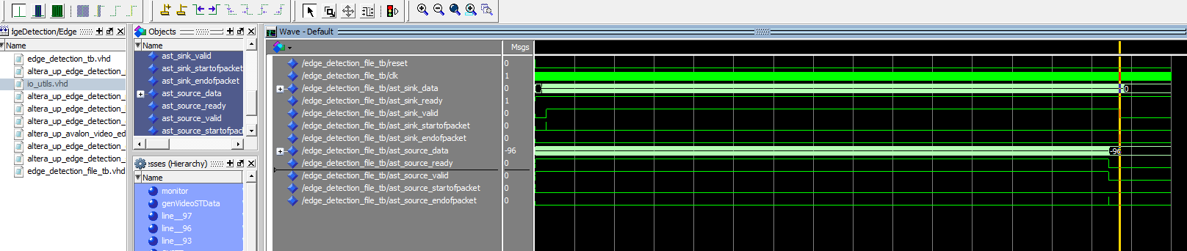
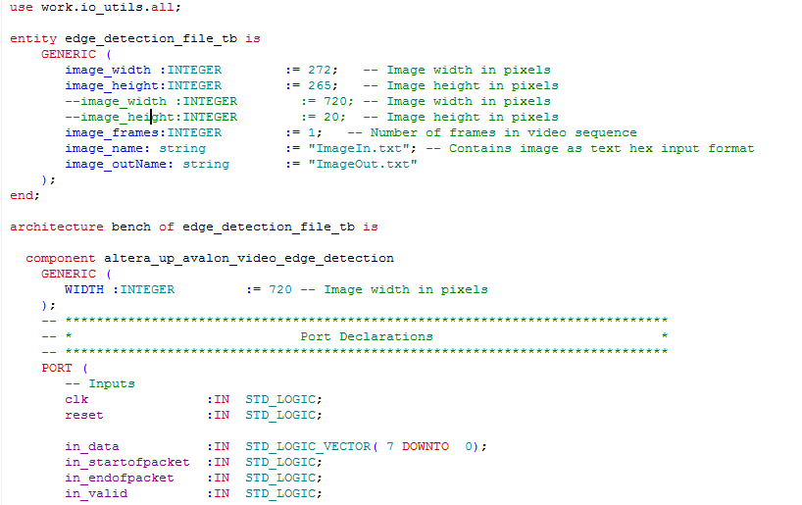
ModelSim testbench for ST bus (video)

Slide 11
Quartus +Qsys project
Nios II software project
    Copy image to memory/SD card
ModelSim testbench for sobel edge filter

