Slide 1
MSc Creative Computing
Practice as Research — Lecture 2
How practice produces knowledge
Mick Grierson — Creative Computing Institute, UAL
1

Slide 2
Practice as Research
Lecture 2 of 8 — How practice produces knowledge
Mick Grierson, Creative Computing Institute, UAL
2
Notes:
This week moves from "what is research?" to "what kind of knowledge does practice actually produce, and why should anyone trust it?" We're drawing on three texts: Smith & Dean, Candy, and Borgdorff. If students haven't read any of them, this session should still make sense — but the discussion will be richer if they have.

Slide 3
Recap: where we left off
Last week we established:
1. Research is a structured attempt to produce something not previously known, in a form others can examine.
2. Practice-based research mostly produces procedural, tacit, and situated knowledge.
3. The difference between a project and a research project is naming the edge, the wager, and the test.
Today's question: how does practice do this? What are the mechanisms? And who has tried to map them?
3
Notes:
Quick recap — don't linger. The point is to bridge into today. Ask if anyone wants to challenge or revise anything from last week before moving on.

Slide 4
Three texts, three frames
We're working with three attempts to explain how practice produces knowledge:
Smith & Dean (2009) — practice and research as an iterative cycle, not two separate activities.
Candy (2006) — a distinction between practice-based and practice-led research, and what counts as evidence.
Borgdorff (2011) — a philosophical argument that artistic practice is itself a form of knowledge production, not merely the subject of it.
Each gives you a different angle. None is complete alone.
4
Notes:
Frame this as a toolkit, not a competition. Different projects will lean harder on different frameworks. The goal is to know all three well enough to choose.

Slide 5
Why does this matter practically?
Because at some point you'll need to answer these questions about your own work:
What kind of knowledge is my project producing?
How do I know it's new?
How do I show someone else it's real?
Where does the knowledge live — in the artefact, in the documentation, in the method, or somewhere else?
If you can't answer these, you have a project but not yet a research project.
5
Notes:
These four questions are the throughline of today's session. Return to them at the end and see if students feel more equipped.

Slide 6
Smith & Dean: the iterative cyclic web
Smith & Dean's central contribution is a diagram — the "iterative cyclic web of practice-led research and research-led practice."
The key insight: practice and research are not sequential (first I research, then I make — or first I make, then I write about it). They are interleaved and mutually generative.
Practice generates questions that research cannot anticipate.
Research reframes what you're doing in the studio, and opens directions you wouldn't have found by making alone.
The cycle runs continuously, not once.
6
Notes:
If you can, project the diagram from the introduction chapter — it's the most cited figure in the book. Ask students whether their current process looks more like a cycle or a straight line.

Slide 7


Slide 8
Smith & Dean: unpacking the cycle
The diagram has three nodes, not a linear sequence:
1. Practice / creative work
2. Research
3. Output (artefact and/or text)
Two paths run through these nodes simultaneously:
Clockwise: the creative practice path. Practice generates output, output prompts further practice.
Anticlockwise: the research path. Research reframes the output, the output raises new research questions.
The two paths intersect and feed each other at every node. That's what makes it a web, not a pipeline. At any point, the direction of travel can reverse — a research insight redirects the practice, a surprise in the studio sends you back to the literature.
7
Notes:
If you can, project the diagram — it's the most cited figure in the book. The key thing to convey is that the two counter-rotating paths are *simultaneous*. Students who treat them as sequential (first make, then research — or first research, then make) miss the point. Ask: which path are you currently on? When did you last switch?

Slide 9
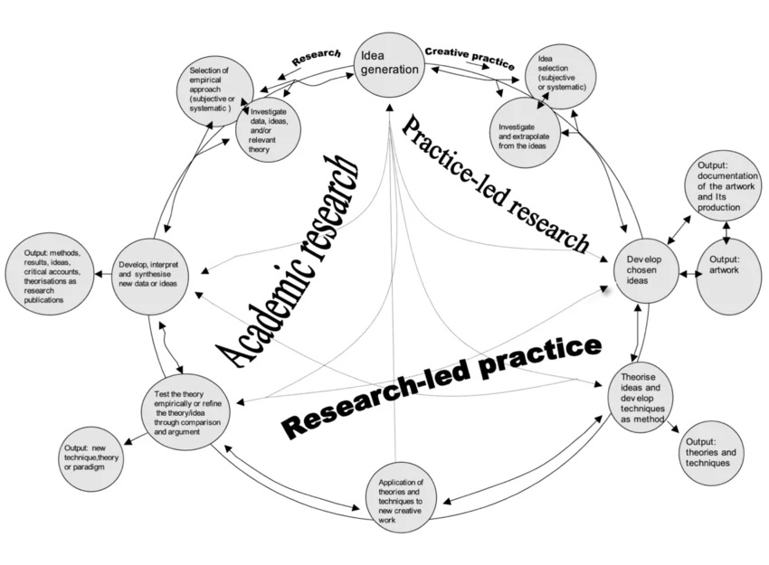

Slide 10
Smith & Dean: what this means for you
Practically, the iterative cyclic web tells you:
Don't wait to finish making before you start contextualising. Read while you make. Let the reading change what you make. Let the making change what you read.
Don't treat the written output as a retrospective report. It's a living document that evolves alongside the practice.
Expect your research question to change. If it doesn't, you probably aren't genuinely cycling.
This is why I asked you to read, make, and refine every week.
8
Notes:
Connect directly back to the three habits from Week 1 (read, make, refine). Smith & Dean gives the theoretical justification for that rhythm.

Slide 11
Candy: practice-based vs practice-led
Linda Candy draws a distinction that the field now uses routinely:
Practice-based research: the creative artefact is the basis of the contribution to knowledge. The claim cannot be made without the artefact. The artefact is not an illustration of the research — it is the research, or at least an indispensable part of it.
Practice-led research: practice is the method that leads to new understandings, but the contribution is primarily articulated in a text — a paper, a thesis, a framework. The practice informs the research but the knowledge output is separable from the artefact.
9
Notes:
Ask students to think of a concrete case for each. A generative installation where the perceptual experience *is* the argument = practice-based. A series of studio experiments that produce a transferable method or framework, written up as a paper = practice-led. Both are valid.

Slide 12
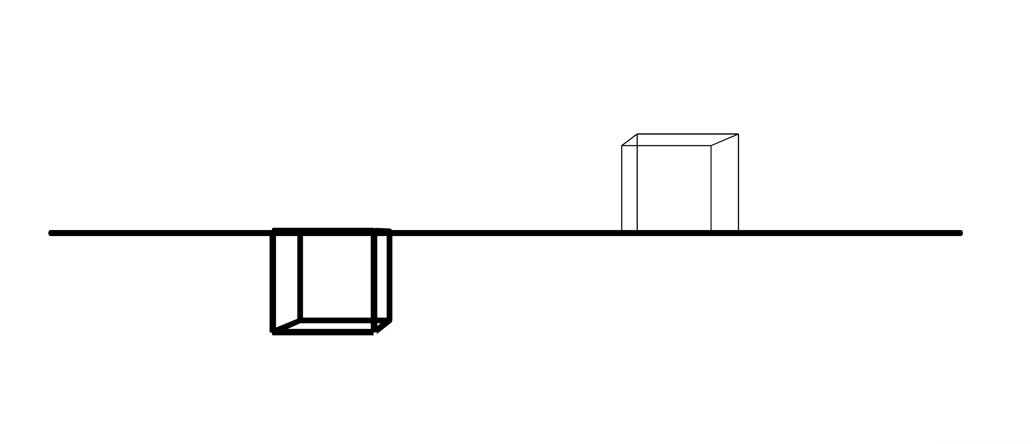

Slide 13
Candy: why the distinction matters
The distinction is not about quality — it's about where the knowledge lives and how you demonstrate it.
If your work is practice-based:
The artefact must be accessible (exhibited, documented, demonstrated).
You must still articulate what knowledge the artefact embodies — but the artefact does crucial work that the writing alone cannot.
Your examiner, reviewer, or audience needs to experience the work, not just read about it.
If your work is practice-led:
The written output carries the primary claim.
The practice generates insight, but the insight is transferable beyond that specific work.
The artefact supports the argument but doesn't replace it.
Most MSc projects at CCI are practice-based. Know which one yours is, and why.
10
Notes:
This has direct implications for how students structure their final submissions. If practice-based, the artefact and its documentation are load-bearing — a weak exhibition or poor documentation sinks the whole project. If practice-led, the written argument is load-bearing — a brilliant artefact won't save a weak text.

Slide 14
Candy: what counts as evidence?
Candy is practical about this. Evidence in practice-based research can include:
The artefact itself, presented in a context where it can be encountered.
Documentation of process (notebooks, iterations, code repositories, video).
Reflective commentary that connects the decisions made to the knowledge produced.
Peer response — exhibition feedback, review, critical reception.
Comparative analysis — how the work differs from, extends, or challenges existing work.
None of these alone is sufficient. The strength is in their combination.
11
Notes:
This directly connects to Weeks 5 and 6 (documentation and reflection). For now, plant the seed: you need to think about evidence from the start, not bolt it on at the end.

Slide 15
Borgdorff: the production of knowledge in artistic research
Henk Borgdorff makes a stronger philosophical claim than either Smith & Dean or Candy.
He argues that artistic practice is not merely a vehicle for research — it is a mode of knowledge production in its own right. The practice doesn't just inform the research; the practice is research.
To make this argument, he draws on a three-part distinction (originally from Christopher Frayling, 1993):
Research into the arts — studying art from the outside (art history, aesthetics, sociology of art).
Research for the arts — instrumental research that serves practice (materials science, tool development).
Research through the arts — research where the artistic practice itself is the epistemic activity.
Borgdorff's position is that the third category — research through the arts — is epistemologically legitimate and distinct.
12
Notes:
This is the most philosophical slide in the deck. Don't rush it. The Frayling triad is simple to state but surprisingly useful for students trying to figure out what kind of research they're doing. Most students' instinctive model is "research *for* the arts" (I study X to make better art). Borgdorff is saying something more radical: the making itself generates knowledge that wouldn't exist otherwise.

Slide 16
Borgdorff: what makes it "research"?
Borgdorff anticipates the obvious objection: "If making art is research, isn't all art research?"
His answer: no. Artistic practice becomes research when it satisfies three conditions:
1. Intent — the practitioner sets out to produce knowledge, not only to make a work.
2. Method — the practice follows some discernible method, even if emergent or improvised, that can be articulated and examined.
3. Context — the work is situated within a relevant discourse, contributing to an ongoing conversation in a field.
Without intent, you have craft. Without method, you have intuition. Without context, you have self-expression. All three have value — but none alone is research.
13
Notes:
This triad (intent, method, context) maps directly onto last week's triad (edge, wager, test). Different language, same underlying logic. Point this out explicitly.

Slide 17
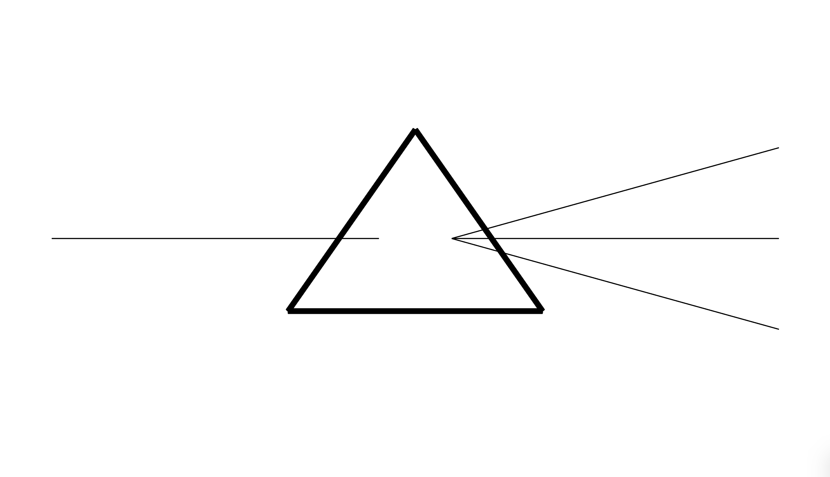

Slide 18
Borgdorff: knowledge that doesn't fit neatly into words
Borgdorff makes a further suggestion that matters for your work. He argues that the knowledge produced through artistic research is often:
Non-propositional — it can't be fully captured in statements of the form "X is true."
Embodied — it's carried in materials, processes, physical actions, perceptual experiences.
Non-discursive — it communicates through forms other than language (sound, movement, visual structure, interaction).
This doesn't make it less real or less rigorous. It means the methods of demonstrating it are different from writing a paper. The artefact, the performance, the installation — these are the vehicles of the knowledge, not just examples of it.
14
Notes:
This is the point where science-background students often push back: "How can something be knowledge if you can't state it propositionally?" Good question. Respond with examples: a surgeon's procedural knowledge, a musician's embodied sense of timing, an engineer's feel for a material. All real, all resistant to full verbalisation. Borgdorff extends this argument to the arts as a domain of inquiry.

Slide 19
Putting the three together
 | Smith & Dean | Candy | Borgdorff
Central claim | Practice and research form an iterative cycle | Practice-based and practice-led are distinct modes | Artistic practice is itself a form of knowledge production
Where knowledge lives | Distributed across the cycle — artefact, text, process | Depends on mode — artefact (based) or text (led) | In the practice and its material outputs
Strength | Maps the process clearly | Gives you practical categories for structuring a project | Provides the philosophical justification
Limitation | Descriptive — doesn't tell you how to evaluate quality | The binary can oversimplify hybrid projects | Can be used to excuse weak articulation ("the work speaks for itself")
15
Notes:
Spend a moment on the limitations row. Each framework has a failure mode. Smith & Dean can become a licence for aimless cycling. Candy can become a pigeonholing exercise. Borgdorff can become a shield against critical scrutiny. Good research uses them as lenses, not as alibis.

Slide 20
The trap: "the work speaks for itself"
The most common misuse of these frameworks — especially Borgdorff's — is the claim that artistic research doesn't need to be articulated because the work speaks for itself.
It doesn't. Or rather: it does, but not to everyone, and not about everything.
The artefact communicates something. But it doesn't communicate its own context, its relationship to prior work, or why its contribution matters.
You still need to write. The writing doesn't replace the work — it does the things the work can't do.
Borgdorff himself is explicit: non-discursive knowledge still needs a discursive frame. The two are complementary.
Don't use these texts as a reason not to write. Use them as a reason to write differently.
16
Notes:
This is the single most important warning in today's lecture. Students who take "practice is research" to mean "I don't need to explain my work" will produce the weakest submissions. The strongest practice-based researchers are also excellent writers — precisely because they understand what language can and can't do.

Slide 21
What this means for your project
Some direct implications:
Your process is part of your output. Document it from the start. Not for assessment bureaucracy — because the choices you make are the research.
Your reading and your making should talk to each other. If your reading list never changes what you build, you're not cycling. If your making never changes what you read, same problem.
Know which mode you're in. Are you producing knowledge that lives in the artefact (practice-based) or knowledge that the artefact helped you discover but that can be stated independently (practice-led)? This determines how you structure everything from documentation to final submission.
Articulate, articulate, articulate. The frameworks give you permission to let the artefact do real epistemic work — but they don't give you permission to be vague about what that work is.
17
Notes:
This is the practical takeaway slide. Pause here and let students think about their own projects. Which mode are they in? Do they know yet? It's fine if they don't — but they should be asking the question.

Slide 22
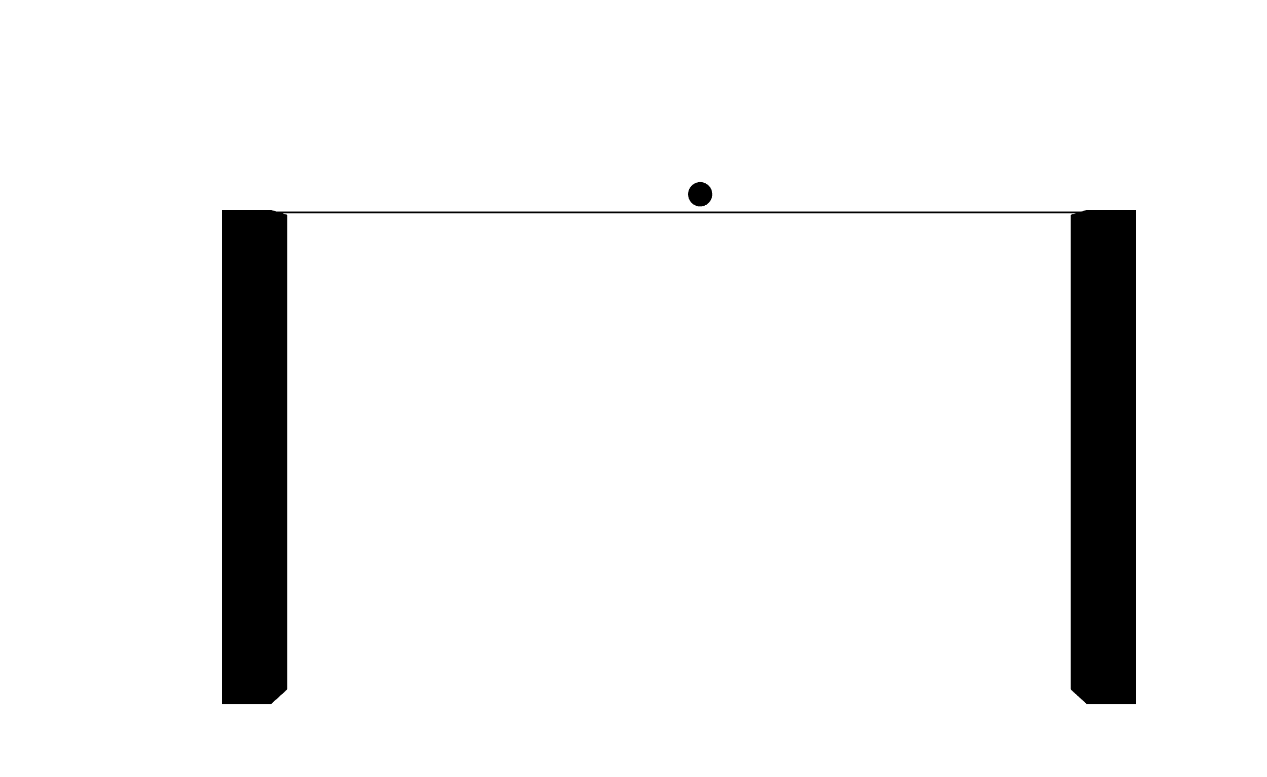

Slide 23
Discussion / exercise (15 minutes)
In pairs or small groups:
1. Take your current project idea (or a project you admire).
2. Try to describe it in Candy's terms: is it practice-based or practice-led?
3. Then apply Borgdorff's three conditions: does it have intent, method, and context?
4. Finally, where are you in Smith & Dean's cycle right now? Which zone are you spending most time in? Which are you neglecting?
Be honest. The point is diagnosis, not performance.
18
Notes:
Give them a full 15 minutes. Circulate and listen. The most useful thing you can do here is ask follow-up questions: "You say it's practice-based — so where does the knowledge live? What would someone need to *experience* to understand your contribution?" Push gently.

Slide 24
For next week
Week 3: Situating research in a field — finding the GAP.
Read one of:
A published paper in your area of interest — any venue (NeurIPS, ISEA, Leonardo, SIGGRAPH, CHI, NIME, etc.)
A review or survey paper that maps a field relevant to your project.
Write a half-page note answering:
What does this paper claim is new?
What prior work does it cite?
What does it not address — and could that gap be your gap?
Bring the note and the paper reference to the session.
19
Notes:
The shift from Week 2 to Week 3 is from "how does practice produce knowledge" to "how do you find out what knowledge is *missing*." The reading task is designed to get them into the literature for the first time. Emphasise: any venue is fine. The goal is to practice reading *as a researcher*, not to find the perfect paper.

Slide 25
Key takeaways
1. Practice and research are not sequential — they cycle. (Smith & Dean)
2. Know whether your knowledge lives in the artefact or in the text — and build accordingly. (Candy)
3. Artistic practice can be a legitimate mode of inquiry — but only with intent, method, and context. (Borgdorff)
4. "The work speaks for itself" is almost always wrong. Write differently, not less.
5. Your process is your research. Document it now. Not later. Now.
20

Slide 26
Questions
What's unclear?
What do you disagree with?
What does this change about how you're thinking about your project?
21

