Slide 1
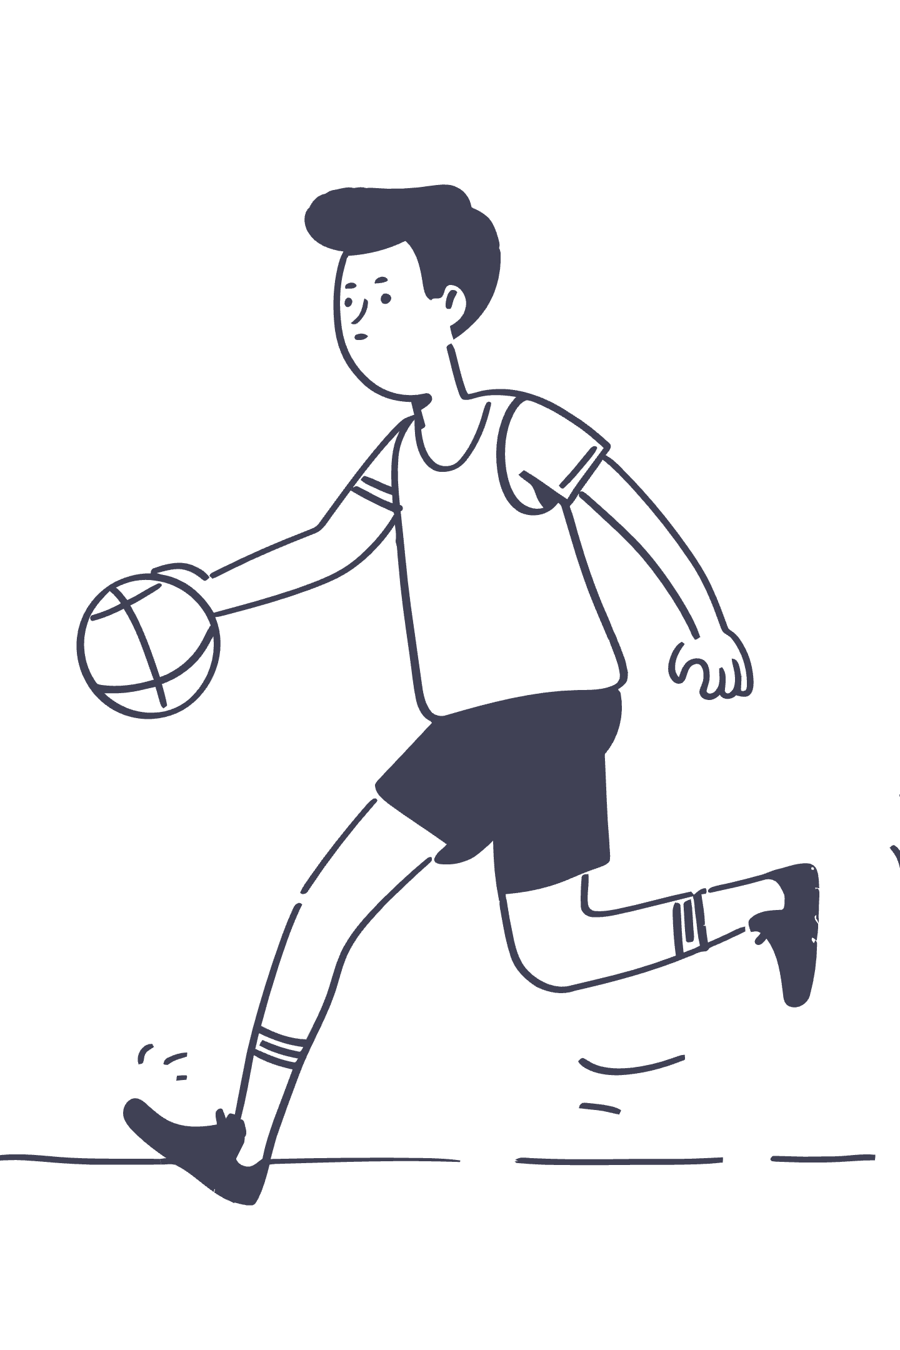
Predicting Chaos: When Data Meets March Madness
Team MJMH
(Misha Semenov, Michael Promisel, Hema Bobba, Jeralene J Maria)

Slide 2




Our Foundation:
A Probability-First Machine Learning Model
Historical NCAA Data
Classification Framework
Tournament matchups, team stats, seeds
Win probability estimation
Log Loss Optimization
Matchup Features
Calibrated probabilities, penalizing overconfidence
Seed diff, tempo, shooting, defense
We built a traditional ML classification model using historical tournament data and matchup-based features as the first step in making predictions.

Slide 3




What the Base Model Measured
Seed & Context
Shooting Profile
Seed difference, location, game importance, neutral-site adjustment
Effective FG%, three-point rate, free throw accuracy, opponent shooting allowed
Defense & Tempo
Playmaking & Impact
Adjusted offensive/defensive efficiency, tempo difference, pace control
Assist differentials, steal rates, block rates, turnover margins

Slide 4
From "Find Cinderella" to "Find Who Gets Upset"
First Idea: Predict " Cinderella"
Try to identify which underdogs will pull off upsets.
Problem: Too Noisy and Broad
Many teams could be Cinderella and usually they have less data available than the favorites.
Reframed: Which Favorites Get Upset?
Focus on vulnerability.
Instead of searching for the best underdog, we chose a different path and tried to predict which team will underperform

Slide 5
The Reality Check
We could build a sound machine learning framework. We could engineer features and tune hyperparameters. But we weren't deep basketball experts who live and breathe March Madness strategy.
The questions haunted us: Which metrics actually matter most in tournament settings? Rebounding? Free throws? Pace? Shot profile? Tournament composure under pressure? The model was strong. Our domain expertise wasn't.
We needed certainty. So we asked expert's opinions.

Slide 6
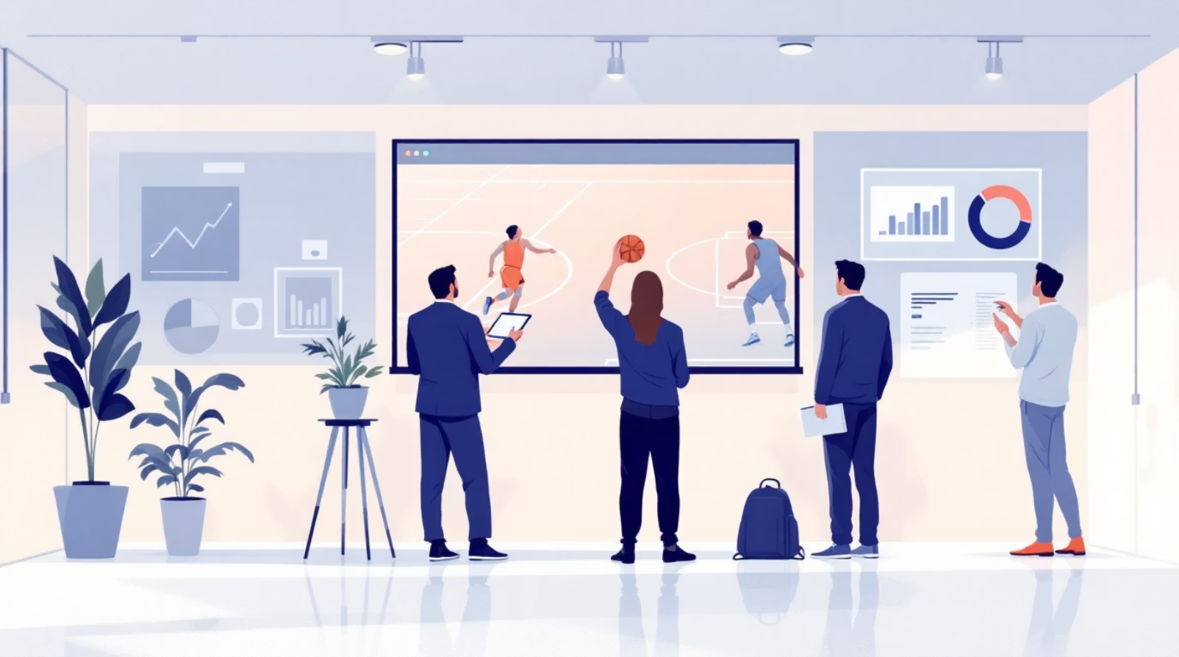
The Expert Opinion Layer
Two Streams of Outside Intelligence
Sentiment analysis from public basketball discussion (Reddit /CollegeBasketball thread)
Expert opinion input via questionnaire (CBS worker who covers March Madness)
The answers were normalized and transformed into predictive features that helped adjust probabilities.

Slide 7
Turning Opinions Into Data: Feature Engineering
01
02
Raw Input Collection
Normalization & Cleaning
Expert forms, public discussion sentiment
Remove bias, standardize scales, filter noise
03
04
Signal Transformation
Team-Level Features
Upset-risk warnings, concern indices, confidence scores, hype indicators
Sentiment-weighted scores, expert vote totals, aggregated adjustment variables
These became measurable inputs that helped us adjust base model probabilities.

Slide 8

What Extra Layers Got Right
4
Correctly Flagged Upset Cases
Expert and sentiment layers identified vulnerability that base model underestimated

Slide 9
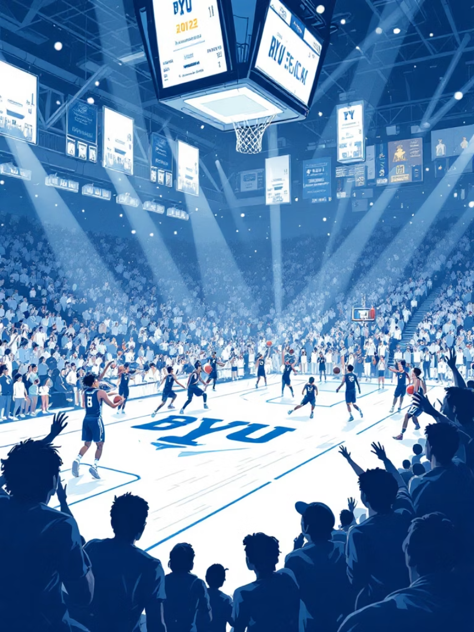
What Happened Next?
BYU was one of the clearest warning cases. Expert opinion and sentiment analysis both strongly suggested vulnerability. The base model still leaned towards the favorite because we did not put enough "trust" in those features.
The Real Lesson
Our base statistical model performed well overall. But we could have guessed 4(!) upsets if assigned enough weight to the expert-opinion,

Slide 10
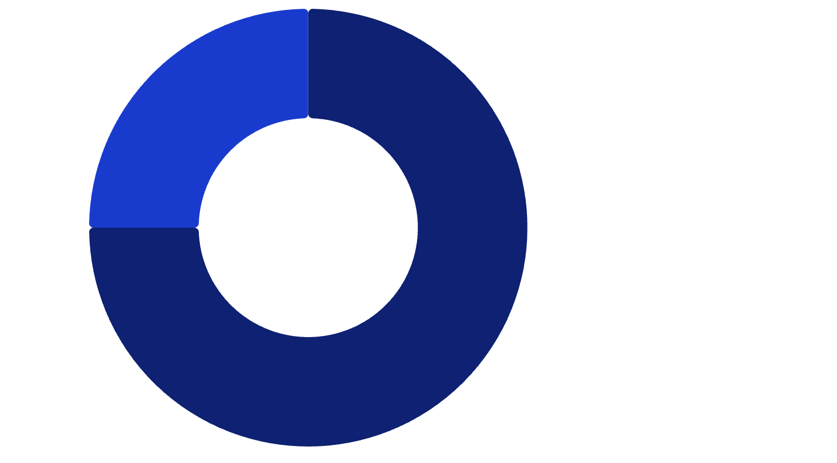
Performance So Far
25%
About the model
Correct Picks·75%
·75%
·
The base model demonstrated 44.9 log loss.
Misses were mainly the upsets.
Could've been even stronger if trusted the experts more.
Incorrect Picks·25%
·
·
75%
With 39 correct picks out of 52 completed games, our model achieved a 75.0% accuracy.

Slide 11
Conclusion & Next Steps
Future Improvements: Refining Our Approach
Preserve Base Model Strength
1
Maintain the robust statistical foundation of our initial ML model, which performed well.
Integrate Expert & Sentiment Layers
2
Continue to incorporate external insights from specialists and public discussion.
Implement Targeted Override Logic
3
Develop selective override rules for teams exhibiting strong underperformance signals or unusual warning signs from expert analysis.

