Slide 1
Examining the Relationship Between Education and Economic Growth: A Country Level Study
1
Team Monet
Faris Al-Dhahi, James Bommentre, Michael Nunbhakdi, Misha Semenov
Data Visualization Spring 2026
Prof. RP Raghupathi

Slide 2
Research Question and Rationale
2
Is there an association between education level and economic growth?
Education was linked to productivity, income growth, and stronger labor market outcomes.
Government investment in education varied significantly across countries and regions. [4, 5]
Prior research showed positive but inconsistent results across income levels and regions.
This study provided evidence to support informed education and economic policy decisions. [3]

Slide 3
Importance
3
Higher education levels were associated with lower poverty rates and a higher standard of living. [2]
Countries that invested more in education tended to show stronger long-term economic performance. [3]
Understanding this relationship can help policymakers decide where to direct education spending.
The findings were relevant to governments, international organizations, and business leaders.
At the individual level, higher education was linked to better employment, higher income and overall quality of life. [1]

Slide 4
Hypotheses and Variables
4
There is a positive association between government education spending and GDP per capita growth.
Higher levels of tertiary enrollment are associated with higher national income levels.
Higher educational attainment is associated with higher GDP growth.
There is an inverse relationship between poverty rates and educational attainment.
  Variables such as education spending, tertiary enrollment, teacher quality, and educational attainment measure development in education.
  GDP growth, GNI per capita, the Gini index, and employment indicators capture overall economic development, income levels, and the labor market.

Slide 5
Data Description
5
59 Countries
7 Years (2014–2020)
13 Variables
Data size (volume): 146 rows × 13 variables × 7 years = 13,286 data points
Source: World Bank — World Development Indicators https://databank.worldbank.org/source/world-development-indicators
Data types: Numeric (integer), Character (categorical)
Scale: Ratio and Nominal
Preprocessing: Data was cleaned and normalized in Excel, with ChatGPT used to assist in structuring and verifying the normalization process.

Slide 6
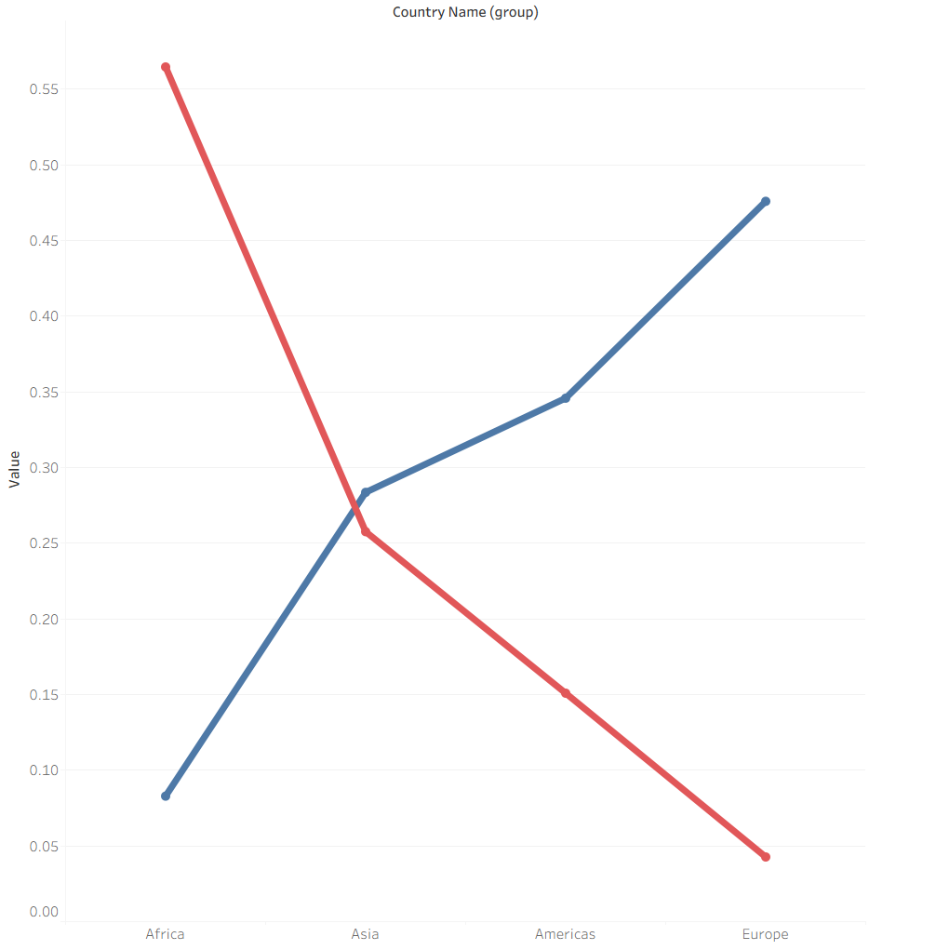

6
Is There an Inverse Relationship Between Tertiary Enrollment and Poverty Across Regions?
Figure 1: A Line Chart of Average Tertiary Enrollment and Poverty Rate Grouped by World Region
Figure 1 is a line chart showing the relationship between average tertiary school enrollment and the average poverty rate across four world regions.
This revealed that as tertiary enrollment increased across regions, poverty rates consistently decreased, with Africa showing the highest poverty and lowest enrollment while Europe showed the opposite.
Countries looking to reduce poverty should consider expanding access to higher education as regions with greater tertiary enrollment consistently showed lower poverty levels.

Slide 7
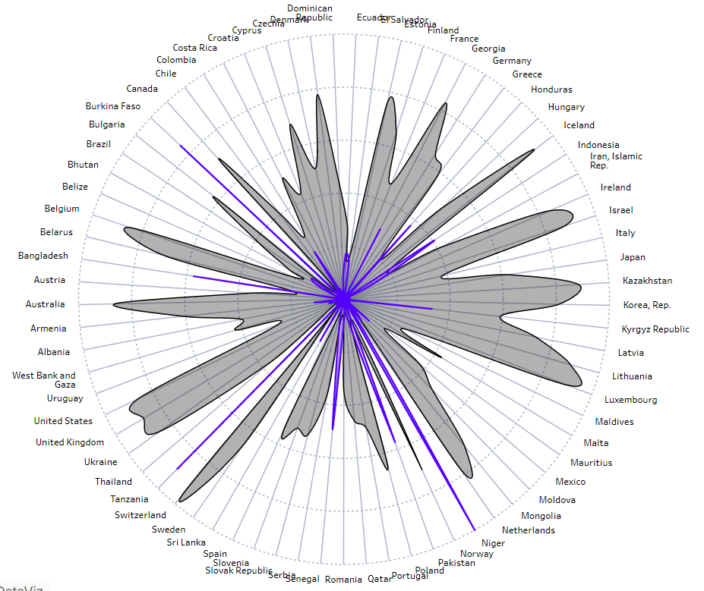
7
Avg. Poverty headcount ($4.20/day)
Is There a Negative Association Between Educational Attainment and Poverty Rates Across Regions?
Avg.Educational Attainment
(At least Bachelor’s)
Figure 2 is a radial chart comparing average bachelor’s attainment and poverty headcount ratios across countries.
Results support the hypothesis and show that higher educational attainment negatively affects economic insecurity (poverty).
Policies that expand access to higher education may help reduce long-term poverty.
Figure 2: A Radial Chart of Poverty Headcount and Bachelor’s Attainment: Country Level Analysis

Slide 8
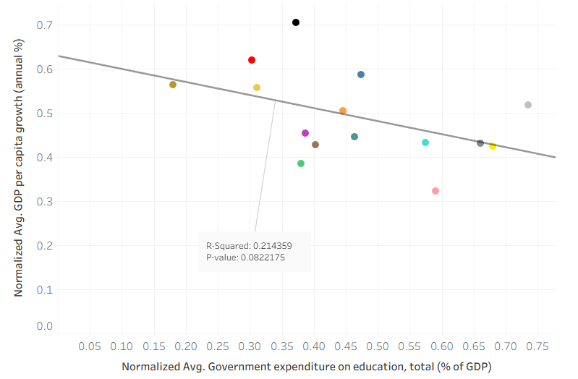
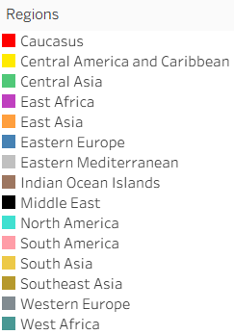
Does government spending on education relate to GDP per capita growth?
8
Figure 3: A scatter plot showing the relationship between average government expenditure on education (% of GDP) and average GDP per capita growth across regions
Figure 3 is a scatter plot showing the relationship between average government expenditure on education (% of GDP) and average GDP per capita growth across countries, with a linear trendline.
The trendline reveals a statistically significant negative association (p-value: 0.08, R²: 0.21); countries that spend more on education tend to have lower GDP per capita growth rates.
Education spending alone does not determine economic growth; policymakers should consider other factors such as trade and infrastructure and see education as a longer term investment when aiming to boost GDP growth.

Slide 9
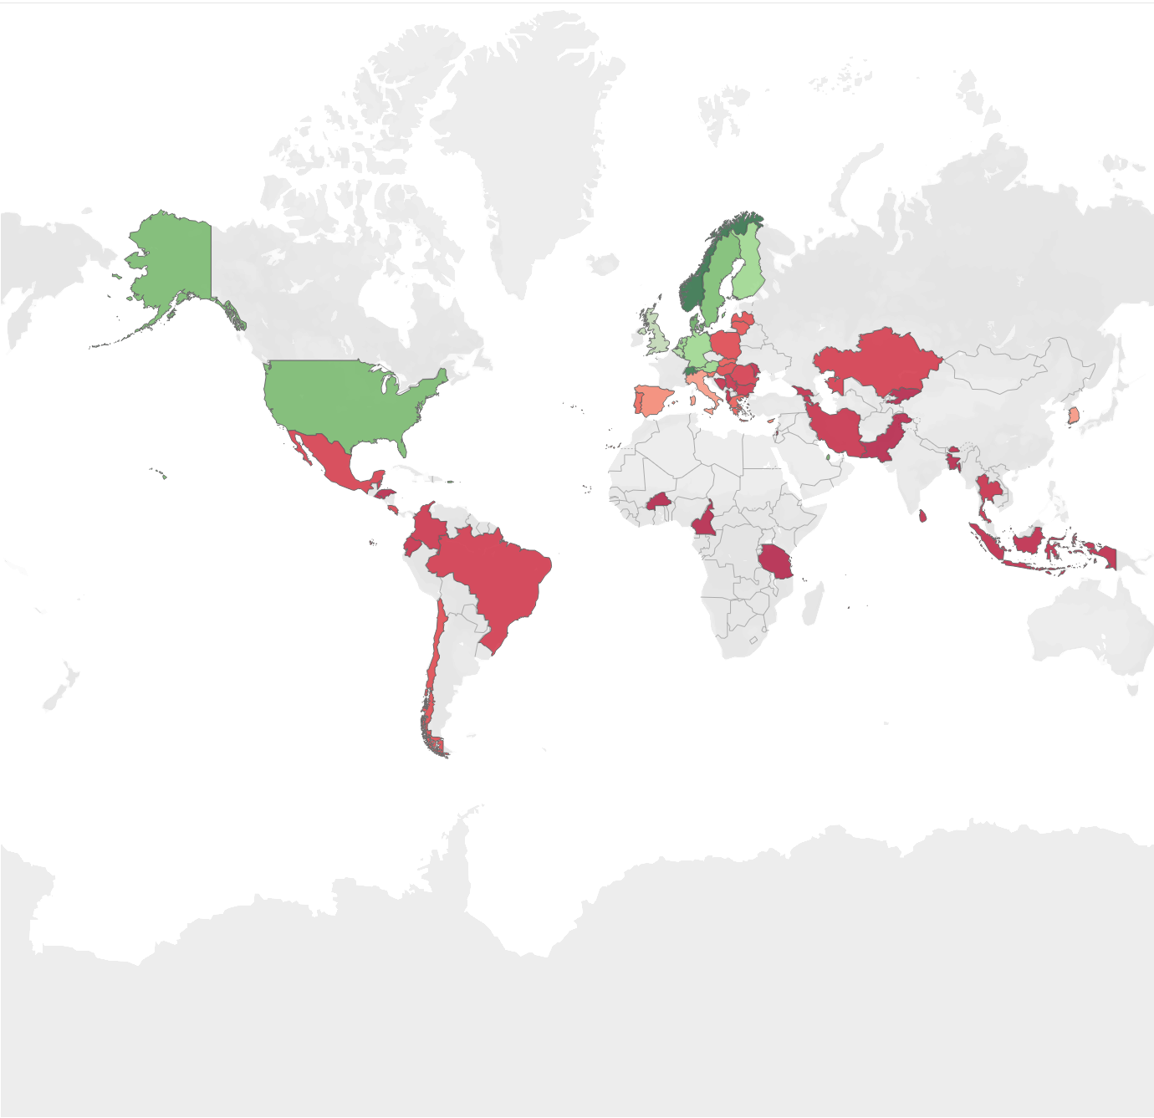
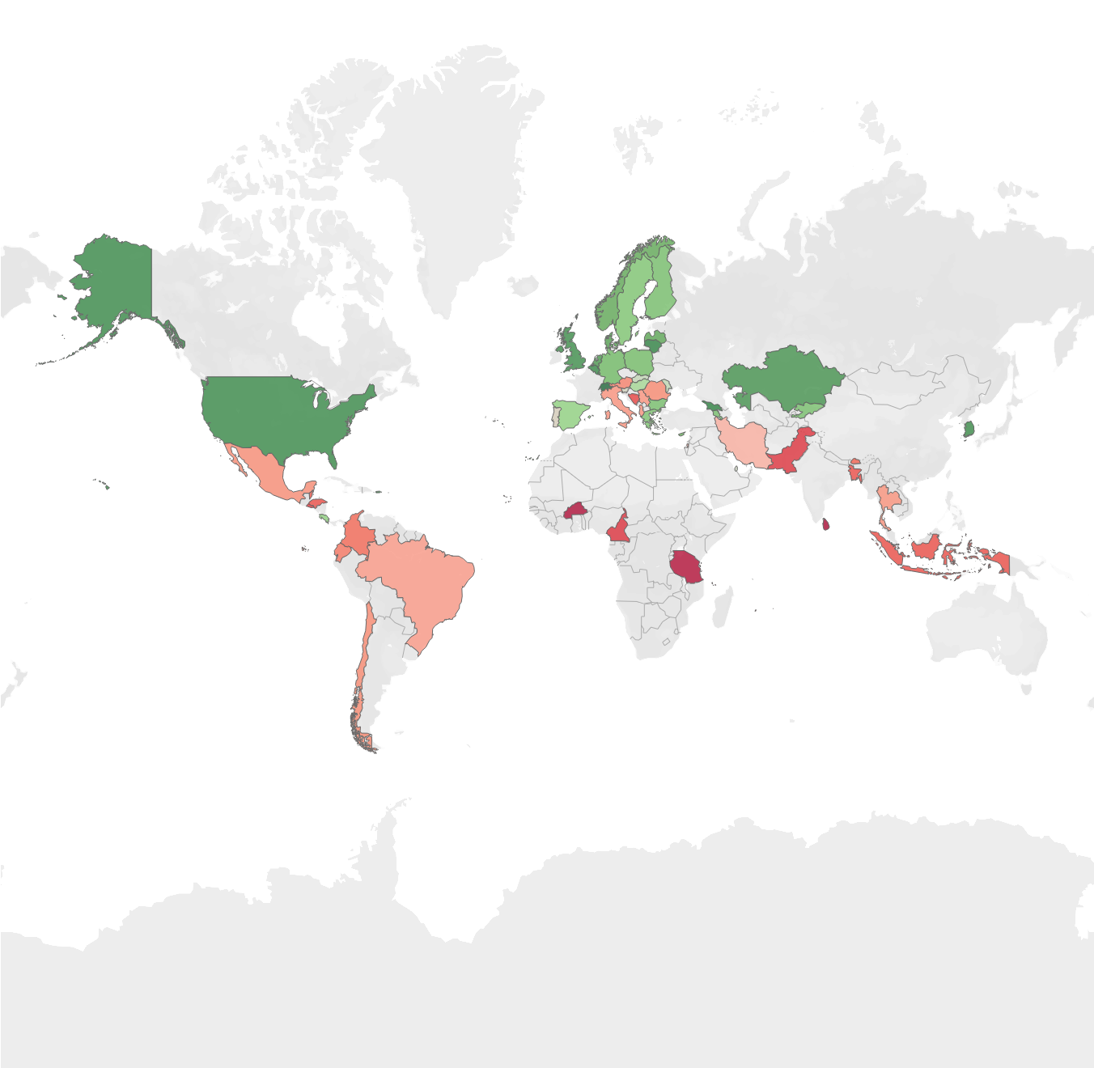
9
Is There a Positive Association Between Educational Attainment and National Income Across Countries?
Figure 4: Side-by-Side Filled Maps of Average Educational Attainment and GNI per Capita Across Countries
This is a side-by-side filled map displaying average educational attainment and GNI per capita across countries from 2014-2020.
This revealed that countries with higher educational attainment consistently showed higher national income, with nearly identical geographic patterns across both maps.
Countries looking to improve national income should prioritize expanding access to higher education as a long-term development strategy.

Slide 10
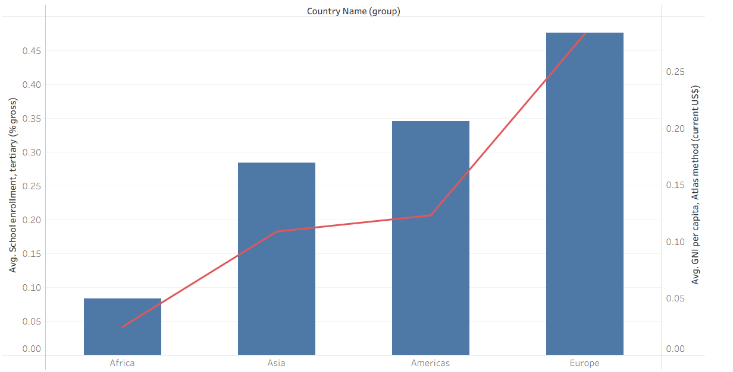

Is There a Positive Relationship Between Tertiary Enrollment and National Income Across Regions?
10
Figure 5: Dual Axis Bar and Line Chart of Average Tertiary Enrollment and GNI per Capita Grouped by World Region
This is a dual-axis bar and line chart showing average tertiary enrollment and GNI per capita across four world regions from 2014-2020.
This showed that as tertiary enrollment increased across regions, so did GNI per capita, with Europe highest and Africa lowest in both.
Countries looking to improve national income should consider expanding access to higher education as a long-term development strategy.

Slide 11
Conclusion & Future Research
11
Overall, higher education levels were positively associated with stronger economic outcomes and lower poverty rates across regions.
There is an inverse relationship between tertiary enrollment and poverty, as enrollment increased across regions, poverty rates consistently decreased.
Countries with higher educational attainment showed significantly lower poverty headcount ratios.
There is a positive association between educational attainment and national income, with countries showing nearly identical geographic patterns across both maps.
Future research should expand the sample size, extend the time period beyond 2020, and explore regional differences within countries. [2, 3, 4]

Slide 12
Scope and Limitations
12
The study covered 59 countries from 2014 to 2020, findings may not apply to all countries and time periods.
The study identified associations, not causation, controlled experiments would be needed to establish direct cause and effect.
Missing data limited country coverage, major countries like China and India were not fully represented.
Uses normalized data to allow for consistent comparison across variables with different scales
Other factors such as governance, infrastructure, and labor market policy were not fully captured.

Slide 13
Implications and Recommendations
13
Governments should treat education spending as a long-term investment, higher spending was linked to stronger GDP growth and lower poverty.
Policymakers should expand access to tertiary education, especially in lower-income countries where enrollment remained low.
Reducing pupil-teacher ratios through teacher hiring and training can improve both education quality and economic outcomes.
International organizations should direct education funding toward high-poverty, low-enrollment countries to address inequality.
Businesses and managers should invest in workforce education and training to improve productivity and drive economic growth.

Slide 14
14
References
Raghupathi, V., & Raghupathi, W. (2020). The influence of education on health: An empirical assessment of OECD countries for the period 1995–2015. Archives of Public Health, 78(20). https://doi.org/10.1186/s13690-020-00402-5
Sultana, T., Dey, S. R., & Tareque, M. (2022). Exploring the linkage between human capital and economic growth: A look at 141 developing and developed countries. Economic Systems, 46(3), 101017. https://doi.org/10.1016/j.ecosys.2022.101017
Hanushek, E. A. (2013). Economic growth in developing countries: The role of human capital. Stanford University. https://hanushek.stanford.edu/sites/default/files/publications/Education%20and%20Economic%20Growth.pdf
Qi, D. (2022). Higher education investment and economic growth: Evidence from global data. Frontiers in Psychology, 13. https://doi.org/10.3389/fpsyg.2022.959026.
Bah, Ibrahim Abubakarr. “The Relationship Between Education and Economic Growth: A Cross-Country Analysis.” Research, Society and Development, vol. 12, no. 5, 2023, article e19312540522. https://doi.org/10.33448/rsd-v12i5.40522
McMahon, Walter W. “The Contribution of Education to Economic Growth.” Knowledge, Evidence and Learning for Development (K4D), UK Department for International Development, 2018. https://assets.publishing.service.gov.uk/media/5b9b87f340f0b67896977bae/K4D_HDR_The_Contribution_of_Education_to_Economic_Growth_Final.pdf

