Slide 1
Potential Ebay Scams
Zion Calvo (zcalvo@ucsc.edu)
Mark Mileyev (mmileyev@gmail.com)
Questions:
How prevalent are fraudulent listings on ebay?
Which categories are more prone to having scams?
Are there any patterns we could find in these items?
Data Sources:
Ebay API: https://developer.ebay.com/DevZone/finding/CallRef/findCompletedItems.html
Scraped Descriptions: https://vi.vipr.ebaydesc.com/ws/eBayISAPI.dll?ViewItemDescV4&item=( ITEM # )
Scraped Seller History: https://feedback.ebay.com/ws/eBayISAPI.dll?ViewFeedback2&userid=%27%20+(USER))

Slide 2
Code / Viz References
Kaggle
Shows Auction Data not Buy it now items
Gave data structure inspiration
Jay Grossman
Used this machine learning project for inspiration on how to structure our scraped data CSV’s
Potentially useful graphs

Slide 3
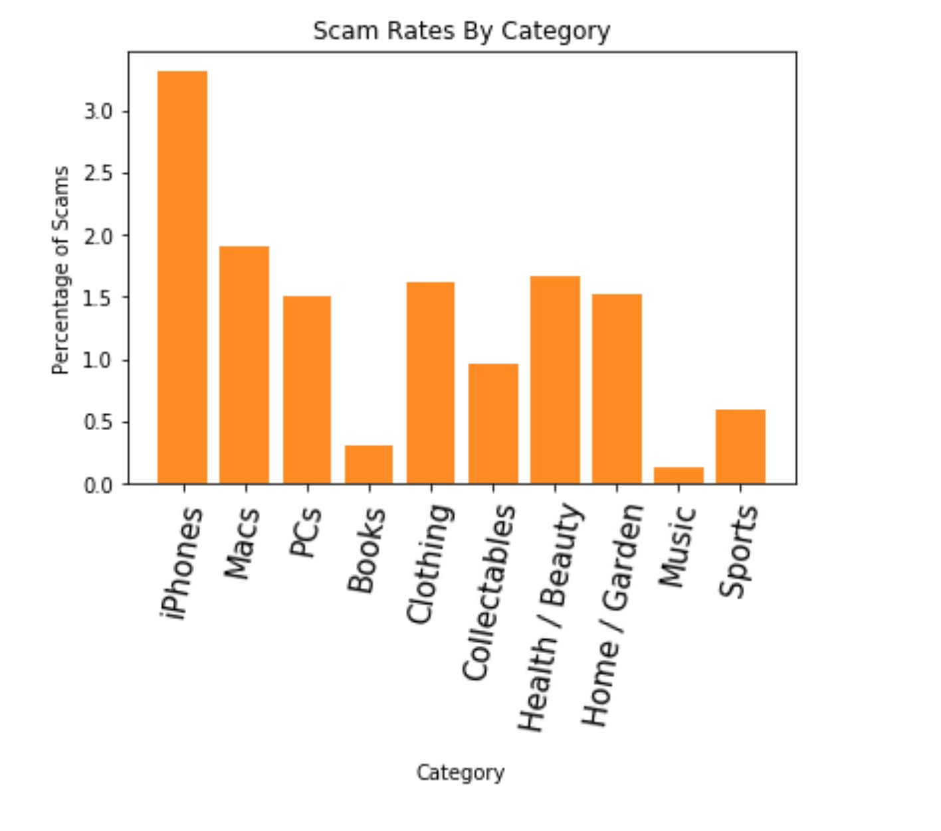
Overview
RESULTS
iPhones had the highest potential scam rate at 3.3%
Books and Music categories appear to have very little fraudulent activity
Other categories vary in the 1-2% range

Slide 4
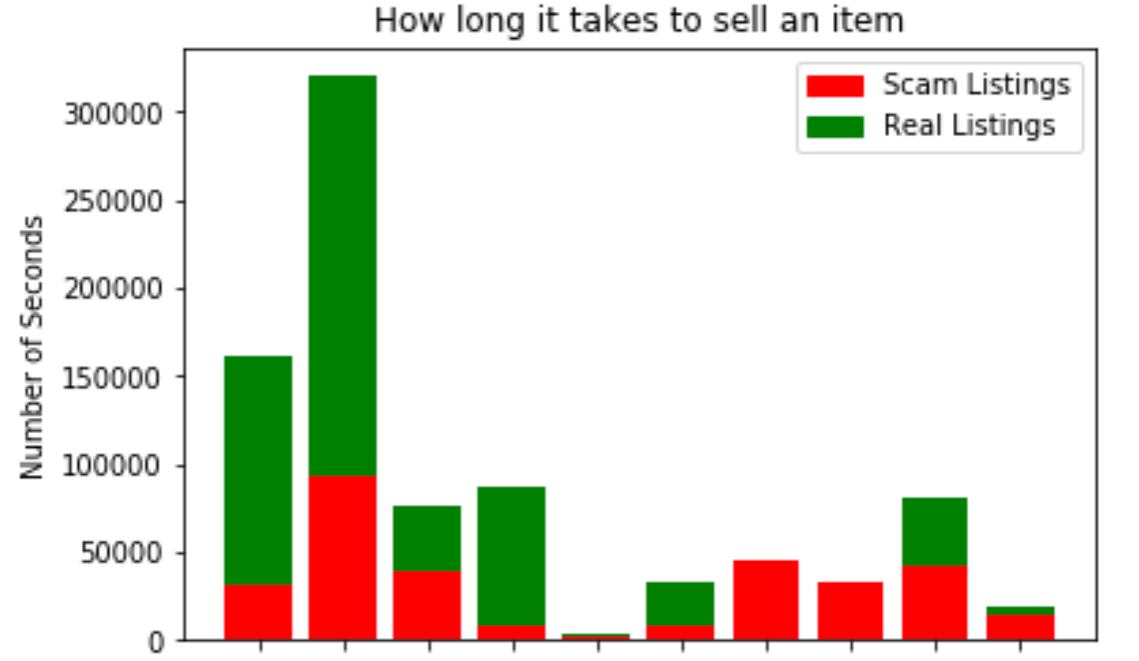
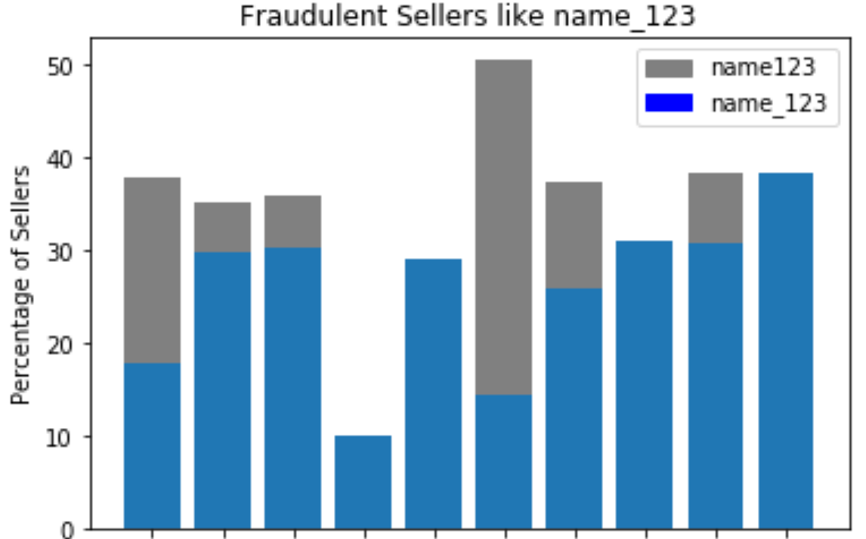
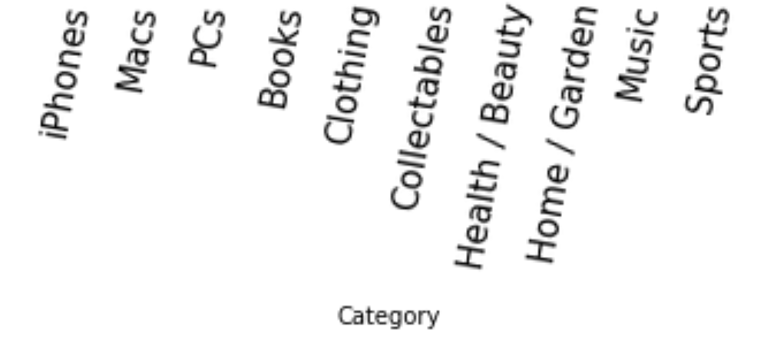
Potentially Fraudulent iPhone listings sell 81% faster than other iPhone listings
Many of the fraudulent seller names follow a pattern suggesting they may be computer generated
Overall, legitimate items take longer due to higher prices

Slide 5
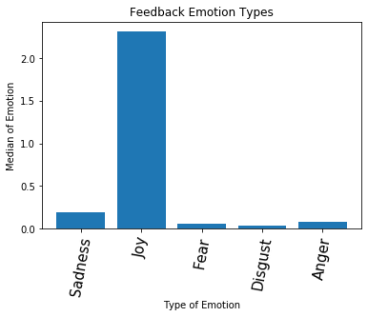
IBM Watson Tone Analyzer shows that the overall sentiment in reviews is positive
We leave out listings with reviews in our possible scam listings because of this positive sentiment

Slide 6
Libraries Used
Pandas
Requests
BeautifulSoup
MatPlotLib
SKLearn
IBM Watson API

Slide 7
Accomplishments
Data Wrangling
Converging multiple data sources into one CSV for each ebay category
Analysis
Using Pandas to effectively answer our questions and filter relevant items
Visualization
Plotted our findings in a format that is easy to understand and visualize

Slide 8
Challenges
Scraping / Building our datasets
Building multiple CSV’s through a multistep process with unpredictable data was a new problem for us
Each scraped item went through a process of first being pulled from ebay API, storing attributes from the API call, then using beautifulsoup to look up the description page of the item and adding onto the attributes. After that, the seller id for the item gets their last 5 reviews scraped with beautifulsoup and requests

