Slide 1
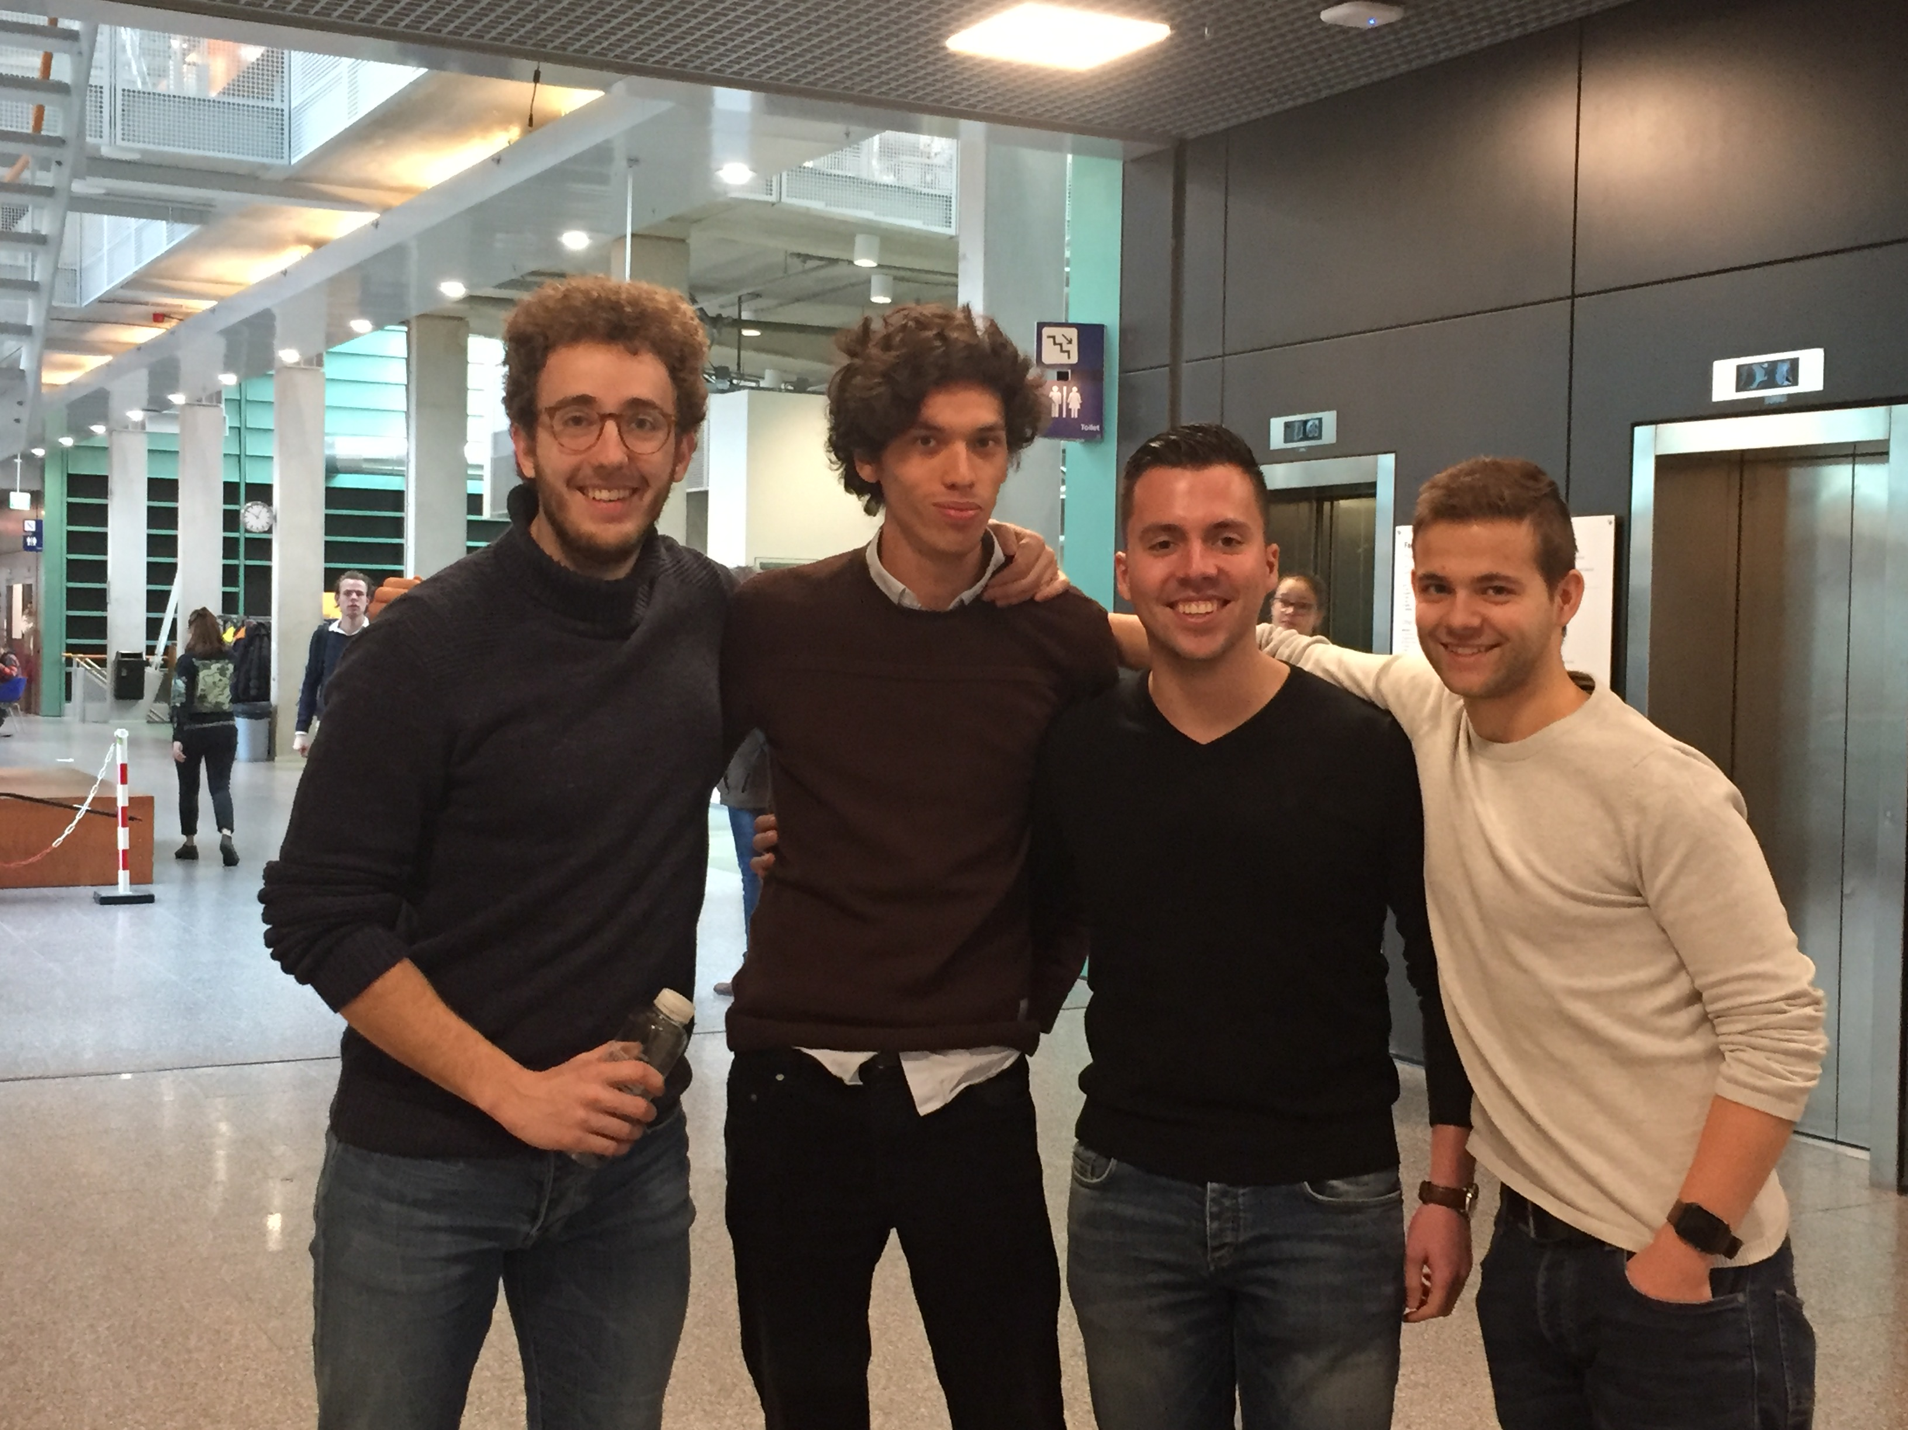

iMaterialist challenge
MLoB
+
Notes:
We’re doing the iMaterialist Challenge. It’s about image classification for clothing items.

Slide 2
Outline
Task distribution
Basic data analysis
Methods
To do

Slide 3
Task distribution
Brian
F1 metric
Dennis
Pre-trained models
Training/testing protocols
Joost
Pre-trained models
Mick
Basic data analysis
Batch generator
Roel
Basic data analysis
Batch generator

Slide 4
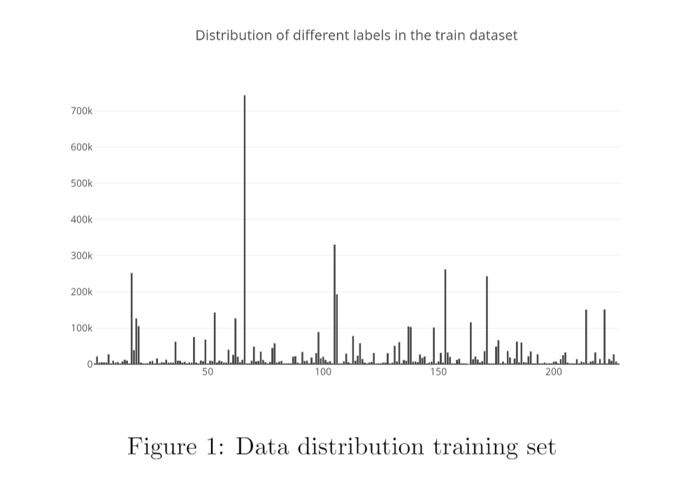
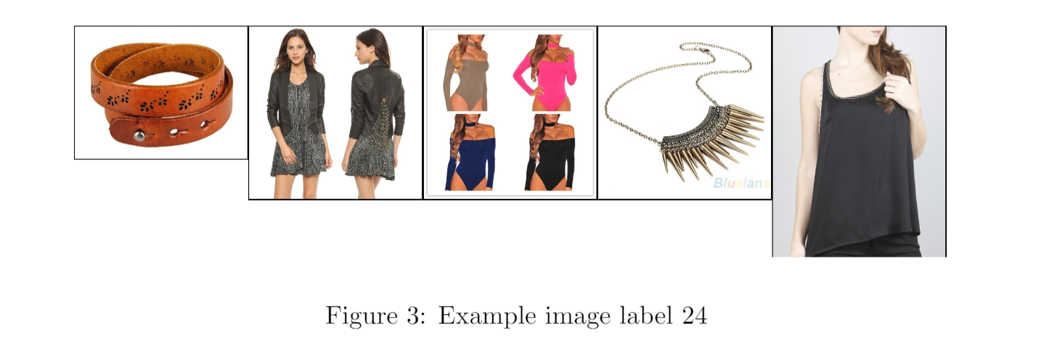
Basic data analysis
1.014.544 training images (+- 80gb)
39.706 test images (+- 3gb)
Imbalanced dataset
Unclear labelling
Notes:
- Dataset imbalance (see image)
- Unclear labeling, suspect that there’s some sort of tree structure, but we do not have information about this.

Slide 5
Methods
Batch generator
Pre-trained models
Inceptionv3
ResNet
Notes:
Batch generator because of size dataset.
Pre-trained models because it performs better and our computational powers are limited.
Freeze last layers etc

Slide 6
To do
Custom multi-label loss function
Ensemble best performing methods

Slide 7
Questions

