Slide 1
Imaterialist Fashion Challenge 2018
MLoB

Slide 2
Outline
Team introduction
Competition
Methods
Results
Discussion

Slide 3
Team
Mick:
Batch generator, Explanatory Data Analysis, GCP, ensembling, thresholding, report
Roel:
Batch generator, Explanatory Data Analysis, Resnet implementation, trhesholding, training networks, report
Dennis:
Implementing networks (Inception, Xception), ML pipeline, Training networks, report
Joost:
Object detection, Ensemble algorithm, report
Brian:
Implementing evaluation method, Object detection, training network, report

Slide 4
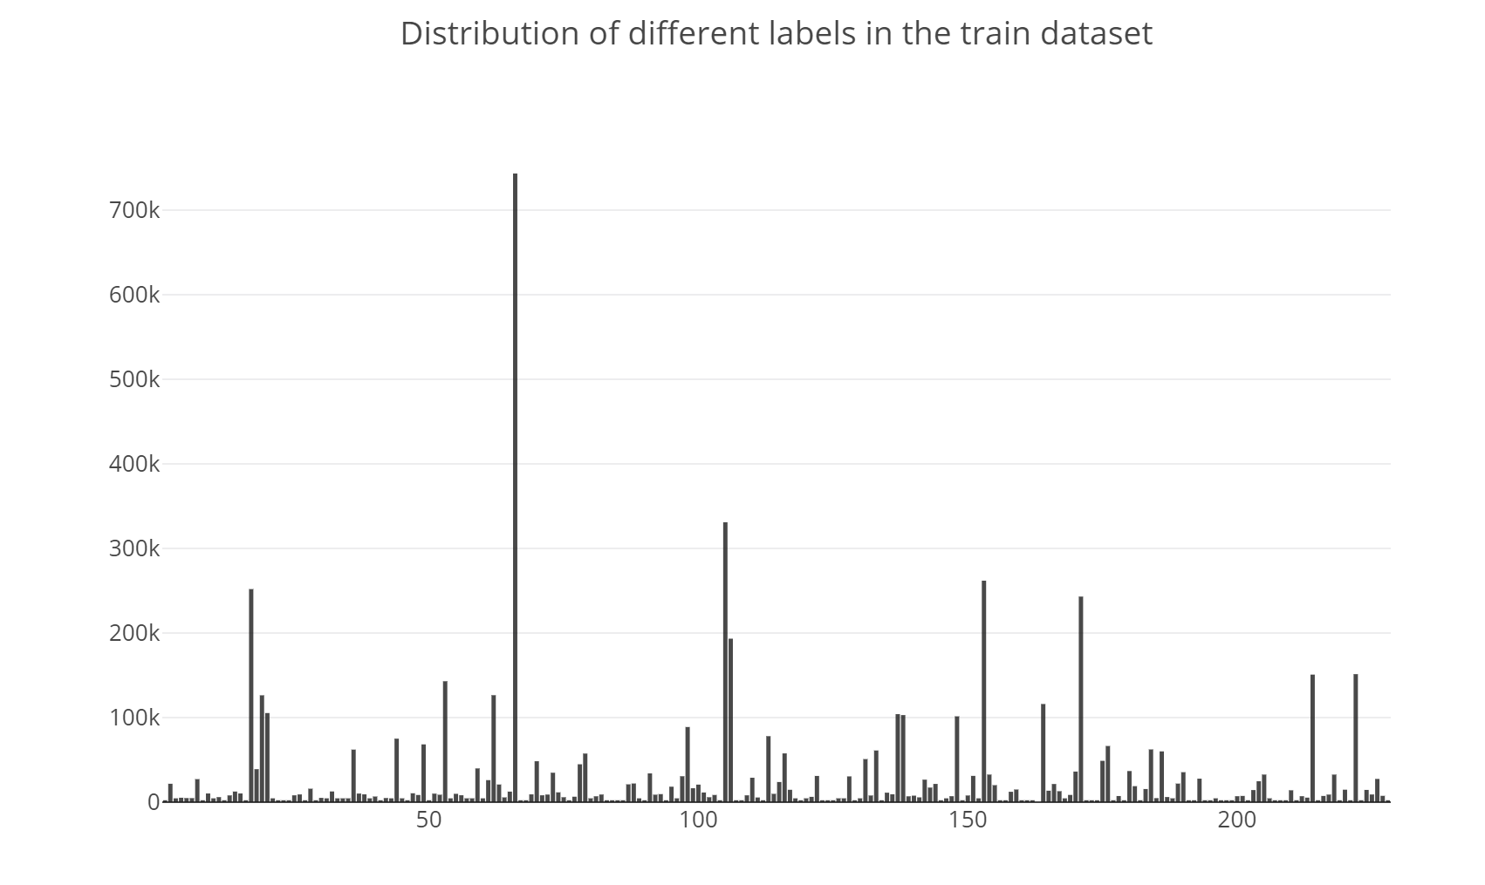
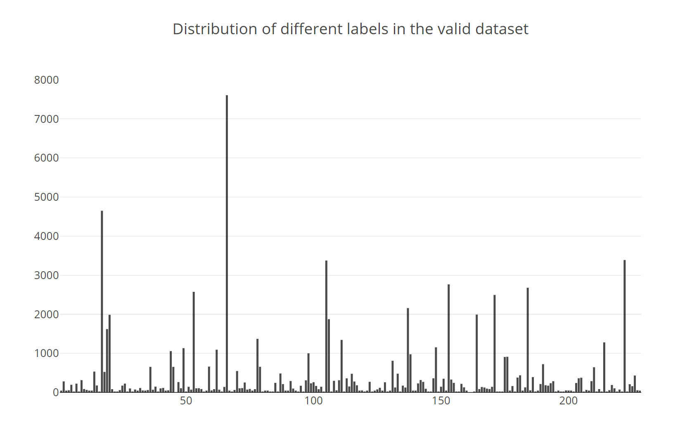
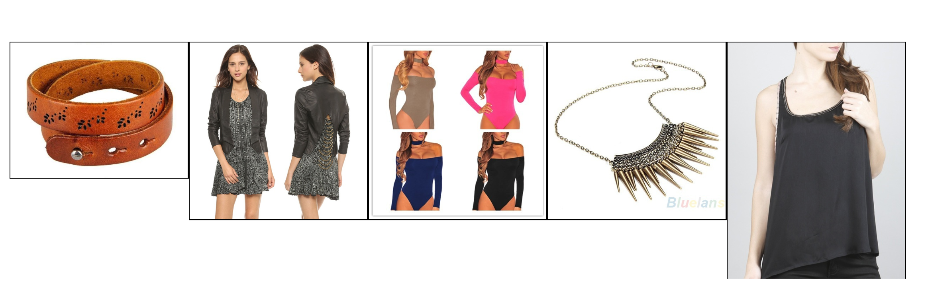
Data Analysis
1.014.544 training images
228 labels in the training dataset
39.706 test images
9.897 validation images
225 labels in validation set
Examples of label 24

Slide 5
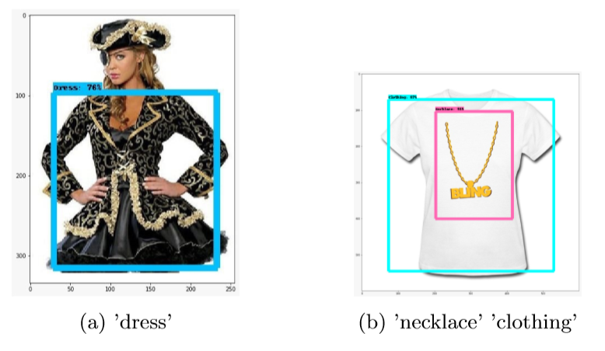
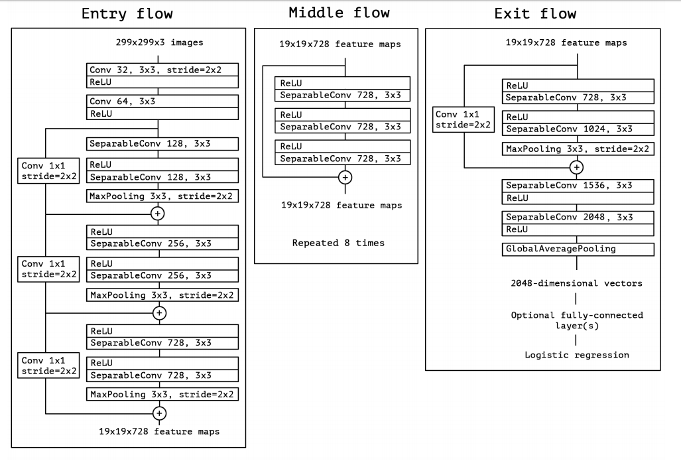
Networks
Object detection
InceptionV3
Xception
ResNet
Pre-compute
Example of object detection
Xception architecture, Chollet, F. (2017). Xception: Deep learning with depthwise separable convolutions. arXiv preprint, 1610-02357.
Notes:
Plaatje toevoegen object detection + xception structuur

Slide 6
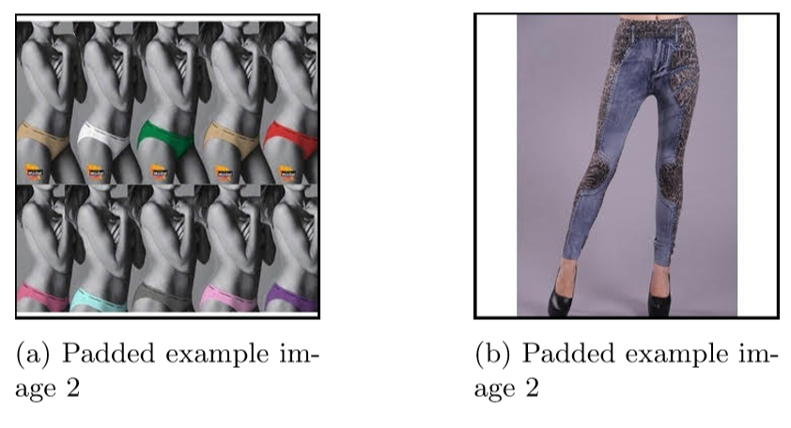
Input differences
Input sizes
224x224
299x299
Data splits
Full
Labels with at least 100 000 occurrences
Labels with at most 100 000 occurrences
Examples of padded images
Notes:
Dropped lower than 500 occ + Plaatje padded image

Slide 7
Ensembling
Ensembling
Soft voting
Partical Swarm Optimization
Thresholding
Finding optimal thresholds per label
Notes:
PSO : Minimize the binary cross entropy

Slide 8
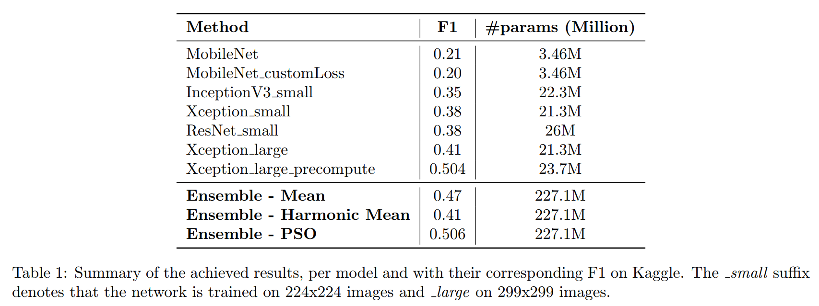
Results
Kaggle final place : 79/212

Slide 9
Reflection
GCP
Simplicity vs Over-Engineering
Stick with the basics (… initially)
Notes:
Conclusie/reflective uit ‘t verslag overnemen

