Slide 1
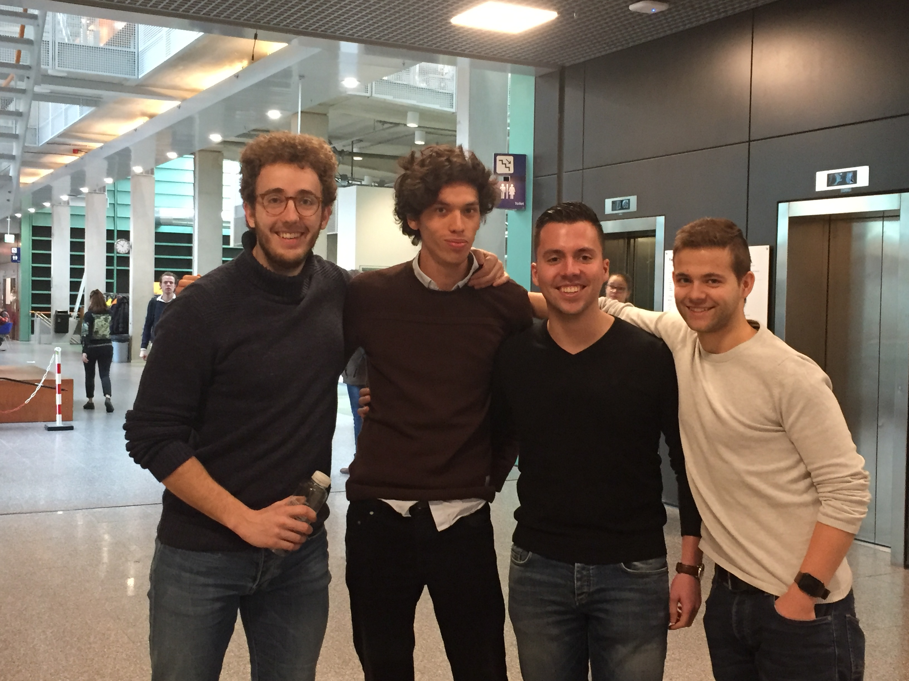
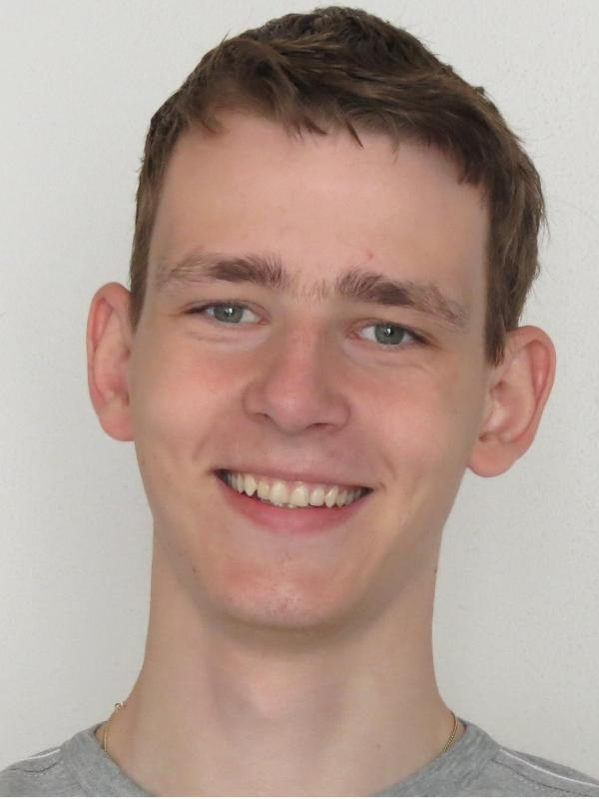
iMaterialist challenge
MLoB
+
Notes:
Hi, our team name is MLoB and we’re Mick and Roel. Our team consists of ourselves, Brian, Dennis and Joost. We’re currently doing the iMaterialist Challenge, which is a challenge where
Competitors are tasked to classify images.

Slide 2
Outline
Task distribution
Basic data analysis
Methods
To do
Notes:
During this presentation we’ll talk about the task distribution, basic data analysis, methods and what we’re going to do for the remaining period of the competition.

Slide 3
Task distribution
Brian
F1 metric
Dennis
Pre-trained models
Joost
Pre-trained models
Mick
Basic data analysis
Batch generator
Roel
Basic data analysis
Batch generator
Notes:
For this past few weeks, Brian was responsible for developing the F1 Metric, Dennis and Joost focused on testing pre-trained models and Roel and myself did the basic data analysis and developed a batch generator.

Slide 4
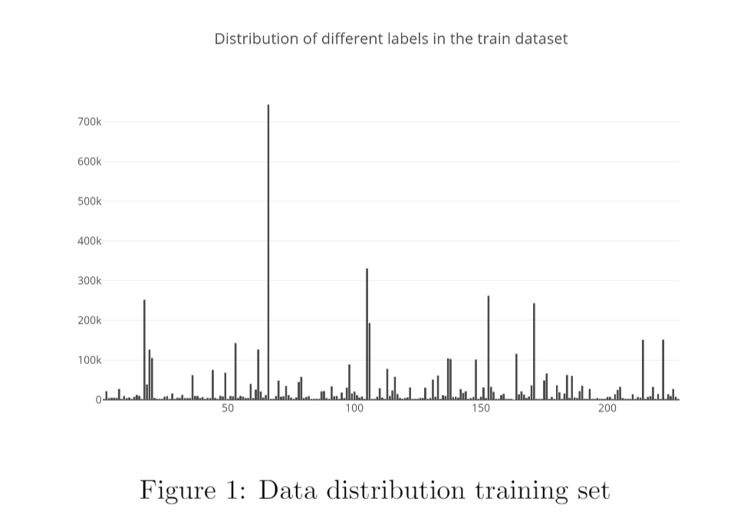
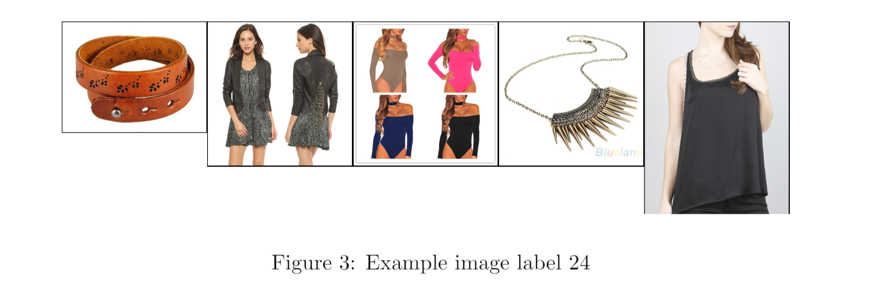
Basic data analysis
1.014.544 training images (+- 80gb)
39.706 test images (+- 3gb)
Imbalanced dataset
Unclear labeling
Notes:
The total training dataset consists of about 1 million images and the test dataset consists of about 40 thousand images. Looking at figure 1, we can see that the dataset is strongly imbalanced. Furthermore, we also noticed that there’s no clear labeling available. Figure 3 shows Five of the images from label 24 and we cannot see any clear connection. We do know that this is a multi-label problem, dus the images that are shown can also be related to other label numbers. However, as the structure of these labels isn’t available, it’s hard for us to interpret. We do suspect that there’s some form of a tree structure, but we do not have any information about this at all.

Slide 5
Methods
Batch generator
Pre-trained models
Inceptionv3
ResNet
Notes:
So far we’ve developed a Batch generator because of size dataset. This generator takes care of the pre processing of the images, which include the dimensions, normalization, horizontal flipping etc.
Of course we use convolutional neural networks, for this challenge we used pre-trained models because it performs better and our computational powers are limited to build a model from scratch.
So far we’ve experimented with two pre-trained networks, the inceptionv3 and the resnet. For this we keep all parameters intact but we unfreeze the last layers to decrease complexity but still be able to capture higher order complexity.

Slide 6
To do
Address multi-label class issues
Ensemble best performing methods
Notes:
For the rest of the course we plan to do a multi label loss function, since each sample image contain many zero class labels, models easily overfit to naïve predictions.
If we have multiple working models we plan to ensemble these together for a final prediction

Slide 7
Questions

