Slide 1
Restaurant Revenue Analysis
Objective: The main objective of the project is to gain insights into the restaurant's sales performance, identify top-selling products, and understand trends in customer purchasing behavior.

Slide 2
Problem Statement
KPI’s Requirement We need to analyze key indicators for our pizza sales data to gain insights into our business performance. Specifically, we want to calculate the following metrics: 1. Total Revenue: The sum of total price of all pizza orders.
2. Average Order Value: The average amount spent per order, calculated by dividing the total revenue by the total number of orders.
3. Total Pizzas Sold: The sum of the quantities of all pizzas sold.
4. Total Orders: The total number of orders placed.
5. Average Pizzas Per Order: Calculated by dividing the total number of pizzas sold by the total number of orders.

Slide 3
Problem Statement
Charts Requirement We would like to visualize various aspects of our pizza sales data to gain insights and understand key trends. We have identified the following requirements for creating charts: 1.Daily Trend for Total Orders: Create a bar chart that displays the daily trend of total orders over a specific time period. This chart will help us identify any patterns or fluctuations in order volumes on a daily basis.
2. Hourly Trend for Total Orders: Create a line chart that illustrates the hourly trend of total orders throughout the day. This chart will allow us to identify peak hours or periods of high order activity.
3. Percentage of Sales by Pizza Category: Create a pie chart that shows the distribution of sales across different pizza categories. This chart will provide insights into the popularity of various pizza category and their contribution of overall sales.

Slide 4
Problem Statement
Charts Requirement 4. Percentage of Sales by Pizza Size: Generate a pie chart that represents the percentage of sales attributed to different pizza sizes. This chart will help us understand customer preferences for pizza sizes and their impact on sales.
5. Total Pizzas Sold by Pizza Category: Create a funnel chart that presents the total number of pizzas sold for each pizza category. .
6. Top 5 Best Sellers by Total Pizzas Sold: Create a bar chart highlighting the top 5 best-selling pizzas based on the total number of pizzas sold.
7. Bottom 5 Worst Sellers by Total Pizzas Sold: Create a bar chart highlighting the bottom 5 worst-selling pizzas based on the total number of pizzas sold.

Slide 5


Tools Used
MS Office/ Excel
MS SQL Server

Slide 6
Steps Performed
Imported Data into MS SQL Database: Created a database named Pizza DB. Imported the table pizza_sales in this database.
After importing the file, fired the following SQL queries :
Total Revenue
SELECT SUM(total_price) as Total_Revenue FROM pizza_sales
Average Order Value
SELECT SUM(total_price)/ COUNT(DISTINCT order_id) as Avg_Order_value from pizza_sales

Slide 7
Total Pizza Sold
Select SUM(quantity) AS Total_Pizza_Sold from pizza_sales
Total Orders
Select COUNT(DISTINCT order_id) AS TotalOrders from pizza_sales
Average Pizza Per Order
SELECT CAST(CAST(SUM(quantity) AS DECIMAL(10,2)) /
CAST(COUNT(DISTINCT order_id) AS DECIMAL(10,2)) AS DECIMAL(10,2))
AS Avg_Pizzas_per_order
FROM pizza_sales

Slide 8
Daily Trend for Total Orders
SELECT DATENAME(DW, order_date) AS order_day, COUNT(DISTINCT order_id) AS total_orders
FROM pizza_sales
GROUP BY DATENAME(DW, order_date)
Hourly Trend for Orders
SELECT DATEPART(HOUR, order_time) as order_hours, COUNT(DISTINCT order_id) as total_orders
from pizza_sales
group by DATEPART(HOUR, order_time)
order by DATEPART(HOUR, order_time)

Slide 9
% of Sales by Pizza Category
SELECT pizza_category, CAST(SUM(total_price) AS DECIMAL(10,2)) as total_revenue,
CAST(SUM(total_price) * 100 / (SELECT SUM(total_price) from pizza_sales) AS DECIMAL(10,2)) AS PCT
FROM pizza_sales
GROUP BY pizza_category
# for January Month
SELECT pizza_category, CAST(SUM(total_price) AS DECIMAL(10,2)) as total_revenue,
CAST(SUM(total_price) * 100 / (SELECT SUM(total_price) from pizza_sales WHERE MONTH(order_date) = 1) AS DECIMAL(10,2)) AS PCT
FROM pizza_sales
WHERE MONTH(order_date) = 1
GROUP BY pizza_category

Slide 10
% of Sales by Pizza Size
SELECT pizza_size, CAST(SUM(total_price) AS DECIMAL(10,2)) as total_revenue,
CAST(SUM(total_price) * 100 / (SELECT SUM(total_price) from pizza_sales) AS DECIMAL(10,2)) AS PCT
FROM pizza_sales
GROUP BY pizza_size
ORDER BY pizza_size
For 1st Quarter
SELECT pizza_size, CAST(SUM(total_price) AS DECIMAL(10,2)) as total_revenue,
CAST(SUM(total_price) * 100 / (SELECT SUM(total_price) from pizza_sales WHERE DATEPART(quarter, order_date)=1) AS DECIMAL(10,2)) AS PCT
FROM pizza_sales WHERE DATEPART(quarter, order_date)=1
GROUP BY pizza_size
ORDER BY pizza_size

Slide 11
Total Pizzas Sold by Pizza Category
SELECT pizza_category,SUM(quantity) AS Total_Pizza_Sold FROM pizza_sales
GROUP BY pizza_category
ORDER BY pizza_category
Top 5 Best Sellers by Total Pizzas Sold
SELECT Top 5 pizza_name, SUM(quantity) AS Total_Pizza_Sold
FROM pizza_sales
GROUP BY pizza_name
ORDER BY Total_Pizza_Sold DESC

Slide 12
USNIG CTE
WITH PizzaRank AS (
SELECT
pizza_name,
SUM(quantity) AS total_quantity,
RANK() OVER (ORDER BY SUM(quantity) DESC) AS sales_rank
FROM
pizza_sales
GROUP BY
pizza_name
)
SELECT
pizza_name,
total_quantity
FROM
PizzaRank
WHERE
sales_rank <= 5;

Slide 13
Bottom 5 Best Sellers by Total Pizzas Sold
SELECT TOP 5 pizza_name, SUM(quantity) AS Total_Pizza_Sold
FROM pizza_sales
GROUP BY pizza_name
ORDER BY Total_Pizza_Sold ASC
Using CTE
WITH PizzaRank AS (
SELECT
pizza_name,
SUM(quantity) AS total_quantity,
RANK() OVER (ORDER BY SUM(quantity) ASC) AS sales_rank
FROM
pizza_sales
GROUP BY
pizza_name
)
SELECT
pizza_name,
total_quantity
FROM
PizzaRank
WHERE
sales_rank <= 5;

Slide 14
Steps Performed
2. Data Cleaning: Converted pizza_size column values.
S -> Small, M -> Medium, L -> Large, XL -> X-Large and XXL - > XX-Large
3. Data Preprocessing:
Fetched Day name from order_date column.
= TEXT(E2, “dddd”)
Converted order_id to distinct Order Id using:
=1/(COUNTIF(B:B,B2))

Slide 15
Steps Performed
4. Data Analysis: Calculated the KPI’s required for the dashboard using Pivot Table.
KPI’ s : Total Revenue, Average Order Value, Total Pizzas Sold. Total Orders and Average Pizzas Per Order

Slide 16
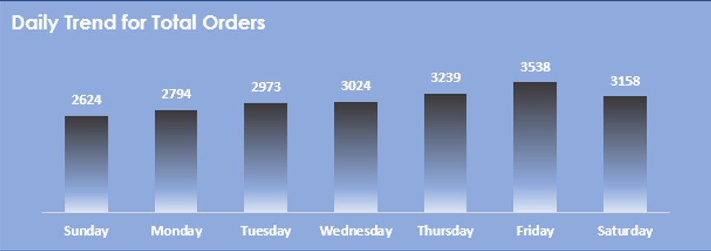
5. Data Visualization and Dashboard Building:
A bar chart to show the trend of total orders day-wise. On weekend(Friday/Saturday) the orders are highest.

Slide 17
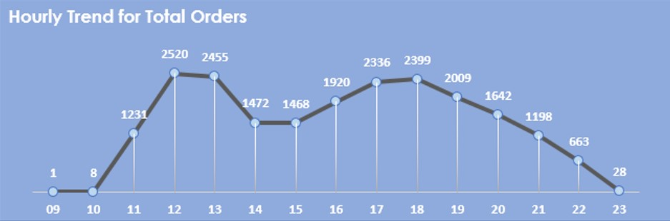
5. Data Visualization and Dashboard Building:
A line chart to show the trend of total orders hourly. There maximum orders between 12-01 PM and 5-6PM.

Slide 18
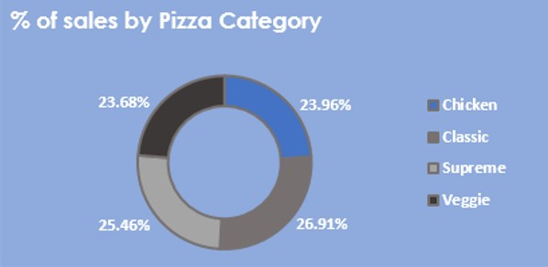
5. Data Visualization and Dashboard Building:
A donut chart to show the category-wise % of sales of Pizzas Classic pizza has the highest % of total orders(26.91%) followed by Supreme(25.46%).

Slide 19
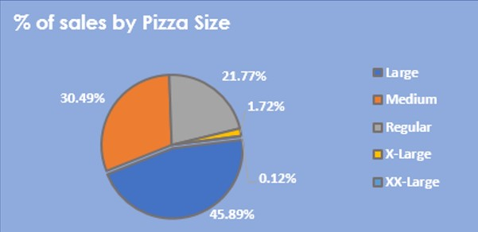
5. Data Visualization and Dashboard Building:
A pie chart to show the size-wise % of sales of Pizzas Large size pizza has the highest % of total orders(45.89%) followed by Medium(30.49%).

Slide 20
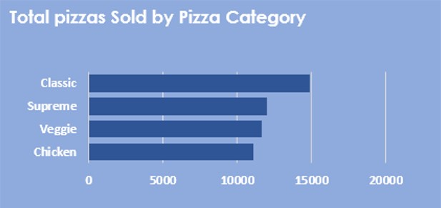
5. Data Visualization and Dashboard Building:
A bar chart to show the total pizza sold by each category .
Classic pizza has the highest total orders followed by Supreme.

Slide 21
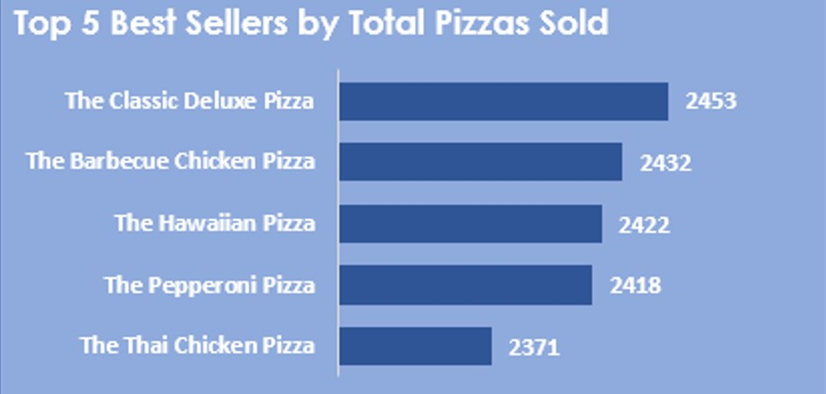
5. Data Visualization and Dashboard Building:
A bar chart to show the Top 5 Best selling pizzas.
The Classic Deluxe pizza Best-Selling pizza.

Slide 22
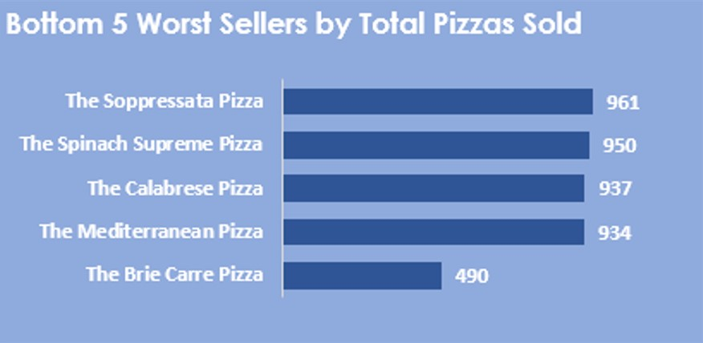
5. Data Visualization and Dashboard Building:
A bar chart to show the Bottom 5 Worst selling pizzas.
The Brie Carre pizza Worst-Selling pizza.

Slide 23
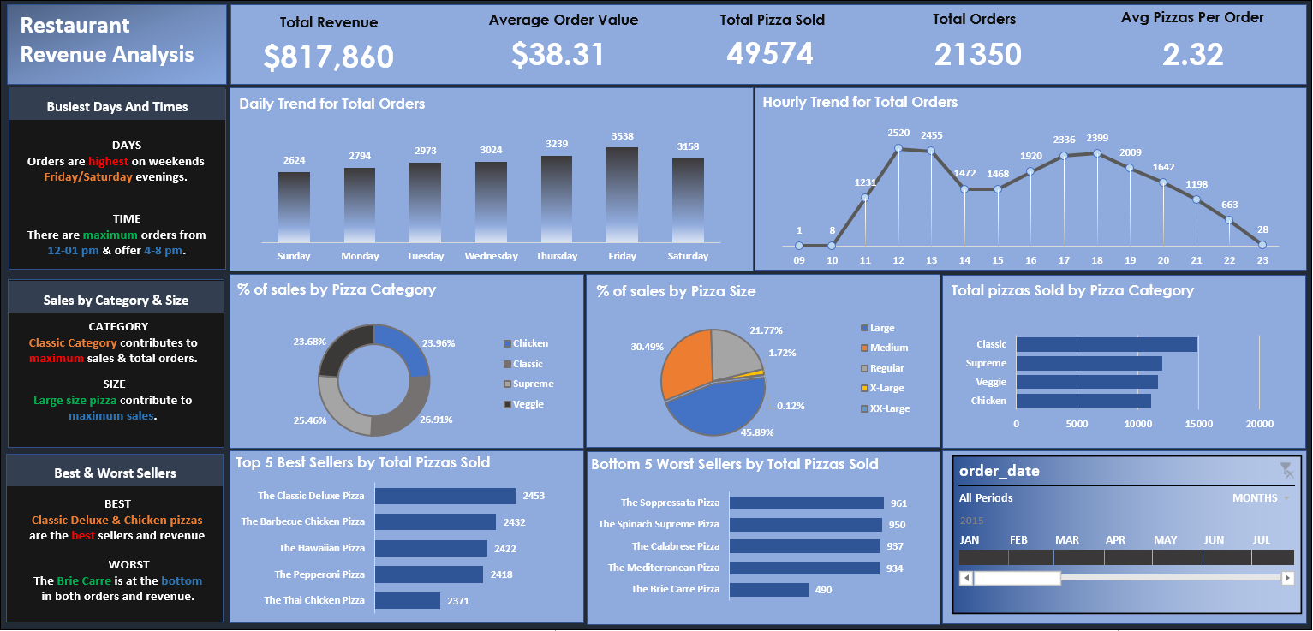
Final Dashboard

