Slide 1

BM Library

Slide 2
Team members:
 | First Name | Work in | Email
Team Leader | Michael Raafat Mafdy | Movie And Books Items and Screens | 220180085@fa-hists.edu.eg
2nd Team Member | Mohammed Osama Mohammed | Adobe XD Design | 220180185@fa-hists.edu.eg
3rd Team Member | Mohammed Yahia Mohammed | Main and RLSCREEN | 220180127@fa-hists.edu.eg
4th Team Member | Ahmed Nasser Hamdy | DARKMODE SYSTEM | 220180462@fa-hists.edu.eg
5th Team Member | Mostafa Khaled Mostafa | LOGIN AND REGISTER | 220180145@fa-hists.edu.eg
6th Team Member | Bassam Khaled Ahmed | STAR AND COVER SYSTEM | 220180413@fa-hists.edu.eg
7th Team Member | Mohammed Ehab Mohammed | BMCHOICES | 220180275@fa-hists.edu.eg

Slide 3
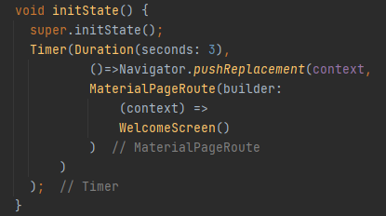
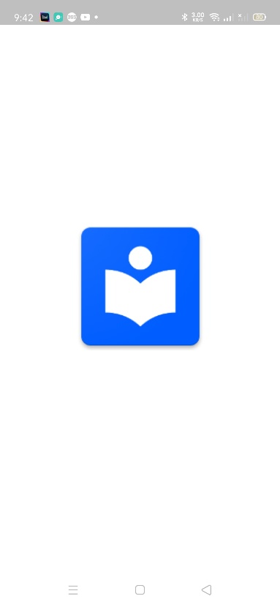
Main (SPLASH SCREEN)
Dart :- That Make Screen Able to Disappear After 3 Seconds.
Flutter :- Design Of Splash Screen in flutter (Background And Icon).

Slide 4

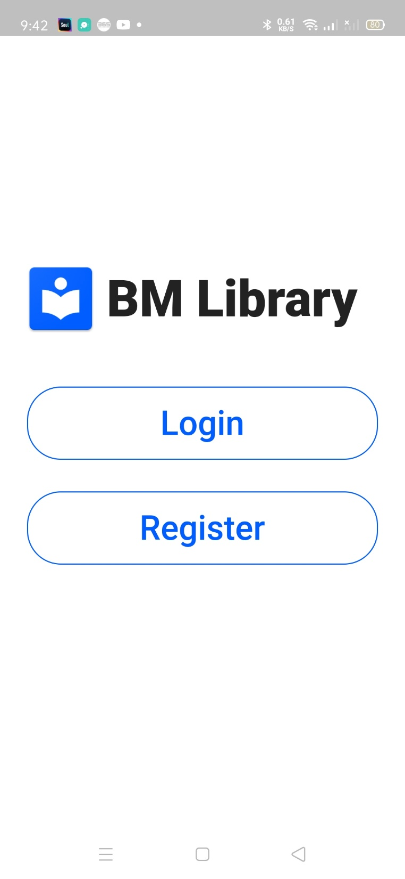
RLScreen (Register or Login)
Dart :- That Make Screen Navigator to Login Screen on Press Login Button.
Dart :- That Make Screen Navigator to Login Screen on Press Register Button.
Flutter :- Design Of Screen in flutter (Icon ,Text And 2 Rounded Icon Button).

Slide 5
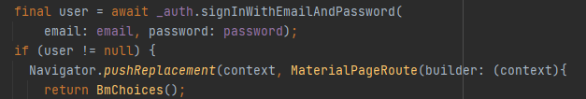
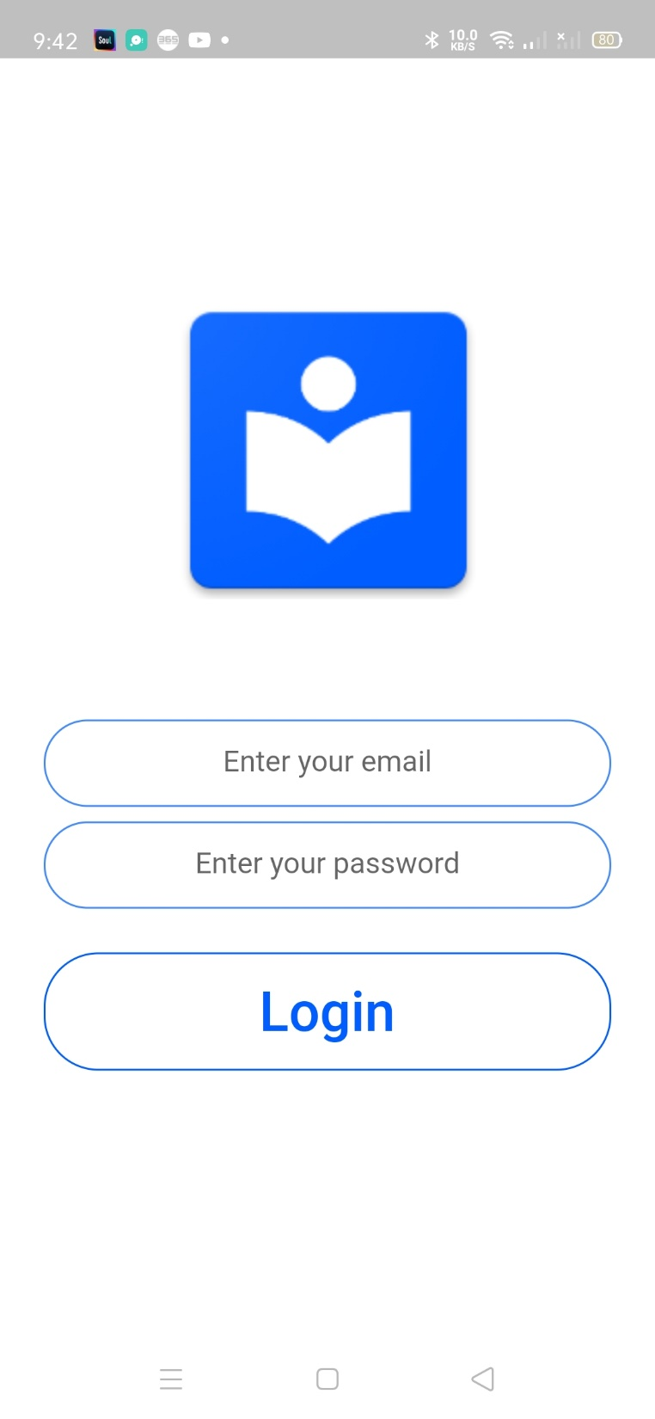
Login Screen
Dart :- That Check If Account Exited and then Navigator to BMCHOICES Screen After Press Login Button.
Flutter :- Design Of Screen in flutter (Icon , 2 TextField And Rounded Icon Button).

Slide 6
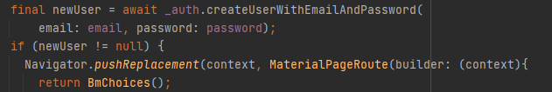
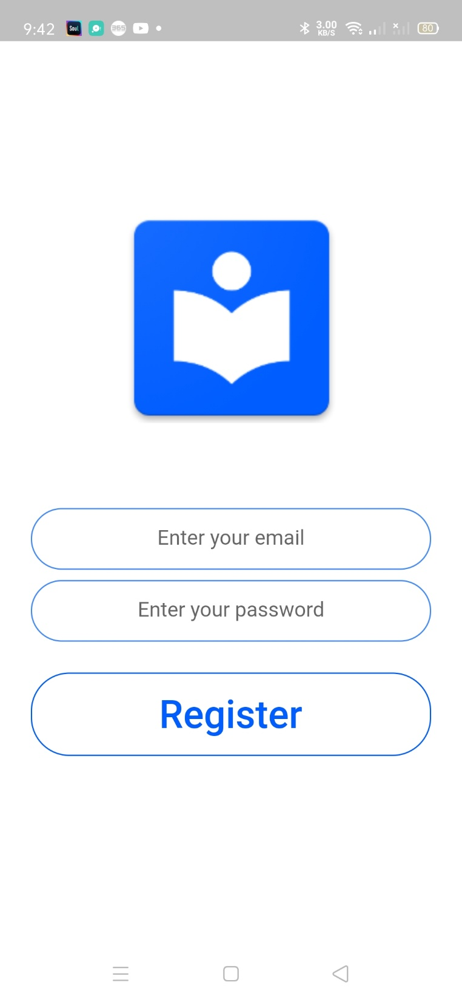
Register Screen
Dart :- That Check If email and password correct and then store in database then Navigator to BMCHOICES .
Flutter :- Design Of Screen in flutter (Icon , 2 TextField And Rounded Icon Button).

Slide 7


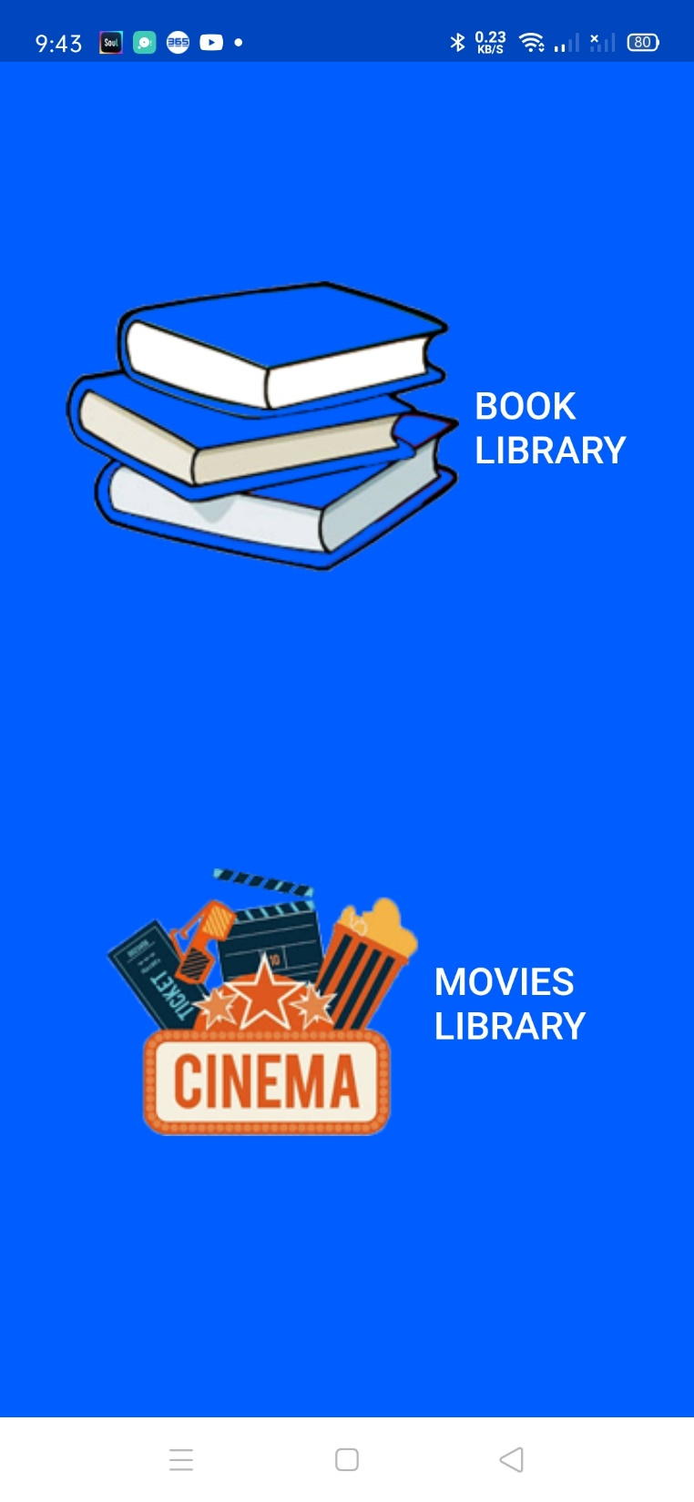
BMCHOICES Screen
Dart :- That Make user Choose Between Movies or Books Screen If Pressed in Two Icon .
Flutter :- Design Of Screen in flutter (2 TextButton.Icon ).

Slide 8
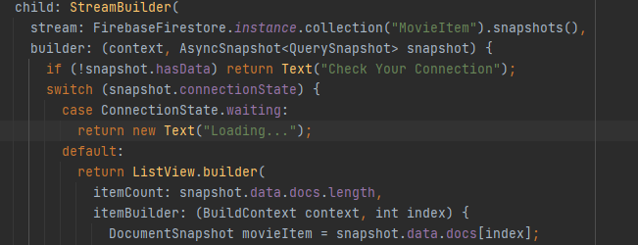
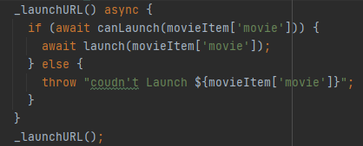
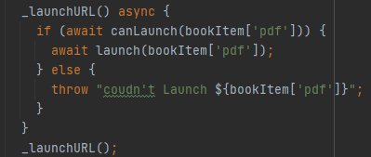
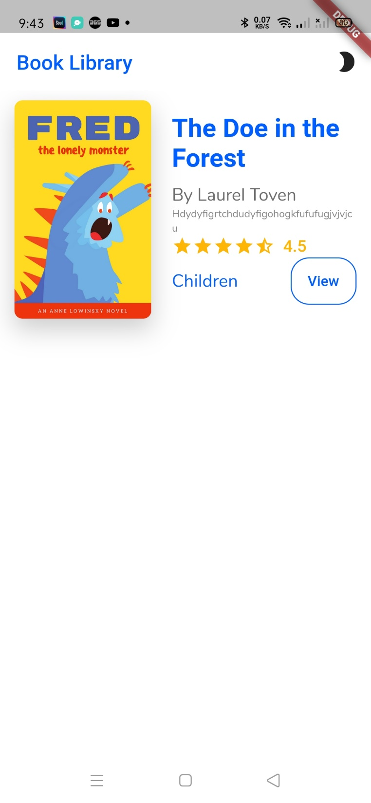
Movie And Books Screen
Dart :- That Make Media Generated From Database But they Worked With internet to Appear Data .
Button of Link :-
Button of View :-
Flutter :- Design Of Screen in flutter (AppBar , Cover , 3Text , RatingSystem and button ).

Slide 9
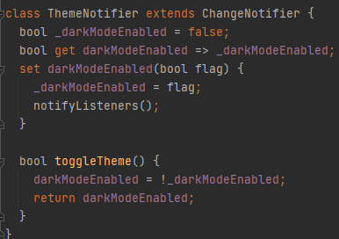
Dark Mode System
Dart :- That Make on Press button Change Colors of Screens As You Need Dark Or Light Mode .
Flutter :- Design Of Screen in flutter (Icon On AppBar).

Slide 10
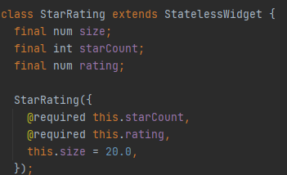
Rating System
Dart :- It’s Class Generated From pubdev helped coders in Apps to Be Have Rating system .
Flutter :- Design Of Screen in flutter (Icon On AppBar).

Slide 11
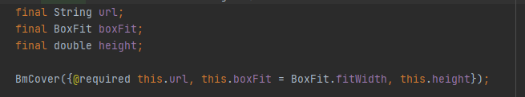
Cover Image
Dart :- It’s Constant Class Imported With Required URL , Size and height To prevent Override.
Flutter :- Design Of Screen in flutter (Just Image).

