Slide 1
Predicting Housing Sale price
Poornima Nandhini Balakrishnan
Micky Kumar
Ayswarya Venkatraman Kandasamy
Notes:
Micky: Hello, My name is Micky and I am here with Poornima and Ayswarya. Today we are here to talk about our machine learning project which predicting Housing Sale price.

Slide 2


If your not going to put money in real estate… Where else
Notes:
Micky: The question you should be asking yourself is If your not going to put money in real estate… Where else?

Slide 3
Objective:
The Housing dataset is from Kaggle describing the sale of individual residential property in Ames, Iowa from 2006 to 2010. The data set contains 2930 observations and a large number of explanatory variables (23 nominal, 23 ordinal, 14 discrete, and 20 continuous) involved in assessing home values.
With the fluctuations in the housing market the objective is to build a stable regression model to predict the housing sale price

Slide 4
EDA : Data Exploration and Analysis
There are 2 datasets train.csv with 1460 rows and 80 columns including the target variable SalePrice
and test.csv with 1459 records with 79 columns without the Saleprice.
Some of them are
Numerical Variables
LotArea: It shows lot size in square feet.
GrLivArea: It tells bbove grade (ground) living area square feet
BsmtFullBath: It tells the number basement full bathrooms
LotFrontage: This tells linear feet of street connected to property.
Categorical Variables
Ordinal Variables
- KitchenQual: It shows the kitchen quality
- Alley: It shows the type of alley access.
- LotShape:It tells the general shape of property.
Nominal Variables
- MSSubClass: It shows the building class.
- MSZoning: It shows the general zoning classification.

Slide 5
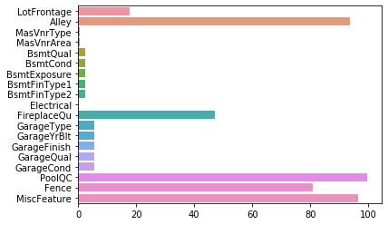
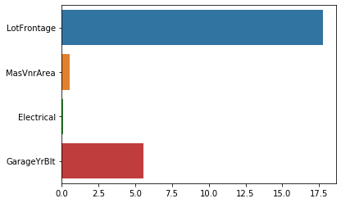
EDA: Missing Values
.
There were lot of missing values in the first pass of the training set
After more analysis it was found that some values of NaN meant that feature was actually not present and it was not missing. Hence they were converted to valid string value

Slide 6
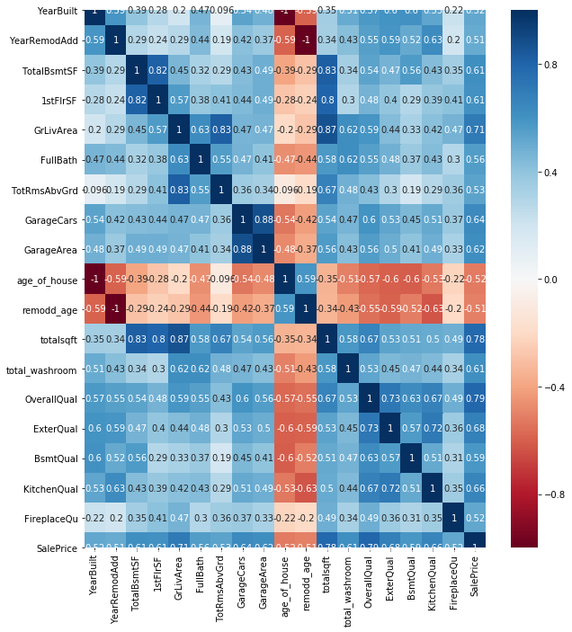
EDA: Correlation
From the correlation plot it can be determined that age of the house and remodelled years are negatively correlated to other variables and also the target variable SalePrice
OverallQual,GrLivArea, total sqft ,ExterQual are positively correlated with target variable
Variable like Garage cars and Garage area
YearBuilt and age of house are strongly negatively correlated. So will drop one of the variables
Notes:
Ayswarya:

Slide 7
Feature Engineering :
Added four new variables to the feature set
No of years since house was built
No of years since house was remodelled
The month and year the house was sold
Total square feet of the house
Total number of washrooms
Pipeline was built for numerical, ordinal and nominal categorical features separately.
Numerical features’ missing values were imputed with median and standardized around the mean
All the ordinal columns were manually mapped based on the weightage of the columns and the missing values were imputed with most frequent value
For e.g. LotShape was mapped as {'Reg':3,'IR1':2,'IR2':1,'IR3’:0} with more weightage to the Regular shape that will bring a positive correlation to Sale Price
And nominal were binary encoded
Notes:
Ayswarya:

Slide 8
Base Model Scores
Model | Cross Validation Mean RMSE Score
Linear Regression | 30675062.876
Lasso | 7058523.7275
Elastic Net | 31031.5764
Kneighbors Regressor | 36780.03959
SVR | 77022.40436
Gradient Boosting Regressor | 28443.8838
Random Forest Regressor | 30333.6189
Ada Boost Regressor | 32838.54978
Notes:
Linear and Kernel PCA did not improve the scores. Hence reverted to back to original
Removing polynomial features also improved the base model score

Slide 9
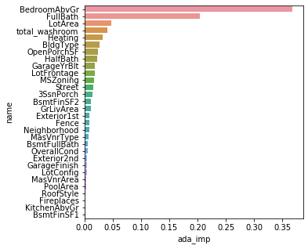
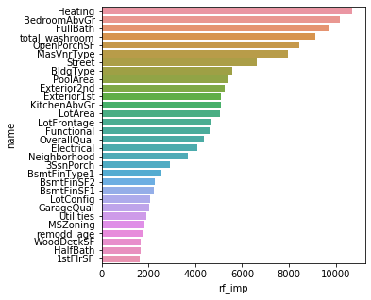
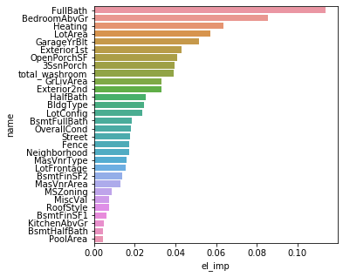
Feature Importance
Notes:
It was quite interesting to see the top predictors of each model. In Elastic there was no feature importance so coeff was used for plotting. Although it might not be indicative of importance of the variables but still they are the predictors in the model.

Slide 10
Model Development
Train dataset was split into 3 sets.
50% was used for training base models and 30% for training metalearner and 20% as validation set
From Base Models following models were selected to perform tuning
ElasticNet
AdaBoostRegressor
GradientBoostingRegressor
RandomForestRegressor
Then I used XGBoost Regressor as MetaLearner to learn from all the models

Slide 11
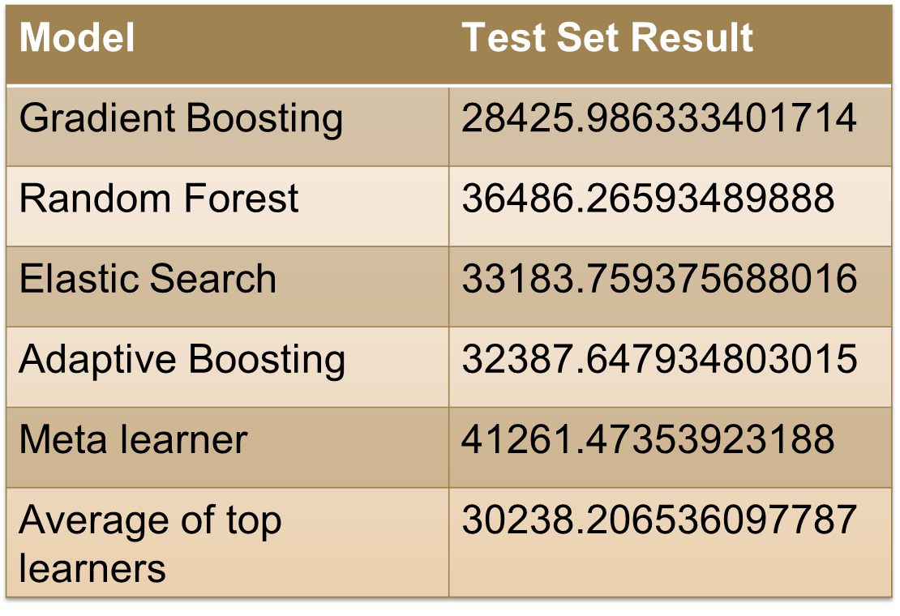
Results:
Notes:
Poornima:

Slide 12
Conclusion:
Gradient Boosting Regressor provided best regression results compared to random forest regressor, adaptive and also Meta Learner
In Kaggle it is in top 32% in the leadership board
Notes:
Poornima:

