Slide 1
Predicting Housing Sale price
Poornima
Micky Kumar
Ayswarya Venkatraman Kandasamy
Notes:
Micky: Hello, My name is Micky and I am here with Poornima and Ayswarya. Today we are here to talk about our machine learning project which predicting Housing Sale price.

Slide 2
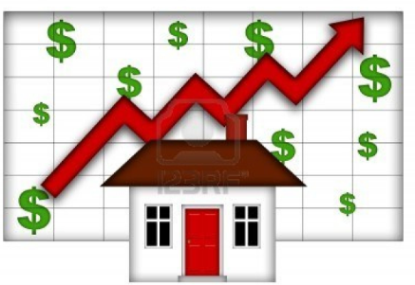

If your not going to put money in real estate… Where else
Notes:
Micky: The question you should be asking yourself is If your not going to put money in real estate… Where else?

Slide 3
Objective:
Develop and evaluate the performance and the predictive model to train and test on data collected from house sale price
Notes:
Micky: The objective that is we are trying predict the performance and models use for house sale price.

Slide 4
Data Process:
Explore data
79 explanatory variables
Feature selection
Cleaning data
Prepare data for model
Notes:
Micky: In the following dataset from the kaggle competition, it contains 79 variables for the test data and 80 variables in the train dataset. Based on that information, the process we used to analysis this problem is first we explore the data., then clean the data and finally prepare the models.

Slide 5
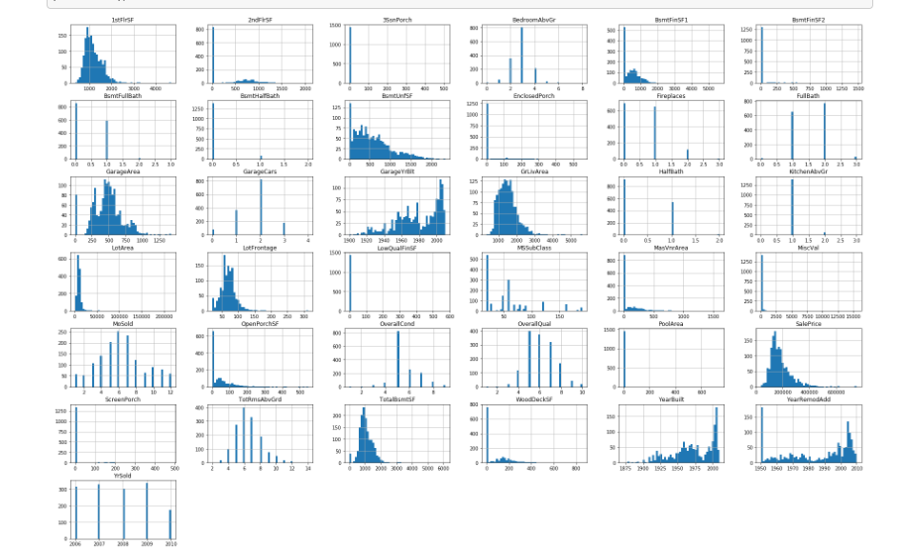
Explore
Notes:
Micky: In explore one thing we look at it is matplotlib inline for the train dataset. It is a little hard to see form the images. But we have decided to histgram chart and keep the bins to 50.

Slide 6
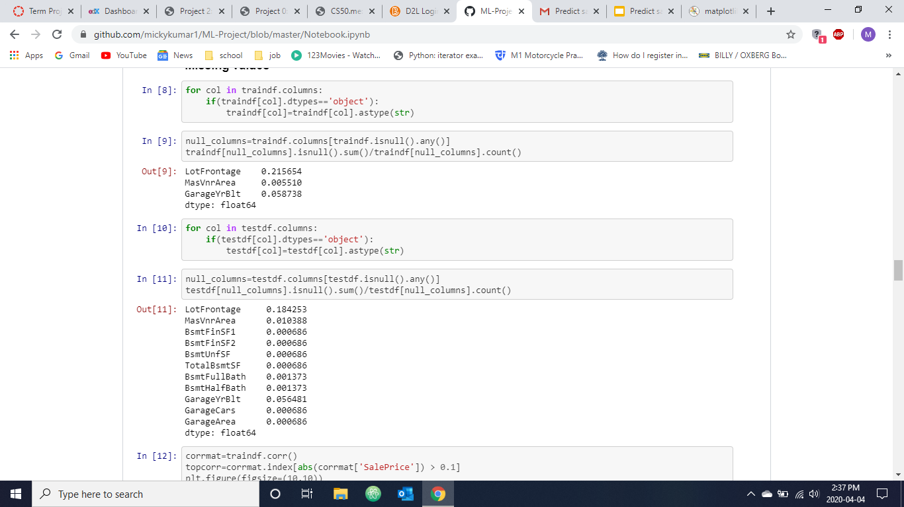
Missing values
Notes:
Micky: In the top image, we can see the missing value based on sum divided by the count for the test data. In the bottom, we have same one except for the train data. In the train data, we can see only 3 variables have missing values. This are LotFrontage, MasVnrArea, and GargeYrblt.
Now I am going to handle it Ayswarya to talk about Correlation map, feature engineering and Regression Algorithms.

Slide 7
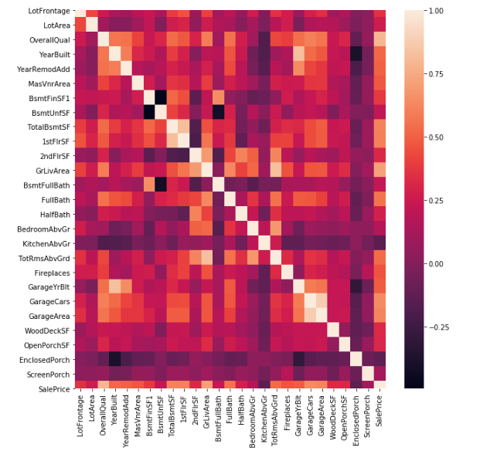
Correlation Map:
Notes:
Ayswarya:

Slide 8
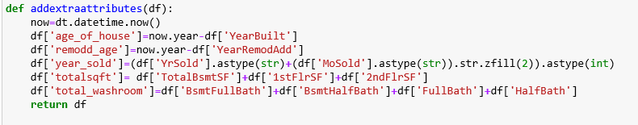
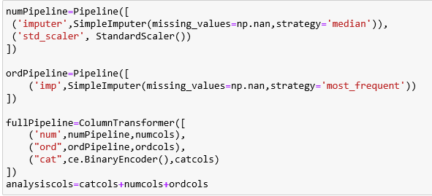
Feature Engineering :
Notes:
Ayswarya:

Slide 9
Regression Algorithms:
 | Cross Validation Score(CV=5)
Linear Regression | 0.82248439, 0.80204839, 0.85063114, 0.85845217, 0.64173928
Lasso | 0.82283526, 0.80250871, 0.87054813, 0.85880556, 0.64167979
Elastic Net | 0.87630322, 0.8328449, 0.83531939, 0.85993959, 0.67800232
Kneighbors Regressor | 0.7948717, 0.73540321, 0.79503801, 0.80827136, 0.69184637
Gaussian NB | 0.00819672, 0.01644737, 0.01485149, 0.01526718, 0
SVR | -0.07021949, -0.06052138, -0.05574727, -0.01534855, -0.05494959
Gradient Boosting Regressor | 0.90443464, 0.83201152, 0.90386332, 0.90941942, 0.89522425
Random Forest Regressor | 0.87040612, 0.83648642, 0.88337562, 0.83135065, 0.83663928
Notes:
Ayswarya:

Slide 10
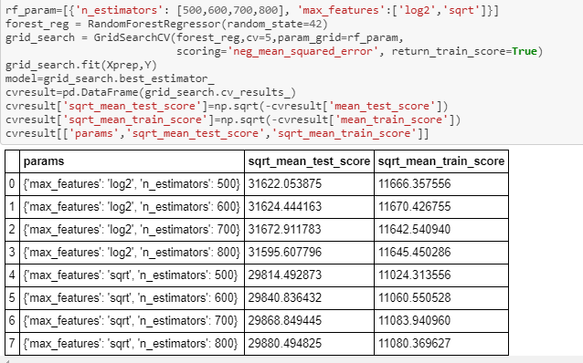
Random Forest Regression:
Notes:
Ayswarya:
Now I going to give the floor to Poornima to continue the models, result and conclusions

Slide 11
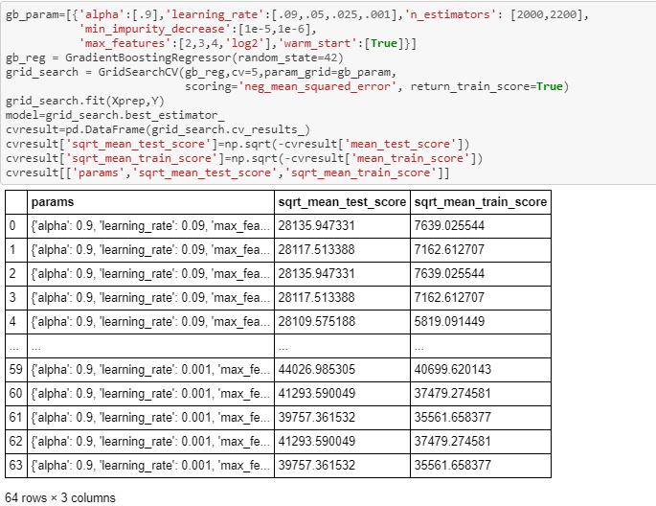
Gradient Boosting Regressor:
Notes:
Poornima:

Slide 12
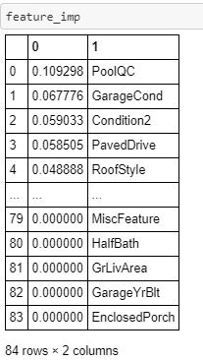
Important Features:
Notes:
Poornima:

Slide 13
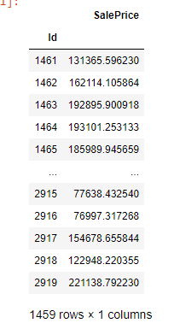
Results:
Notes:
Poornima:

Slide 14
Conclusion:
Gradient Boosting Regressor provided best regression results compared to random forest regressor
Kaggle results
Predictive model like this would be very valuable for a real state agent & home buyers who could make use of the information provided in a daily basis
Notes:
Poornima:

