Slide 1
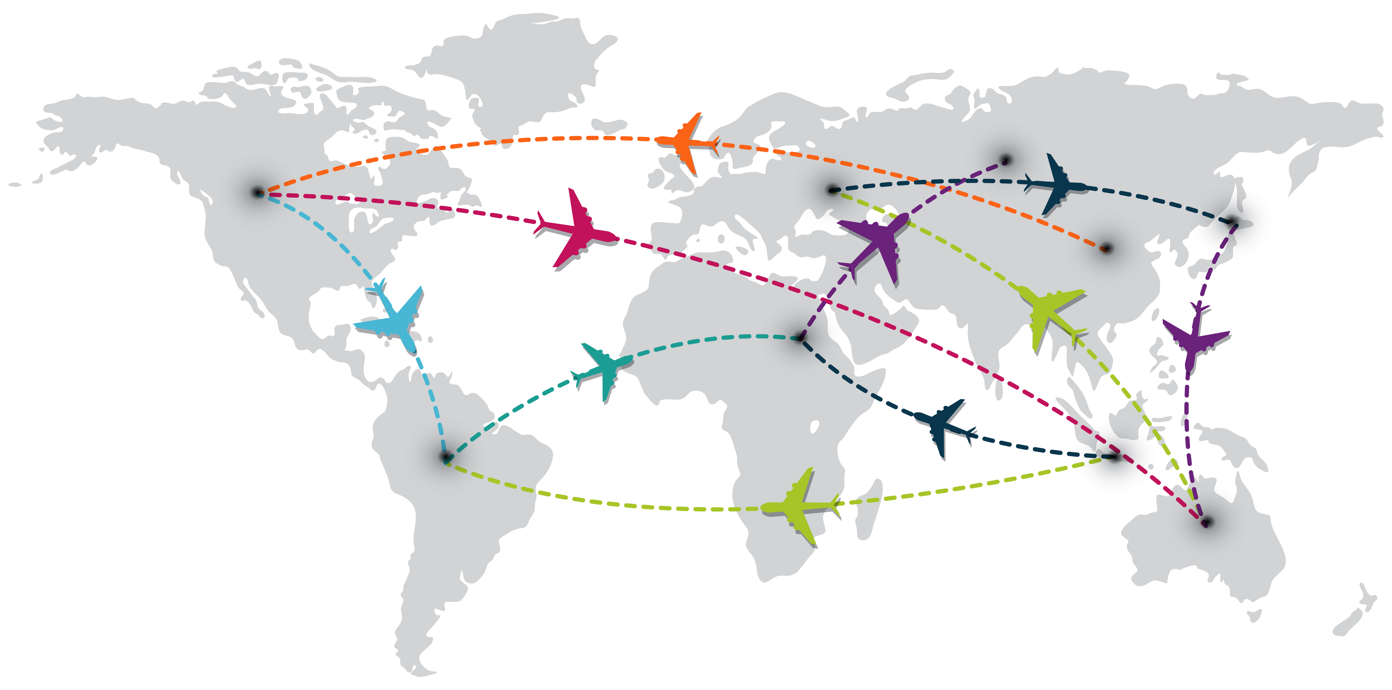
Analyzing Airlines Delays: Insights into Flight Performance
Thuc Nguyen Duy

Slide 2
Contents
Introduction and problem statement
Problem solving
Data understanding
Data cleaning
EDA and Analysis
Conclusion

Slide 3
Introduction and problem statement
Introduction:
The aviation industry faces significant challenges with flight delays, impacting passenger satisfaction and operational efficiency.
Flight delays disrupt schedules, cause financial losses, and create negative experiences for customers.
Problem statement:
Why analyze delays? To understand the root causes of delays and propose actionable recommendations.
Key questions:
+ Which airlines and airports have the highest delay rates?
+ What are the primary causes of delays?

Slide 4
Problem solving
Understanding aviation data
Data collection
Data preparation
Insights and Recommendations
Perform analysis and modeling

Slide 5
Data understanding
Data overview:
The dataset contains 3351 rows and 21 columns.
Time period: December 2019 and 2020.
Key metrics: carriers, airports, arrival flights, delayed flights, and delay reasons.

Slide 6
Data understanding
Data Structure:
Time of data
Includes columns containing information about the time the data was collected: [year] and [month]
Analysis object:
Contains the columns that we will consider as objects for analysis: [carrier], [carrier_name], [airport] and [airport_name]
Total number of flights and number of flights delayed more than 15 minutes.
Contains 2 columns: number of flights arriving at the airport [arr_flights] and number of flights delayed more than 15 minutes [arr_del15].
Number of flight delays by factors
Contains columns for the number of flights delayed for various reasons: [carrier_ct], [weather_ct], [nas_ct], [security_ct] and [late_aircraft_ct].
Total number of flights by status
Contains columns showing flight status (by number): [arr_cancelled], [arr_diverted] and [arr_delay]
Total minutes of delay by factors
Contains columns for the total number of minutes the flight was delayed for various reasons:[carrier_delay], [weather_delay], [nas_delay], [security_delay] and [late_aircraft_delay]

Slide 7
Data cleaning
Handle missing values.
Identify and remove outliers in delay times:
The type of data that our data has is statistical data that reflects the situation that has occurred. The data in numerical columns are statistics of the number of flights that had problems corresponding to the [airport], [carrier] columns,...
Therefore, I think there is no need to check outliers in this case.
Standardize column formats for consistency:
According to IATA regulations, airline codes and airport codes must be capitalized.

Slide 8
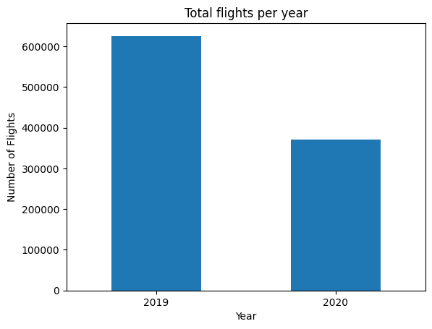
EDA and Analysis
Exploratory Data Analysis (EDA):
Total flights per year
Based on the chart, it can be seen that the total number of flights in December 2019 is more than in 2020.

Slide 9
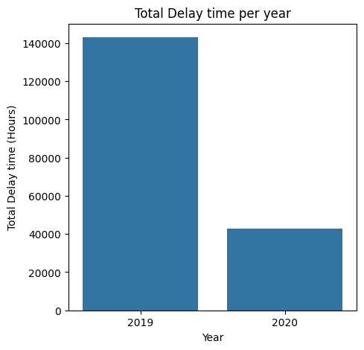
EDA and Analysis
Exploratory Data Analysis (EDA):
Total delay time per year
Based on the chart, it can be seen that the total delay time of flights in December 2019 is more than in 2020.

Slide 10
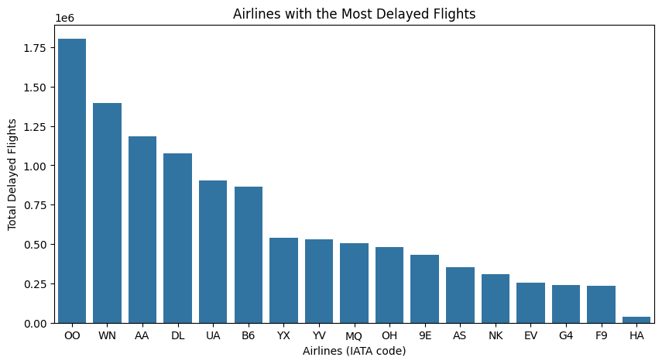
EDA and Analysis
Exploratory Data Analysis (EDA):
Most delayed flights by airline

Slide 11
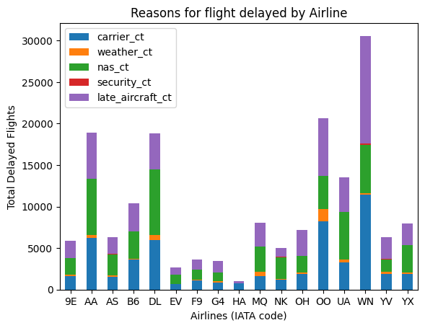
EDA and Analysis
Exploratory Data Analysis (EDA):
Reasons for flight delayed by Airline
Based on the chart, we can see that the 3 main reasons for flight delays are: carrier, NAS and late aircraft. These are also 3 reasons affected by the system or human factors,... and can be controlled to minimize.

Slide 12
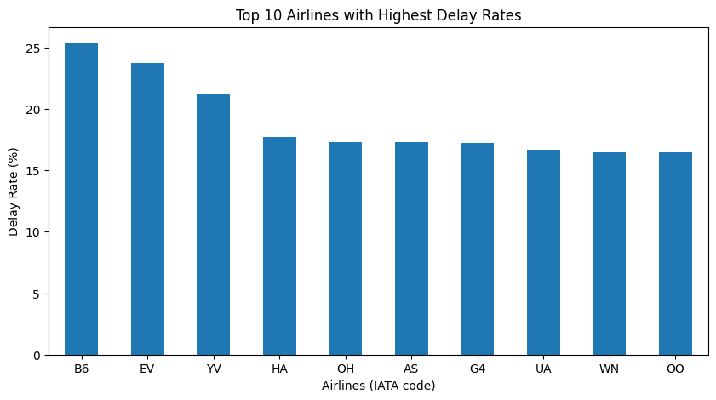
EDA and Analysis
Analysis:
Top 10 Airlines with Highest Delay Rates

Slide 13
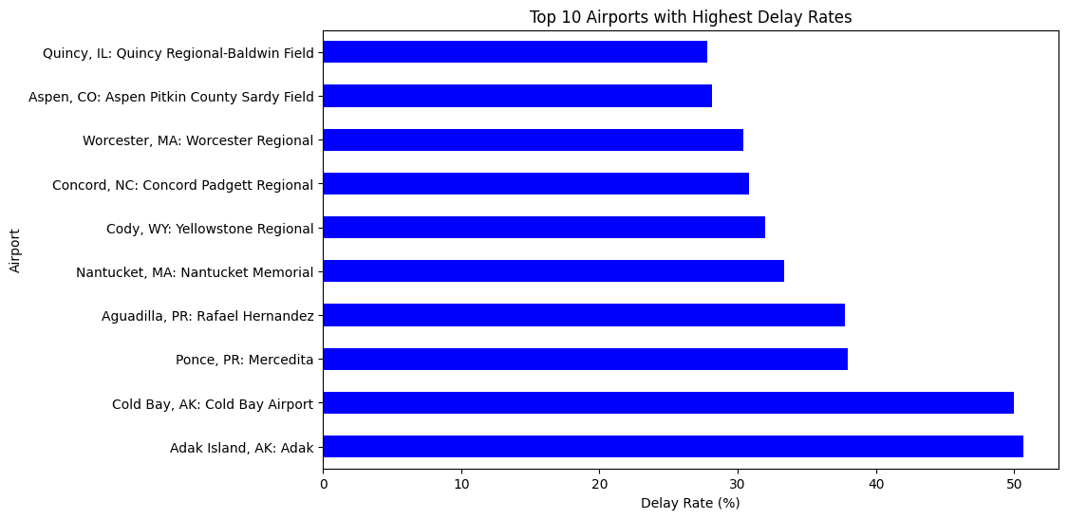
EDA and Analysis
Analysis:
Top 10 Airports with Highest Delay Rates

Slide 14
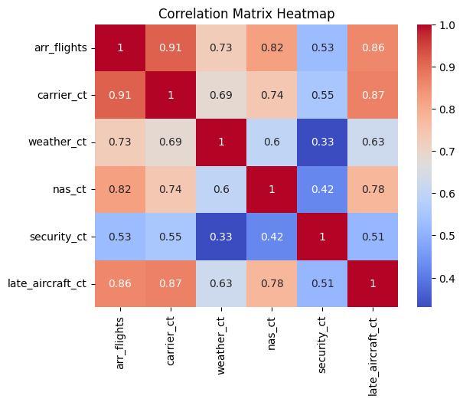
EDA and Analysis
Analysis:
Correlation Analysis for Delay Factors
There is a very strong correlation between delay causes:
- carrier_ct and arr_flights
- nas_ct and arr_flights
- late_aircraft_ct and arr_flights
This can be explained by the fact that most flights are delayed for these 3 reasons: carrier, NAS and late aircraft.

Slide 15
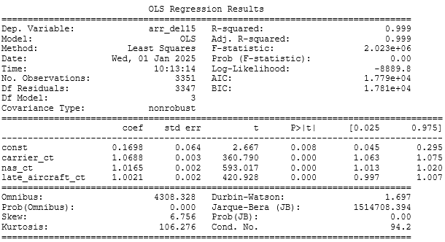
EDA and Analysis
Analysis:
Multiple Linear Regression: Predict delay > 15 minutes [arr_del15] using delay types: [carrier_ct], [late_aircraft_ct] and [nas_ct]
Result after running and evaluating the model:
The model explains 99.9% of the variance in the number of flights delayed by more than 15 minutes (arr_del15), indicating an excellent fit.

Slide 16
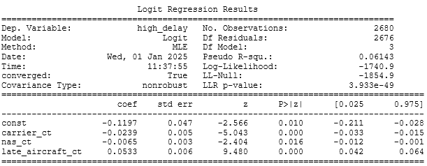
EDA and Analysis
Analysis:
Logistic Regression: Classify whether an airline has a high delay rate (above 15% ) using delay types: [carrier_ct], [late_aircraft_ct] and [nas_ct]
Results after running and evaluating the model:
- The model demonstrates meaningful relationships between the predictors and [high_delay], particularly highlighting the role of late aircraft delays as a strong contributor to high delays.
- Our model predicted 68.6% of data correctly.

Slide 17
Conclusion
Effectiveness of Analysis: The models and analysis effectively identified trends and key factors affecting delays.
Key Insights:
Airlines and airports with high delays can focus on operational efficiency.
Addressing main causes like: carrier, NAS and late aircraft could significantly reduce delays.
Recommendations:
Airlines: Optimize flight schedules, allocate flight times and on-duty crew time reasonably.
Airports: Invest in infrastructure and traffic management.
Collaboration: Foster coordination among aviation stakeholders.

Slide 18
Thank You !

