Slide 1





October 7, 2026
Developer keynote
PART 1 · SOFTWARE RELEASE
What's New in Particleworks 9.0 & Granuleworks 4.0
Issei Masaie
General Manager · Prometech Software
PART 2 · APPLICATIONS
Application Examples & Case Studies
Iori Saigo
Application Engineer · Prometech Software
Modena, Italy
BPER FORUM Monzani

Slide 2
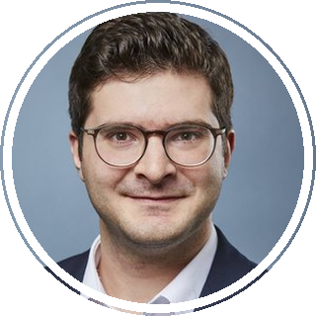
October 7, 2026
Industrial speaker
Simulation of Shot Peening: A CFD-DEM Coupled Case Study
MTU AERO ENGINES
Alpcan Güray
Modena, Italy
BPER FORUM Monzani

Slide 3

October 7, 2026
Academic speaker
An Integrated Simulation Approach for Stator Oil Jacket and Jet Cooling Systems
UNIVERSITY OF MODENA AND REGGIO EMILIA
Michelangelo Raimondo
Modena, Italy
BPER FORUM Monzani

Slide 4

October 7, 2026
Industrial speaker
CHT Analysis of a Reciprocating Pump
R&D CFD
Leonardo Lanciotti
Modena, Italy
BPER FORUM Monzani

Slide 5
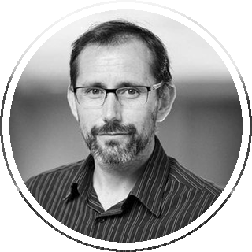
October 7, 2026
Academic speaker
Moving Particle Simulation of Eroded Pelton Runners
HES-SO VALAIS//WALLIS
Jean Decaix
Modena, Italy
BPER FORUM Monzani

Slide 6
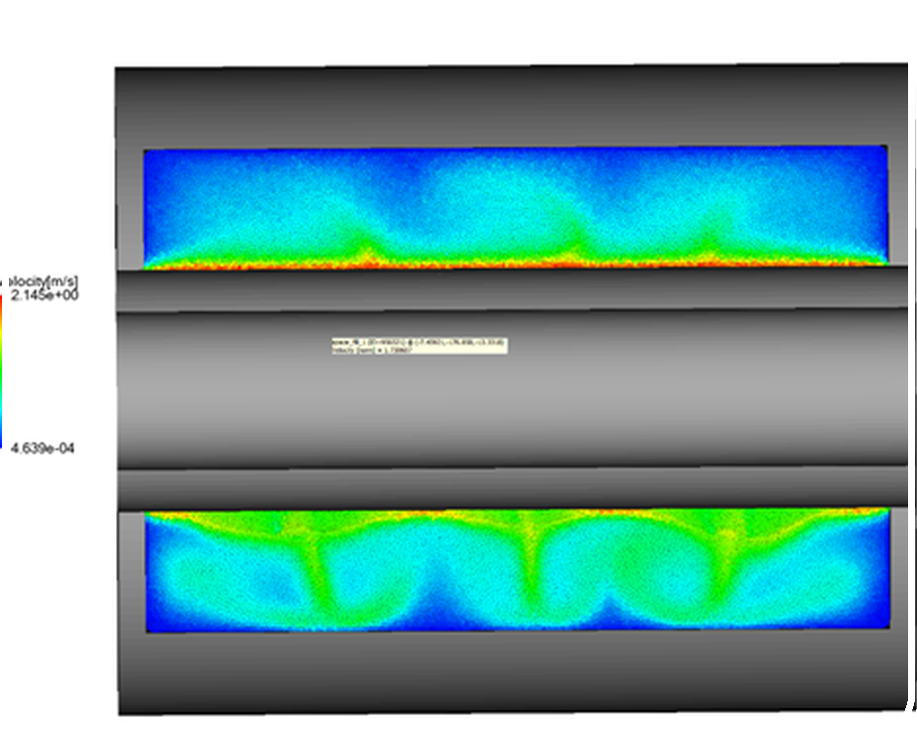

October 7, 2026
Industrial speaker
Integrating Particleworks into SKF Engineering Tools: Part I — Verification of Heat Transfer Coefficient
SKF
Lijun Cao
Modena, Italy
BPER FORUM Monzani

Slide 7
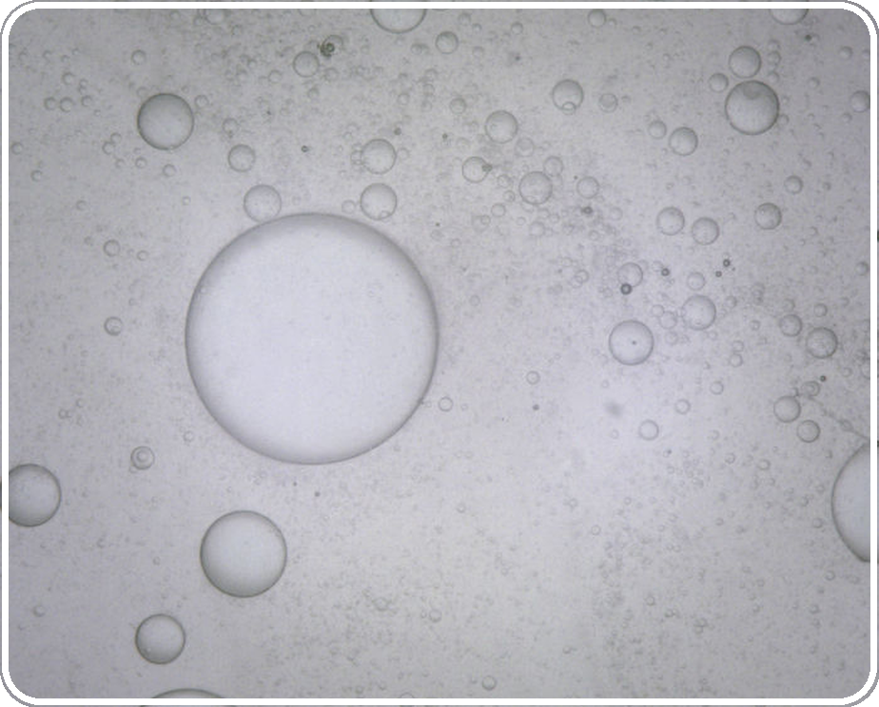

October 7, 2026
Industrial speaker
Direct Optical Air-in-Oil Measurement for Gearings and Hydraulic Systems
DEEPFLUID
Dr. Lukas Hafner
Modena, Italy
BPER FORUM Monzani

Slide 8
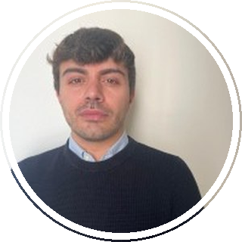
October 7, 2026
Industrial speaker
Study of the Lubrication on Carrier Roller using a CFD 3D-MPS Method
TRACK ONE
Leonardo Tiberi
Modena, Italy
BPER FORUM Monzani

Slide 9
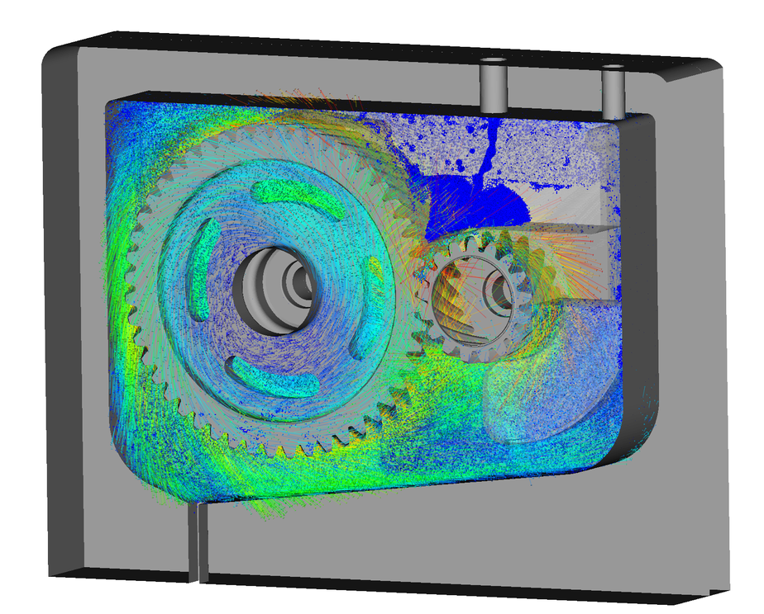
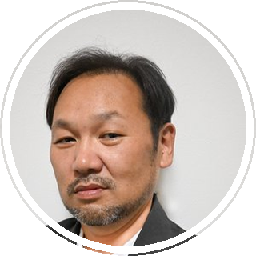
October 7, 2026
Industrial speaker
Application of Particleworks to Gear Lubrication Analysis and Its Expansion to R&D on Airflow Effects
UNIVANCE CORPORATION
Naohiro Fujita
Modena, Italy
BPER FORUM Monzani

Slide 10
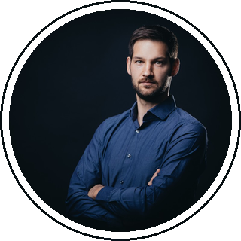
October 7, 2026
Industrial speaker
From Formation to Dissolution: Air Bubble Dynamics in Gear Oil of an Electric 3-Speed Drivetrain
IAV
René Kockisch
Modena, Italy
BPER FORUM Monzani

Slide 11
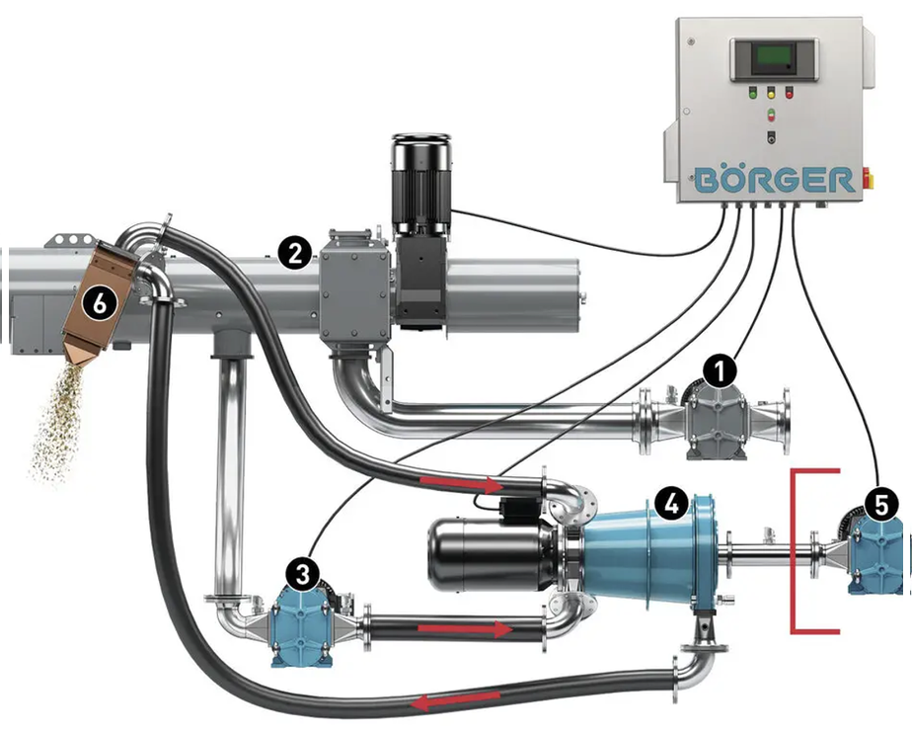
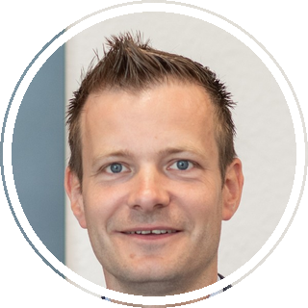
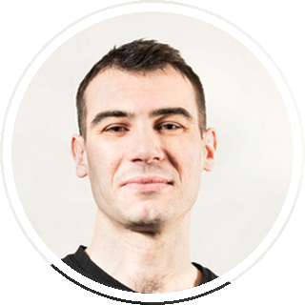
October 7, 2026
Industrial speaker
Simulation of Sand Separation and Wear in the Börger FlowSep
Bernd Valtwies
BÖRGER GMBH
Riccardo Sala
ENGINSOFT
Modena, Italy
BPER FORUM Monzani

