Slide 1
Convolutional Neural Network
Seoul National University
Dept. of Computer Science and Engineering
Seonghwan Choi

Slide 2
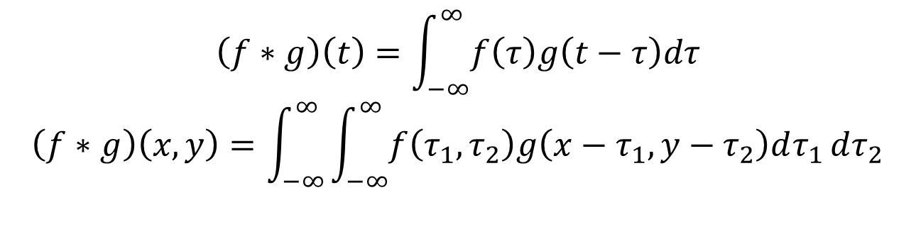
Convolution
$$\left(f∗g\right)\left(t\right)=\int_{−∞}^{∞}{f\left(τ\right)g\left(t−τ\right)dτ}$$
$$\left(f∗g\right)\left(x,y\right)=\int_{−∞}^{∞}{\int_{−∞}^{∞}{f\left(τ_{1},τ_{2}\right)g\left(x−τ_{1},y−τ_{2}\right)dτ_{1}}dτ_{2}}$$

Slide 3
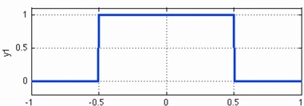
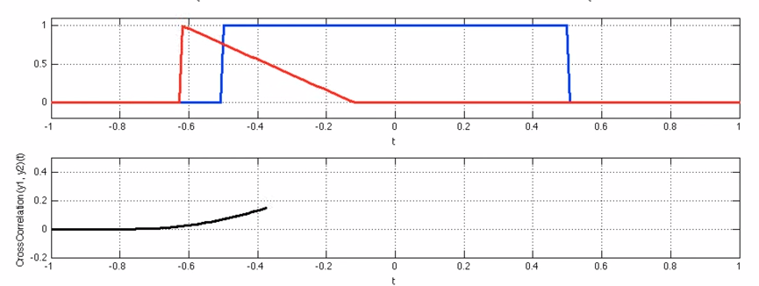
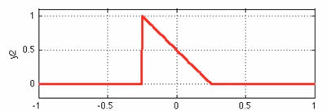
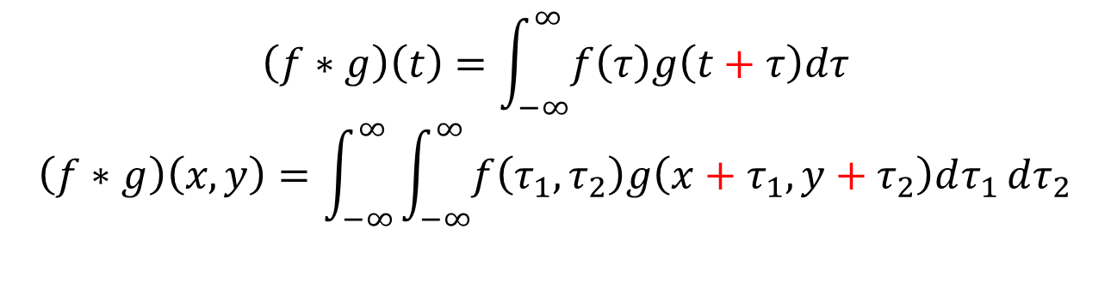
Correlation – what we use
$$\left(f∗g\right)\left(t\right)=\int_{−∞}^{∞}{f\left(τ\right)g\left(t+τ\right)dτ}$$
$$\left(f∗g\right)\left(x,y\right)=\int_{−∞}^{∞}{\int_{−∞}^{∞}{f\left(τ_{1},τ_{2}\right)g\left(x+τ_{1},y+τ_{2}\right)dτ_{1}}dτ_{2}}$$
input
filter

Slide 4
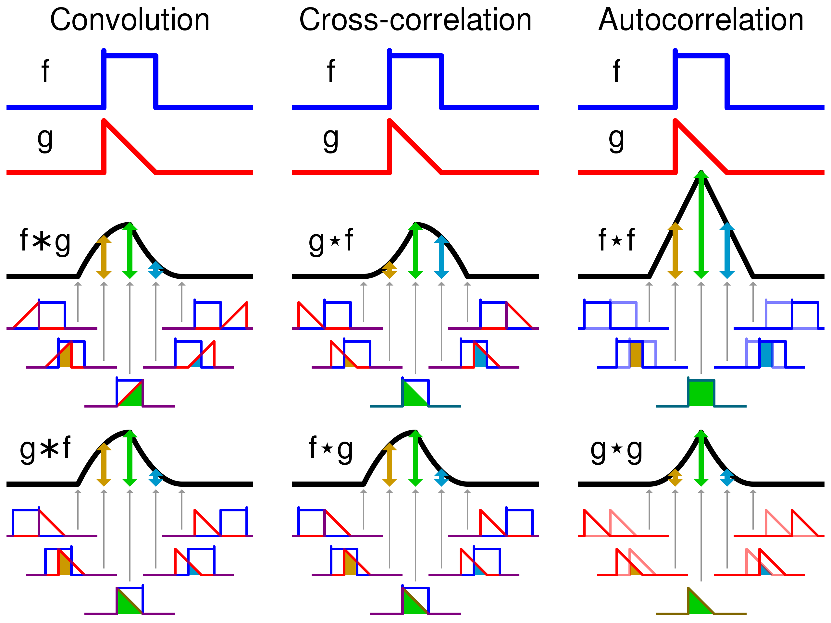
Convolution vs Correlation

Slide 5
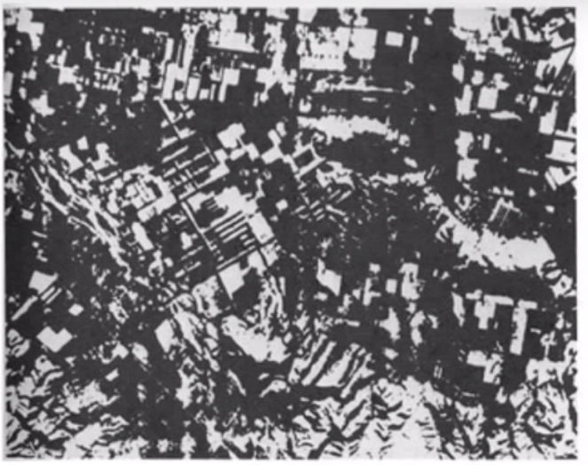

Correlation - Example
*

Slide 6
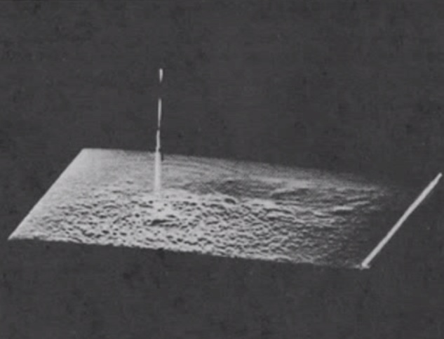
Correlation - Example

Slide 7
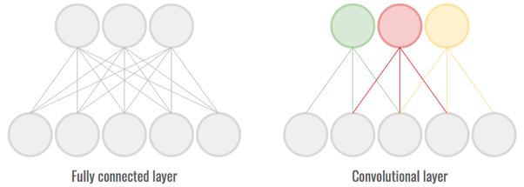
What is CNN?
Linear layer(FNN)
n input, m output -> m*n matrix (# of weight is mn)
Each output node is fully connected to all n inputs
CNN
For many data “with positional information’
By using ‘kernels’ with limited size
‘kernel’ means – same weight for many ‘spots’ of data
Tradeoff : expressiveness of each layer <-> connection cost

Slide 8




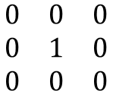
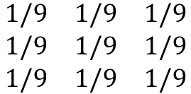
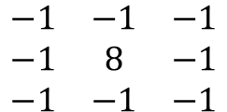
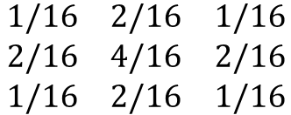
Kernel as a ‘filter’
$$\begin{matrix}−1 & −1 & −1 \\ −1 & 8 & −1 \\ −1 & −1 & −1\end{matrix}$$
$$\begin{matrix}0 & 0 & 0 \\ 0 & 1 & 0 \\ 0 & 0 & 0\end{matrix}$$
$$\begin{matrix}1/9 & 1/9 & 1/9 \\ 1/9 & 1/9 & 1/9 \\ 1/9 & 1/9 & 1/9\end{matrix}$$
$$\begin{matrix}1/16 & 2/16 & 1/16 \\ 2/16 & 4/16 & 2/16 \\ 1/16 & 2/16 & 1/16\end{matrix}$$
Kernel works as a 'filter’, and it REALLY IS!

Slide 9
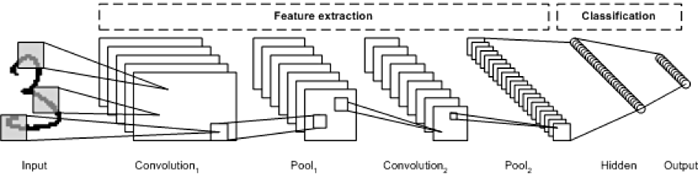
CNN Structure
Using many kernels(channels) for each layer
Data : ‘wider’ to 'deeper'
Generally, Conv-Subsampling-C-S-….-FNN

Slide 10
Kernel size, Stride
Stride : 보폭 – how many blocks to cross at a time

Slide 11
Padding
Learning ‘edges’ of data
To maintain output size
zero-padding

Slide 12
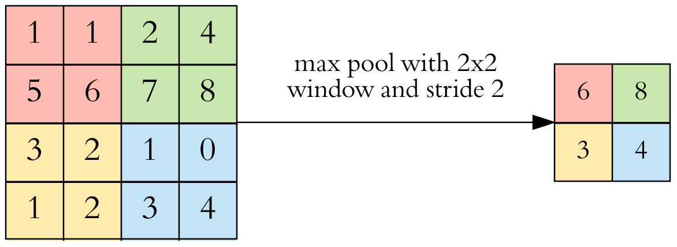
Pooling
To reduce output size
Maxpooling, avgpooling..

Slide 13

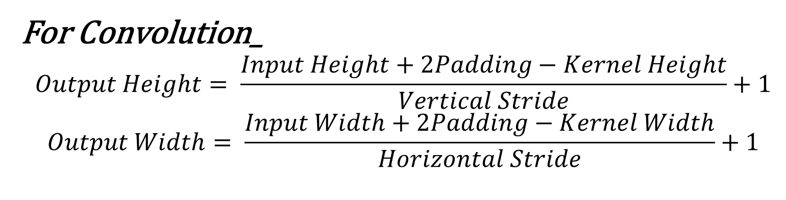
Output Size
For Convolution_
$$Output Height= \frac{Input Height+2Padding−Kernel Height}{Vertical Stride}+1$$
$$Output Width= \frac{Input Width+2Padding−Kernel Width}{Horizontal Stride}+1$$
For Pooling_
$$OutputW/H= \frac{InputW/H}{PoolingSize}$$

Slide 14



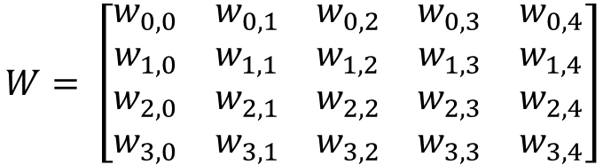


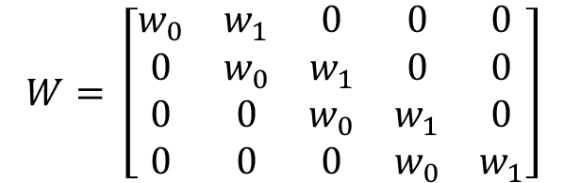
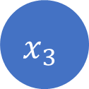
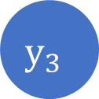
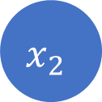

Weight of CNN – reducing complexity
Imagine a 1d-conv layer
kernel
: (w0, w1) weight
$$y_{0}$$
$$y_{1}$$
$$y_{2}$$
$$y_{3}$$
$$W= \left[\begin{matrix}w_{0} & w_{1} & 0 & 0 & 0 \\ 0 & w_{0} & w_{1} & 0 & 0 \\ 0 & 0 & w_{0} & w_{1} & 0 \\ 0 & 0 & 0 & w_{0} & w_{1}\end{matrix}\right]$$
kernel
kernel
kernel
kernel
$$x_{0}$$
$$x_{1}$$
$$x_{2}$$
$$x_{3}$$
$$x_{4}$$
$$W= \left[\begin{matrix}w_{0,0} & w_{0,1} & w_{0,2} & w_{0,3} & w_{0,4} \\ w_{1,0} & w_{1,1} & w_{1,2} & w_{1,3} & w_{1,4} \\ w_{2,0} & w_{2,1} & w_{2,2} & w_{2,3} & w_{2,4} \\ w_{3,0} & w_{3,1} & w_{3,2} & w_{3,3} & w_{3,4}\end{matrix}\right]$$

Slide 15

Normalization – LRN
LRN-Local Response Normalization
Competitive normalization layer
If one kernel strongly activates certain node, regulate that node’s output when near kernels are applied.
$$b_{x,y}^{i}=a_{x,y}^{i}{\left(k+α\sum_{j=\max\left(0,i−\frac{r}{2}\right)}^{\min\left(i+\frac{r}{2},f_{n}−1\right)}{{a_{x,y}^{j}}^{2}}\right)}^{−β}$$
$$b_{x,y}^{i}:normalized output of node\left(x,y,i\right)$$
$$a_{x,y}^{i}:not normalized output of node\left(x,y,i\right)$$
$$k :bias, r :depth−radius, α,β$$

Slide 16
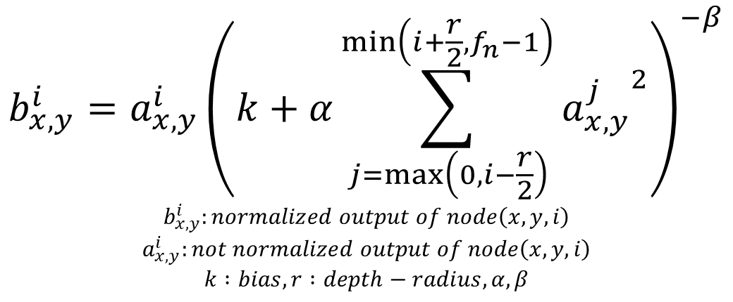
Normalization – LRN
$$b_{x,y}^{i}=a_{x,y}^{i}{\left(k+α\sum_{j=\max\left(0,i−\frac{r}{2}\right)}^{\min\left(i+\frac{r}{2},f_{n}−1\right)}{{a_{x,y}^{j}}^{2}}\right)}^{−β}$$
$$b_{x,y}^{i}:normalized output of node\left(x,y,i\right)$$
$$a_{x,y}^{i}:not normalized output of node\left(x,y,i\right)$$
$$k :bias, r :depth−radius, α,β$$

Slide 17
http://taewan.kim/post/cnn/
https://en.wikipedia.org/wiki/Kernel_(image_processing)
https://towardsdatascience.com/applied-deep-learning-part-4-convolutional-neural-networks-584bc134c1e2

