Slide 1
PRAML Bishop - classificationtext = (4.1 - 4.1.4)
머신러닝 스터디 2주차(2019.9.25)
컴퓨터공학부 2018 - 송우경

Slide 2
TODAY TOPICs are
What is Hyper-plane?
Multiple class discrimination: one-vs-rest, one-vs-one
Least Squares for classification
Fisher`s Linear discriminant
Let`s start 비숍 !

Slide 3


what is hyper-plane
generalize
f = nonlinear
= activation function
= link function^(-1)
Then, how can we classify?

Slide 4
what is hyper-plane
>=0 C1
< C2
y(X) = 0 is decision plane !
what is the meaning of w, y(X), w0?

Slide 5
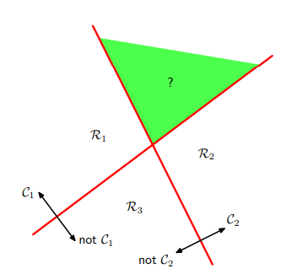
for Multiple classes
how to make plane:
one-vs-rest
How can we solve this problem?
How many decision planes?

Slide 6
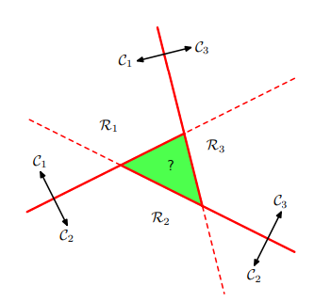
for Multiple classes
how to make plane:
one-vs-one
How can we solve the problem again?
How many decision planes?

Slide 7
for Multiple classes - adding
SVM (Support Vector Machine)
one-vs-rest
Let`s think about
배타성, 모든점 분류가능성, 모든 클래스 존재성
what are good and bad things?

Slide 8
for Multiple classes - adding
SVM (Support Vector Machine)
one-vs-rest
Let`s think about
배타성, 모든점 분류가능성, 모든 클래스 존재성
what are good and bad things? time is good
y comparison? 1:n-1?

Slide 9
for Multiple classes - adding
SVM (Support Vector Machine)
one-vs-one
Votes
what are good and bad things? 1:1 ! votes, not y comp !
but Time is..
So, one vs rest is a practical method.

Slide 10


LEast squares
Do you remember Engineering Mathe..?
I will show you how to get w vectors.

Slide 11



LEast squares
what are good and bad things?

Slide 12
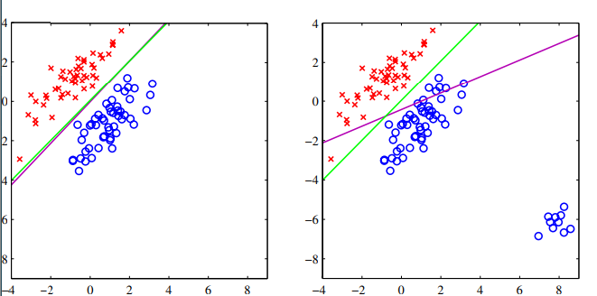
LEast squares
what are good and bad things? vs logistic : too vulnerable
to error

Slide 13
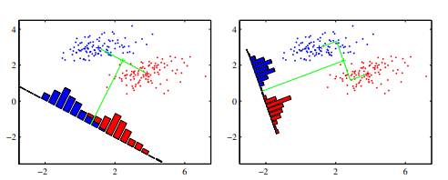
Fisher`s Linear discriminant
Let`s GO !

Slide 14


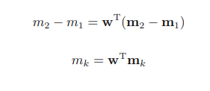
Fisher`s Linear discriminant
project to w vector
Maximize
Hmm.
How about make w bigger?

Slide 15
Fisher`s Linear discriminant
Good.
But there is a serious PROBLEM.

Slide 16
Fisher`s Linear discriminant

Slide 17


Fisher`s Linear discriminant
Let`s maximize Fisher criterion.

Slide 18


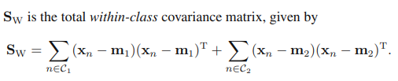


Fisher`s Linear discriminant
Let`s maximize
Fisher criterion.
Let`s test with Sw is isotropic.

Slide 19
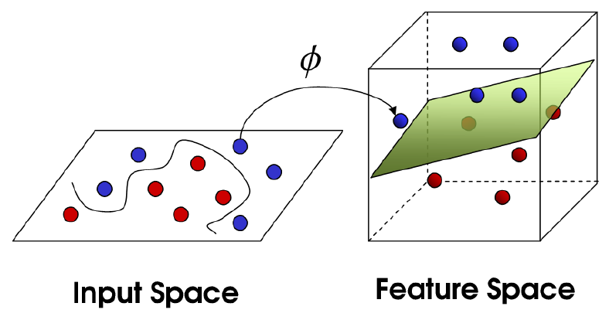
Kernel function
Make non-linear linear
N -> infinite dimension
Gaussian kernel
- Taylor
Very very interesting, doesn`t it?

Slide 20
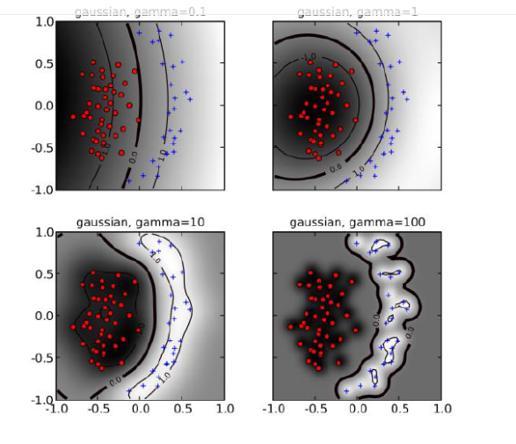
Kernel function
Very very Surprising, doesn`t it?

Slide 21
reference
Pattern Recognition and Machine Learning
Christopher M. Bishop
[공업수학] 최소자승법 Least Square - https://pinkwink.kr/191
multiclass svm, one vs rest, one vs one – https://ddiri01.tistory.com/207
kernel function -
http://m.blog.daum.net/_blog/_m/articleView.do?blogid=0YW8F&articleno=136
https://ratsgo.github.io/machine%20learning/2017/05/30/SVM3/

Slide 22
Thank you all for listening.

