Slide 1
PRAML Bishop - Neural Networktext = (5.1 - 5.2)
머신러닝 스터디 4주차(2019.11.13)
컴퓨터공학부 2018 – 송우경
Pre-requisite : 2주차 ppt 다중클래스 분류

Slide 2
TODAY TOPICs are
Feed-forward Network Function : Perceptron
Weight-space symmetries
How to train neural Network
Training Optimization
Let`s continue 비숍 !

Slide 3
Before start..
Why do we need neural?

Slide 4


Before start..
Why do we need neural?

Slide 5
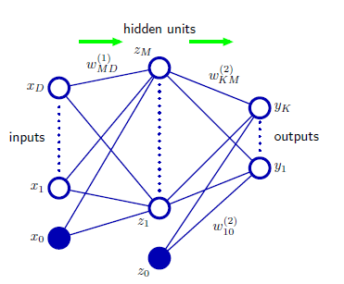
Feed-forward Network : Perceptron
Forward Propagation
MultiLayer Perceptron
Difference between original perceptron?
If sigma & h is Linear?

Slide 6
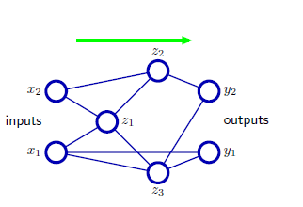
Feed-forward Network : Perceptron
Skip-layer
How many layers?

Slide 7
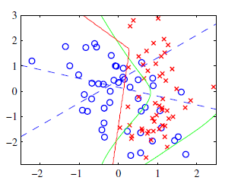
Weight space symmertries
activation func h -> tanh
-> sigmoid
2^M * M!

Slide 8




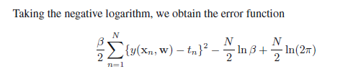
How to train neural network
Regression 참고
N -> Gaussian distribution B -> precision

Slide 9
How to train neural network
(1) Regression
N -> Gaussian distribution B -> precision

Slide 10


How to train neural network
(1) Regression
N -> Gaussian distribution B -> precision

Slide 11



How to train neural network
(2) Binary classification

Slide 12


How to train neural network
(2) Binary classification

Slide 13


How to train neural network
(3) Multiclass (mutually independent) classification

Slide 14
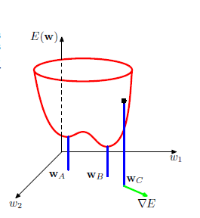
Optimize training
Local minima comparing 해야
How can we do more precisely?
T y r

Slide 15



Optimize training
Nonlinear -> unconvex possible..
…my assumption : f(linear)

Slide 16

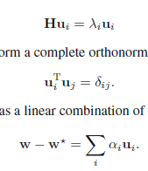

Optimize training
Minimun candidate
O(W^3) Symmetric,real..

Slide 17
Optimize training
Do you know the meaning of
Eigenvector,value
And y = Ax ?

Slide 18
reference
Pattern Recognition and Machine Learning
Christopher M. Bishop

Slide 19
Thank you all for listening.

