Slide 1

Security Token 2.0
by micobo ©

Slide 2
NEW FEATURES
ERC1400 & ERC20 compatibility
Modular constraints
Whitelist
Locking periods / partition
Spending limits / time / partition
Off-chain validation
Partitions
Free transactions for token holders
Controller operations
Document management

Slide 3
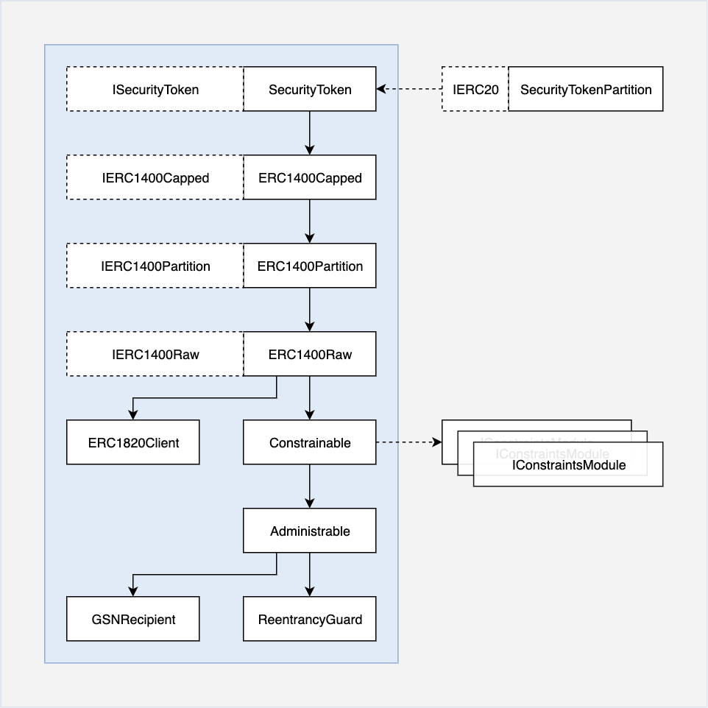
Architecture Security Token

Slide 4
Administrable roles management
Nr | Role | Description
0 | ADMIN | Manage roles / add partitions
1 | CONTROLLER | Force token transfer
2 | MINTER | Mint tokens
3 | PAUSER | Pause transactions
4 | BURNER | Burn tokens
5 | CAP_EDITOR | Edit caps for partitions
6 | MODULE_EDITOR | Edit constraints modules
7 | DOCUMENT_EDITOR | Edit documents
8 | WHITELIST_EDITOR | Edit whitelist
9 | TIME_LOCK_EDITOR | Edit time-lock module
… | NEW_ROLES | …

Slide 5
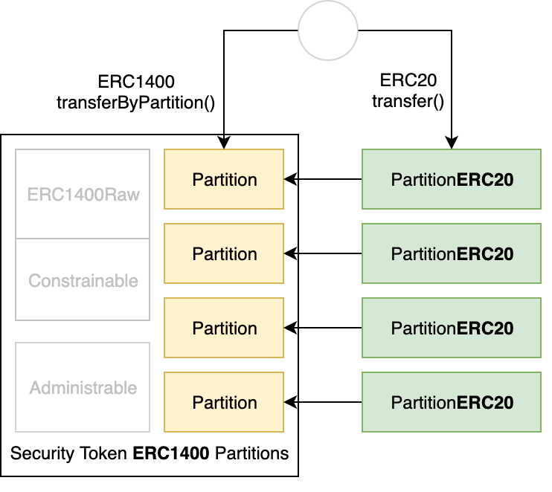
Partitions ERC1400 & ERC20

Slide 6
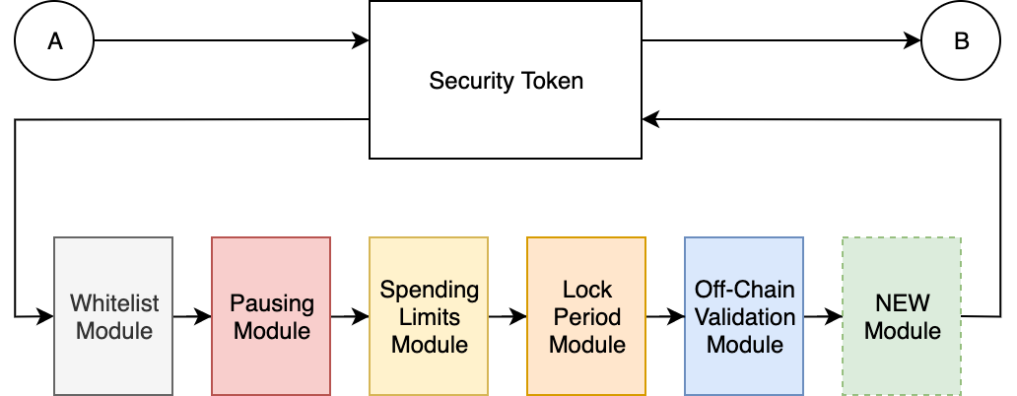
Modular Constraints Whitelist, Spending limits, lock periods, off-chain validation

Slide 7
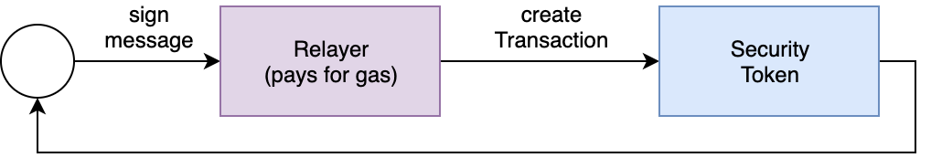
Free transactions Gas Station Network – Meta-Transactions

